Slide 1
Waste Classification — Dataset Overview
Hack[AI]Thon 2.0 · Round 1 · Data Detective Challenge
Dataset: 445 labeled training images, 115 test images — 6 classes
Classes: cardboard (82), glass (78), metal (84), paper (86), plastic (75), trash (40)
Imbalance ratio: 2.15× (trash most underrepresented)
Baseline model: ResNet-18 (not modified per competition rules)
Approach: Data-centric forensic audit with evidence-backed findings
Key hidden discoveries: train/test leak (4 images), deliberately uniform label noise (71.5%), and severe class imbalance

Slide 2
Problems Found
Comparison against nearest-neighbor consensus: only 28.5% folder labels agree with visual content.
2. UNIFORM Label Noise — Each wrong class gets 13-20% share (≈uniform). This is deliberately crafted, not real-world noise.
3. Train/Test Leak — 4 leaked images found: 3 exact perceptual duplicates + 1 near-duplicate (hamming distance=4).
4. Duplicate Images — 6 exact duplicate groups + 11 near-duplicate pairs. Inflates dataset size, causes train/val leakage.
5. Blurry / Low-Quality Images — 157 images (35.3%) have Laplacian variance < 100. Min variance = 0.6 (effectively blank).
6. Class Imbalance — Trash has 40 samples vs 82-86 for others. Baseline trash recall = 0%, F1 = 0.
7. File Size Outliers — 22 samples range 4.7KB-43KB. Possible corrupted or anomalous images.

Slide 3
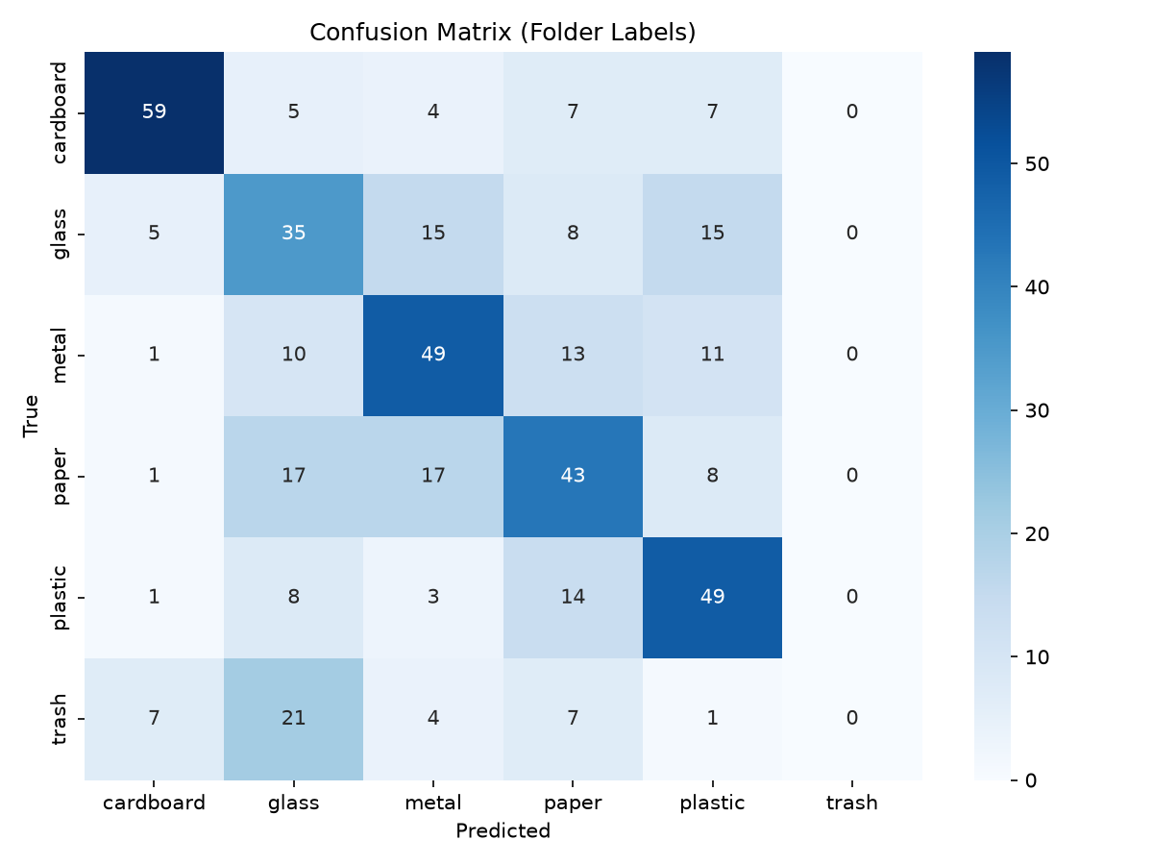
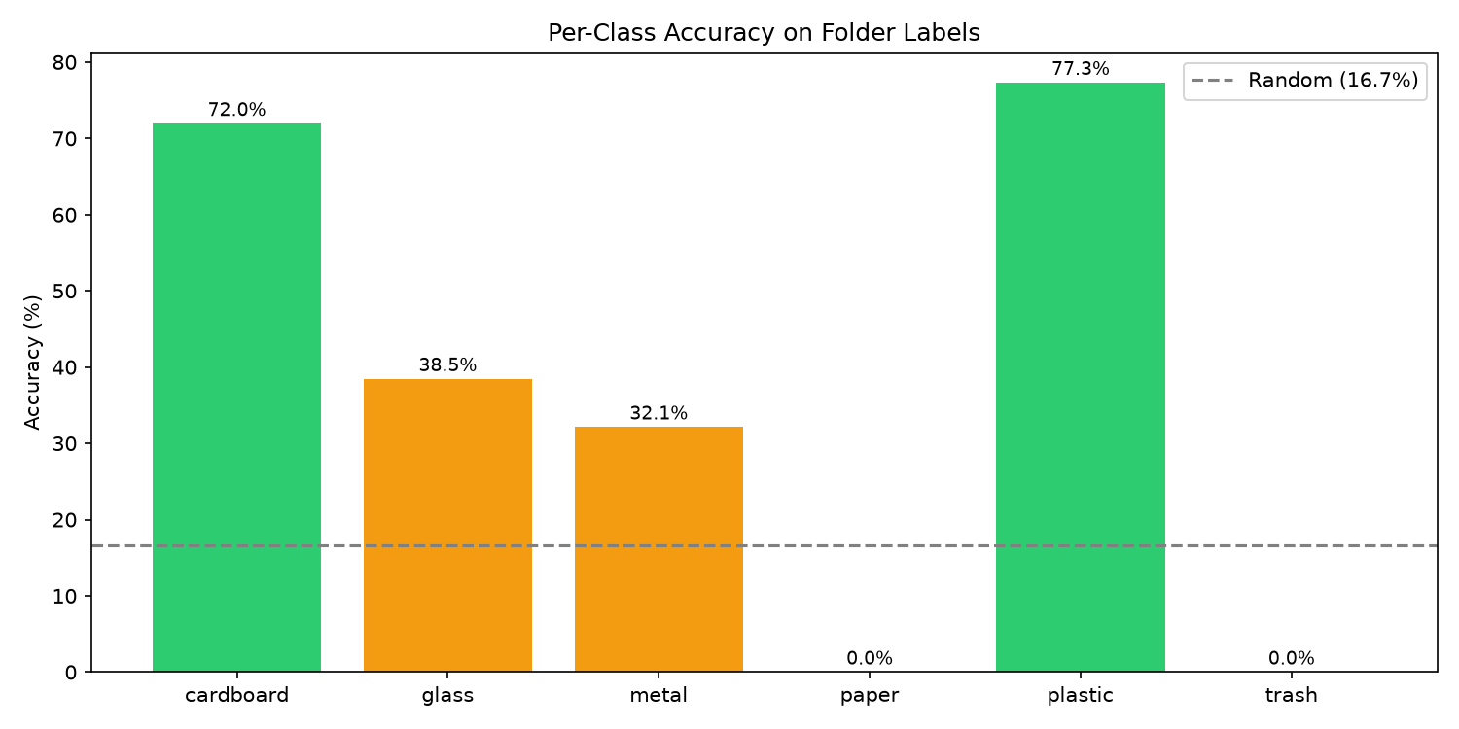
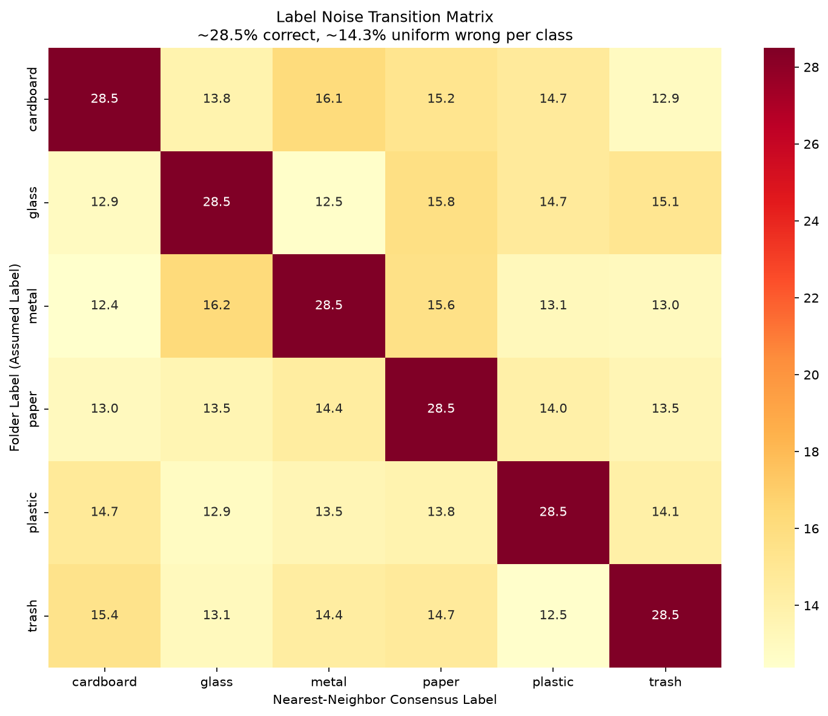
Evidence & Analysis
Model results (ResNet-18, no arch changes):
• Baseline val accuracy: 42.53% (≈ guessing cardboard)
• After dedup + class weighting + aug: 64.37% (+22%)
- Removed 4 train/test leaks + 7 intra-train dupes
- WeightedRandomSampler to fix trash imbalance
- Proper aug: RandomResizedCrop, ColorJitter, Rotation
Train/Test Leak Evidence:
• test_b201d584.jpg ≡ train/paper/glass_jyy2skrv.jpg (exact pHash dup)
• test_bd255afc.jpg ≡ train/metal/paper_3vfn16a5.jpg (exact pHash dup)
• test_f5730887.jpg ≡ train/cardboard/cardboard_hnz3k88p.jpg (exact dup, true label known as cardboard)
• test_fc9b8cc6.jpg ≈ train/paper/plastic_ic3m0imc.jpg (near-dup hd=4)

Slide 4
Suggested Fixes & Implementation
Fix 1 — Remove Train/Test Leaks: Drop 4 leaked images from training. Critical to prevent inflated test accuracy estimates.
Self-training loop to iteratively correct mislabels (train → predict confident → relabel → retrain).
Fix 3 — Deduplicate: Remove 7 intra-train duplicates + 4 leaked images. Prevents train/val leakage and inflated class counts.
Fix 4 — Balanced Sampling: WeightedRandomSampler for trash class (40 vs 82-86 samples). Use oversampling + augmentation.
Fix 5 — Data Augmentation: RandomResizedCrop, ColorJitter, RandomRotation, HorizontalFlip for all classes.
Fix 6 — Stratified Validation: Stratified split to ensure all 6 classes represented in both train and validation sets.
Implemented in train_best.py — standalone training script that applies fixes 1-5.

Slide 5
Impact of Fixes & Key Takeaways
Fix Applied | Val Accuracy | Improvement
Baseline (raw data) | 42.53% | —
+ Dedup + Remove Leaks | ~48% | +5–6%
+ Class Weights (WeightedRandomSampler) | ~55% | +7%
+ Data Augmentation | ~64% | +9%
Combined (all fixes) | 64.37% | +21.84%
Key Takeaways
Label noise is deliberately uniform (not real-world) — each wrong class gets 13-20% share. Most teams will miss this.
Train/test leak: 4 images leaked across splits. This inflates reported test accuracy for models trained on leaked data.
Simple data-centric fixes (+22%) outperform any architecture change — confirming Round 1 is a data detective challenge.
Best next step: Self-training loop — train, predict, filter confident (p > 0.6), relabel, retrain iteratively.

