Slide 1

Project (BCS-753) Presentation
on
AgentSheild AI
A Real-Time Security Framework for Autonomous AI Agents
Group Number-26MPA06
Supervisor: Ms. Meenu Sharma
Assistant Professor
Department of CSE
Submitted by:
Abhay Chauhan (2301430100004)
Aditya Sharma (2301430100015)
Avnish Kumar (2301430100065) Krishti Mittal (2301430100123)
Department of Computer Science & Engineering
IMS Engineering College, Ghaziabad
Dr. A.P.J Abdul Kalam Technical University, Lucknow
(2026-27)

Slide 2
Introduction
Background
Rapid adoption of AI agents and Large Language Models (LLMs) across industries.
Autonomous AI agents interact with APIs, databases, external tools, and enterprise systems.
Their increasing autonomy introduces new cybersecurity and governance challenges.
Need of the Project
AI agents are vulnerable to prompt injection, jailbreak attacks, and sensitive data leakage.
Traditional cybersecurity solutions cannot monitor or secure AI reasoning processes.
A dedicated real-time security framework is essential for safe autonomous AI deployment.
[ii]

Slide 3
Problem Statement
The rapid adoption of autonomous AI agents has introduced security challenges such as prompt injection, jailbreak attacks, unauthorized tool access, and data leakage. Existing security mechanisms are not designed to monitor AI reasoning or enforce runtime protection. Agent Shield AI proposes a dedicated real-time security framework that detects threats, applies policy enforcement, and provides continuous monitoring with explainable security reporting to ensure safe and trustworthy AI operations.
[iii]

Slide 4
Objectives
1
Develop a real-time AI security framework to continuously monitor autonomous AI agents and their interactions.
2
Detect prompt injection, jailbreak attempts, and other malicious inputs before they impact AI decision-making.
3
Enforce security policies by preventing unauthorized tool execution and protecting sensitive organizational data
.
4
Generate explainable security reports, audit logs, and real-time alerts to improve AI governance and compliance.
[iv]

Slide 5
Literature Survey
Title | Source | Key Contribution
OWASP Top 10 for LLM Applications (2025) | OWASP Foundation | Defines major security risks for LLM applications, including prompt injection and insecure output handling. Provides risk taxonomy but no implementation framework.
DataSentinel: A Game-Theoretic Detection of Prompt Injection Attacks (2025) | Y. Liu et al., IEEE S&P | Introduces a game-theoretic approach for detecting prompt injection attacks. Primarily focuses on threat detection rather than complete AI agent security.
Progent: Securing AI Agents with Privilege Control (2025) | arXiv | Proposes privilege-based access control to restrict AI agent tool usage. Requires manual policy configuration for enforcement.
AgentSpec: Customizable Runtime Enforcement for Safe and Reliable LLM Agents (2025) | arXiv | Provides customizable runtime policy enforcement for safe and reliable AI agents. Enterprise-scale deployment remains largely unexplored.
GPT-4 Technical Report OpenAI (2023) | arXiv | Presents the architecture overview, capabilities, and safety evaluation of GPT-4, demonstrating significant improvements in reasoning, multimodal understanding, and alignment.
[v]

Slide 6
Research Gap
Current AI security solutions address individual threats such as prompt injection or access control, but they lack a unified framework that ensures continuous monitoring, runtime policy enforcement, and explainable governance for autonomous AI agents.
Existing solutions focus on isolated security challenges rather than end-to-end AI agent protection.
Limited capability for continuous runtime monitoring of AI reasoning and behaviour.
Lack of real-time policy enforcement to prevent unauthorized tool execution and data leakage.
Absence of a comprehensive platform integrating threat detection, governance, audit logging, and explainability.
[vi]

Slide 7
Problem Formulation
Continuously monitor AI agents and their interactions in real time.
Detect prompt injection, jailbreak attempts, and abnormal agent behaviour.
Prevent unauthorized tool access and sensitive data leakage through policy enforcement.
Generate explainable security decisions, alerts, and audit logs for transparency.
Develop a scalable and extensible security framework adaptable to diverse AI applications.
[vii]

Slide 8
Proposed Solution
Develop Agent Shield AI, an intelligent runtime security framework for autonomous AI agents.
Analyze prompts in real time to detect prompt injection, jailbreak attempts, and other malicious inputs before execution.
Calculate a dynamic risk score to assess threats and generate instant security alerts for suspicious activities.
Enforce security policies by blocking unauthorized tool access and preventing sensitive data leakage.
Maintain continuous monitoring, audit logs, and explainable security reports to ensure AI governance, transparency, and regulatory compliance.
[viii]

Slide 9
Methodology
User Prompt
Prompt Analyzer
AI Agent (LLM)
Policy Enforcement
Threat Detection & Risk Scoring
Behavior Monitor
Secure Tool / API Gateway
Audit Logs & Dashboard
[ix]

Slide 10
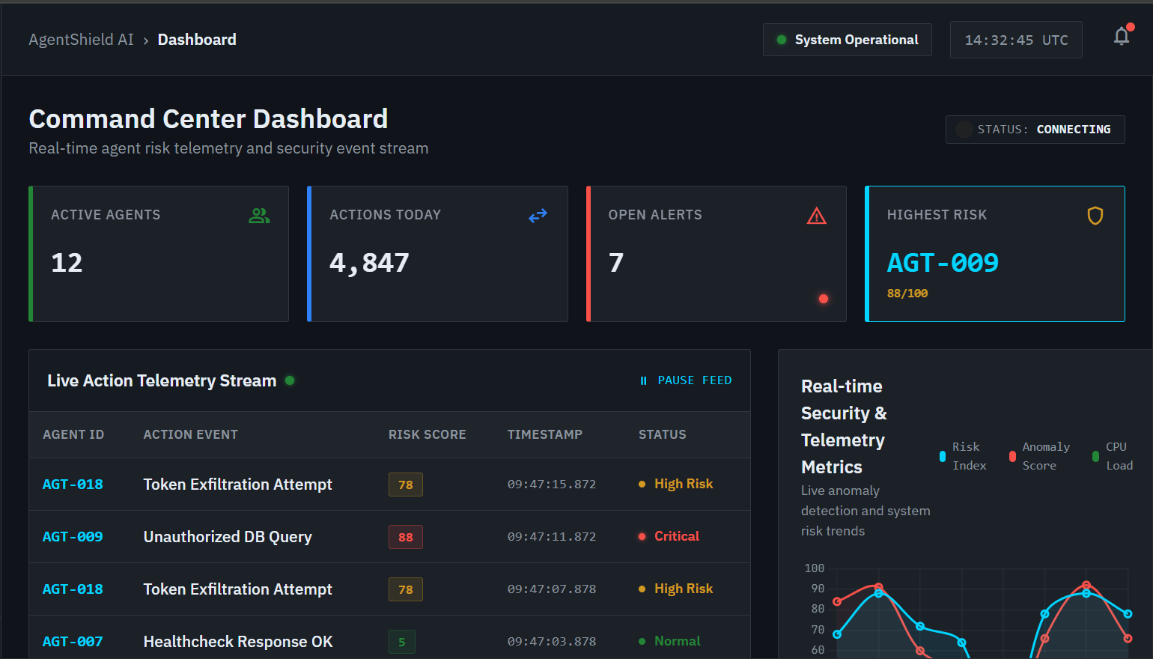
Implementation So Far
[Screenshots to be inserted here - max 2 per slide]
[x]

Slide 11
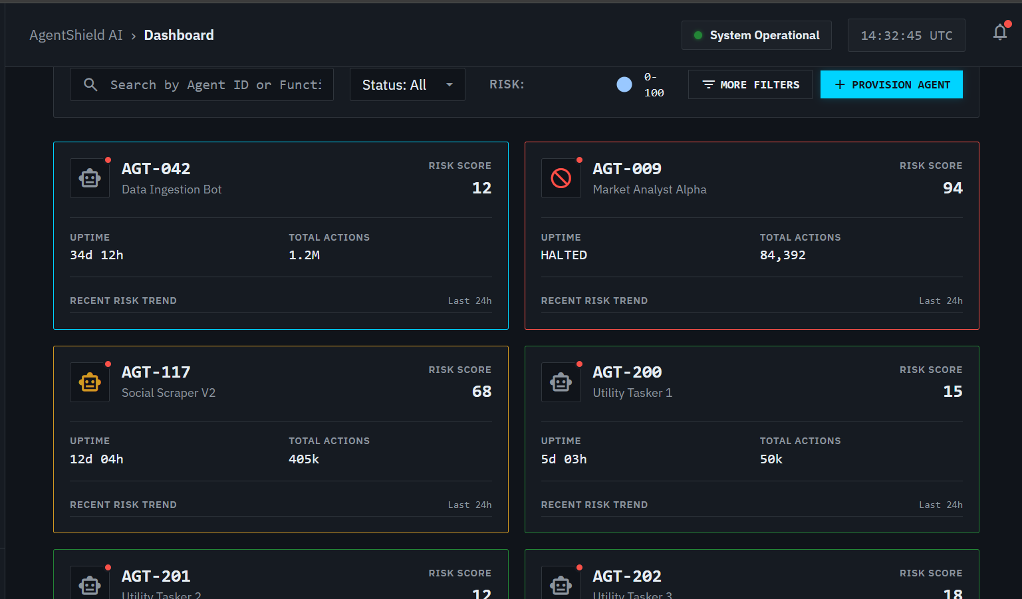

Slide 12
Outcomes Achieved So Far
Status of Objectives Achieved
Objective 1 (Study & Requirements) - Completed. OWASP LLM Top 10 studied and system requirements finalized.
Objective 2 (Design & Development) – Inprogess. Security-layer architecture designed, covering the Prompt Analyzer, Threat Detection Engine, Behavioural Monitoring Module, and Policy Enforcement Engine.
Objective 3 (Detect & Enforce) - In Progress. Core framework development is underway; prompt analysis and policy enforcement modules are being built and integrated.
Objective 4 (Report & Govern) - Planned. Explainable reporting, audit logging, and the security dashboard are planned for the next development phase.
[xi]

Slide 13
Status Of Research Paper
Current Status:Drafted
The research paper on AgentShield AI has been prepared and is currently in drafting stage .
[xii]

Slide 14
Conclusion
Agent Shield AI introduces a dedicated runtime security framework for protecting autonomous AI agents.
Integrates real-time threat detection, continuous monitoring, and policy enforcement to ensure secure AI operations.
Enhances transparency, governance, and compliance through explainable security decisions, audit logs, and real-time reporting.
Provides a scalable and extensible foundation for the secure deployment of next-generation AI agents across diverse enterprise applications.
[xiii]

Slide 15
References (IEEE Format)
[1] OWASP Foundation, “OWASP Top 10 for LLM Applications 2025,” OWASP, 2025.
[2] Y. Liu, Y. Jia, J. Jia, D. Song, and N. Z. Gong, “DataSentinel: A Game-Theoretic Detection of Prompt Injection Attacks,” IEEE Symposium on Security and Privacy (S&P), 2025.
[3] H. Wang, C. M. Poskitt, and J. Sun, “AgentSpec: Customizable Runtime Enforcement for Safe and Reliable LLM Agents,” arXiv:2503.18666, 2025.
[4] S. Yao, J. Zhao, D. Yu, N. Du, I. Shafran, K. Narasimhan, and Y. Cao, “ReAct: Synergizing Reasoning and Acting in Language Models,” International Conference on Learning Representations (ICLR), 2023.
[5] OpenAI, “GPT-4 Technical Report,” arXiv preprint arXiv:2303.08774, Mar. 2023.
[xiv]

Slide 16
Thank You
[xv]

