Slide 1
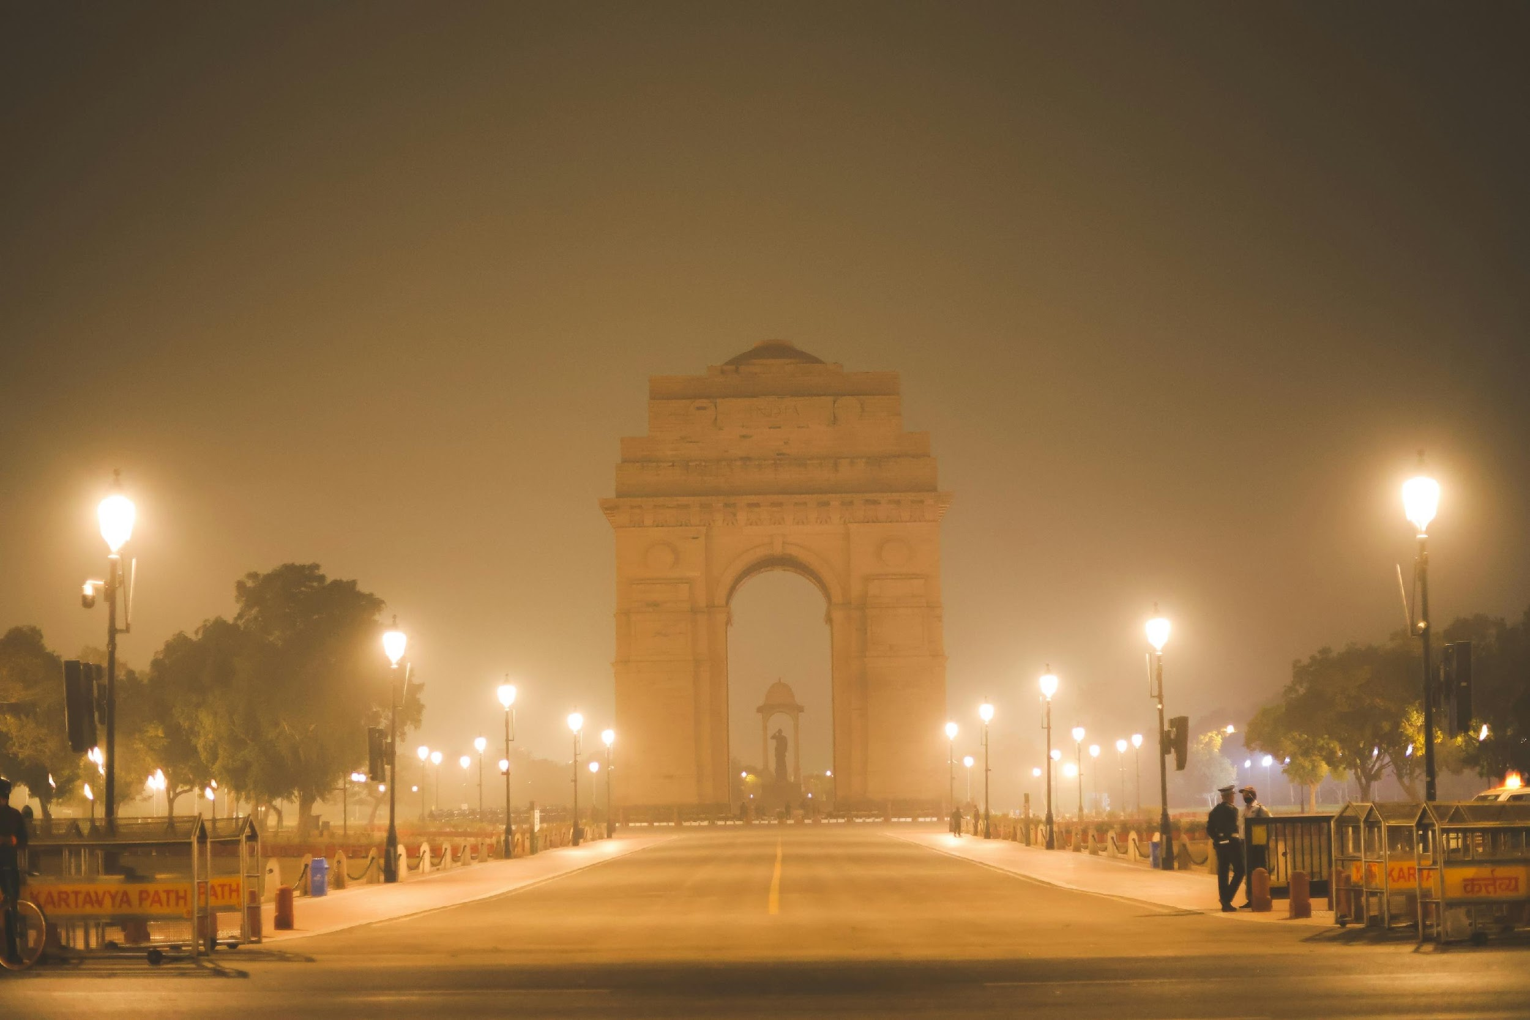
CLEAN–AIR OS
ENABALING “RIGHT TO BREATHE FOR EVERY CITIZEN OF OUR COUNTRY”
A Data-Driven Governance Framework for Delhi’s Air Quality Transformation
- Delhi’s air crisis is a coordination and execution problem — not a data problem.

Slide 2
Executive Summary
  Fragmented data & unclear ownership
  One focused Operating System (data → triggers → owners)
  CLEAN–AIR OS playbook scaled from Ward → City → State

Slide 3
THE COORDINATION GAP
Air quality data
(DPCC / CPCB)
Fire / Burn Data
(FIRMS / SAFAR)
Weather Data
(IMD)
Traffic Emission
(DTCP)
| | | | | | | | | G A P | | | | | | | |
Delhi Government Departments
(Environment, Transport)
Central Government Agencies
(MOEFCC)
Municipal Bodies
(MCD,NDMC,SDMC,EDMC)
| | | | | | | | | G A P | | | | | | | |
No Dashboards
No Shared Command Center
No coordinated ‘detect+decide+act” system
RESULT : DELAYED RESPONSES , SILOED DECISION MAKING, WEAK EXECUTION
Prepared by: Aditya Shroff

Slide 4
THE OWNERSHIP GAP – CURRENT STATE - RACI
Function / Task | Delhi Env Dept | DPCC | MCD | Transport Dept | Delhi Police | Industries Dept | CPCB
Air-quality monitoring | C | A/R | I | I | I | I | C
Construction dust control | I | C | R | I | C | I | I
Road dust & sweeping | I | C | R | I | I | I | I
Traffic emission control | C | C | I | A/R | R | I | I
Industrial emissions | C | R | I | I | I | R | C
Waste burning enforcement | I | C | R | I | R | I | I
Stubble burning | I | I | I | I | I | I | C
Public alerts & communication | A/R | C | I | I | I | I | C
Emergency response (GRAP) | R | C | C | C | C | C | I
Cross-state coordination | R | I | I | I | I | I | C
Forecasting & meteorology | I | C | I | I | I | I | R
Compliance verification | I | R | C | C | C | C | C

Slide 5
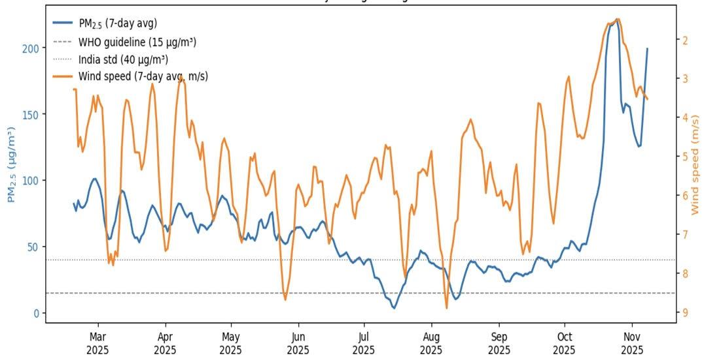
“DELHI” : THE UNDER PRIVILEGED GUY WHO GETS EXPOSED BY WIND
INSIGHTS
PM₂.₅ spikes consistently occur during low wind “stagnation weeks,” confirming wind speed as the strongest short-term driver of pollution build-up.
Even during sustained high-wind periods, PM₂.₅ rarely falls below India’s standard, indicating a strong structural emissions baseline.
The October–November PM₂.₅ explosion shows a meteorology–emissions compounding effect, not just weather-induced trapping.
Meteorology amplifies pollution episodes but does not create them
Emission load is so high that even “good” weather cannot clean Delhi’s air.
Delhi’s worst pollution events are multi-factor shocks, where meteorology amplifies emissions, not vice-versa.
INTERPRETATION

Slide 6







WHAT DOES DELHI NEEDS : ABILITY TO THINK!!!
DETECT
FUSE
LEARN
“A CENTRAL COMMAND CENTER IS REQUIRED TO BRIDGE THE GAP”
DIAGNOSE
ACT
DECIDE

Slide 7
“NEW DELHI” – The Future Governance Stack
POLICY LAYER
When policy, operations, and data work together, India’s biggest environmental problems becomes easy to solve
Policy Mandates + Annual targets
Emergency protocols
Inter agency role ownership distribution roadmap
Citizen Protection Guidelines
Compliance Frameworks
OPERATIONAL GOVERNANCE LAYER
Escalation Matrix
SLA based response timelines
Integrates (Traffic, DPCC, (industrial violations), Municipal Bodies, PWD, Fire
CONTROL LAYER
War level Dashboards
Central Command Centre
Triggered Interventions
Feedback

Slide 8
SOURCES
OpenAQI India Dataset – Delhi PM₂.₅ daily/hourly data (2020–2025) OpenAQ API; accessed 2024–2025
https://openaq.org/
CPCB / DPCC Continuous Monitoring Stations (Delhi)
Official government monitors; ITO, Anand Vihar, RK Puram etc.
https://app.cpcbccr.com/ccr/#/caaqm-dashboard-all/caaqm-landing
Government of India – National Air Quality Standards (NAAQS) Central Pollution Control Board
https://cpcb.nic.in/uploads/National_Ambient_Air_Quality_Standards.pdf
WHO Global Air Quality Guideline (PM₂.₅ = 15 μg/m³ annual) World Health Organization, 2021 update
https://www.who.int/publications/i/item/9789240034228
OECD – Economic Consequences of Outdoor Air Pollution
https://www.oecd.org/
NASA FIRMS METEORLOGY - https://firms.modaps.eosdis.nasa.gov/
McKinsey – Digital Twins in Operations
https://www.mckinsey.com/capabilities/operations/our-insights/digital-twins
BCG – Smart Cities & Air Quality Governance
https://www.bcg.com/publications

Slide 9
Thank You
I’d Love to connect if you have the ability to move systems.
ADITYA SHROFF | + 1 (437)–663 4453 | LinkedIn

Slide 10
Exhibit - 3.1 : OS Architecture : From Sensors to Command Centre
PHYSICAL AND EDGE
CONNECTIVITY AND DATA INGESTION
DATA ANALYTICS AND GOVERNANCE
Any Sensor Feed
IOT HUB
City Data Lakehouse
• Roadside AQ (PM₂.₅ / NOₓ / CO)
• Traffic & congestion
• Construction dust & noise
• Industrial & DG stacks
• Waste-burning cameras
• Met masts, satellite fire
• Citizen & ward app reports
• Device identity & certificates
• Onboarding & health
• Command / control channel
• Unified timeseries tables
• Spatial layers & metadata
• Golden record for air-quality
Real time streams
Analytics Brain
Kafka (RTS)
• Nowcast & 24–72h toxic-day risk
• Source fingerprints & clusters
• Hotspot maps & levers
• Alert thresholds & SLAs
• High-volume event streams
• Multiple consumers
• Replay & durable log
Control Loop
Ward/Edge Gateway
Convert MODBUS / BACnet / analog → MQTT / OPC-UA
Local buffering & simple rules
Secure VPN to city cloud
Batch and API Ingestion
Batch loads
Commands
• Hourly/daily dumps (S3,blobs)
• Govt portals, inventories
• Vendor / OpenAQ APIs
City and Ward Command Rooms
Action Agencies (public private partnership)
Apps and Dashboards

Slide 11

CHAPTER 1
Delhi’s Air Quality Today
Bryan Jhonson, Tech Millionaire –
“The pollution levels were equivalent to smoking over one cigarette per day — it’s not just numbers; it’s earnestness for life expectancy”

Slide 12
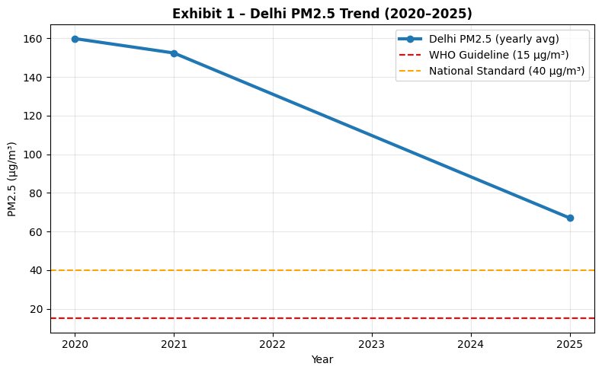
Exhibit – 1.1: Air Quality Snapshot (Jan 2020 – Oct 2025)
Insights
Mean PM₂.₅ ≈ 146 µg/m³ → 9× WHO limit.
8 Severe Days (9 % of total) > 250 µg/m³
2020 → 2025 drop of ~58 % but still unsafe.
Data coverage inadequate — real-time response lags (Reliability Issues)
Interpretation
Despite measured improvement, Delhi’s PM₂.₅ levels remain 4× above national limits and 9× WHO guidelines.
A sharp decline is seen in 2021 because of covid pandemic
Figure 1 – Yearly average PM₂.₅ for Delhi based on daily citywide PM₂.₅ data (OpenAQ/CPCB, 2020–24); the 2025 value is derived from ITO station daily PM₂.₅ (2025 file) used as a proxy for the citywide average.

Slide 13
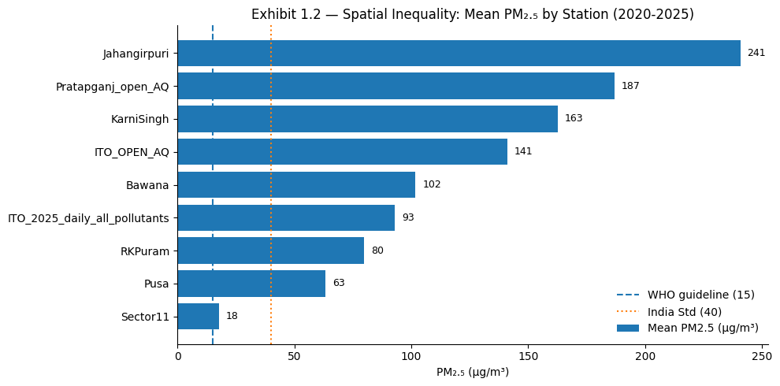
Exhibit – 1.2 – Spatial Inequalities
Insights
Spatial disparity > 4×: Jahangirpuri ≈ 241 µg/m³ vs Pusa ≈ 63 µg/m³.
Five of eight stations exceed 100 µg/m³ average.
All sites exceed WHO (15 µg/m³) and India (40 µg/m³) limits.
Persistent hotspots in industrial and traffic-dense zone
Interpretation
Delhi’s air pollution is not uniform — localized emission clusters dominate.
Enforcement and mitigation must be region-specific rather than city-wide.
Highlights the need for spatially coordinated real-time monitoring layers in CLEAN–AIR OS.
Figure 2 - BAR CHART – 2025 mean PM₂.₅ by station (ITO, RK Puram, Pusa, Jahangirpuri, Bawana, etc.)
Neglect Sector 11 – Data Reliability and continuity issue.

Slide 14
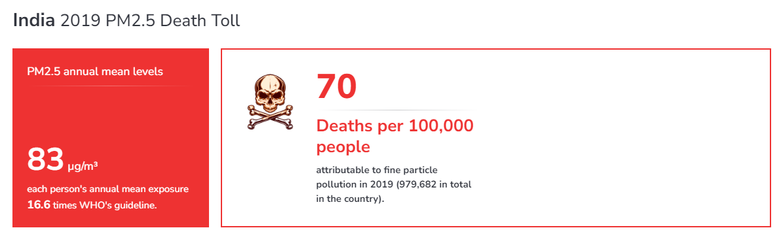
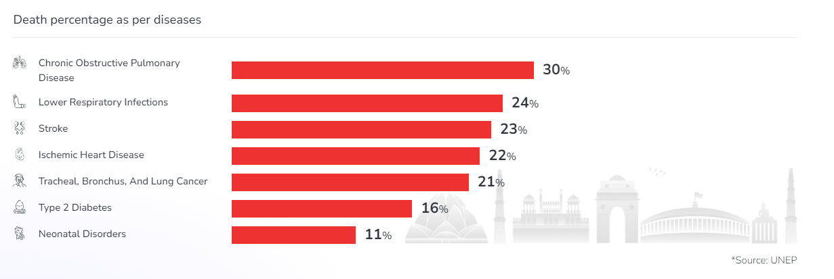
Exhibit – 1.3 – Air Pollution As Public Health Emergency
“Air pollution is a public health emergency hiding in plain sight.”
— Jane Burston, Clean Air Fund Health Policy Wat
Figure 3 : India already sees ~70 deaths per 100,000 people linked to fine particulate pollution. Source : AQI.in
Air Pollution Kills Silently - “but the data exposes the emergency”
Figure 4 : – Health impacts are not abstract: chronic respiratory disease, lower respiratory infections, heart disease, and stroke together account for >75% of pollution-linked deaths. Source: AQI.in

Slide 15
CHAPTER – 2 – ANATOMY OF THE PROBLEM
INSERT QUOTE AND IMAGE

Slide 16
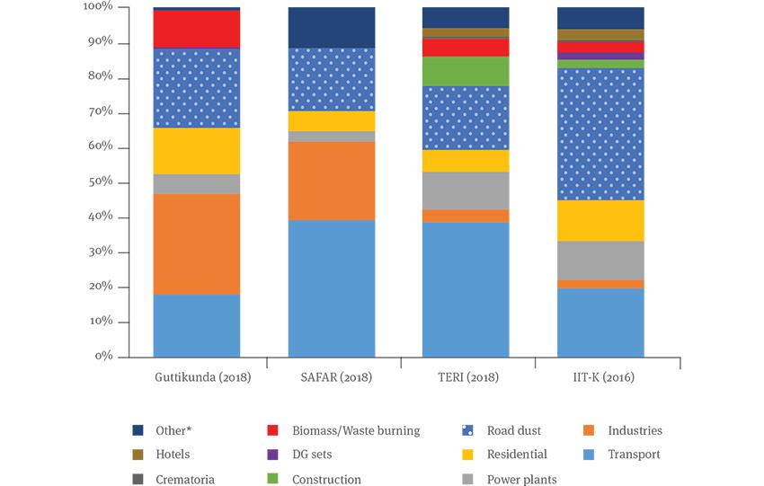
Exhibit – 2.2 Excavating The Pain Points (Distribution)
Pro tip : Precision in distribution + correlation is the single biggest unlock for sustainable, city-wide scaling.
Insights
Transport + road dust = the dominant slice across all four studies – the first lever, every time.
Industry + power stacks stay in the top tier contributors wherever the industrial belt is in scope.
Residential fuel, biomass burning and construction form a stubborn “background smoke” that never fully disappears.
Interpretation
Tackling spikes (biomass, construction) without lowering the residential “background” will never deliver truly clean days – both must be managed together.
Stack controls in industrial belts are necessary, but not sufficient, for clean air.
If we don’t fix vehicles and road dust, nothing else will move the needle.
Figure 6 - Exhibit 2.2 — Delhi’s PM₂.₅ Source Contribution is Consistently Multi-Sectoral: Across four independent studies (IIT-Kanpur 2016, Guttikunda 2018, SAFAR 2018, TERI 2018), road dust, transport emissions, residential/biomass burning, and secondary areas.

Slide 17

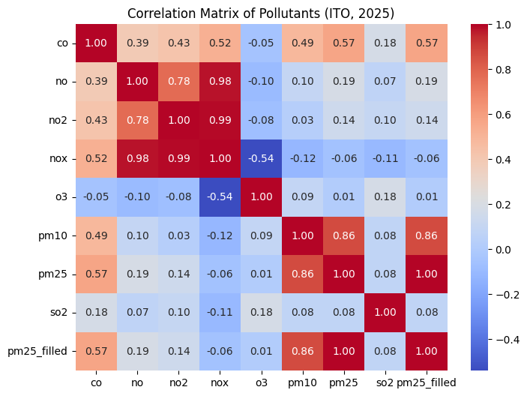
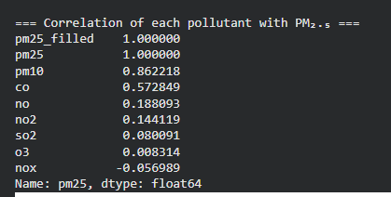
Exhibit 2.3 – Inner Circle – Who Spikes When it spikes (Correlation)
Insights
PM₂.₅ travels with PM₁₀ and CO, not with NOₓ – two clear pollutant “families” show up.
NO, NO₂ and NOₓ move almost perfectly together, while O₃ moves in the opposite direction.
SO₂ is weakly linked to everything, suggesting a minor role at ITO in 2025.
Interpretation
Figure 7 - Pollutant Correlation Matrix (ITO, 2025)
Dust + dirty combustion controls (PM₂.₅/PM₁₀/CO) will deliver more health gain here than NOₓ-only measures.
NOₓ compliance alone won’t guarantee PM₂.₅ improvement – CLEAN–AIR OS must track PM-specific levers in parallel.
These correlation clusters are “event fingerprints” we can use to classify spikes and trigger the right agencies fast.

Slide 18
CHAPTER – 3 – Blueprint Towards clean air

Slide 19
Exhibit 3.3 : ANALYTICS STACK (THE BRAIN)
City Command Room Dashboard
Ward level action views
Hotspot Detection + forecasts
SLA scorecards
OUTPUT LAYER
SLA Triggers + Threshold creation
Escalation Logic
Lever Mapping
Multi agency coordination rulebook
LOGIC CREATION
Strengthening these highlighted logic layers ensures we don’t fall into the “AI hype trap” and instead build a system that is predictable, explainable, and government-ready for the future
Source attribution + fingerprinting
Forecasting + categorical emissions tracking + escalation index
Hotspot + spike recognition + impact scoring
ANALYTICAL ENGINE
Time series alignment and spatial indexing
Missing value repair
Multi - Source stitching + Golder Hour Record
DATA PREPARATION
➡ SLA Scorecards = A matrix by which our bible can learn
➡ SLA Triggers = Bible + Geeta
➡ Fingerprinting = Comparing
➡ “Golden Hour = hourly gold-standard dataset (clean, fused, aligned).”

Slide 20
CHAPTER – 4 – SCALABLITY AND EXECUTION

Slide 21
Exhibit 4.1 – SCALABLITY AND ITS DEPENDENCE ON ACCURATE LEVERS ATTRIBUTION
Insights from Chapter 2 | What it means (Lever Logic) | What must scale
Transport + road Dust domination | Stable, repeatable levers : will behave uniformly | SLA Logic, AQI Logic
Industrial belts (Nitrogen family) | Zone specific levers : requires building zonal logic | Zonal Attribution Cross ward Hotspot Detection
Construction + waste burning + chimney stacks | Local, unpredictable : requires dense sensor network + fast detection | Local Node Gateways Spike Rules
Long Tail Stabilization | Neglect the residential plus approved construction sites after identifying major levers | City OS Layer Golden Hour Record City Layer SLA

Slide 22
Exhibit 4.2 – WHAT INCREASES, WHAT STABILIZES
Category | Ward | Zone | City | What Normalizes
Sensors | 10-20 | 50-100 | 500-700 | Device Templates, Metadata rules
Gateways | 1 | 4-5 | 35-50 | Gateway Protocols + data schema
Alerts | 5-15 | 30-60 | 200-400 | Trigger rules +SLAs
Agencies | 2-3 | 5+ | 10-12 | Governance Structure + Response SLAs
Command | Ward | Zonal | City OS | Dashboards + Escalation Matrix
Data Volume | Ward | Zonal | City OS | Dashboards + Escalation Matrix

Slide 23
Exhibit 4.3 – THE CLEAN – AIR OS SUSTAINABLITY MODEL
PILLARS | METHOS DO WE SUSTAIN THE SYSTEM
1. Revenue Engine | Data Apis (mobility, weather, health tech)
 | Premium sensor meshes for high rises
 | OS Layer Licensing
2. Operating efficiency | Shared SLA across agencies
 | Edge – Gateway - data lake architecture lowers cost
 | Digital compliance and Fines (OPEX)
3. Strategic Expansion | Talent and Resource sharing to other cities and countries
 | Clean – Air Academy training + certifications
 | Annual SLA Report + Transparency to assure Grants + Global Funding
SUMMARY
Government pays for stability, private players play for precision and scale and the OS funds itself

