Slide 1
SENTINEL
Integrated Video Management and Analytics Platform
A hybrid of Model 1 (Centralised CCTV Registry and GIS Mapping) and Model 2 (Unified Viewing and Metadata Analytics), with event-triggered evidence capture (Pipeline 3) designed and validated separately. Model 3 federation is the documented integration path.
Police
GSRTC
Municipal
Panchayat
Health
One platform. Five departments. Watching is not storing.
Gujarat Police Innovation Challenge 2026 · Home Department / SCRB · Submission by Adi
SENTINEL · Gujarat Police Innovation Challenge 2026
Notes:
Open with the sentence that is graded: a registration number handed over live returns that vehicle's complete timestamped route across the network.

Slide 2
The problem, and what is actually graded
TODAY
THE LIVE TEST CASE
26 government departments run independent, standalone CCTV systems
Mixed analog and IP cameras, different vendors and VMS platforms, incompatible feed protocols
Storage fragmented: cloud for some, local for others, retention from 7 days to over 15
Sites as much as 1,000 km apart, from the border districts to Somnath and Dwarka
Tracing one vehicle means asking each department separately, by hand
A registration number is handed over on evaluation day.
Identify, trace and present that vehicle's movement across the integrated network
Complete route: timestamped, location-wise, across camera locations and departments
Continuous cross-referencing of live feeds against a watchlist, with automated real-time alerts
A working system. Mock-ups and concept videos are not considered
SENTINEL · Gujarat Police Innovation Challenge 2026
Notes:
The problem is heterogeneity first and scale second. The test case is a single vehicle route.

Slide 3
Proposed model: a hybrid, with justification
MODEL 1 · mandatory
MODEL 2 · viewing + analytics
PIPELINE 3 · evidence
MODEL 3 · federation
Camera registry, the control plane
GIS console: department layers, coverage sectors, activity, gaps
Onboarding by form, CSV and API
Built and demonstrated
Direct pull, departments untouched
Two different systems in one viewer
ANPR metadata, no central video
Built and demonstrated
Rolling buffer, promote on a match only
60 s clip, SHA-256, audit row
Designed and validated separately
Not built in the demo
Adapter per vendor VMS
Department-side collector for NAT and SDK-only sites
Answers heterogeneity, not scale
Integration path in the HLD
Why not Model 4, Central VMS and AI Platform: 80,000 cameras at 3 Mbps is about 240 Gbps sustained into one facility, a procurement and physical-plant problem before it is a budget line. Analysing at the edge sends only text rows and plate crops, about 23 Mbps, roughly 10,000 times less. [model]
SENTINEL · Gujarat Police Innovation Challenge 2026
Notes:
Justify the hybrid: Model 1 is mandatory, Model 2 gives unified viewing and analytics without central storage, Pipeline 3 evidence capture is designed and validated separately and is not built in the demo, Model 3 answers heterogeneity, and Model 4 is ruled out by the bandwidth arithmetic.

Slide 4
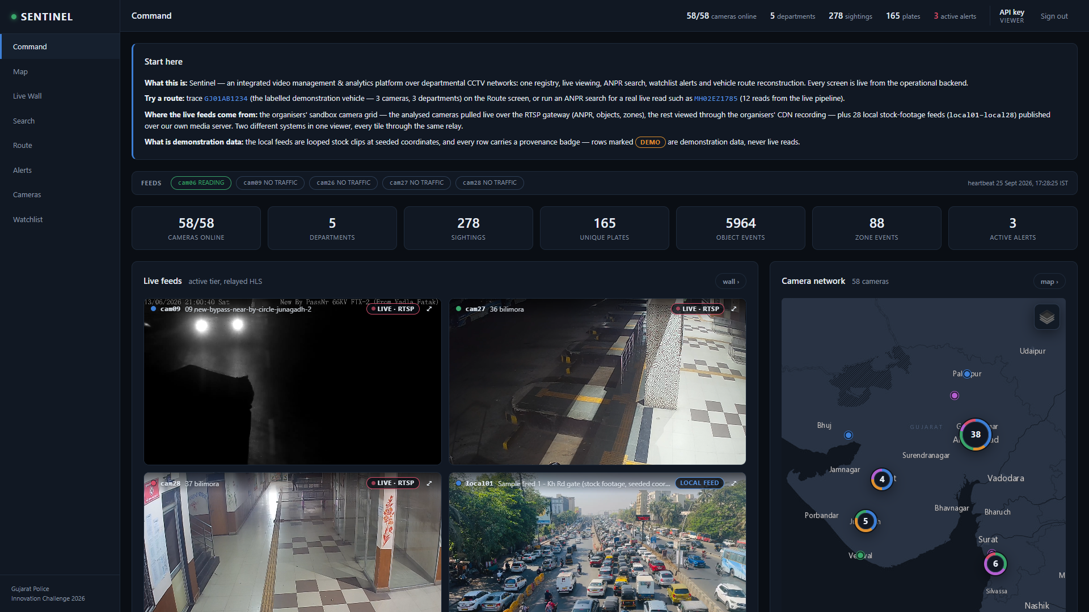
What we built: the Command view
One screen: live tiles, GIS, alerts, plate reads, analytics and feed health, all served by the operational backend
1
Live tiles Analysed feeds relayed, not recorded: a self-overwriting 20 s window is the only video on disk.
2
GIS 58 cameras: the organisers' 30 and 28 local sample feeds, clustered by city.
3
Alerts Alert rows tailed from the database and pushed over Server-Sent Events in about 2 s [estimate].
4
Feed status Reading, no traffic or feed down, judged by each pull's own freshness.
5
Start here The first screen says which data is demonstration data. Demo rows carry a DEMO badge.
6
Reads and analytics Latest plate reads, object, person and zone-event counts from the live detector.
Command view, live: sandbox cameras cam09, cam27 and cam28 over RTSP and sample feed local01, all through the relay (captured 25 Sep 2026)
SENTINEL · Gujarat Police Innovation Challenge 2026
Notes:
This is the Command screen the demo opens on, captured from the running platform. Three sandbox cameras are pulled live over RTSP and one tile is a local sample feed; all four play through the relay. The Start-here panel tells the evaluator which data is demonstration data. Captured from the running platform on 25 September 2026 (1920x1080, signed in through the script key path; no credential is on screen).

Slide 5
Architecture: one pull, three pipelines, one registry
MODEL 1 REGISTRY + GIS the control plane: id, department, location, bearing, field of view, stream URLs (never credentials), codec, health, tier, zones. Nothing downstream hard-codes a camera.
CAMERA GRID > ONE pull per camera (RTSP over TCP) > NODE
PIPELINE 1 · LIVE VIEW
PIPELINE 2 · AI ANALYTICS
PIPELINE 3 · EVIDENCE
Relay to the control room: Command and the Live Wall
hls.js tiles; the API holds the upstream session
Persists: a self-overwriting 20 s relay window only
Motion gate, detect, track, crop, OCR
Match against the LOCAL cached watchlist
Persists: text rows plus a plate crop of about 2 KB
Fixed-size rolling buffer per camera
Promote 30 s either side, on a watchlist match only
Persists: clip, SHA-256, audit row
relayed, not recorded · built
text and crop only · built
designed and validated separately; not built in the demo
Governing rule: video becomes permanent only where a specific, logged, auditable watchlist match justifies it. In the demonstrated system, where Pipeline 3 is not built, no video is kept beyond the 20-second relay window.
SENTINEL · Gujarat Police Innovation Challenge 2026
Notes:
One pull per camera, three pipelines, the registry underneath. Pipelines 1 and 2 are built; Pipeline 3 is designed and validated separately and is not built in the demo. State the governing rule plainly: video is kept only where a logged watchlist match justifies keeping it, and in the demo no video is kept beyond the 20-second relay window.

Slide 6
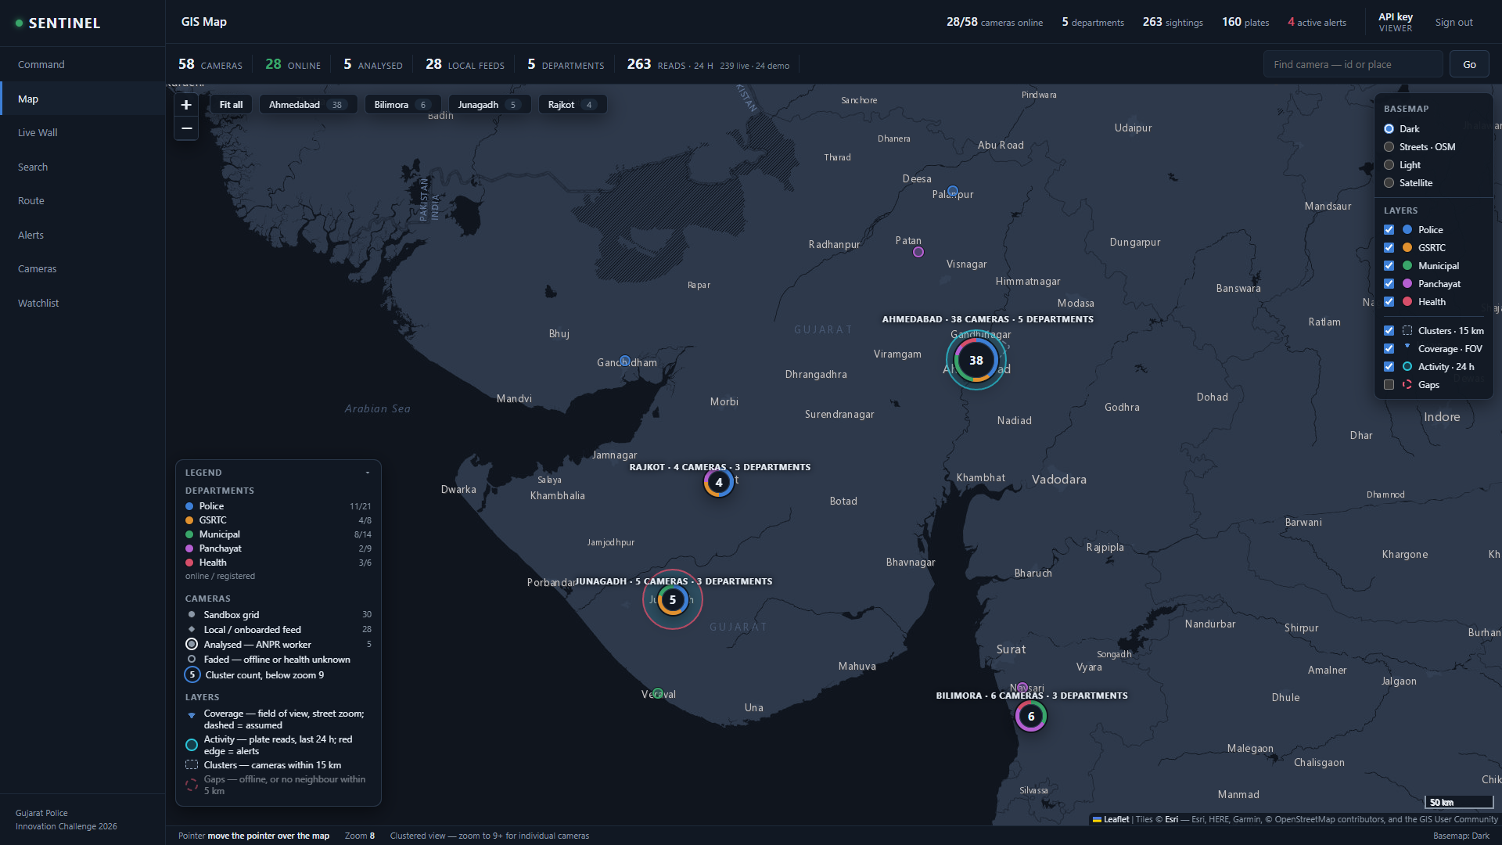
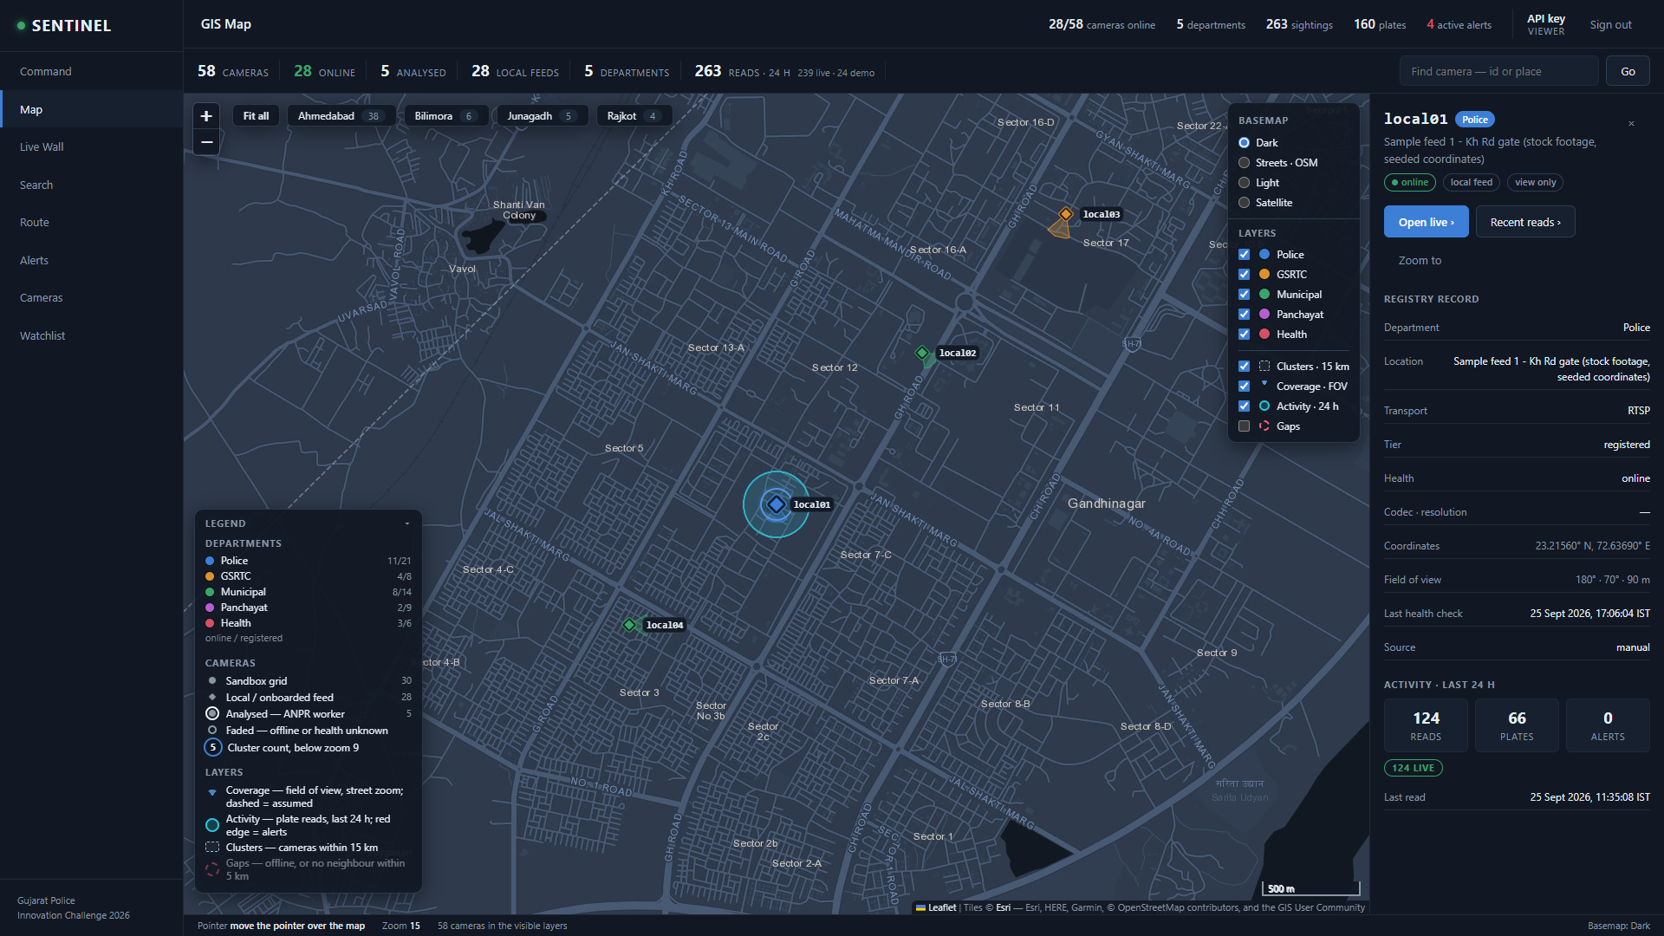
Model 1: registry, GIS console and the named deliverables
GIS console, live: all 58 cameras clustered by city, department layers, basemap choice and legend
Zoomed to Gandhinagar: pins by department, field-of-view sectors, 24 h read activity and the camera's registry record
MODEL 1 DELIVERABLES: BUILT
Registry portal with a GIS console: street, light and satellite basemaps; department layers, coverage sectors, activity, cluster hulls, coverage gaps
Onboarding by form, bulk CSV (each row accepted or rejected with a reason) and POST /api/cameras, every action audited
58 cameras registered: the organisers' 30 across 5 departments and 28 local sample feeds; registry API documented as OpenAPI; gap-analysis report; health monitoring
Disclosed: the catalogue carries only id and name. Departments and coordinates of the sandbox cameras and of the sample feeds are seeded in committed files.
SENTINEL · Gujarat Police Innovation Challenge 2026
Notes:
Every Model 1 deliverable is built. The left capture is the whole registry on the GIS console; the right is zoomed to Gandhinagar with a camera's record open, showing field-of-view sectors and 24-hour read activity. Disclose that departments and coordinates were assigned: the catalogue carries only id and name, and the 28 sample feeds are stock footage at seeded coordinates. Captured from the running platform on 25 September 2026 (1920x1080, signed in through the script key path; no credential is on screen).

Slide 7
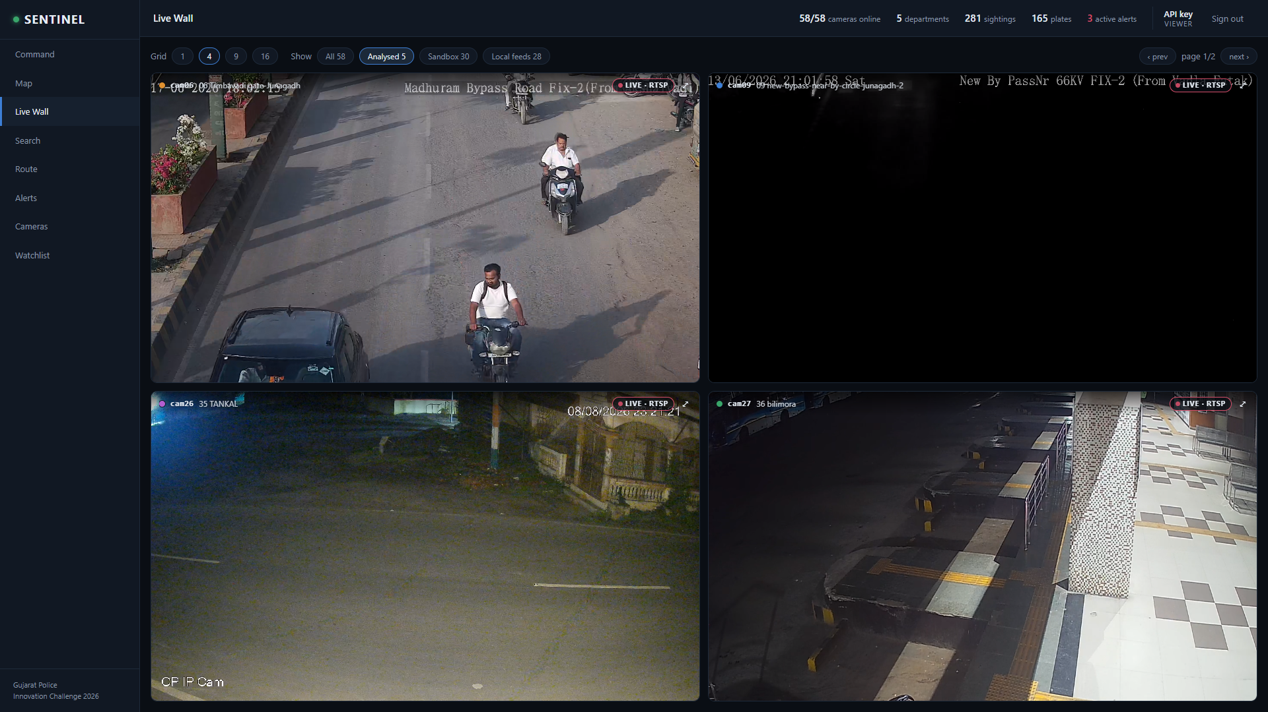
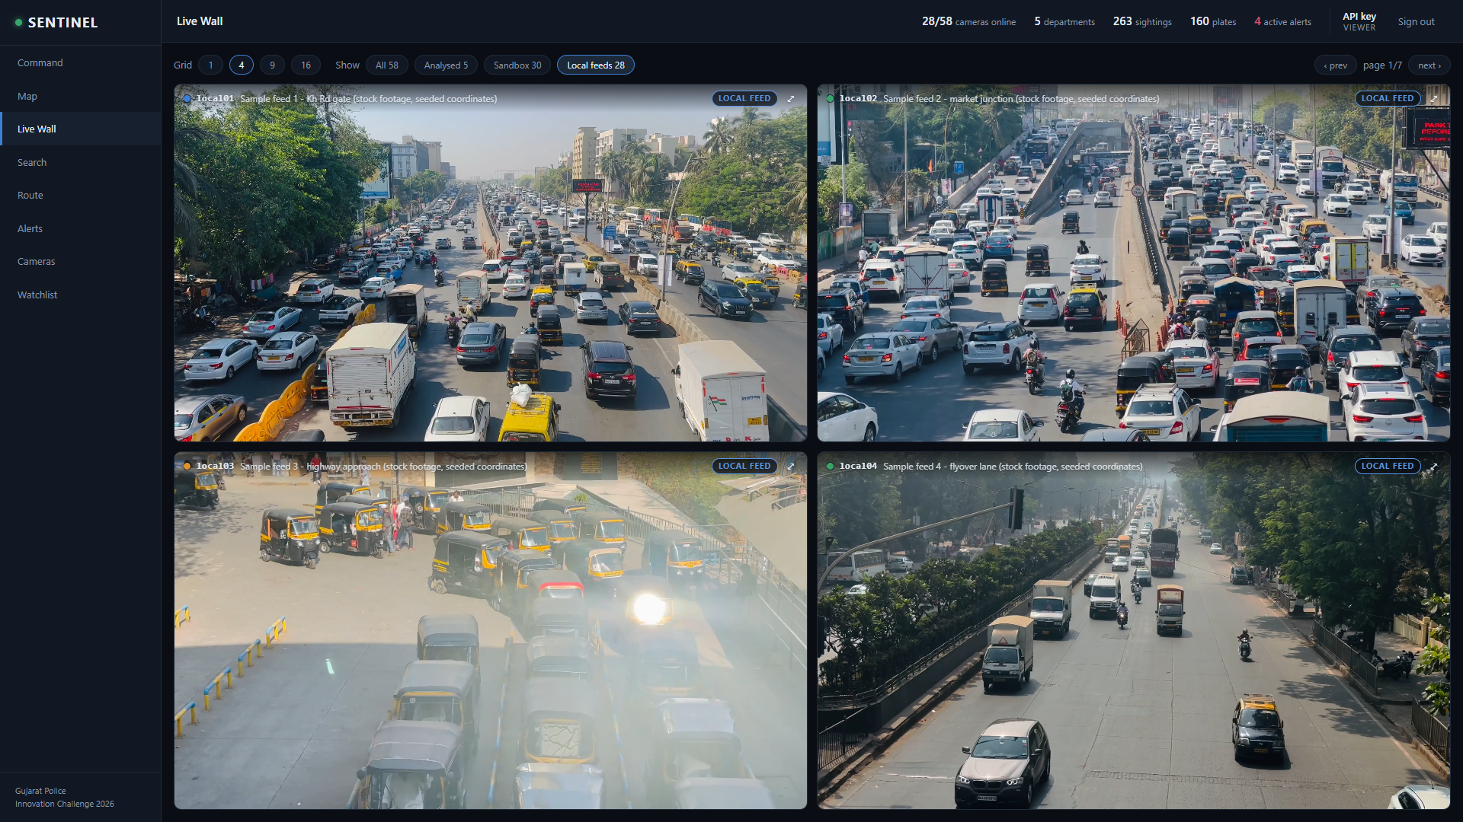
Model 2: two different systems in one viewer
System A, the organisers' sandbox: four analysed cameras pulled live over RTSP and played through the relay
System B, a local camera server: 28 stock-footage feeds (sample clips at seeded coordinates, labelled on every tile)
One pull per camera, RTSP over TCP and never UDP; decoder warnings on join are logged, never fatal
All timing from PTS; jittered exponential backoff (2 s base, 30 s cap) and a stall watchdog on every pull
Consume-only: no publishing, no control-API calls, no footage download
Every registered camera opens on the Live Wall through the relay: the node's own pull, the organisers' CDN recording, or the local server's HLS
Only the tiles on screen hold a stream; the relay sits behind the login and is rate-limited
The sample feeds are stock footage, not sandbox footage and not filmed by the team
SENTINEL · Gujarat Police Innovation Challenge 2026
Notes:
The Model 2 deliverable: two different systems in one viewer. System A is the organisers' sandbox gateway, pulled live over RTSP, one pull per camera; system B is a local mediamtx server publishing 28 stock-footage feeds. Every item on the organisers' pre-submission checklist is implemented. The H.265 sandbox tiles need a browser that decodes HEVC; the capture on the left was taken in Chrome. Captured from the running platform on 25 September 2026 (1920x1080, signed in through the script key path; no credential is on screen).

Slide 8
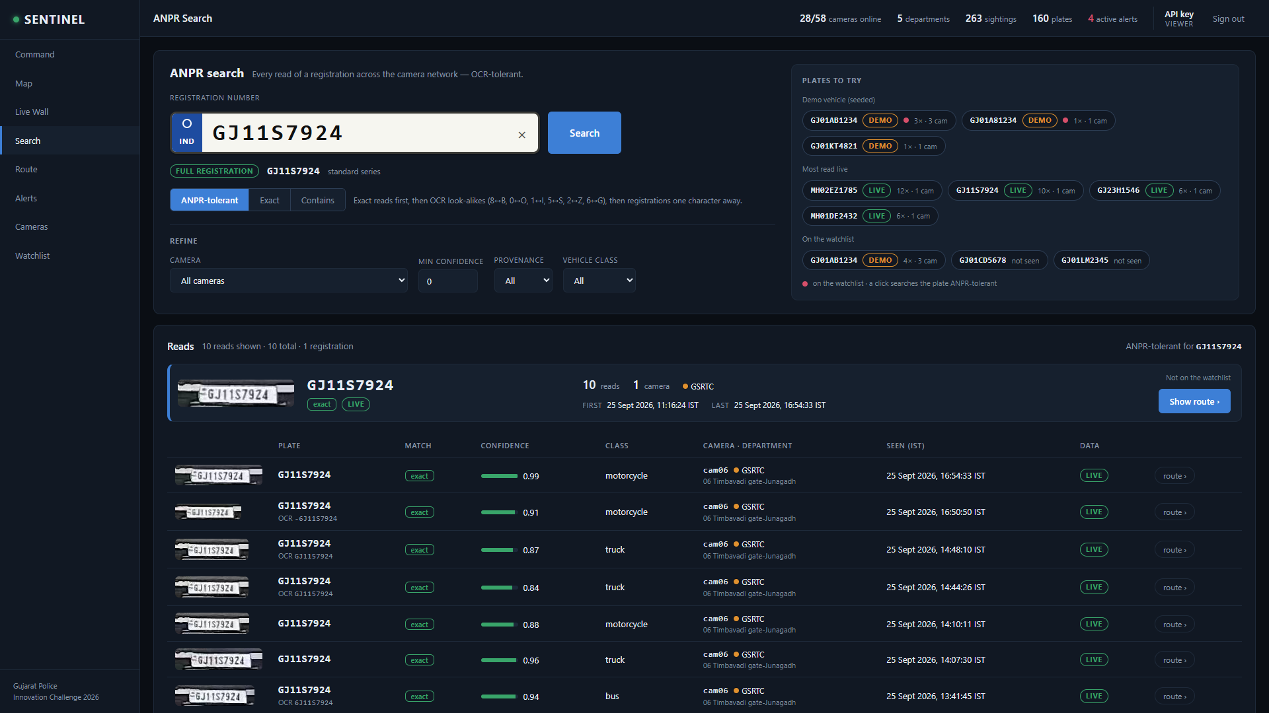
Video analytics: ANPR, objects, intrusion, tracking
1
Motion gate MOG2 skips static frames; measured skip rate 0 to 54% by camera [measured]
2
Detect YOLOX-S (Apache-2.0) on ONNX Runtime, on the GPU through DirectML. Never Ultralytics (AGPL)
3
Track A greedy IoU and centre-distance tracker on PTS deltas: an IoU tracker, not ByteTrack
4
Crop and OCR The vehicle crop, never the frame, upscaled and read by PaddleOCR PP-OCRv5 mobile
5
Plate grammar Indian format with position-aware coercion (GJ1157924 stored as GJ11S7924); a track's reads are voted; raw OCR kept
6
Events Object and person counts, intrusion polygons, directional line crossing
ANPR on the live sandbox: every read of GJ11S7924 on cam06, the OCR text kept beside the coerced plate, with crop, confidence, class and provenance
Facial recognition: described, not built. Face detection at the edge, then embedding, then matching against an authorised gallery only, with the same edge-cached posture. No general-population face database. Non-match embeddings are not retained. Every match is logged.
MEASURED ON THE LIVE SANDBOX, 25 SEP (10-minute run, five cameras over RTSP, laptop GTX 1650): inference 0.6 to 1.5 fps per camera; peak GPU memory 119 MiB; peak RAM 1,749 MB; plate-read rate 0.062 [measured]. The ANPR viability gate passed; the binding stage was CPU OCR, not the GPU.
SENTINEL · Gujarat Police Innovation Challenge 2026
Notes:
Real plate reads on a government feed: cam06 on the live sandbox, with the OCR text kept beside the coerced plate. The measured figures are the only [measured] numbers in the submission, from the formal 10-minute run on 25 September. Captured from the running platform on 25 September 2026 (1920x1080, signed in through the script key path; no credential is on screen).

Slide 9
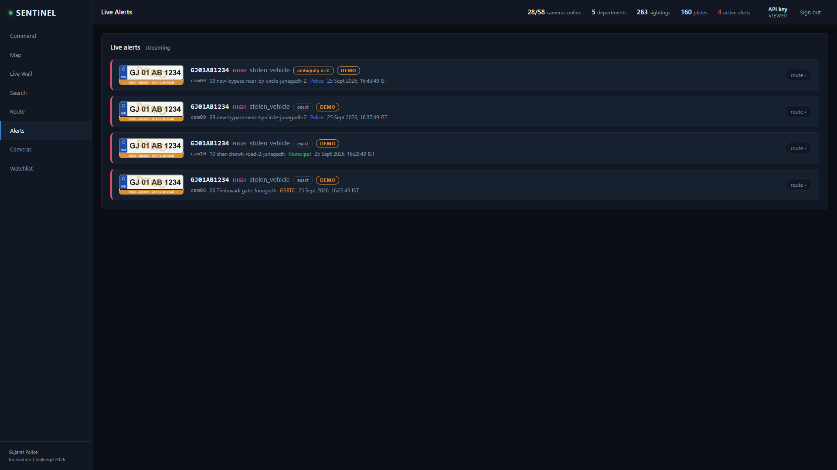
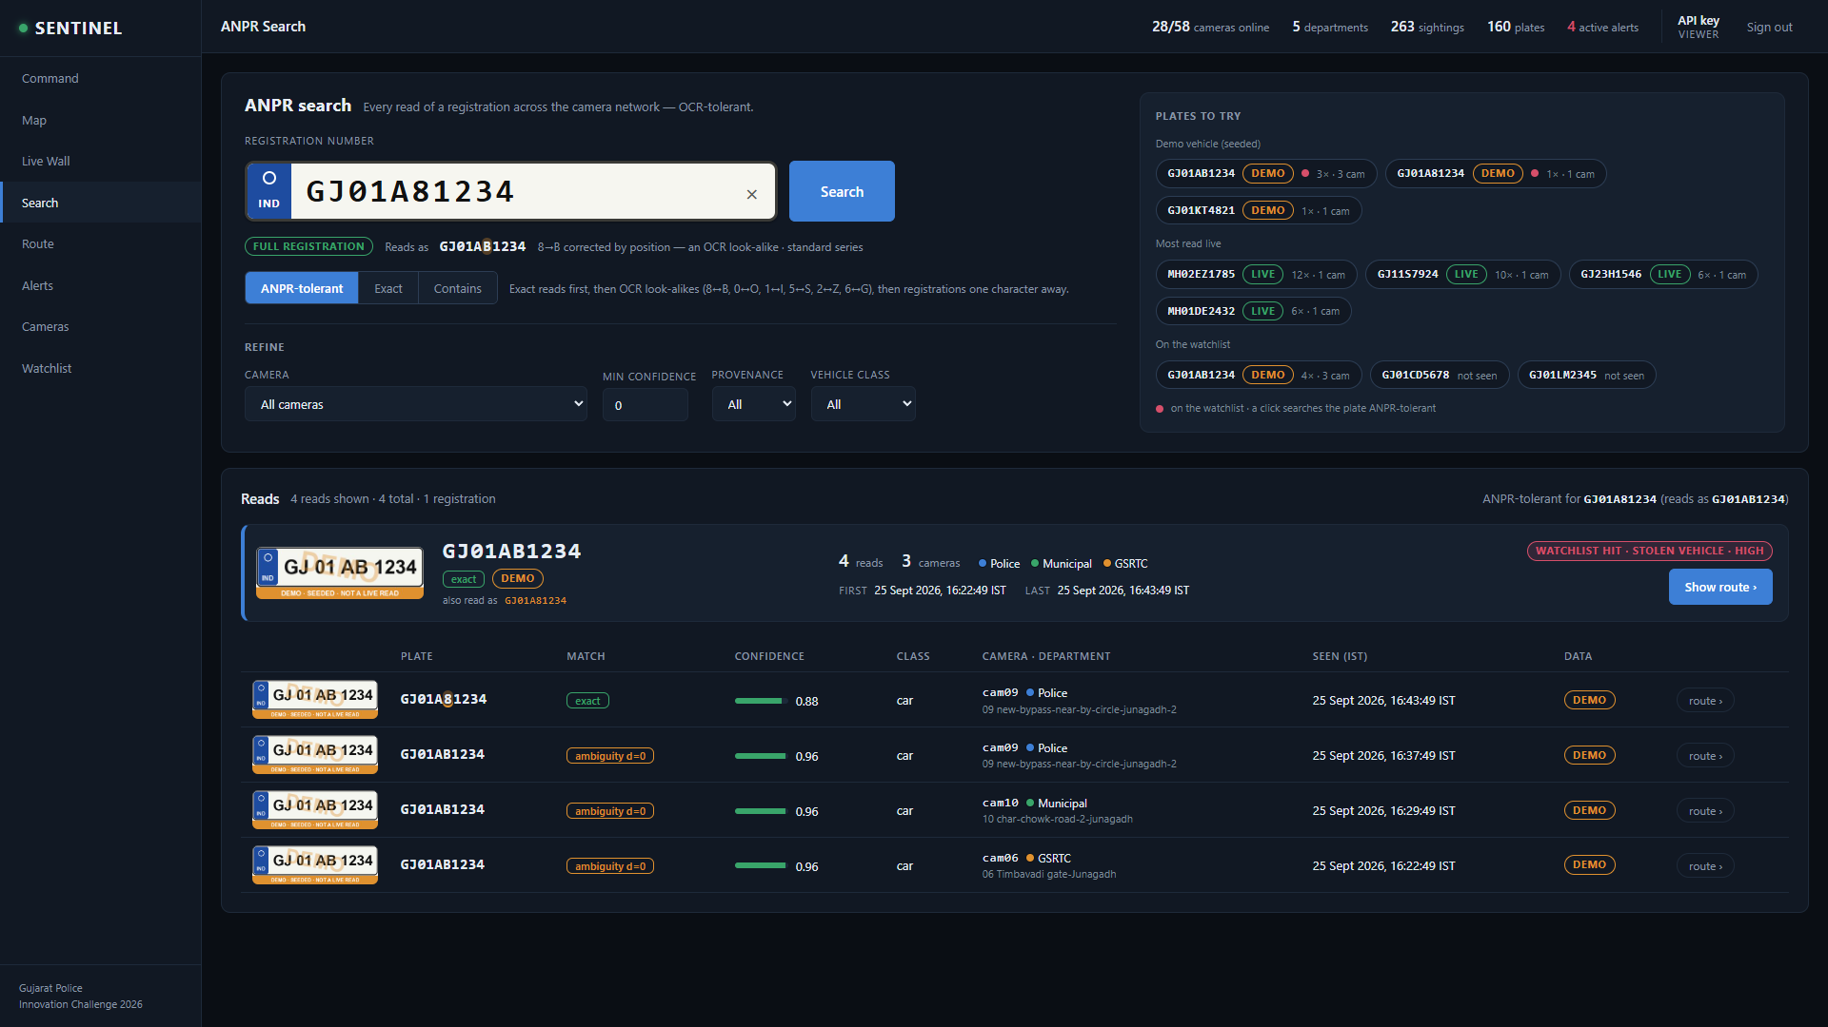
Watchlist correlation and real-time alerting
Alert stream: plate crop, severity, category, match type and a DEMO badge on every demonstration row
A mistyped query (GJ01A81234) still finds the watchlisted vehicle: the 8/B look-alike is corrected by position
Matching is local, against a cached watchlist: never a per-detection call to VAHAN or eGujCop
Three match types in order: exact, OCR-ambiguity (O/0, I/1, S/5, B/8, Z/2, G/6, Q/0), then confusion-weighted fuzzy
Alerts fire on exact and ambiguity; fuzzy is shown and flagged, not alerted by default; partial reads never alert
Sighting written before matching; alert row written before broadcast; the API tails the alerts table and pushes Server-Sent Events
Five-minute cooldown per plate per camera, derived from the database rather than process memory
Acknowledgements persisted and audited under the operator's name; every plate lookup is audited too
SENTINEL · Gujarat Police Innovation Challenge 2026
Notes:
Edge-cached matching is an architectural decision. Central matching at 80,000 cameras is about 1,333 queries per second against VAHAN [model], which would take down the state's own system of record. The alerts shown are for the labelled demonstration vehicle, injected through the real write path. Captured from the running platform on 25 September 2026 (1920x1080, signed in through the script key path; no credential is on screen).

Slide 10
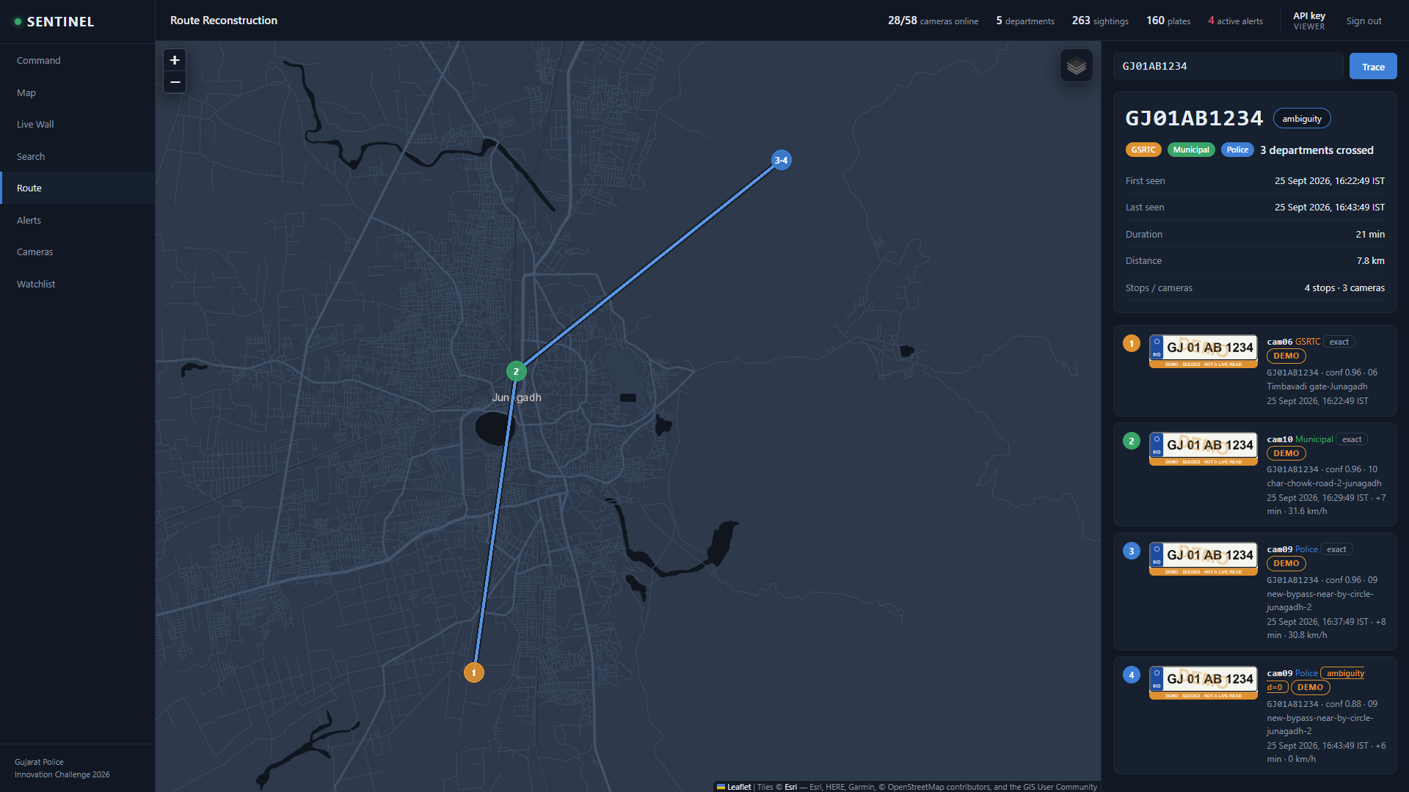
Route reconstruction: the scored capability
GET /api/plates/{plate}/route
Ordered stops: camera, department, coordinates, timestamp, crop, match type and provenance
Elapsed time and implied speed only within one clock; an implausible speed flags the stop as suspect
Fuzzy candidates are surfaced and marked, never silently merged
departments_crossed is the integration proof
Coverage gaps are shown rather than hidden
Route export and detection report as CSV and printable HTML, each with a provenance column
Disclosed: no real vehicle has been read on two sandbox cameras. The route shown is demonstration data, labelled DEMO on every screen and export.
GJ01AB1234, the labelled demonstration vehicle: 4 stops, 3 cameras, 3 departments, numbered in time order with crops and implied speeds
SENTINEL · Gujarat Police Innovation Challenge 2026
Notes:
The scored endpoint. The route shown is the labelled demonstration vehicle, injected through the real write path at three sandbox cameras in three departments; no real vehicle has yet been read on two sandbox cameras, and the slide says so. Point at departments crossed: a route across Police, GSRTC and Municipal cameras is proof of integration. Captured from the running platform on 25 September 2026 (1920x1080, signed in through the script key path; no credential is on screen).

Slide 11
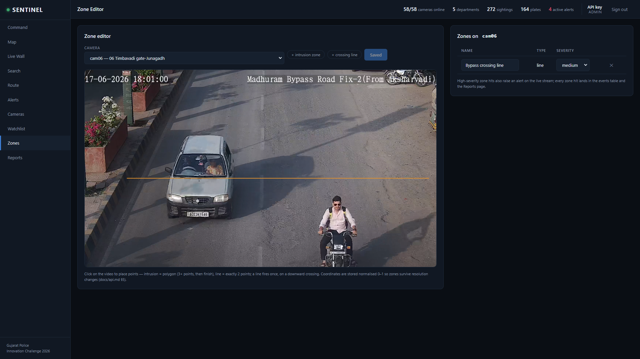
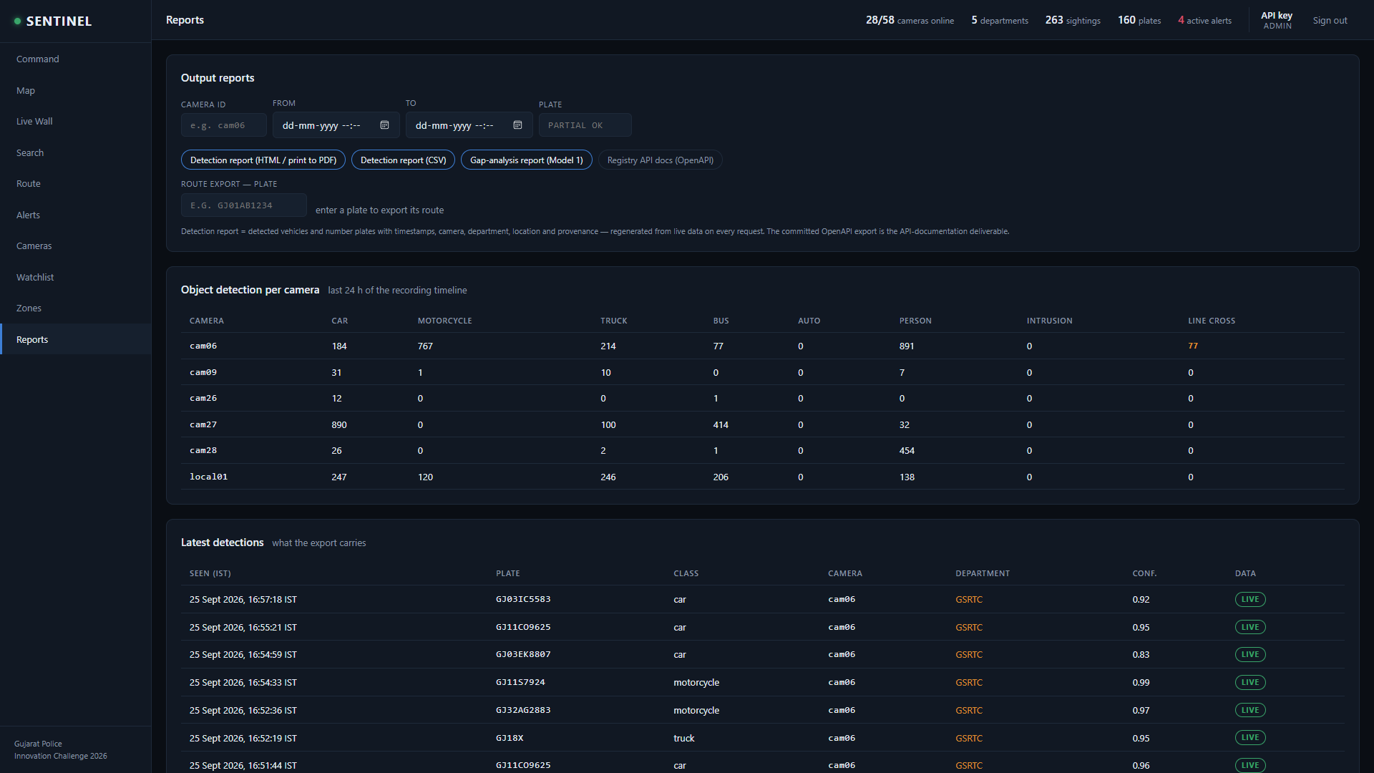
Beyond ANPR: intrusion zones, object counts, output reports
Zone editor on the live cam06 picture: the crossing line that fired 53 line-crossing events on the live sandbox during the measured afternoon run
Reports: detection report as CSV and printable HTML, gap analysis, OpenAPI; object counts per camera; every row labelled live or demo
Intrusion: a tracked object's foot point must be inside a zone for two consecutive sampled frames before it fires; a line crossing is measured against the last confirmed side, with direction. High-severity zones raise alerts on the same stream.
Object and person detection: per-class events, throttled to one per class per camera every 5 s of stream time, counted on Command and in Reports. Zones are stored in normalised 0 to 1 coordinates, so they survive a change of resolution.
SENTINEL · Gujarat Police Innovation Challenge 2026
Notes:
Evaluation Area 5 names four analytics. Object and person detection come with the detector; intrusion and line crossing come from zones drawn on the live picture. The crossing line on cam06 is the one that produced the first zone events on a real feed. Captured from the running platform on 25 September 2026 (1920x1080, signed in through the script key path; no credential is on screen).

Slide 12
Why edge-first: what crosses the WAN at 80,000 cameras
All figures are [model], from one plate read per camera per minute, to be replaced by measurement in the pilot
240 Gbps
>
23 Mbps
10,000x
raw video, centralised (1080p at 3 Mbps)
text rows and plate crops, edge-first
less WAN load
GPU FLEET: SIZING FOLLOWS ENGINEERING CHOICES [model]
DECODE IS USUALLY THE BINDING CEILING
Naive: every frame, full-frame ANPR | 30 / GPU | 2,667 GPUs
5 fps sampling | 50 | 1,600
plus motion gating | 100 | 800
plus cascade and INT8 | 150 | 533
plus ROI and tuning | 200 | 400
Every stream is H.264 or H.265 decoded before any model sees it, and decode engines cap at roughly 20 to 40 sessions per GPU [estimate]
At 30 per GPU, decode alone needs 2,667 GPUs, so tuning inference to 200 streams per GPU leaves the tensor cores about 85% idle [model]
Mitigation: decode only the frames that are inferred, prefer H.265, CPU-decode low-fps tiers, provision against the ceiling that binds
The laptop run adds a lesson: its binding stage was OCR on the CPU, so a node budgets OCR on the accelerator too
SENTINEL · Gujarat Police Innovation Challenge 2026
Notes:
This is the number that decides the architecture, and it is also why Model 4 was not chosen. Every figure on this slide is a model from stated assumptions, and is labelled as such.

Slide 13
Storage at scale
Per day, statewide. [model] from one plate read per camera per minute
3.46 TB
0.23 TB
220 GB
detection snapshots as full frames
plate crops of about 2 KB instead, 15 times less
evidence clips at 10,000 hits per day
Retention tiers: hot for 7 days, warm for 90, then a cold or frozen archive. Sighting records run to about 115 million a day, 42 billion a year and 21 TB a year indexed [model], so shard and tier from day one. Retrofitting that after the index is built is a migration with no good window.
Full frames only for confirmed watchlist hits, where the evidence clip exists anyway. Unmatched sighting crops expire in days rather than years.
Evidence capture (Pipeline 3) is designed and validated separately and is not built in the demo: a fixed-size rolling buffer per camera stays flat and promotes a hashed clip only on a match. In the demo, the only video on disk is the self-overwriting 20-second relay window per analysed camera.
Retention by data class, purged on a schedule: proposed non-hit crops 30 days, sighting rows 180 days, hit evidence for the life of the case [estimate]. Each department's own 7 to 15-day video retention is untouched. The purge is part of the pilot build.
SENTINEL · Gujarat Police Innovation Challenge 2026
Notes:
The class of data most designs forget, detection snapshots, is 15 times larger than the one they optimise. Store crops, not frames. Every figure here is a model.

Slide 14
Cybersecurity, privacy and auditability
Credentials
Login and roles (built)
Encryption
Environment or secret store only. Never hard-coded, logged, persisted or shown unmasked; the registry holds URL templates with placeholders filled in memory. A vault with per-department rotation in production.
People sign in as viewer, evaluator or admin. Passwords only as scrypt hashes; server-side sessions in HttpOnly, SameSite=Strict cookies expiring after 8 h; lockout after five failures. Department scoping is added in production.
TLS on every hop the platform controls. When the demo is published, it goes out over an outbound-only tunnel with TLS terminated on the laptop. Encryption at rest for the evidence store and the databases in production.
Hardening (built)
Audit (built)
Privacy
Nothing is reachable without signing in except the login page, /api/health and static assets. Content-Security-Policy, nosniff, frame denial, rate limits on expensive reads. Only the API port is published.
An append-only audit table names the user for every onboarding, watchlist change, acknowledgement, zone edit and login, and for every plate lookup, search and route export. Pipeline 3 adds hashed evidence rows.
Relayed, not recorded: text and a 2 KB crop per read. Retention by data class, designed to the DPDP Act, 2023 duties. Facial recognition only ever against an authorised gallery.
SENTINEL · Gujarat Police Innovation Challenge 2026
Notes:
Cybersecurity architecture, Dimension 4. Login, roles, sessions and the audit trail are built and running on the demonstrated platform; department scoping and the vault are the production additions.

Slide 15
Deployment, scalability and the phased rollout
EDGE
REGIONAL
CENTRAL
district or department
district cluster
SCRB or state data centre
pull, decode, motion gate, detect, OCR, local watchlist match, ring buffer. Emits text and crops
aggregation, regional search index, evidence store, model rollout, camera health scoring
statewide search, cross-region route correlation, watchlist master, and VAHAN, SARTHI, eGujCop, AFIS and NAFIS enrichment
RESILIENCE AND DAY-2 OPERATIONS
PHASED STATEWIDE ROLLOUT
Reconnect storms: jittered backoff, admission control, staggered cold start, and a circuit breaker per department
Split-brain ownership: distributed camera leases, so never two pulls and never duplicate alerts
The alert path is the real single point of failure: detections are persisted before alerting, with synthetic end-to-end tests
A quality score per camera including drift detection, feeding a ranked maintenance worklist. Shadow then canary model rollout. GitOps configuration
0
Sandbox, now 30 sandbox cameras and 28 sample feeds, one node
1
Pilot district one department's real cameras, measured streams per accelerator, Pipeline 3 built
2
Multi-district 3 to 5 departments, federation adapters and collector
3
Statewide towards 80,000 cameras, HA and DR, enrichment integrations
SENTINEL · Gujarat Police Innovation Challenge 2026
Notes:
Edge, regional, central. On day-2 operations: at a 2% failure rate, about 1,600 cameras are broken at any moment [model], so health scoring and a ranked worklist are required rather than optional.

Slide 16
What this system does not do, and why
No evidence clips in the demonstrated system
No arbitrary rewind, no central recording of all video
Pipeline 3 is designed and validated separately and is not built. No alert links a clip, and no video is kept beyond the 20-second relay window.
Both the privacy posture and the 240 Gbps arithmetic rule it out. Video is captured on justified cause only.
No real cross-camera route on the sandbox feeds
No Model 3 federation, no live facial recognition
No real vehicle has been read on two sandbox cameras. The route shown is a demonstration vehicle labelled DEMO everywhere; the scored test uses the organisers' own vehicle.
The sandbox holds no departmental VMS to federate, so Model 3 is the documented integration path. Facial recognition is described with its privacy controls, not built and not claimed.
Plate recall on these feeds is low, and stated
Demonstration data, disclosed
Wide overview cameras put plates at 10 to 25 px [estimate]. Plate-read rate 0.062, 12 reads in 195 vehicle tracks [measured]; cam06 gave 55 real reads over the afternoon, and the ANPR viability gate passed on that evidence.
Sandbox geography is seeded (the catalogue has id and name only); the 28 sample feeds are stock footage at seeded coordinates; the demo vehicle is labelled. Figures are marked [measured], [model] or [estimate]; the 30 versus 50 camera gap is recorded.
SENTINEL · Gujarat Police Innovation Challenge 2026
Notes:
State each of these before the panel has to ask.

Slide 17
Operational benefits and impact on policing
Hours become seconds
One platform, 26 departments
Alerts operators act on
A registration number returns a timestamped, location-wise route across departments on one screen, instead of a manual request to each of them.
Departments keep their systems untouched. The connector ladder and the department-side collector reach vendor-locked and NAT-bound sites.
Local matching, cooldowns, a plate crop on every alert and an acknowledgement trail. No alert floods, and no neighbour's car alerted on a fuzzy read.
Evidence that holds up
Coverage that stays usable
A cost position the State can own
Built: every lookup, change and acknowledgement is audited under a named user. Designed for the pilot: clips promoted on justified cause, each with a SHA-256 and an audit row.
Health scoring, drift detection and a ranked maintenance worklist for the roughly 2% of cameras that are always broken [model].
Linked components are Apache, MIT and BSD; ffmpeg runs as a separate GPL process. No per-camera licence avoids about 4 crore rupees a year at 500 rupees per camera [model]. On-premise avoids cloud egress.
SENTINEL · Gujarat Police Innovation Challenge 2026
Notes:
Close on impact: hours down to seconds, one platform across departments, an audit trail on every lookup, and a cost position the State can own outright.

Slide 18
Submission package
DELIVERED
LINKS
Solution presentation: this deck, as PPTX and PDF
Technical proposal and HLD: the eight required elements and the ten dimensions, with measured, modelled and estimated figures labelled, as PDF
Workflow and integration diagram (SVG, PNG and PDF)
Demo video 1, own feed: onboarding, detection, watchlist correlation, automatic alert
Demo video 2, government-provided feed: viewing, ANPR with crops, vehicle and person detection, line crossing, detection report
Registry API documentation (OpenAPI), sample onboarded dataset, gap-analysis report, detection report as CSV and HTML
Source repository: Python 3.13 with FastAPI and SQLite for the demo, React with Leaflet and hls.js, YOLOX-S and PaddleOCR under Apache-2.0
Source repository: github.com/adityashroff06-code/sentinel-gujarat
Demo video 1 (unlisted): to be added at submission
Demo video 2 (unlisted): to be added at submission
Hosted platform: to be added at submission; evaluator credentials go on the submission form only
HLD (PDF): deliverables/HLD.pdf in the repository
Every link is opened from a private window before submission. The repository, its history, the videos and the screenshots are swept for credentials before submission.
Sentinel: one platform, five departments, watching is not storing.
SENTINEL · Gujarat Police Innovation Challenge 2026
Notes:
Final slide: the submission package. The video links and the hosted URL are added at submission, after each is opened from a private window; evaluator credentials go on the submission form only, never in the deck or the repository.

