Slide 1
UPI
RISK DESK
Fraud ring detection and merchant risk analytics
An end-to-end risk intelligence platform for messy payments data
TEAM OF 5 | TRANSORG AGENTIQ DATATHON | TRACK 1
Team leader: Aditya Shukla
Data window: 1 Jan - 31 Mar 2026 / 90 days

Slide 2
THE BUSINESS QUESTION
From messy payments to decisions
Fraud operations need more than a yes/no transaction label.
PROJECT NORTH STAR
The desk connects identity, transactions, merchants and disputes to answer the questions a risk team actually asks.
Make every risk flag explainable, traceable and actionable.
WHY
Why is this merchant risky?
WHO
Which users and merchants form rings?
Output
WHERE
A clean analytics model + risk worklists + interactive dashboard + graph agent
Where are the biggest control gaps?
Source: UPI Risk Desk project outputs
UPI RISK DESK / 02

Slide 3
DIFFERENTIATORS
Why our solution is different
Most fraud demos stop at a model score. We built what an investigator can actually use on Monday morning.
01
Explainable risk scores
02
Fraud-ring graph detection
Additive scores, not a black box. Every flag lists the exact signals that fired: repeat disputes, chargeback ratio > 30%, fraud-type reasons, missing settlement account.
72K-node / 106K-edge property graph links users, payments, merchants and chargebacks, so connected rings surface instead of isolated cases.
SCORE 80 = 5 NAMED REASONS
121 SUSPICIOUS CLUSTERS
03
Data-quality correction
04
Business-ready worklists
70 logged checks repair IDs, PAN / Aadhaar formats, dates and duplicates before any metric is computed, and every repair is traceable.
Ranked, filterable, exportable queues of merchants, users and rings, plus a graph agent that answers analyst questions in plain English.
400 DUPLICATES REMOVED
234 MERCHANTS TO REVIEW
Source: src/analytics.py, src/agent.py, src/clean.py, outputs/data_quality_report.csv
UPI RISK DESK / 03

Slide 4
SOLUTION ARCHITECTURE
Before -> after: raw files become decisions
BEFORE: 4 RAW FILES
PIPELINE (PYTHON)
AFTER: DECISION OUTPUTS
track1_upi_transactions.csv
CLEAN
src/clean.py
Interactive dashboard
20,400 rows incl. duplicates
standardize + de-duplicate + 70 checks
outputs/upi_risk_desk.html
track1_kyc_records.csv
MODEL
SQLite star schema
Risk worklists (CSV)
Mixed ID / PAN / Aadhaar formats
dim_users / dim_merchants / facts
merchant / user scores, clusters
track1_merchants_master.csv
SCORE
src/analytics.py
Graph agent
Missing accounts, bad statuses
explainable merchant + user scores
plain-English graph queries
track1_chargebacks.json
GRAPH
NetworkX + src/cycles.py
Data-quality ledger
IDs disagree with payments
clusters, rings, circular loops
every repair, traceable
Stack: Python / pandas / SQLite / NetworkX / Chart.js single-file dashboard / GitHub Pages
UPI RISK DESK / 04

Slide 5
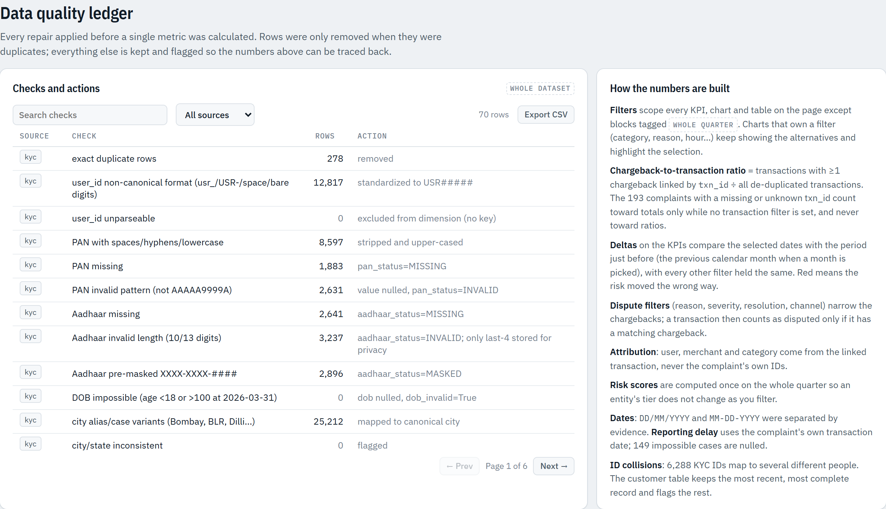
DATA FOUNDATION
Four messy sources, one analytics model
We repaired inconsistent IDs, amounts, dates, statuses and links before measuring risk.
TRANSACTIONS
KYC RECORDS
20,000 rows
28,920 users
After removing 400 duplicates
Identity, status, risk segment
MERCHANT MASTER
CHARGEBACKS
4,343 merchants
2,800 complaints
Category, status, settlement
Reason, severity, resolution
400
duplicate payments removed
INR 51.9 L
volume inflation avoided
Screenshot: Data quality ledger in the live dashboard / outputs/data_quality_report.csv
UPI RISK DESK / 05

Slide 6
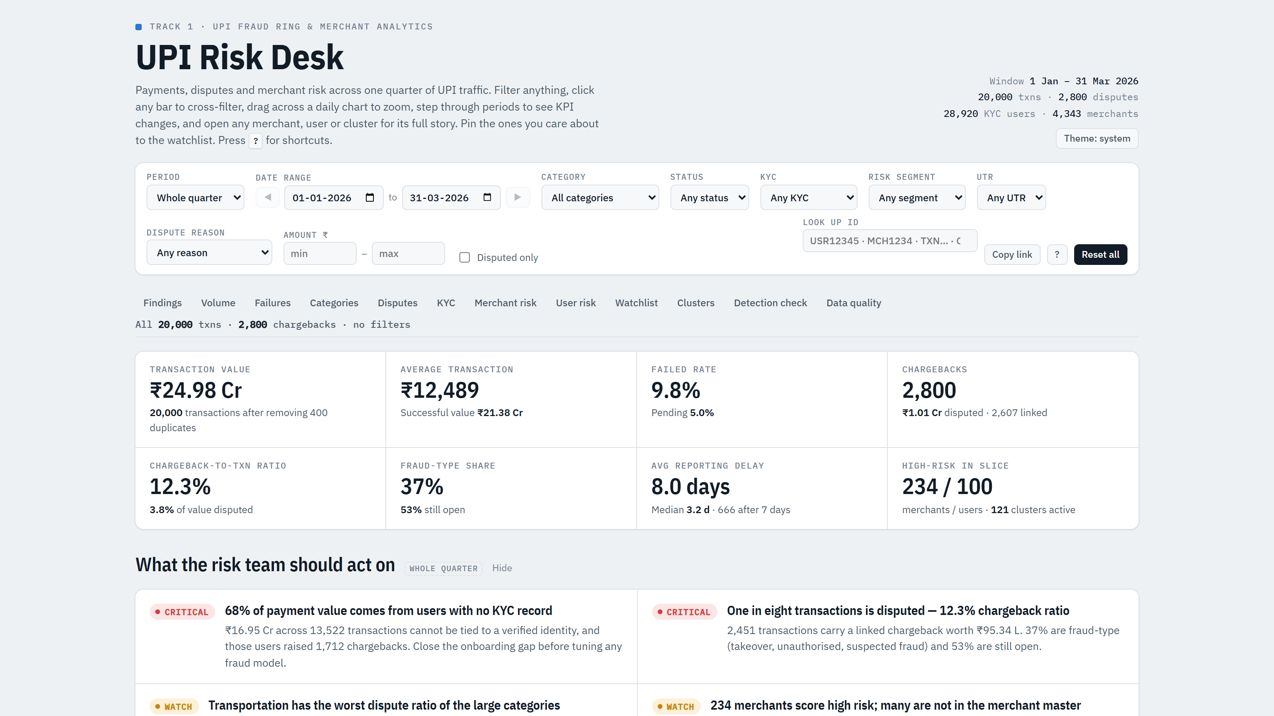
DASHBOARD / REAL SCREENSHOT
The live dashboard: the quarter at a glance
1
10 cross-filters
Period, category, status, KYC, segment, UTR, reason, amount, ID lookup.
2
8 headline KPIs
INR 24.98 Cr value, 12.3% chargeback ratio, 8.0-day avg reporting delay.
3
Findings, auto-written
Critical / watch / info cards the risk team should act on.
4
Shareable views
Every filter state is a copyable link for handoffs.
Live: adityashukla2615.github.io/upi-risk-desk/outputs/upi_risk_desk.html
UPI RISK DESK / 06

Slide 7
RISK FINDINGS
Three findings that should change controls
01
Identity gap
02
Rejected KYC
03
Late reporting
67.6%
15.0%
666
of payments came from users with no KYC record
dispute rate, higher than verified users at 13.2%
disputes were reported more than 7 days after payment
Risk implication
Risk implication
Risk implication
Step-up identity checks before payment
Rejected KYC should block or step up payments
Prioritize delayed fraud complaints for review
Source: UPI Risk Desk project outputs
UPI RISK DESK / 07

Slide 8
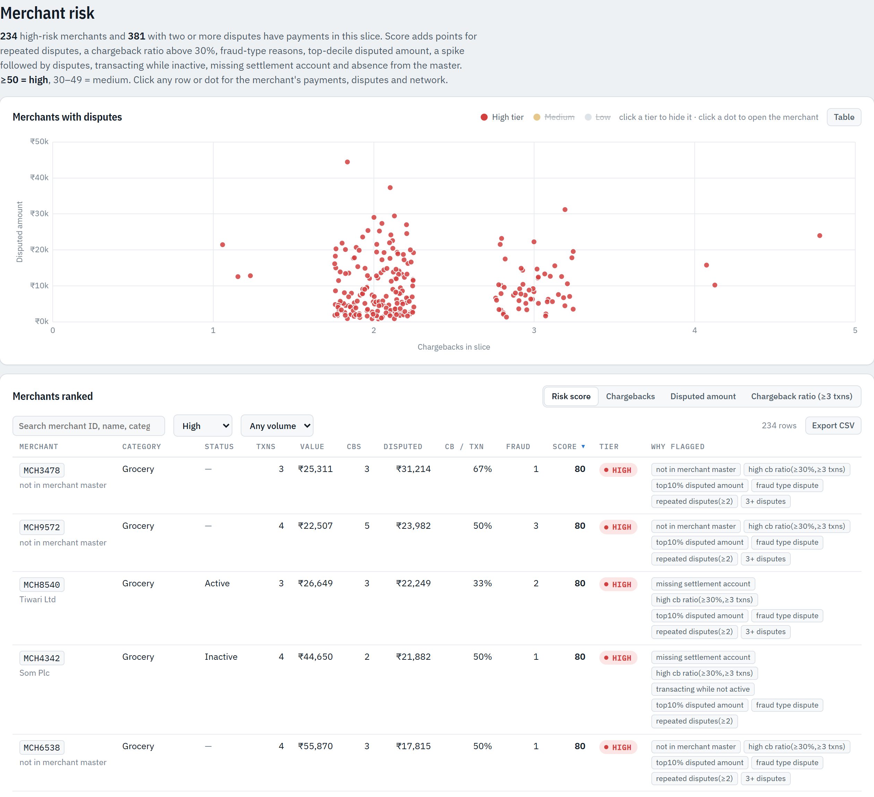
EXPLAINABLE MERCHANT RISK / REAL SCREENSHOT
234 high-risk merchants, each with its reasons
234
100
HIGH-RISK MERCHANTS
HIGH-RISK USERS
Score >= 50
184 repeat disputers
HOW THE SCORE IS BUILT
Repeated disputes and a chargeback ratio above 30%
Fraud-type reasons and top-decile disputed amount
Transacting while inactive or missing settlement account
Not in the merchant master (never onboarded)
Filter tier = High -> 234 rows, each tagged with the signals that fired. Export CSV = investigator worklist.
Source: outputs/risk/merchant_risk_scores.csv / dashboard Merchant risk section
UPI RISK DESK / 08

Slide 9
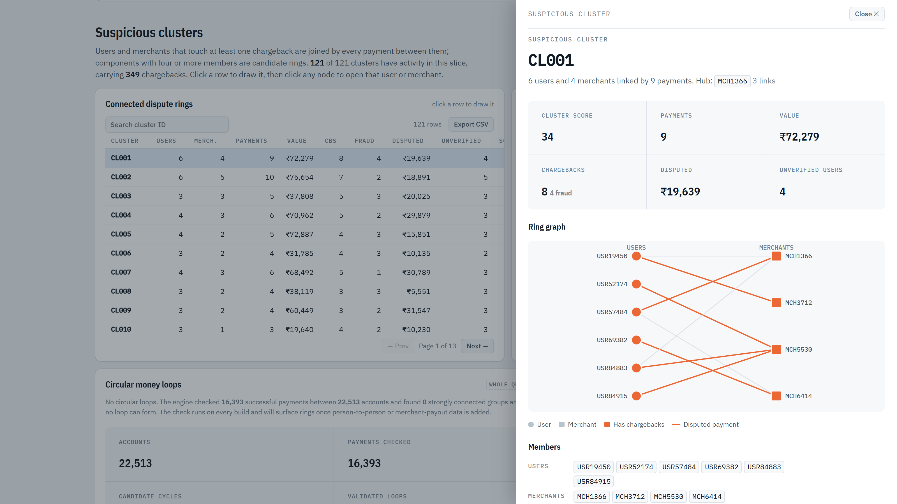
GRAPH DETECTION / REAL SCREENSHOT
Fraud rings: connected cases, not isolated disputes
121
SUSPICIOUS CLUSTERS
Components of >= 4 members
72K / 106K
GRAPH NODES / EDGES
Users, payments, merchants, CBs
RING CL001
6 users -> 4 merchants via 9 payments. 8 chargebacks (4 fraud-type), 4 unverified users, hub merchant MCH1366.
Source: outputs/risk/suspicious_clusters.csv / dashboard Suspicious clusters drawer
UPI RISK DESK / 09

Slide 10
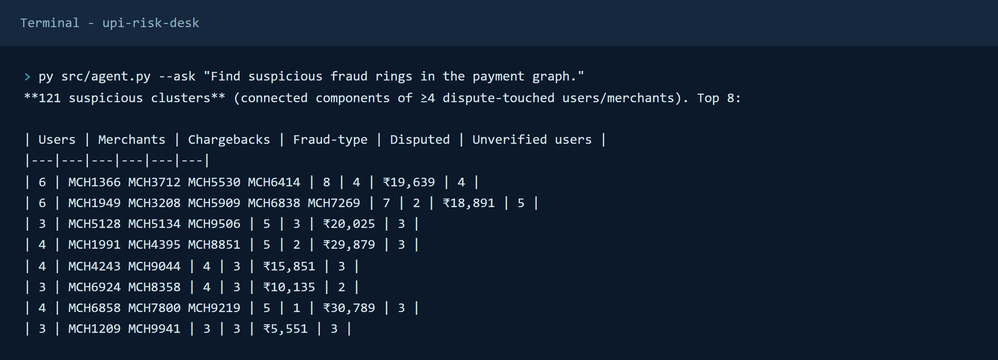
GRAPH AGENT / REAL OUTPUT
Ask the graph agent in plain English
HOW IT WORKS
Loads the clean star schema as a NetworkX property graph
Intent router maps a question to a graph traversal
Answers entity + aggregate questions from one model
Router is swappable for an LLM, query layer unchanged
OTHER QUESTIONS IT ANSWERS
"Which merchant has the highest chargeback-to-transaction ratio?"
"Show disputes reported after 7 days."
"Tell me about MCH9572."
"Which KYC status has the highest transaction amount?"
Run: py src/agent.py --ask "..." / 14 example queries in outputs/agent_demo.md
UPI RISK DESK / 10

Slide 11
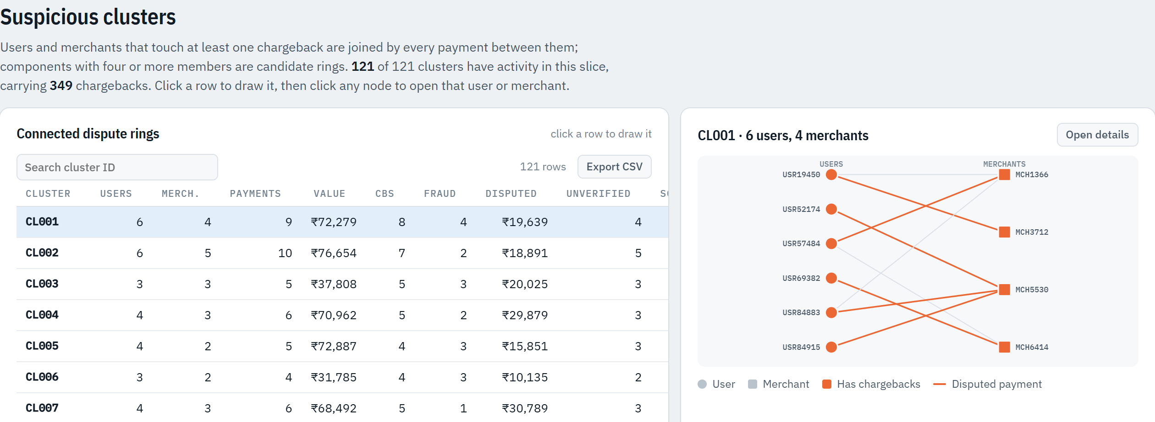
DEMO SCRIPT
2-minute live demo flow
0:00
STEP 1
0:30
STEP 2
1:00
STEP 3
1:30
STEP 4
Show KPI dashboard
Filter high-risk merchants
Open a suspicious ring
Ask the graph agent
Open the live page. Point at INR 24.98 Cr, 12.3% chargeback ratio, and the auto-written findings.
Merchant risk -> hide Medium/Low tiers, set table tier = High. 234 merchants with reasons.
Clusters -> click CL001 -> Open details. 6 users, 4 merchants, 8 chargebacks.
Terminal: py src/agent.py --ask "Find suspicious fraud rings in the payment graph."
Live: adityashukla2615.github.io/upi-risk-desk/outputs/upi_risk_desk.html
UPI RISK DESK / 11

Slide 12
IMPACT
What the desk delivers in one quarter of data
400
INR 51.9 L
DUPLICATE PAYMENTS REMOVED
VOLUME INFLATION AVOIDED
Removed before any ratio, so nothing is double-counted.
Duplicates would have overstated value by INR 51.86 L.
234
121
HIGH-RISK MERCHANTS
SUSPICIOUS CLUSTERS
Ranked worklist with the reasons each one was flagged.
Connected dispute rings to investigate as networks, not one-offs.
UPI RISK DESK / 12

Slide 13
VALIDATION AND LIMITS
We tested the tempting explanations too
A good risk desk should show what it ruled out, not only what it found.
Missing UTR
Failed 9.7% vs 9.8%; disputed 12.6% vs 12.2%
NO SIGNAL
Peak-hour load
Failures stay around 8-11% across the day
NO SIGNAL
Volume spikes
2 spike days; 0 follow-on disputes
NO SIGNAL
Circular money loops
16,393 payments checked; 0 cycles (money only flows user -> merchant)
NONE FOUND
Predictive backtest
Merchant AUC 0.47; user AUC 0.53
WORKLIST, NOT FORECAST
Interpretation
Current scores prioritize investigation; future runs should add labels and monitor detection quality before automated decisions.
Source: UPI Risk Desk project outputs
UPI RISK DESK / 13

Slide 14
RECOMMENDED CONTROLS
From insight to action
01
Gate rejected KYC
Block or step-up UPI payments until identity status is resolved.
02
Prioritize late fraud
Route >7-day unauthorized complaints to an accelerated review queue.
03
Investigate rings
Use shared user-merchant paths to review connected components, not isolated cases.
04
Protect attribution
Keep txn_id as the source of truth when dispute identifiers disagree.
Next milestone: move from explainable worklists to labelled, monitored detection.
Source: UPI Risk Desk project outputs
UPI RISK DESK / 14

Slide 15
OWNERSHIP AND DELIVERY
Team of 5
Project team and responsibilities
★
Aditya Shukla
2
Ishaan Sandhwar
3
Piyush Priyanshu
TEAM LEADER - 12408482
Reg. no. 12416912
Reg. no. 12412878
Risk analytics, metrics and delivery
Data engineering and model build
Graph intelligence and clusters
4
Deepak Kumar Behera
5
Harsh Sharm
Reg. no. 12412575
Reg. no. 12412500
Dashboard and BI
Agent, validation and storytelling
Shared outcome: a decision-ready risk desk, not just a collection of charts.
Source: UPI Risk Desk project outputs
UPI RISK DESK / 15

Slide 16
THE TAKEAWAY
LIVE DEMO
Clean the identity.
Connect the network.
Act on the explanation.
Dashboard
+
Graph agent
DASHBOARD
UPI Risk Desk turns messy payment data into a practical investigation queue for risk teams.
adityashukla2615.github.io/upi-risk-desk/outputs/upi_risk_desk.html
CODE
github.com/adityashukla2615/upi-risk-desk
Thank you

