Slide 1
TRANSORG AGENTIQ DATATHON · TRACK 1
FRAUD RING INTELLIGENCE
UPI RISK DESK
Fraud ring detection and merchant risk analytics
20,000 payments from four broken source systems, cleaned into one model and turned into a live risk desk: nine analyst views, an explainable score behind every entity, a leak-free replay engine and five AI agents that can work the desk.
TEAM LOOSERS · LEADER: ADITYA SHUKLA
Data window 1 Jan – 31 Mar 2026 · 90 days
121 rings · 314 customers · 254 merchants
adityashukla2615.github.io/upi-risk-desk

Slide 2
THE PROBLEM
A transaction label is not a risk answer
02
Four source systems disagreed with each other before anyone could ask a single risk question.
WHY
WHO
WHERE
Why is this merchant risky?
Which users and merchants move together?
Where are the control gaps?
Needs its own dispute history, its master record and its settlement setup — not one score.
Needs the payment graph. Rings never show up in a row-by-row classifier.
Needs identity and KYC state joined to the disputes they produce.
What the raw bundle looked like
track1_upi_transactions.csv
20,400 rows
400 exact duplicates · ₹ / Rs. / INR / "27.3k" amounts · 6 date formats · 6 id spellings
track1_chargebacks.json
2,884 rows
34 reason spellings · severity as P1–P4 and H/M/L · ids that disagree with the payment
track1_kyc_records.csv
29,198 rows
16 KYC status variants · 41 city spellings · 6,288 customer ids reused by different people
track1_merchants_master.csv
4,355 rows
82 category spellings · MCC as MCC-7011 / 07011 / 5311.0 · 1,412 colliding ids
Raw row counts before de-duplication · every defect logged in outputs/data_quality_report.csv

Slide 3
SOLUTION ARCHITECTURE
Four messy files to a working risk desk
03
One deterministic pipeline. Every stage writes an artefact the next stage — and any judge — can open.
01
02
03
04
CLEAN
MODEL
SCORE
SERVE
src/clean.py
star schema + SQLite
src/analytics.py
command center + agents
repair and flag, never delete
fact_transactions · fact_chargebacks
additive merchant / user scores
9 analyst views, no server
70 quality checks logged
dim_users · dim_merchants
121 dispute rings from the graph
leak-free replay engine
400 duplicate payments removed
indexed risk views
out-of-time backtest every run
5 agents over 16 shared tools
72K / 106K
19
9
16
0
1
graph nodes / edges
unit tests
dashboard views
agent tools
servers to run
self-contained page
py src/clean.py → py src/analytics.py → py src/build_dashboard.py → py src/agent.py

Slide 4
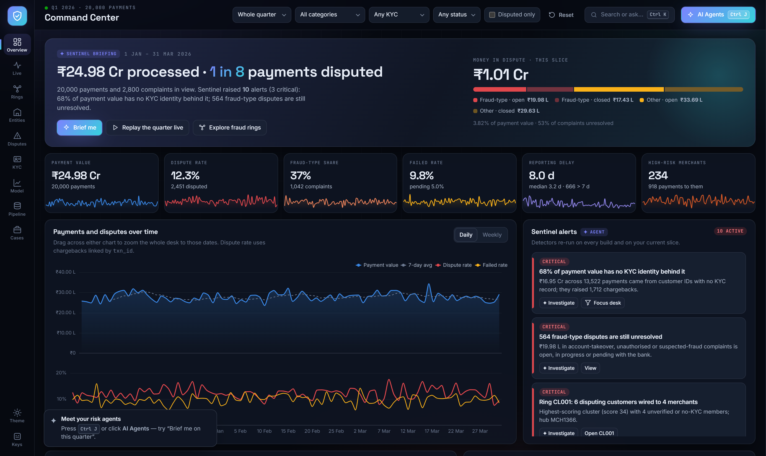
PRODUCT · LIVE SCREENSHOT
The desk a risk analyst actually opens
04
1
Sentinel briefing
The page opens with a written verdict and the money at stake, not a wall of charts.
2
Exposure, not just counts
₹1.01 Cr in dispute, split by fraud-type and by whether it is still open.
3
KPIs that move
Sparklines and prior-period deltas; drag the trend to zoom the whole desk to those dates.
4
Alerts that act
Ten detectors re-run on every build; each alert can filter the desk or open a case.
outputs/upi_risk_desk.html · one file, no server, 20,000 payments embedded

Slide 5
BUSINESS METRICS · Q1 2026
One quarter of UPI traffic, measured
05
PAYMENTS
PAYMENT VALUE
DISPUTE RATE
MONEY IN DISPUTE
20,000
₹24.98 Cr
12.3%
₹1.01 Cr
after 400 duplicates removed
₹21.38 Cr settled successfully
2,451 disputed payments
3.8% of payment value
FRAUD-TYPE SHARE
STILL UNRESOLVED
MEAN REPORTING DELAY
KYC COMPLETION
37%
53%
8.0 d
77.4%
1,042 of 2,800 complaints
1,492 open or with the bank
median 3.2 d · 666 after 7 days
8.2% rejected · 28,920 customers
Dispute rate by merchant category
Transportation
Restaurants
Grocery
Hotels
Pharmacy
books with ≥ 1,000 payments
Grocery holds the most money in dispute: ₹29.38 L
13.4%
12.8%
12.4%
11.6%
11.5%
overall 12.3%
Recomputed on every run into outputs/metrics.json · dispute rate = payments with ≥1 linked chargeback ÷ payments

Slide 6
CLEANING STRATEGY
Repair and flag — never quietly delete
06
Rows are dropped only when they are duplicates. Everything else is fixed where evidence supports it, otherwise nulled and flagged.
The rules that mattered
Two judgement calls that changed the answer
Identifiers
USR12345 · usr-12345 · 12345 · TXN-00001234
digits extracted → USR##### / MCH#### / TXN########
Attribute disputes through txn_id
Amounts
₹23,027.53 · Rs. 6362.9 · 27.3k · Not Available · negatives
All 2,607 linked complaints carry a user_id and merchant_id that differ from the payment they dispute. Using the complaint's own ids would blame the wrong merchants.
symbols stripped, k×1000, text → null, sign errors flagged
Timestamps
ISO · DD/MM · MM-DD · DD-Mon-YYYY · epoch seconds
day/month order proven from the data itself, not assumed
Measure delay from the complaint's own date
Enums
16 KYC states · 34 reason spellings · 82 categories
Against the linked payment, 1,057 complaints look reported before the payment; against their own transaction date only 149 do, with a sane median of 3.2 days.
canonical sets; MCC ↔ category mapping verified 1:1
Identity
PAN shape · Aadhaar 10/13 digits · 41 city spellings
validated; only the last 4 Aadhaar digits ever stored
FAKE VOLUME AVOIDED
Duplicates
400 payments · 84 complaints · 278 KYC · 12 merchants
₹51.9 L
400 duplicate payments
removed before any ratio
removed — they would have inflated value by ₹51.9 L
src/clean.py · every decision counted in outputs/data_quality_report.csv

Slide 7
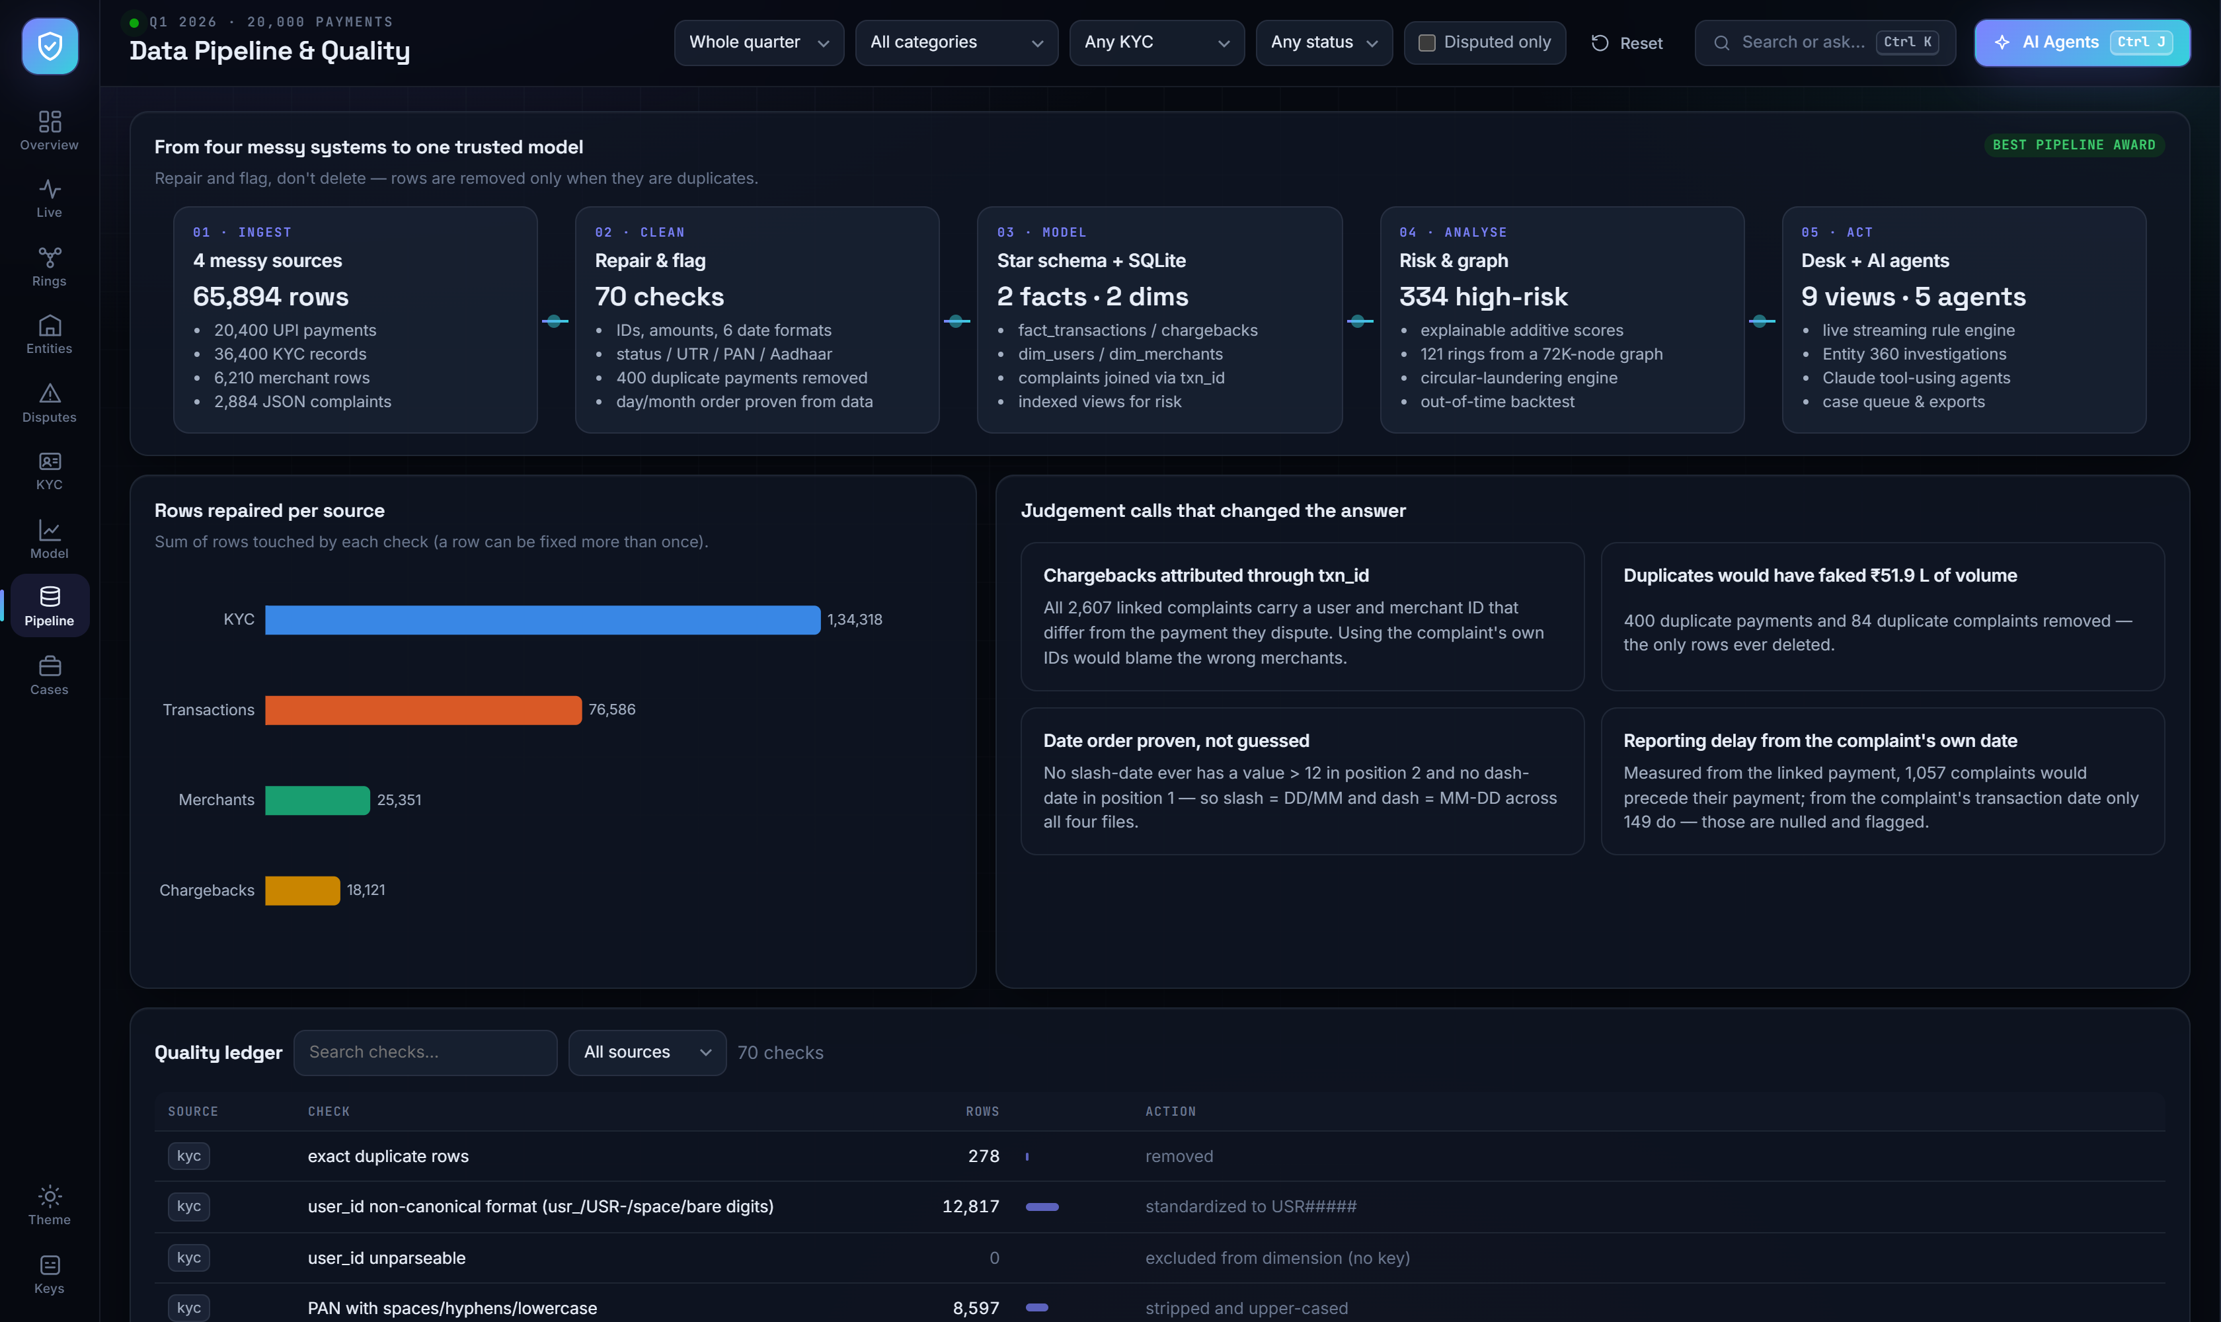
DATA QUALITY · LIVE SCREENSHOT
The pipeline shows its own working
07
1
70-check ledger
Every check names what was wrong, how many rows it touched and what the pipeline did about it.
2
Coverage is stated, not hidden
32.4% of payments match a KYC record and 48.2% a master merchant — orphans are kept and flagged.
3
Flags travel with the row
was_negative, utr_status, pan_status, id_record_count stay on the fact tables for any analyst to filter.
4
Reproducible
One command rebuilds every table, metric and page from the raw files.
outputs/data_quality_report.csv · outputs/clean/*.csv · outputs/upi_analytics.db

Slide 8
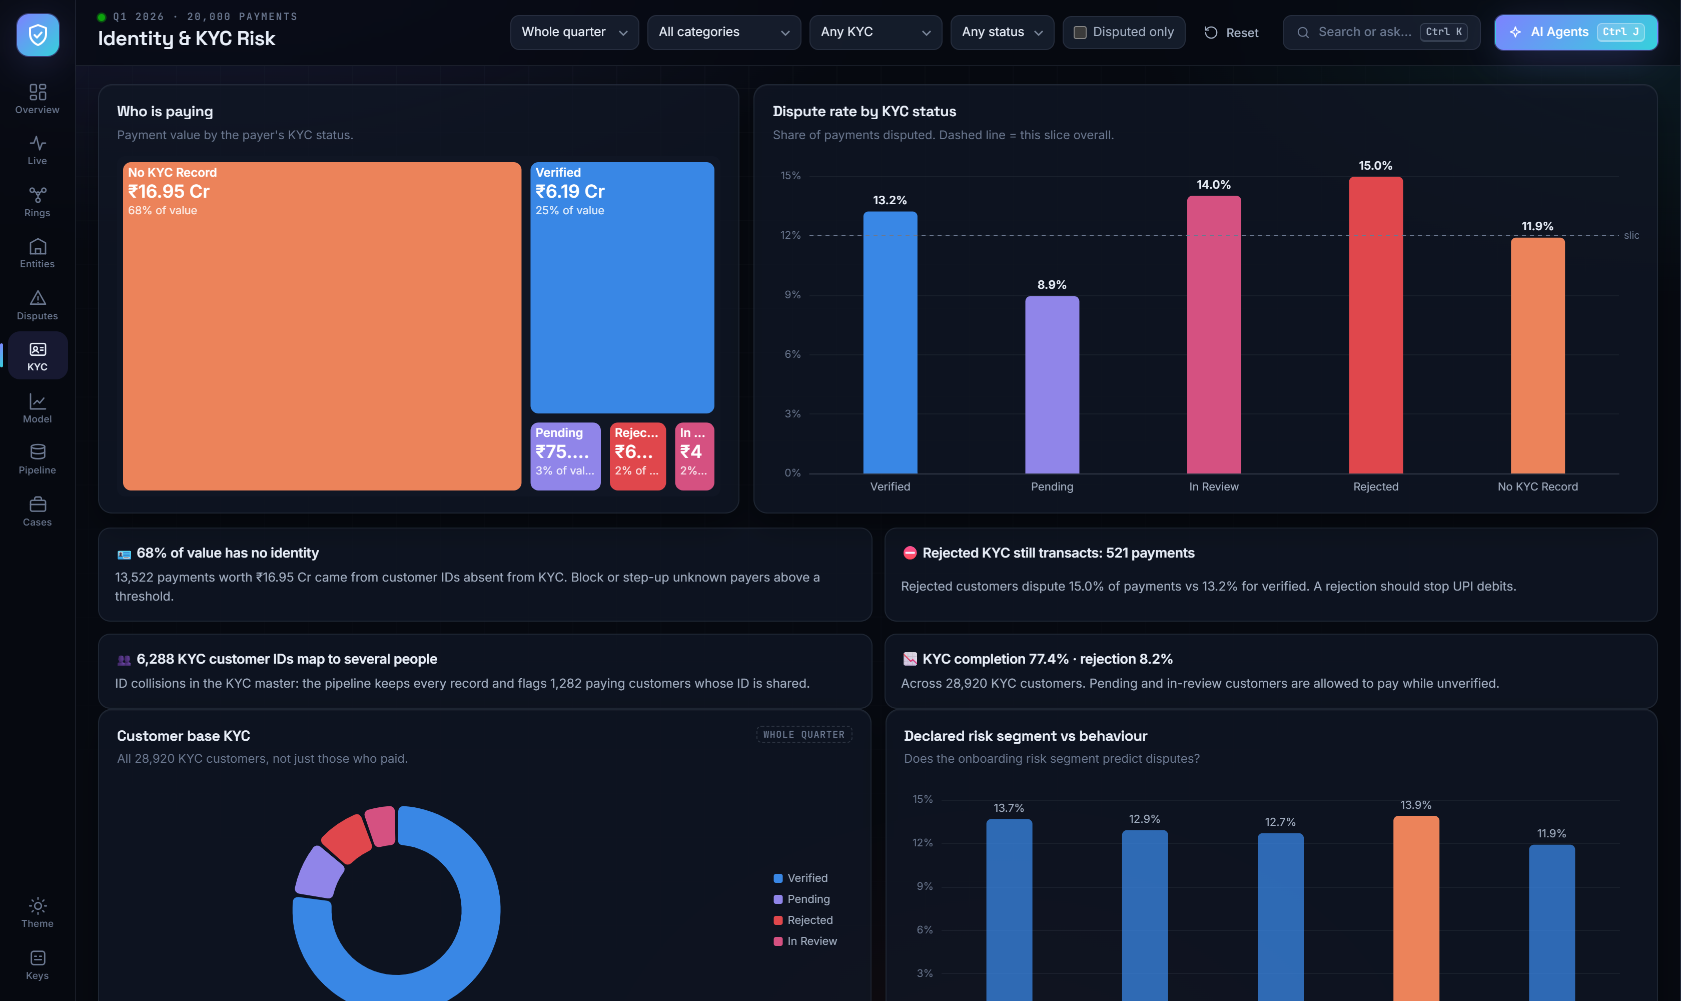
FINDING 01 · KYC
Identity is the biggest control gap
08
67.6%
of payments have no KYC record
₹16.95 Cr — 67.9% of value — from customer ids with no identity behind them
15.0%
dispute rate for rejected KYC
versus 13.2% verified and 8.9% pending: rejected customers are still transacting
6,288
customer ids map to several people
plus 1,412 merchant ids; every colliding record is kept in *_all_records.csv
Fix onboarding before tuning detection.
KYC view · identity-gap treemap, dispute rate by KYC state, customer base composition

Slide 9
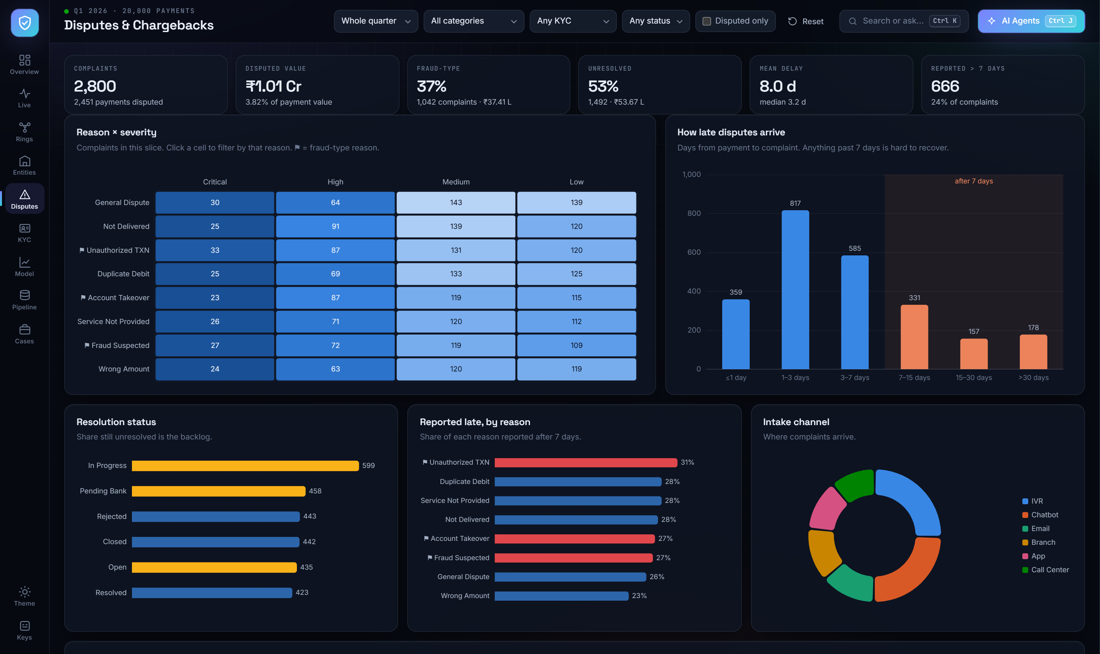
FINDING 02 · DISPUTES
One in eight payments is disputed
09
37%
fraud-type complaints
account takeover, unauthorised and suspected fraud: 1,042 of 2,800
53%
still unresolved
1,492 complaints open, in progress or pending with the bank
666
reported after 7 days
unauthorised payments are the latest — 27% past the 7-day mark
Takeovers surface fastest (6.8 d), duplicate debits slowest (9.9 d).
Disputes view · reason × severity heatmap, reporting-delay curve, resolution backlog

Slide 10
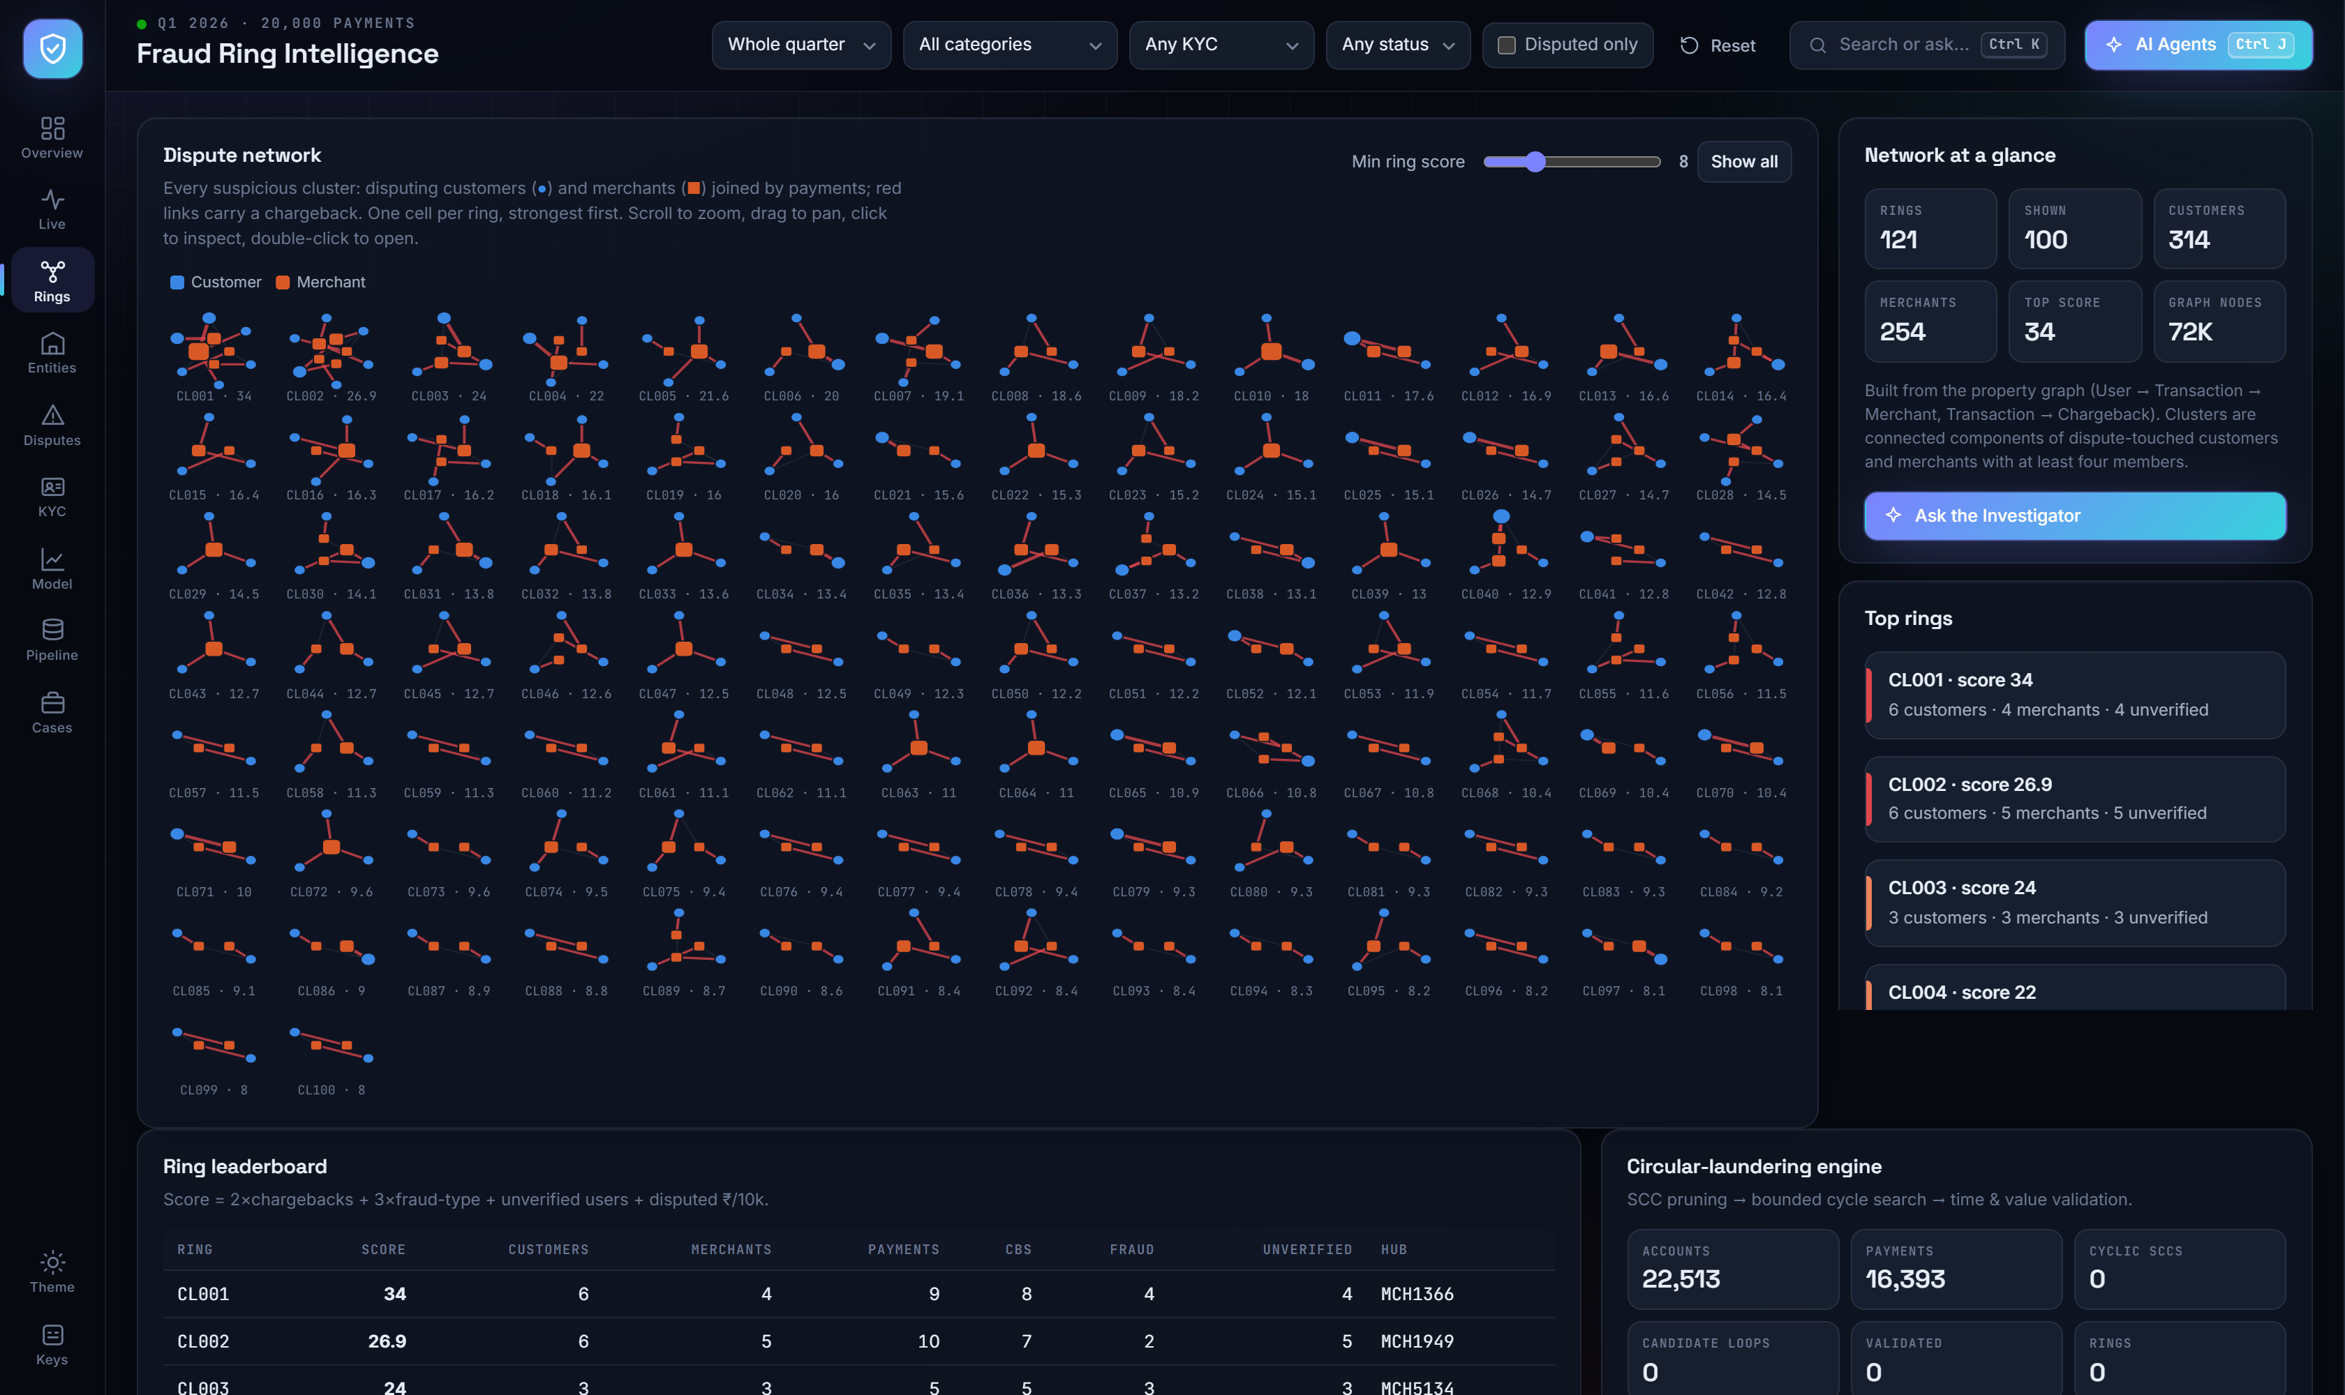
FINDING 03 · GRAPH
Fraud is networked, so we score networks
10
1
121 connected rings
Components of dispute-touched customers and merchants with at least four members, drawn strongest-first.
2
CL001 · score 34
6 customers and 4 merchants, 9 payments, 8 chargebacks, 4 fraud-type, 4 unverified customers, hub MCH1366.
3
Score = 2×CB + 3×fraud + unverified + ₹/10k
Ranked so a reviewer starts with the ring that carries the most money and the most fraud.
4
Circular laundering: 0 rings
22,513 accounts and 16,393 payments checked. Every payment runs user → merchant, so no cycle can exist — proven, not assumed.
src/agent.py property graph · src/cycles.py laundering engine, 15 unit tests

Slide 11
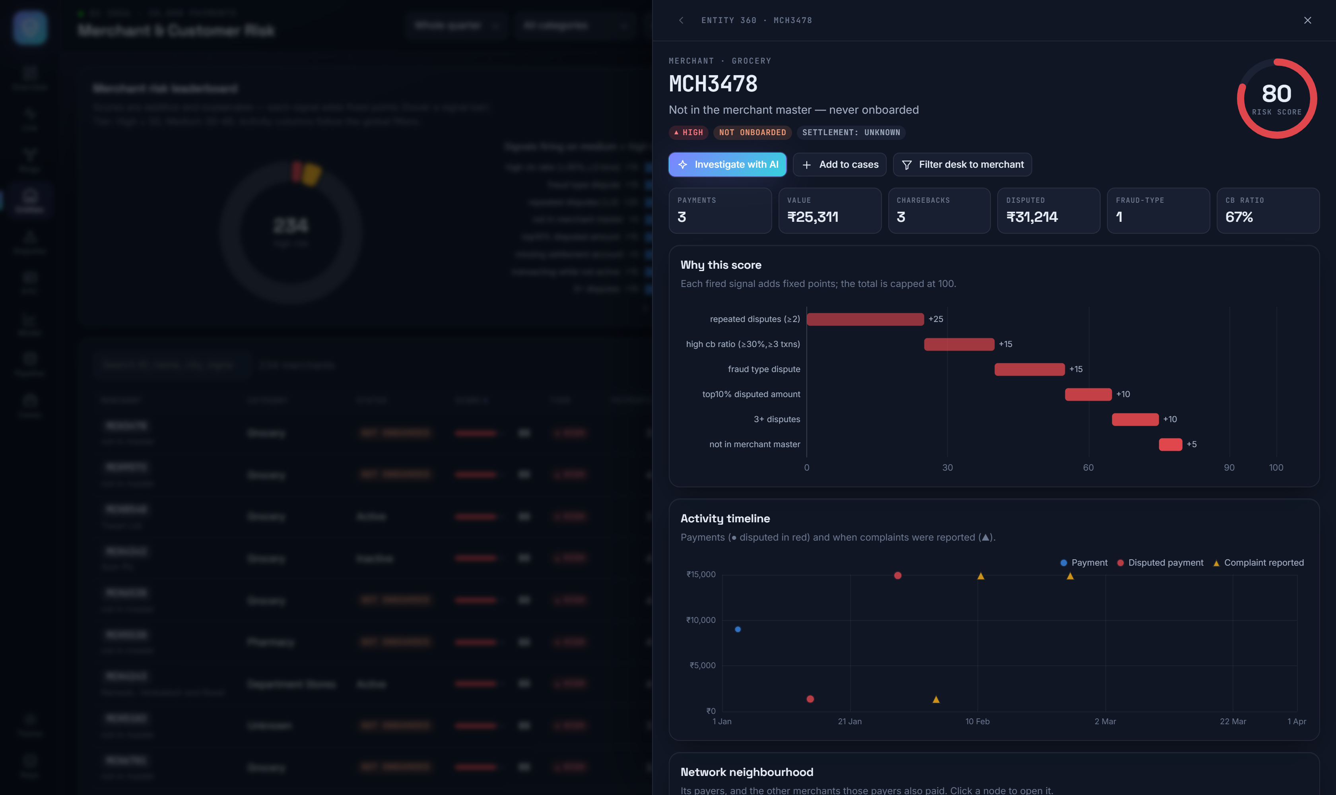
EXPLAINABLE RISK · ENTITY 360
Every score explains itself
11
An analyst never sees a bare number. Opening any entity shows the signals that fired, what each one added, its payment timeline and who it shares counterparties with.
MERCHANT SIGNALS
+25
repeated disputes (≥2)
+15
chargeback ratio ≥30% on ≥3 payments
+15
any fraud-type dispute
+10
top-decile disputed amount
+10
transacting while not active
+5
absent from the merchant master
High ≥ 50 · medium 30–49 · worklists in outputs/risk/*.csv
234
100
381
high-risk merchants
high-risk users
repeat disputers
Entities view · score waterfall, activity timeline, ego network, one-click case filing

Slide 12
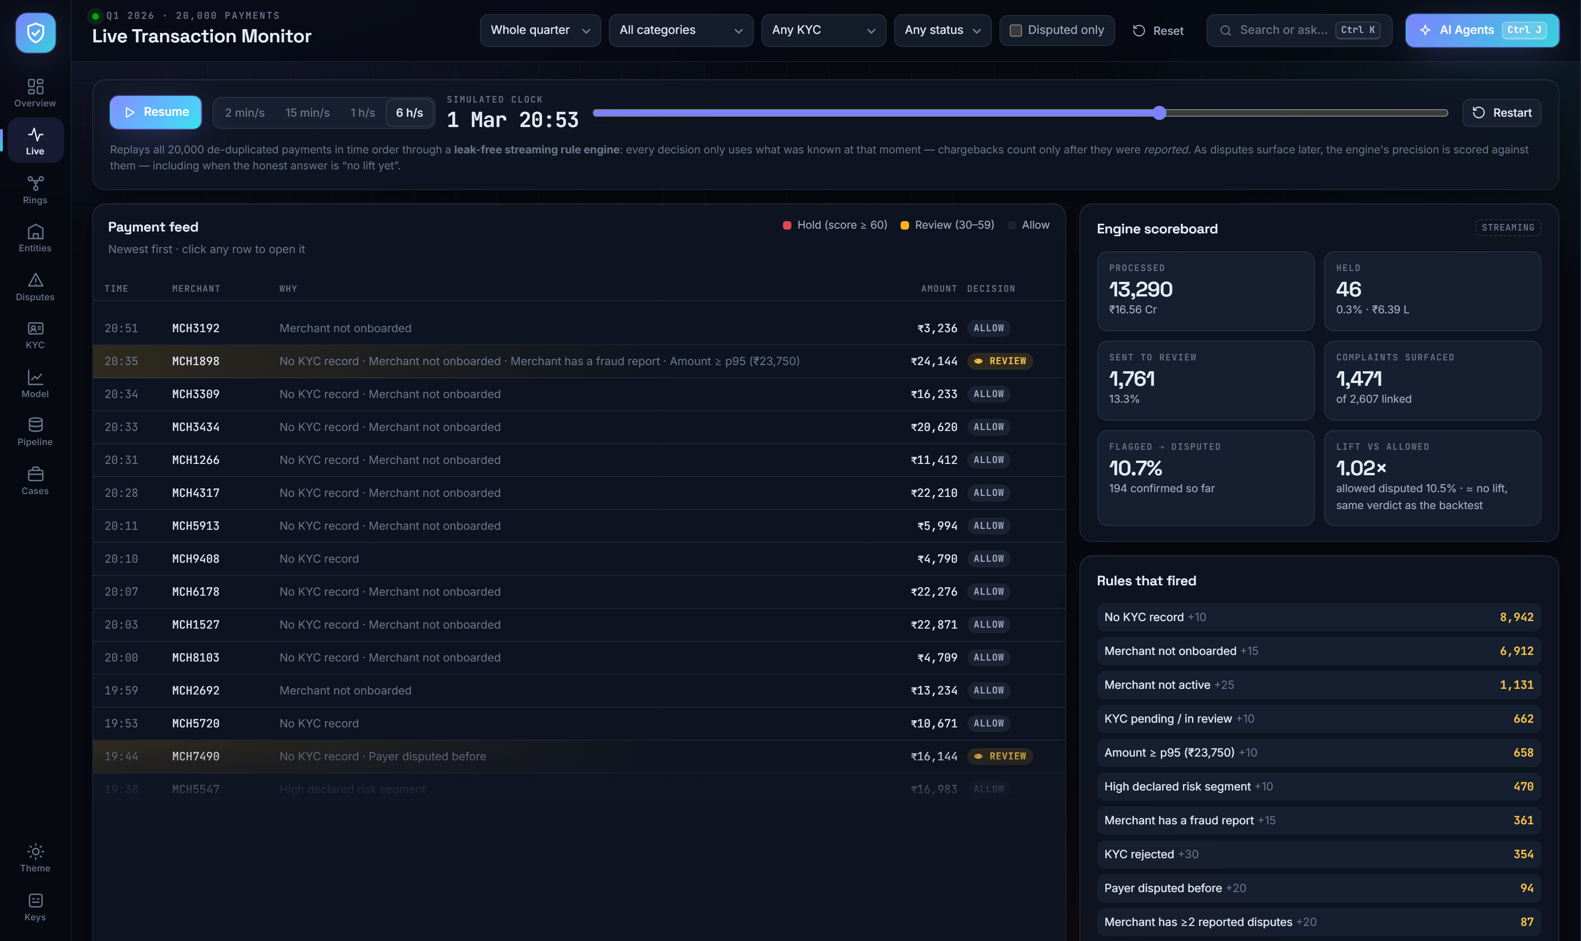
LEAK-FREE RULE ENGINE
Replay the quarter as if it were live
12
1
Time-ordered replay
All 20,000 de-duplicated payments stream through the engine in the order they happened.
2
No leakage by construction
A decision only uses what was known at that moment; a chargeback counts only after it was reported.
3
Hold · review · allow
Score ≥ 60 holds, 30–59 goes to review; every row shows which rules fired and what they added.
4
It scores itself
As disputes surface, the engine reports its own precision and lift — including when the honest answer is none yet.
Live view · the same rules an issuer would run in production, replayed on history

Slide 13
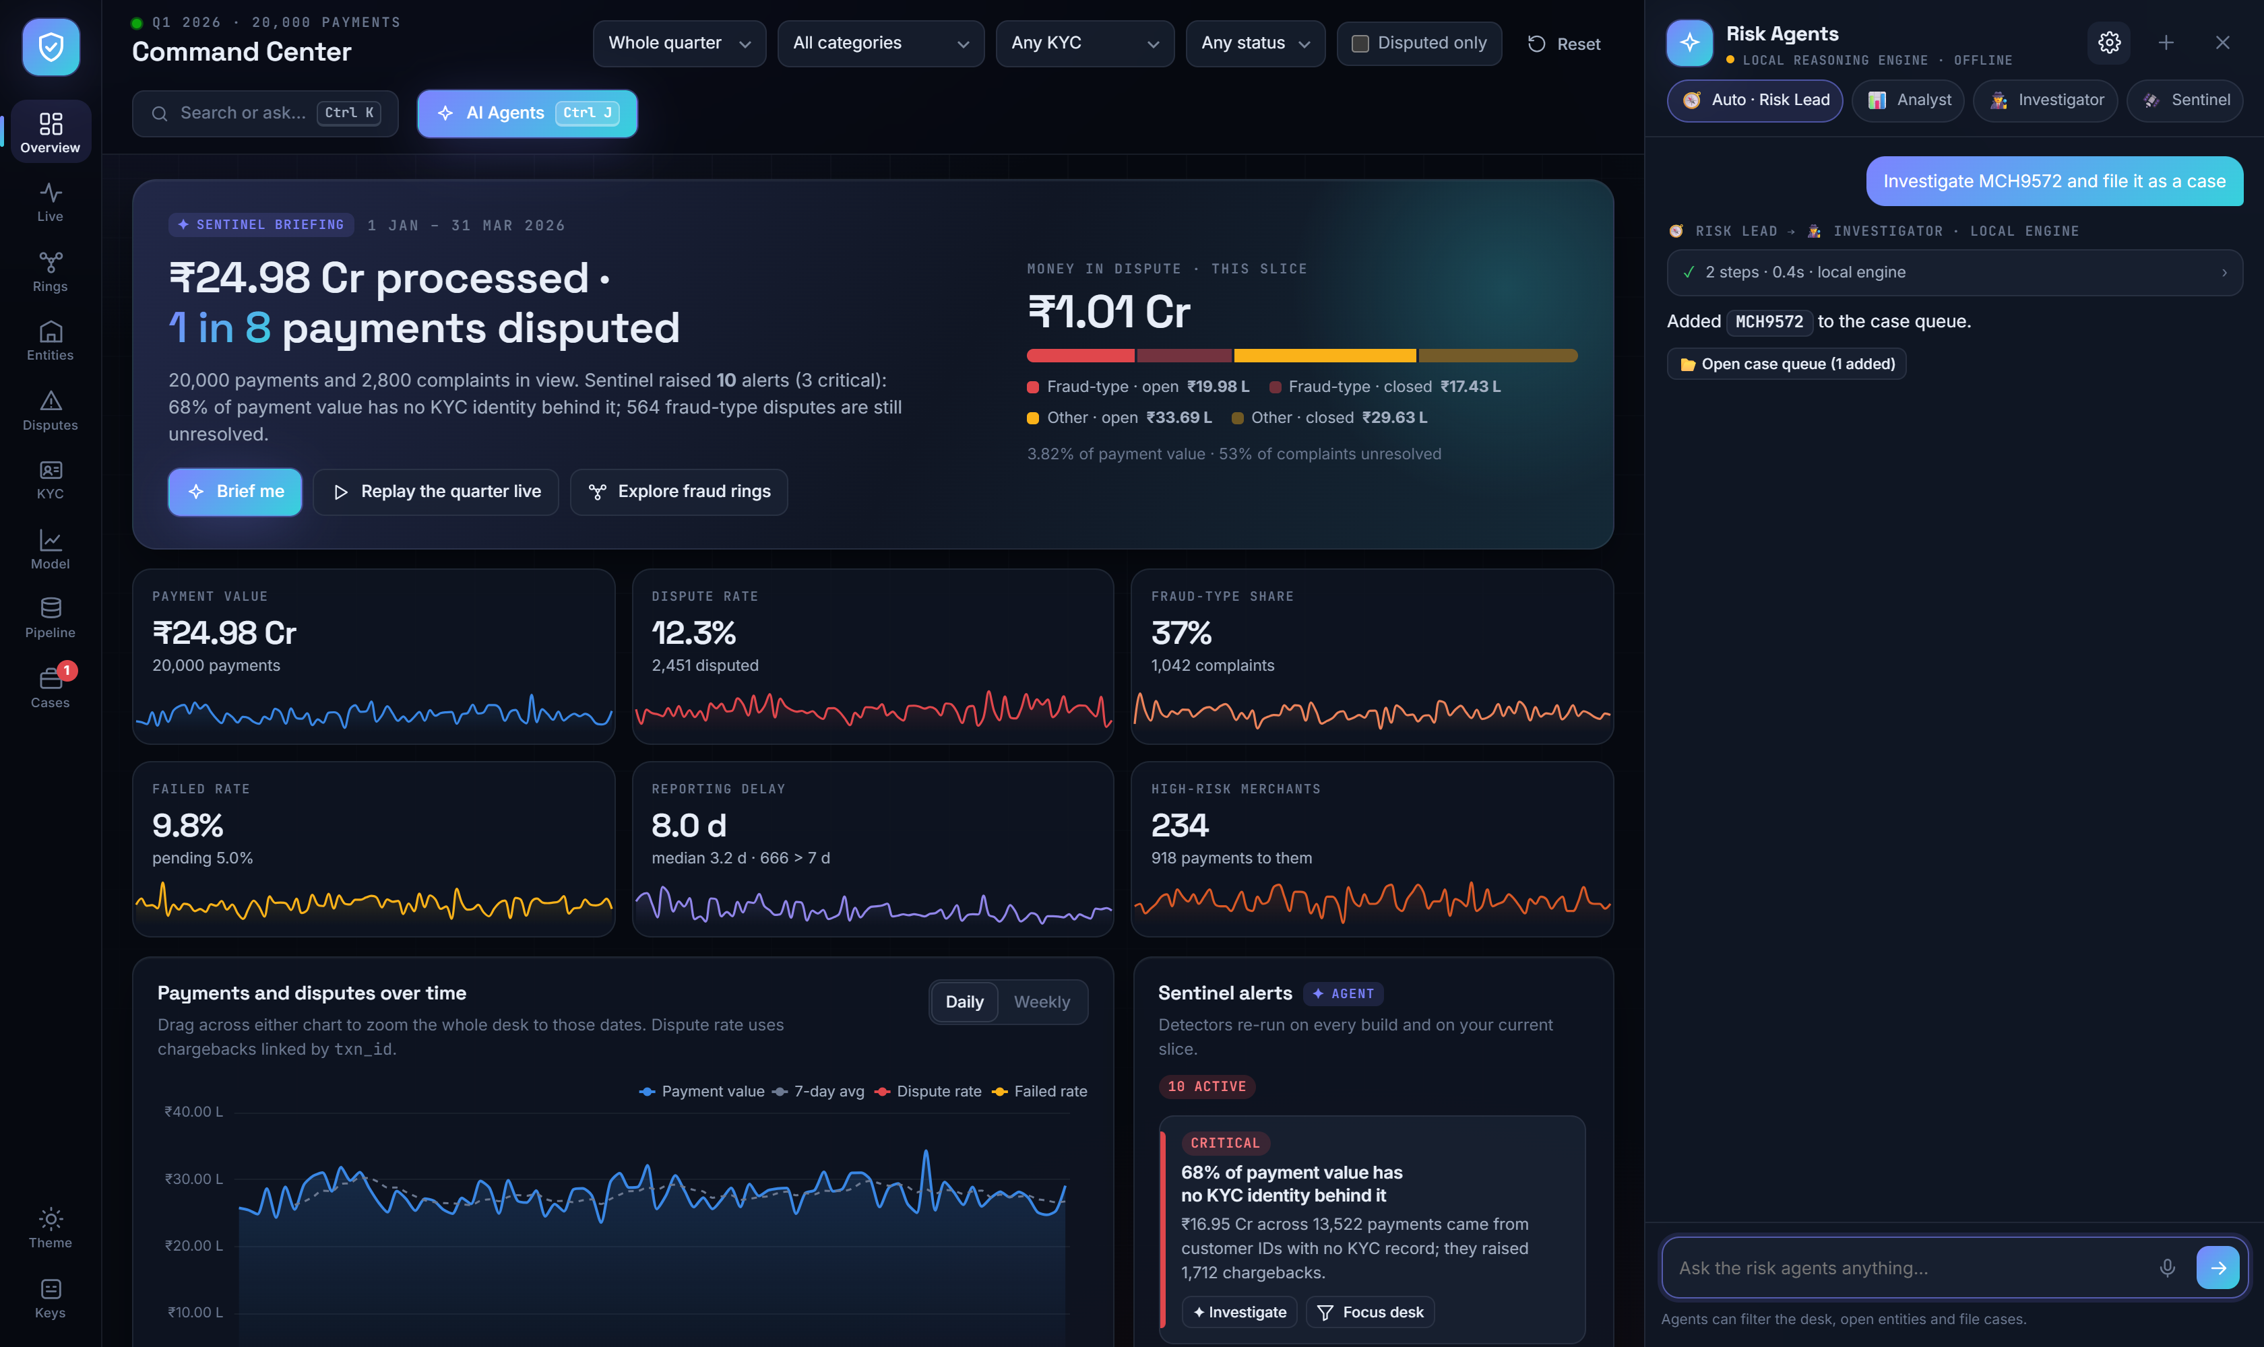
AI RISK AGENTS
Five agents that work the desk, not just talk
13
Risk Lead
plans, routes and delegates to specialists in parallel, then synthesises
Analyst
KPIs, breakdowns, trends, rankings, period comparisons
Investigator
entity and ring deep dives: score explained signal by signal
Sentinel
anomaly detectors: identity gap, rejected-KYC activity, backlog, spikes
Reporter
executive briefs and case-queue summaries with next actions
Two brains, one tool registry.
With an Anthropic key the agents run on Claude Opus 5 — streamed reasoning, real tool use, real delegation. Without one, a deterministic local reasoning engine plans the same 16 tools, so the demo never breaks. Tools filter the desk, open entities and file cases, and every answer shows its trace. src/llm_agent.py runs the same team in Python over a read-only SQL tool that blocks writes and PAN / Aadhaar / UTR columns.
The Investigator ran its tools and filed MCH9572 into the case queue.
dashboard/command_center/js/08_tools.js · 09_agents.js · 10_local.js · tests/test_llm_tools.py

Slide 14
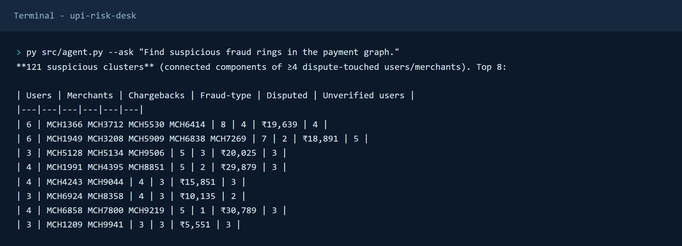
TERMINAL AGENT · REAL OUTPUT
Ask the graph in plain English
14
EXAMPLE QUERIES
"Which merchant has the highest chargeback-to-transaction ratio?"
"Are any merchants sharing an unusual number of disputing customers?"
"Find suspicious fraud rings in the payment graph."
"Investigate MCH9572."
Every answer is a traversal of the property graph — built from the cleaned model, so the number on screen can always be traced back to rows.
72K
106K
12 / 12
All 12 datathon example questions are answered in outputs/agent_demo.md, produced by the same deterministic router — no model call needed.
nodes: users, payments, merchants, categories, complaints
edges: PAID · TO · DISPUTED_BY · HAS_KYC · IN_CATEGORY
datathon example questions answered end to end
py src/agent.py --ask "..." · py src/llm_agent.py for the Claude-powered team

Slide 15
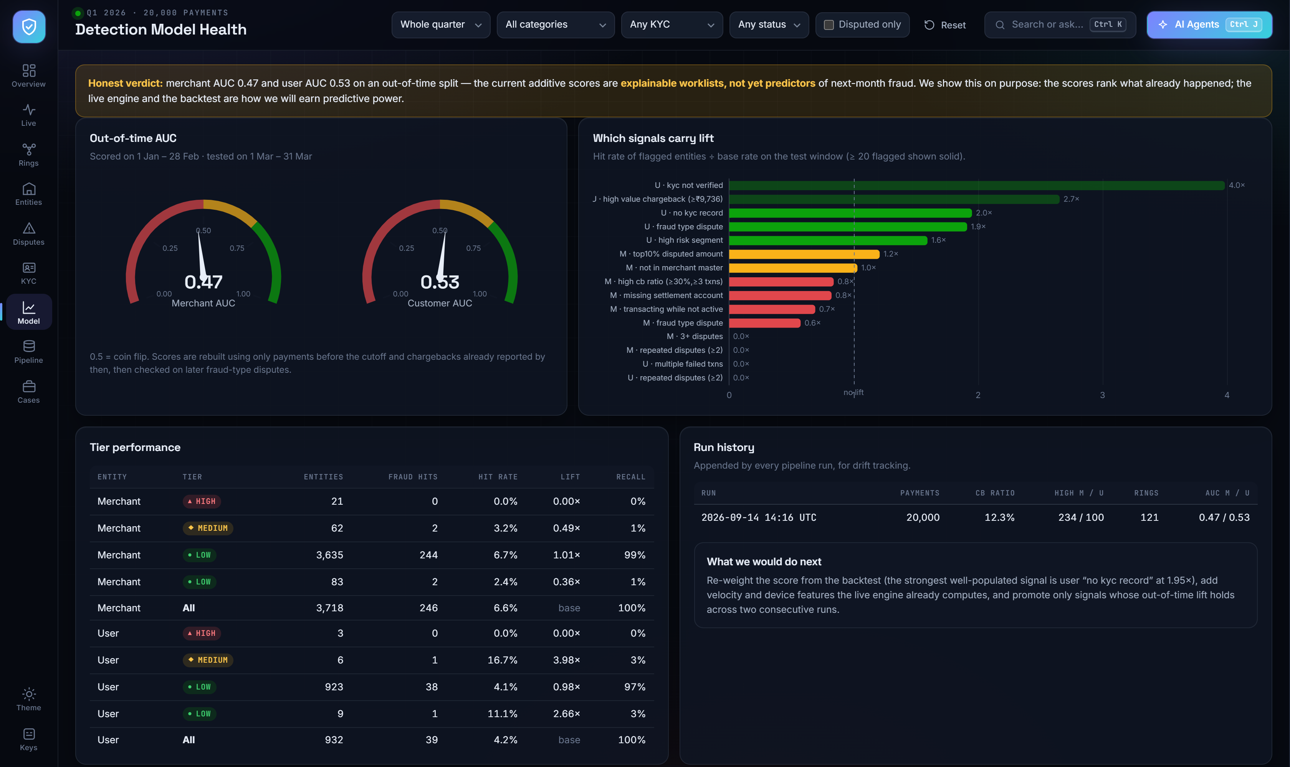
DETECTION QUALITY · HONEST BACKTEST
We report what the scores cannot do yet
15
1
Out-of-time split
Score on 1 Jan – 28 Feb using only chargebacks reported by then; test on fraud-type disputes in March.
2
AUC 0.47 / 0.53
Merchant and customer scores are no better than a coin flip on next-month fraud. We show it rather than hide it.
3
Some signals do carry lift
Unverified KYC 4.0×, high-value chargeback 2.7×, no KYC record 2.0× — but on samples too small to reweight.
4
Tracked every run
metrics_history.csv appends each run's KPIs and AUC, so drift is visible before anyone trusts the score.
Model view · outputs/risk/backtest_tiers.csv · backtest_signals.csv · outputs/metrics_history.csv

Slide 16
VALIDATION
The tempting explanations we ruled out
16
A risk desk is only credible if it also reports the hypotheses that died.
Missing UTR predicts failure or dispute
failed 9.7% vs 9.8% · disputed 12.6% vs 12.2%
NO SIGNAL
Failures cluster at peak hours
8–11% every hour of the day, Sunday lowest at 8.8%
SYSTEMIC, NOT LOAD
Volume spikes precede disputes
2 spike days across the quarter, 0 follow-on disputes
NOT PRESENT
Duplicate-debit complaints match duplicate rows
352 complaints, 0 repeats within 24 h after de-duplication
WAS A FEED DEFECT
Money moves in laundering loops
22,513 accounts, 16,393 payments, 0 cyclic components
IMPOSSIBLE HERE
The scores predict next-month fraud
merchant AUC 0.47 · customer AUC 0.53
WORKLIST, NOT FORECAST
Each test is reproducible from outputs/metrics.json and the risk worklists

Slide 17
FROM INSIGHT TO ACTION
What the risk team should change on Monday
17
01
Gate rejected KYC
Rejected customers still transact and dispute the most (15.0%). Block or step up UPI payments until identity is resolved.
02
Close the identity gap
68% of payment value has no KYC record behind it and 6,288 ids are shared. Fix onboarding and id hygiene before tuning any model.
03
Escalate late fraud
Unauthorised complaints are the latest to arrive (27% past 7 days). Route them to an accelerated queue instead of the general backlog.
04
Investigate rings, not rows
121 components link disputing customers through shared merchants. Work the ring leaderboard top-down and file cases from the desk.
05
Keep txn_id as the source of truth
Complaint-side ids disagree with the payment they dispute. Attribution through txn_id is what keeps merchant ratios honest.
Next milestone: earn predictive power — re-weight from the backtest, add velocity features, promote only signals whose out-of-time lift holds

Slide 18
DEMO SCRIPT
Two-minute live demo
18
0:00
STEP 1
0:30
STEP 2
1:00
STEP 3
1:30
STEP 4
Open the Command Center
Explore the rings
Open Entity 360
Let the agents work
Sentinel briefing, ₹1.01 Cr exposure, KPI tiles. Drag the trend to zoom the desk.
121 clusters, strongest first. Open CL001: 6 customers, 4 merchants, 8 chargebacks.
MCH3478 scores 80 — every point explained, with its timeline and ego network.
Ctrl J: "Investigate MCH9572 and file it as a case" — the agent runs tools and fills the case queue.
Fallbacks if the network is slow: the page is one self-contained file, the agents fall back to the local reasoning engine, and Ctrl K jumps to any view, id or ring instantly.
adityashukla2615.github.io/upi-risk-desk

Slide 19
OWNERSHIP AND DELIVERY
Team Loosers
19
★
Aditya Shukla
2
Ishaan Sandhwar
3
Piyush Priyanshu
TEAM LEADER - 12408482
12416912
12412878
Agents, validation and storytelling
Data engineering and the analytics model
Graph intelligence and ring detection
4
Deepak Kumar Behera
5
Harsh Sharm
12412575
12412500
Command Center, dashboards and visual analytics
Risk analytics, metrics and delivery
What we built together
A decision-ready risk desk: four broken files cleaned into one auditable model, explainable worklists for 234 merchants and 100 customers, 121 fraud rings, a leak-free replay engine, an honest detection check and five agents that can act on all of it.
TransOrg AgentIQ Datathon · Track 1 · UPI Fraud Ring & Merchant Analytics

Slide 20
THE TAKEAWAY
Clean the identity.
Connect the network.
Explain every flag.
LIVE
Command Center
9 views · 5 agents · no server
DASHBOARD
adityashukla2615.github.io/upi-risk-desk
CODE
github.com/adityashukla2615/upi-risk-desk
UPI Risk Desk turns 20,000 messy payments into an investigation queue a risk team can work — and is honest about what it cannot predict yet.
RUN IT
py src/clean.py
py src/analytics.py
py src/build_dashboard.py
Thank you

