Slide 1
What is an end effector?
An end effector is the device that is at the end of a robotic arm.
There are two main types of end effectors: Grippers and tools.
We can think of an end effector like a human hand. Even though a human hand is very versatile, an end effector has one great advantage that humans do not have and that is the interchangeability of end effectors. If the end effector is not suitable than it can be changed unlike the human hand.

Slide 2
Grippers
Grippers are the end effectors used for holding the parts or objects
Grippers are devices which can be used for holding or gripping an object.
They include what you might call mechanical hands and also anything like hooks, magnets and suction devices which can be used for holding or gripping.
Grippers take advantage of point-to-point control (exact path that the robot takes between what it is picking up and where it is placing it.
Grippers should be designed so that it requires the minimum amount of manoeuvring in order to grip the work piece
Applications of grippers :- Machine Loading and unloading, picking and placing of parts on conveyor, material handling, bottle handling, arranging parts onto pallets, etc

Slide 3
Types of Grippers
Mechanical Grippers
Hooks and Scoops
Magnetics Grippers
Vacuum Grippers
Expandable Bladder Type Grippers
Adhesive Grippers

Slide 4
1) Mechanical Grippers
We can think of a mechanical gripper as a robot hand. A basic robot hand will have only two or three fingers
A mechanical hand that wraps around an object will rely on friction in order to secure the object it is holding.
Friction between the gripper and the object will depend on two things, First is the type of surface whether it be metal on metal, rubber on metal, smooth surfaces or rough surfaces and the second is the force which is pressing the surfaces together.
Mechanical grippers are often fitted with some type of pad usually made from polyurethane as this provides greater friction. Pads are less likely to damage the work piece. Pads are also used so to have a better grip as the polyurethane will make contact with all parts of the surface when the gripper is closed
Mechanical grippers can be designed and made for specific purposes and adjusted according to the size of the object. They can also have dual grippers. We are all familiar with the saying ‘two hands are better than one” and robots benefit from having dual grippers as they can increase productivity, be used with machines that have two work stations where one robot can load two parts in a single operation, operations in which the size of objects or part change due to the machining processes and where the cycle time of the robot is too slow to keep up with the production of other machines.

Slide 5
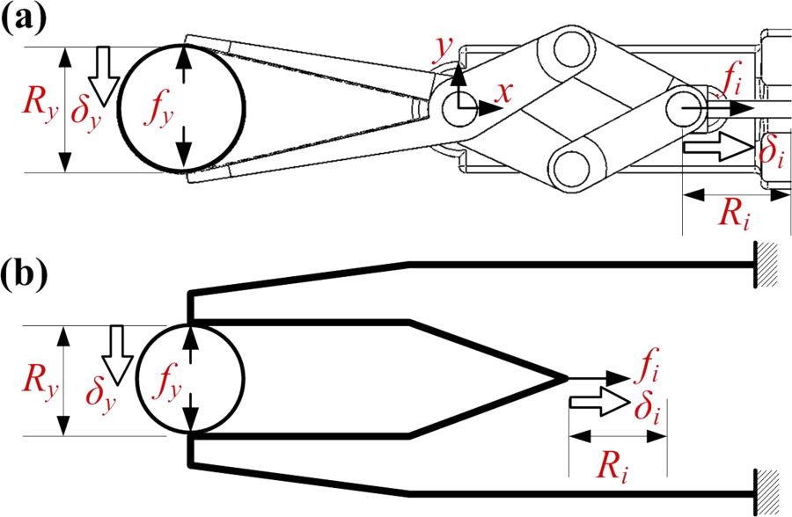
Mechanical Grippers design

Slide 6
In a mechanical gripper, the holding of an object can be done by two different methods such as:
1) Using the finger pads as like the shape of the work part.
2) Using soft material finger pads.
In the first method, the contact surfaces of the fingers are designed according to the work part for achieving the estimated shape. It will help the fingers to hold the work part for some extent.
In the second method, the fingers must be capable of supplying sufficient force to hold the work part. To avoid scratches on the work part, soft type pads are fabricated on the fingers. As a result, the contact surface of the finger and co – efficient of friction are improved. This method is very simple and as well as less expensive. It may cause slippage if the force applied against the work part is in the parallel direction. The slippage can be avoided by designing the gripper based on the force exerted. µ n_{f} F_{g} = w ………………… 1 µ => co – efficient of friction between the work part and fingers n_{f} => no. of fingers contacting
F_{g} => Force of the gripper w => weight of the grasped object
The equation 1 must be changed if the weight of a work part is more than the force applied to cause the slippage. µ n_{f} F_{g} = w g …..……………. 2 g => g factor
During rapid grasping operation, the work part will get twice the weight. To get rid out of it, the modified equation 1 is put forward by Engel Berger. The g factor in the equation 2 is used to calculate the acceleration and gravity.
The values of g factor for several operations are given below: g = 1 – acceleration supplied in the opposite direction. g = 2 – acceleration supplied in the horizontal direction. g = 3 – acceleration and gravity supplied in the same direction.

Slide 7
2) Hooks and Scoops
Hooks and scoops are the simplest type of end effectors that can be classes as grippers.
A scoop or ladle is commonly used to scoop up molten metal and transfer it to the mould
A hook may be all that is needed to lift a part especially if precise positioning in not required and if it is only to be dipped into a liquid.
Hook are used to load and unload parts hanging from the overhead conveyors. The parts to be handled by a hook must have some sort of handle, eyebolt or ring to enable the hook to hold it.
Scoops are used for handling the materials in liquid or power from, the limitation of scoop is, it is difficult to control the amount of martial being handled by the scoop. In addition, spilling of the material during handling is another problem.

Slide 8
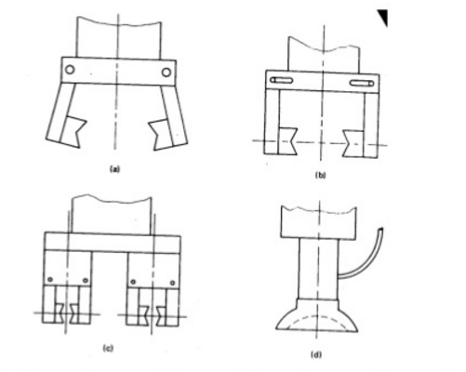
Hooks and Scoops design

Slide 9
3) Magnetic Grippers
Magnetic grippers obviously only work on magnetic objects and therefore are limited in working with certain metals.
For maximum effect the magnet needs to have complete contact with the surface of the metal to be gripped. Any air gaps will reduce the strength of the magnetic force, therefore flat sheets of metal are best suited to magnetic grippers.
If the magnet is strong enough, a magnetic gripper can pick up an irregular shaped object. In some cases the shape of the magnet matches the shape of the object
A disadvantage of using magnetic grippers is the temperature. Permanent magnets tend to become demagnetized when heated and so there is the danger that prolonged contact with a hot work piece will weaken them to the point where they can no longer be used. The effect of heat will depend on the time the magnet spends in contact with the hot part. Most magnetic materials are relatively unaffected by temperatures up to around 100 degrees.
Electromagnets can be used instead and are operated by a DC electric current and lose nearly all of their magnetism when the power is turned off.
Permanent magnets are also used in situations where there is an explosive atmosphere and sparks from electrical equipment would cause a hazard

Slide 10
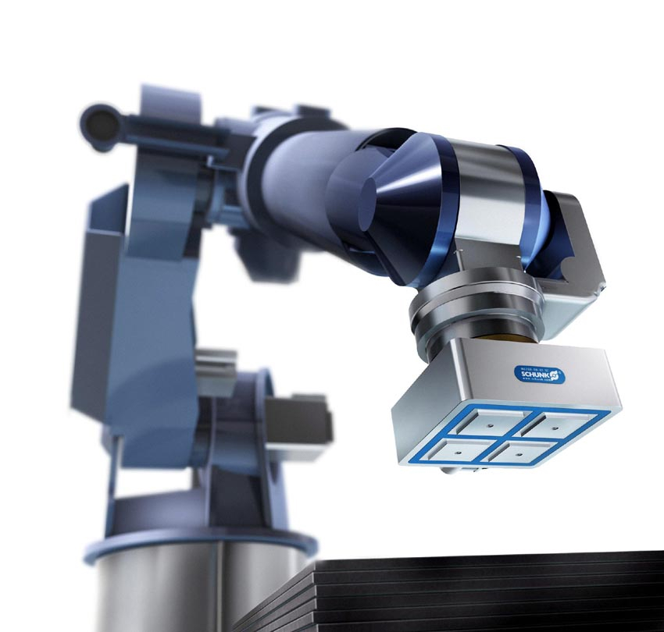
Magnetic Grippers design

Slide 11
4) Suction Grippers
There are two types of suction grippers:
Devices operated by a vacuum – the vacuum may be provided by a vacuum pump or by compressed air
Devices with a flexible suction cup – this cup presses on the work piece. Compressed air is blown into the suction cup to release the work piece. The advantage of the suction cup is that if there is a power failure it will still work as the work piece will not fall down. The disadvantage of the suction cup is that they only work on clean, smooth surfaces.
There are many more advantages for using a suction cup rather than a mechanical grip including: there is no danger of crushing fragile objects, the exact shape and size does not matter and the suction cup does not have to be precisely positioned on the object
The downfalls of suction cups as an end effector include: the robot system must include a form of pump for air and the level of noise can cause annoyance in some circumstances

Slide 12
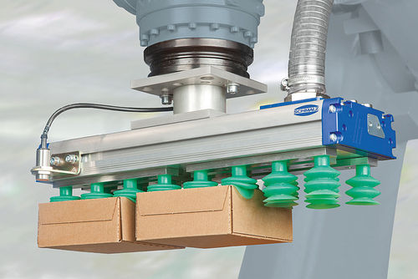
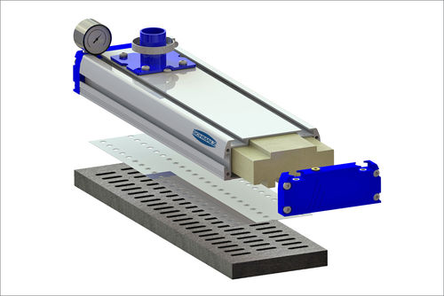
Vacuum gripper design

Slide 13
5) Expandable Bladder Type Grippers
A bladder gripper or bladder hand is a specialized robotic end effector that can be used to grasp, pick up, and move rod-shaped or cylindrical objects.
The main element of the gripper is an inflatable, donut-shaped or cylindrical sleeve that resembles the cuff commonly used in blood pressure measuring apparatus.
The sleeve is positioned so it surrounds the object to be gripped, and then the sleeve is inflated until it is tight enough to accomplish the desired task.
The pressure exerted by the sleeve can be measured and regulated using force sensors.
Bladder grippers are useful in handling fragile objects. However, they do not operate fast, and they can function only with objects within a rather narrow range of physical sizes.

Slide 14
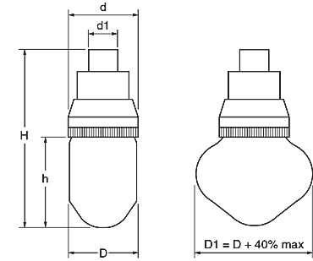
Expandable Bladder Type Grippers

Slide 15
6) Adhesive Grippers
Adhesive Substance can be used for grasping action in adhesive grippers.
In adhesive grippers, the adhesive substance losses its tackiness due to repeated usage. This reduces the reliability of the gripper. In order to overcome this difficulty, the adhesive material is continuously fed to the gripper in the form of ribbon by feeding mechanism.
A major asset of the adhesive gripper is the fact that it is simple. As long as the adhesive keep its stickiness it will continue to function without maintenance, however, there are certain limitations, the most significant is the fact that the adhesive cannot readily be disabled in order to release the grasp on an object. Some other means, such as devices that lock the gripped object into place, must be used.
The adhesive grippers are used for handling fabrics and other lightweight materials.

Slide 16
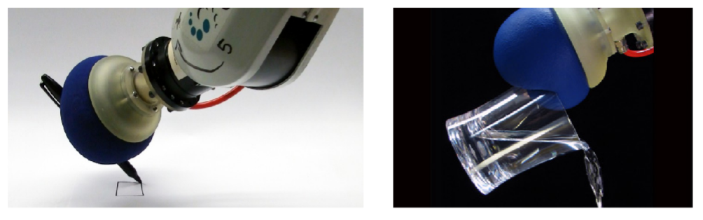
Adhesive Grippers Design

