Slide 1
Lane Detection for Autonomous Vehicles
Team Hashira | Code for Bharat 2.0

Slide 2
Problem Statement
Autonomous navigation requires robust lane detection.
Poor or missing road markings can confuse the system.
Accurate lane detection is critical for safety and control.

Slide 3
Objective
Develop a Python-based pipeline to detect lane lines from video input.
Use computer vision techniques (OpenCV) to process frames.
Output video with real-time lane overlay.

Slide 4
Proposed Solution
Frame-by-frame processing of input video.
Apply Canny edge detection and ROI masking.
Use Hough Transform to detect straight lines.
Overlay detected lane lines on original video.

Slide 5
Tech Stack
Languages: Python
Libraries: OpenCV, NumPy
Tools: GitHub, VS Code, Google Colab (optional)

Slide 6
Architecture Flow
1. Read video frame
2. Apply Canny edge detection
3. Mask region of interest (ROI)
4. Detect lines using Hough Transform
5. Draw and overlay lane lines
6. Save or display output

Slide 7
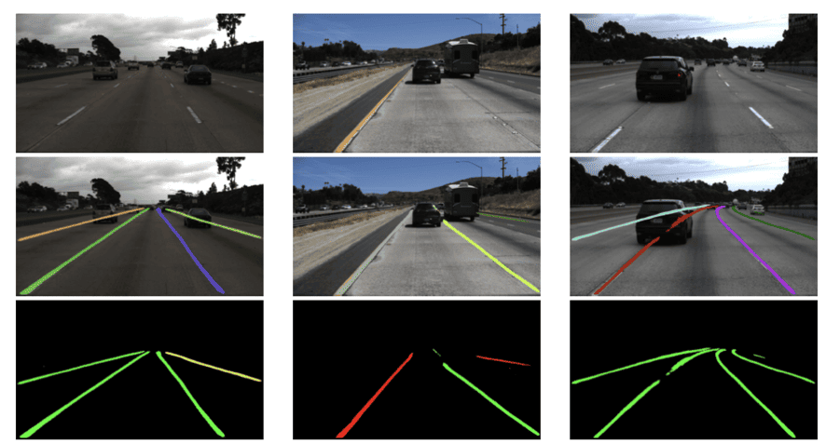
Sample Input vs Output
Left: Raw video frame
Right: Lane detection overlay

Slide 8
Project Folder Structure
main.py - Entry point script
lane_detection.py - Lane detection pipeline
utils.py - Drawing and display helpers
test_videos/ - Input videos
output_videos/ - Output with overlay
recording.mp4 - Demo video

Slide 9
Results
Tested on urban and highway road videos.
Successfully detected lanes in clear daylight conditions.
Runs in real-time (~20 FPS on CPU).

Slide 10
Future Scope
Add support for curved lane detection.
Integrate with object detection for complete ADAS.
Use deep learning models for better accuracy.

Slide 11
Acknowledgment
Thanks to Code for Bharat 2.0 organizers.
Supported by open-source community and mentors.
Developed by Team Hashira.
Team members: Aditya Singh, Devang Shukla

Slide 12
GitHub & Demo
GitHub Repo: repo
Demo Video: recording.mp4 available in the repo.

