Slide 1
Django Rest Framework
serializes = in Django rest framework it is responsible for convert the complex data type such as query to json and xml form which is converted to python data type. This process is known as serialization
Deserlizer = in Django rest framework it is reverse the serlization process means it is responsible for convert the json data to complex data type this process is known as dieselization

Slide 2
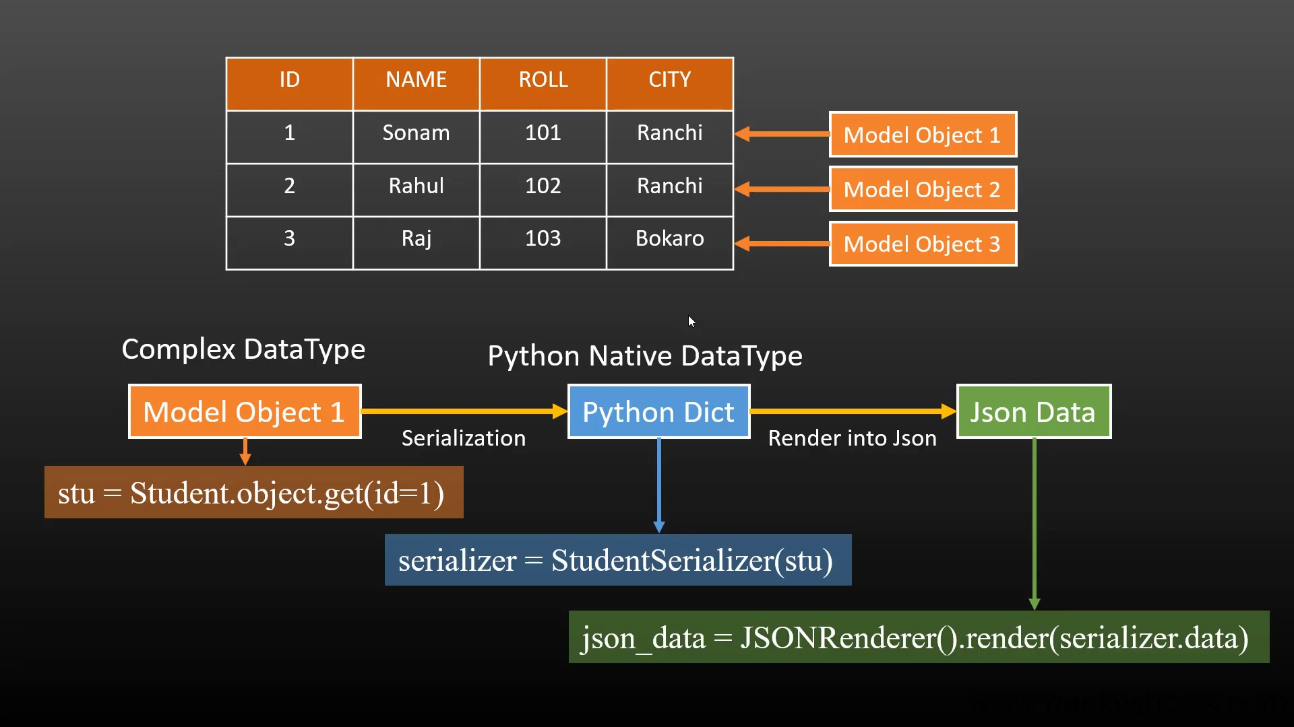
Process of Serialization

Slide 3
