Slide 1




Internship Project Presentation | Nov 2026
02:00 AM · FLAGGED
Transactional Fraud Detection Analysis
$1.00 · APPROVED
Machine Learning, SQL Analytics & Real-Time Risk Intelligence
End-to-End Financial Transaction Security Framework
Full Pipeline: Data Profiling, SQLite Analytics, ML Modeling, and Streamlit Dashboard
Trained on 284,807 Real Transactions from Kaggle / ULB Dataset
PRESENTED BY
Aditya Kumar
Yash Bhankale
Anjali Krishna
$2,125.87 · BLOCKED
LIVE PROJECT
https://transactional-fraud-detection-analysis.streamlit.app/

Slide 2




The Business Problem & Industry Context
INTRODUCTION · BUSINESS PROBLEM
Balancing Financial Loss Prevention with Frictionless User Experience
Multi-Billion Dollar Impact
The Needle in the Haystack
The False Decline Threat
Financial fraud accounts for tens of billions in annual dispute & chargeback losses.
Fraud comprises less than 0.2% of total transaction stream.
Overly sensitive fraud rules cause false declines, embarrassing customers and losing revenue.
Project Goal
Engineer a high-precision, high-recall detection engine that minimizes friction while catching fraud.

Slide 3





Project Objectives & Architecture
INTRODUCTION · ARCHITECTURE
Five Core Technical Pillars
1
2
3
4
5
Data Profiling & Hygiene
SQL Analytics
Exploratory Data Analysis
Machine Learning Pipeline
Interactive Deployment
Audit 284,807 transactions without data loss or target leakage.
Construct SQLite database for parameterized monetary and hourly queries.
Identify monetary, diurnal, and latent feature patterns.
Train Logistic Regression and Random Forest using balanced weighting.
Deliver Streamlit monitoring dashboard with live transaction scoring demo.

Slide 4





Dataset Overview & Class Imbalance
DATA & EDA · DATASET OVERVIEW
Understanding the Extreme Skewness in Real Financial Data
Corpus Size: 284,807 transactions spanning 48 hours (172,792 seconds).
284,807
Target Distribution: 284,315 Legitimate (99.827%) vs. 492 Fraudulent (0.173%).
TRANSACTIONS
0.173%
Extreme Imbalance Ratio: Exactly 1 fraud for every 578 legitimate transactions.
FRAUDULENT (492)
Feature Set: 28 PCA-transformed latent components (V1-V28), plus Time and Amount.
1 : 578
Evaluation Requirement: Accuracy is meaningless (99.83% naive baseline); PR-AUC and Recall are paramount.
FRAUD TO LEGITIMATE

Slide 5
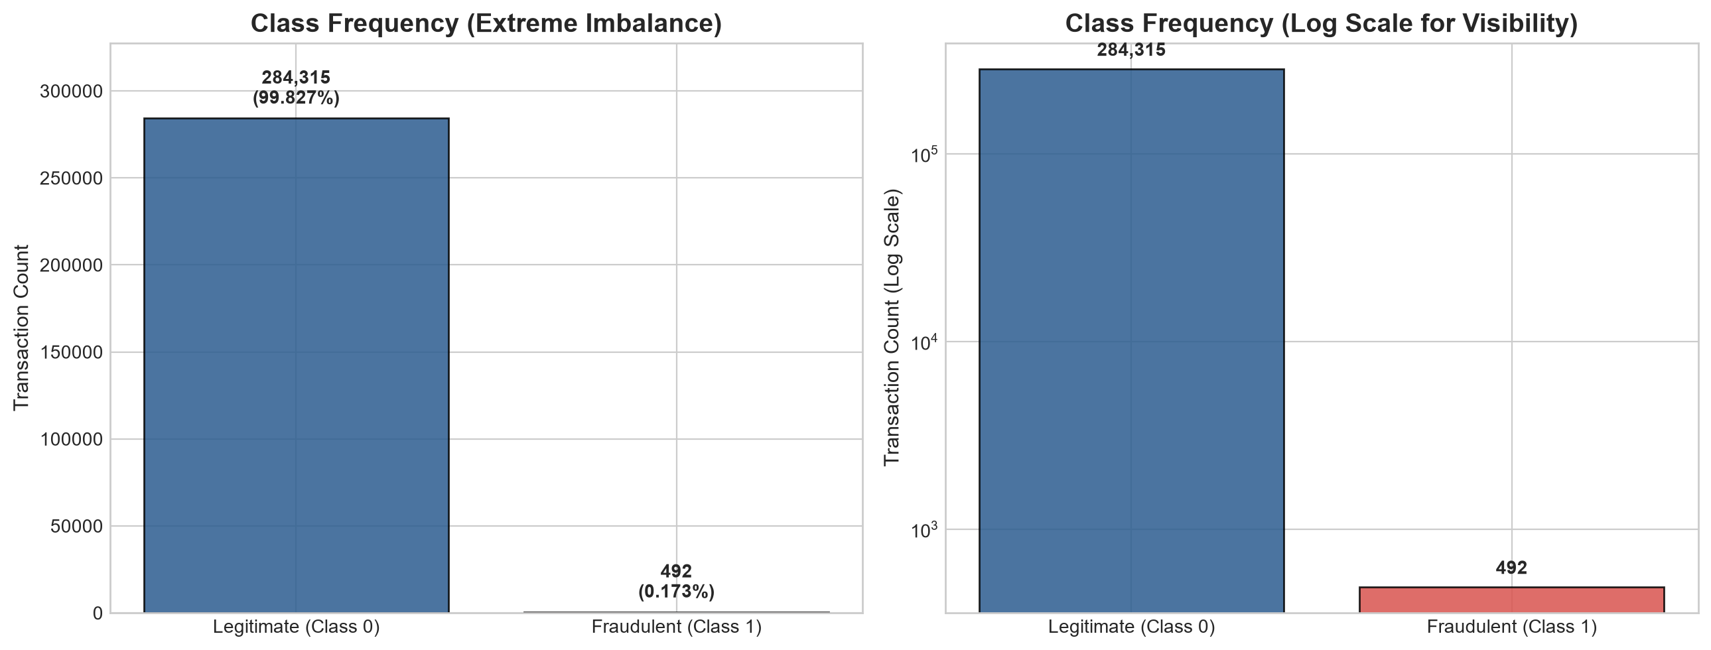
Class Frequency (Extreme Imbalance)
FIGURE · CLASS DISTRIBUTION
Extreme Imbalance Ratio: Exactly 1 fraud for every 578 legitimate transactions.

Slide 6




Data Cleaning & SQLite Relational Analytics
DATA & EDA · SQLITE ANALYTICS
Auditing Data Integrity and Querying Financial Tiers
Data Hygiene
Exactly 0 missing values and 0 infinite values across all 31 columns.
Duplicate Audit
1,081 duplicate rows identified containing 32 fraud records—retained to preserve card swipe retry patterns.
Total Transaction Volume
Total Fraud Loss
$25,162,590.01
$60,127.97
across corpus
Monetary Comparison
High Value Risk
Transactions between - show highest fraud concentration (149 cases).
$88.35
$122.21
$88.29
Overall Average
Fraud Mean
Legit Mean

Slide 7
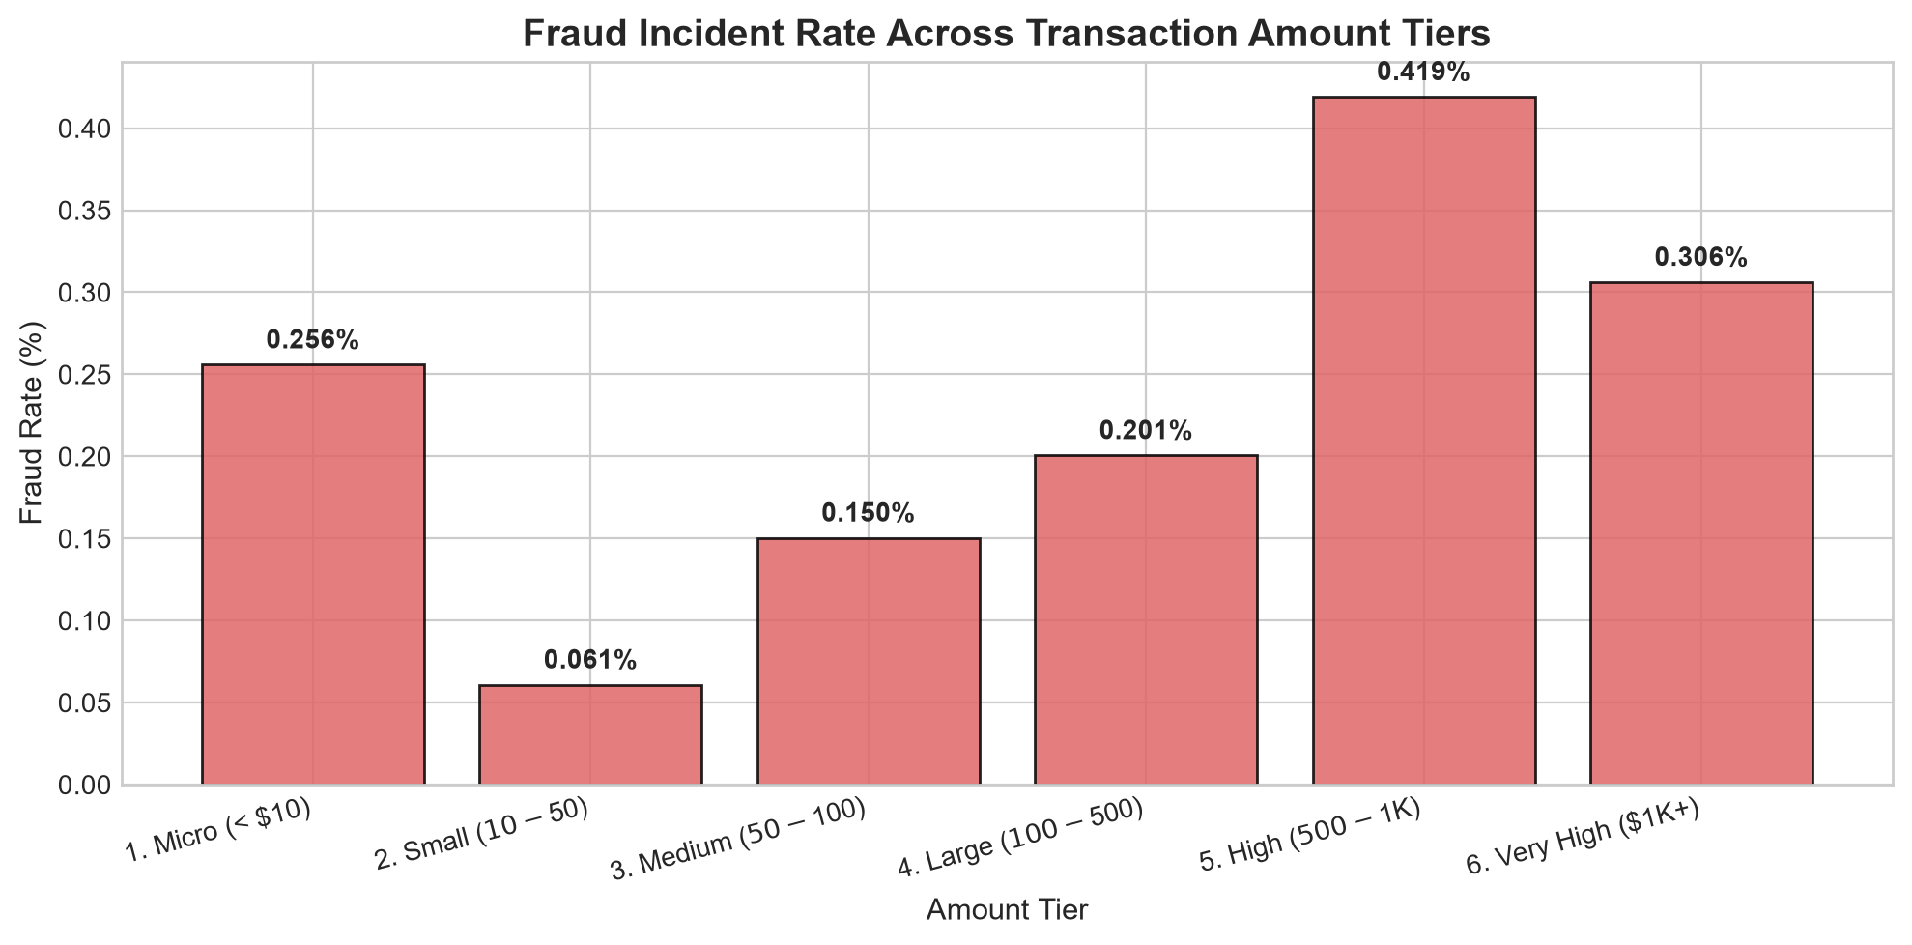

Fraud Incident Rate Across Amount Tiers
FIGURE · AMOUNT TIERS
0.419%
Highest-risk tier
High ($500 – 1K)
0.061%
Lowest-risk tier
Small ($10 – 50)

Slide 8




Key Exploratory Findings & Behavioral Patterns
DATA & EDA · BEHAVIORAL PATTERNS
Uncovering When and How Fraud Occurs
Late-Night Diurnal Surge
Legitimate volume drops between 1 AM and 5 AM as users sleep.
Peak Fraud Rate
Spikes to 1.713% at 2:00 AM (an almost 10x multiplier above baseline!).
1.713%
AT 2:00 AM
Monetary Bimodal Strategy
Micro-charges ($1.00) for balance testing, followed by large thefts up to $2,125.87.
Top Discriminative Negative Signals
V17 (r = -0.327), V14 (r = -0.303), V12 (r = -0.261).
Top Discriminative Positive Signals
V11 (r = +0.155), V4 (r = +0.133).

Slide 9
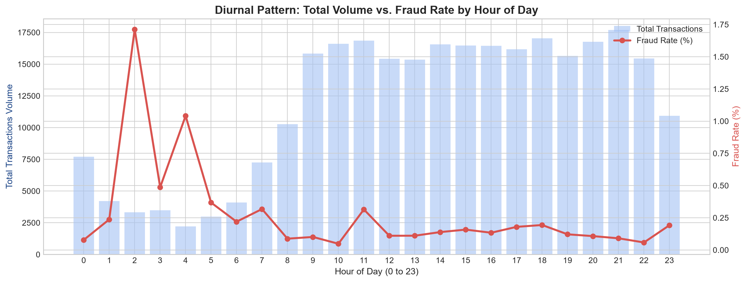
Diurnal Pattern: Volume vs. Fraud Rate by Hour
FIGURE · HOUR OF DAY
Peak Fraud Rate: Spikes to 1.713% at 2:00 AM (an almost 10x multiplier above baseline!).
Late-Night Diurnal Surge: Legitimate volume drops between 1 AM and 5 AM as users sleep.

Slide 10
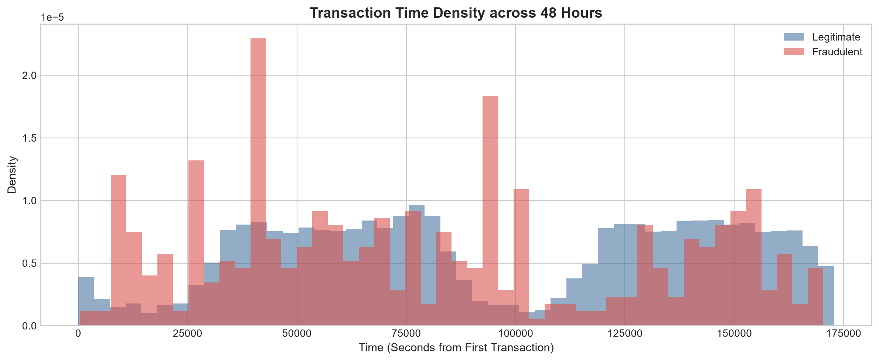
Transaction Time Density across 48 Hours
FIGURE · TIME DENSITY
Corpus Size: 284,807 transactions spanning 48 hours (172,792 seconds).

Slide 11
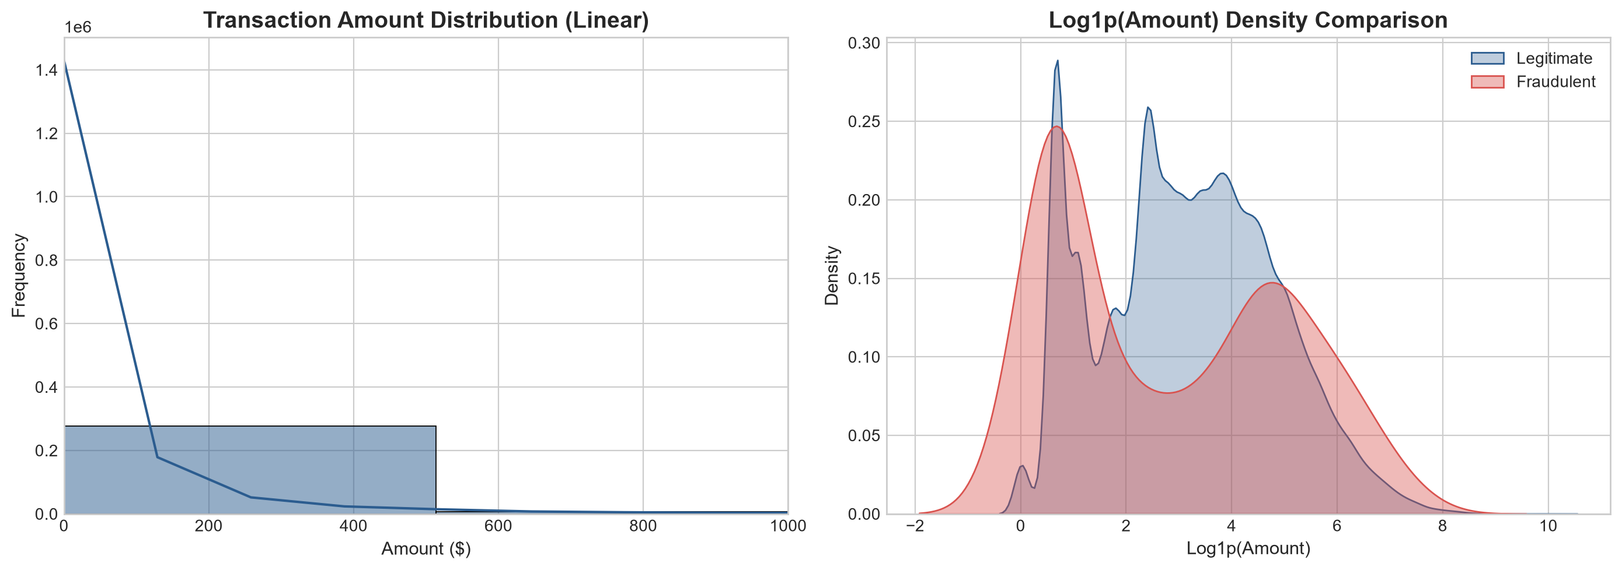
Transaction Amount Distribution
FIGURE · AMOUNT DISTRIBUTION
Monetary Bimodal Strategy: Micro-charges ($1.00) for balance testing, followed by large thefts up to $2,125.87.

Slide 12
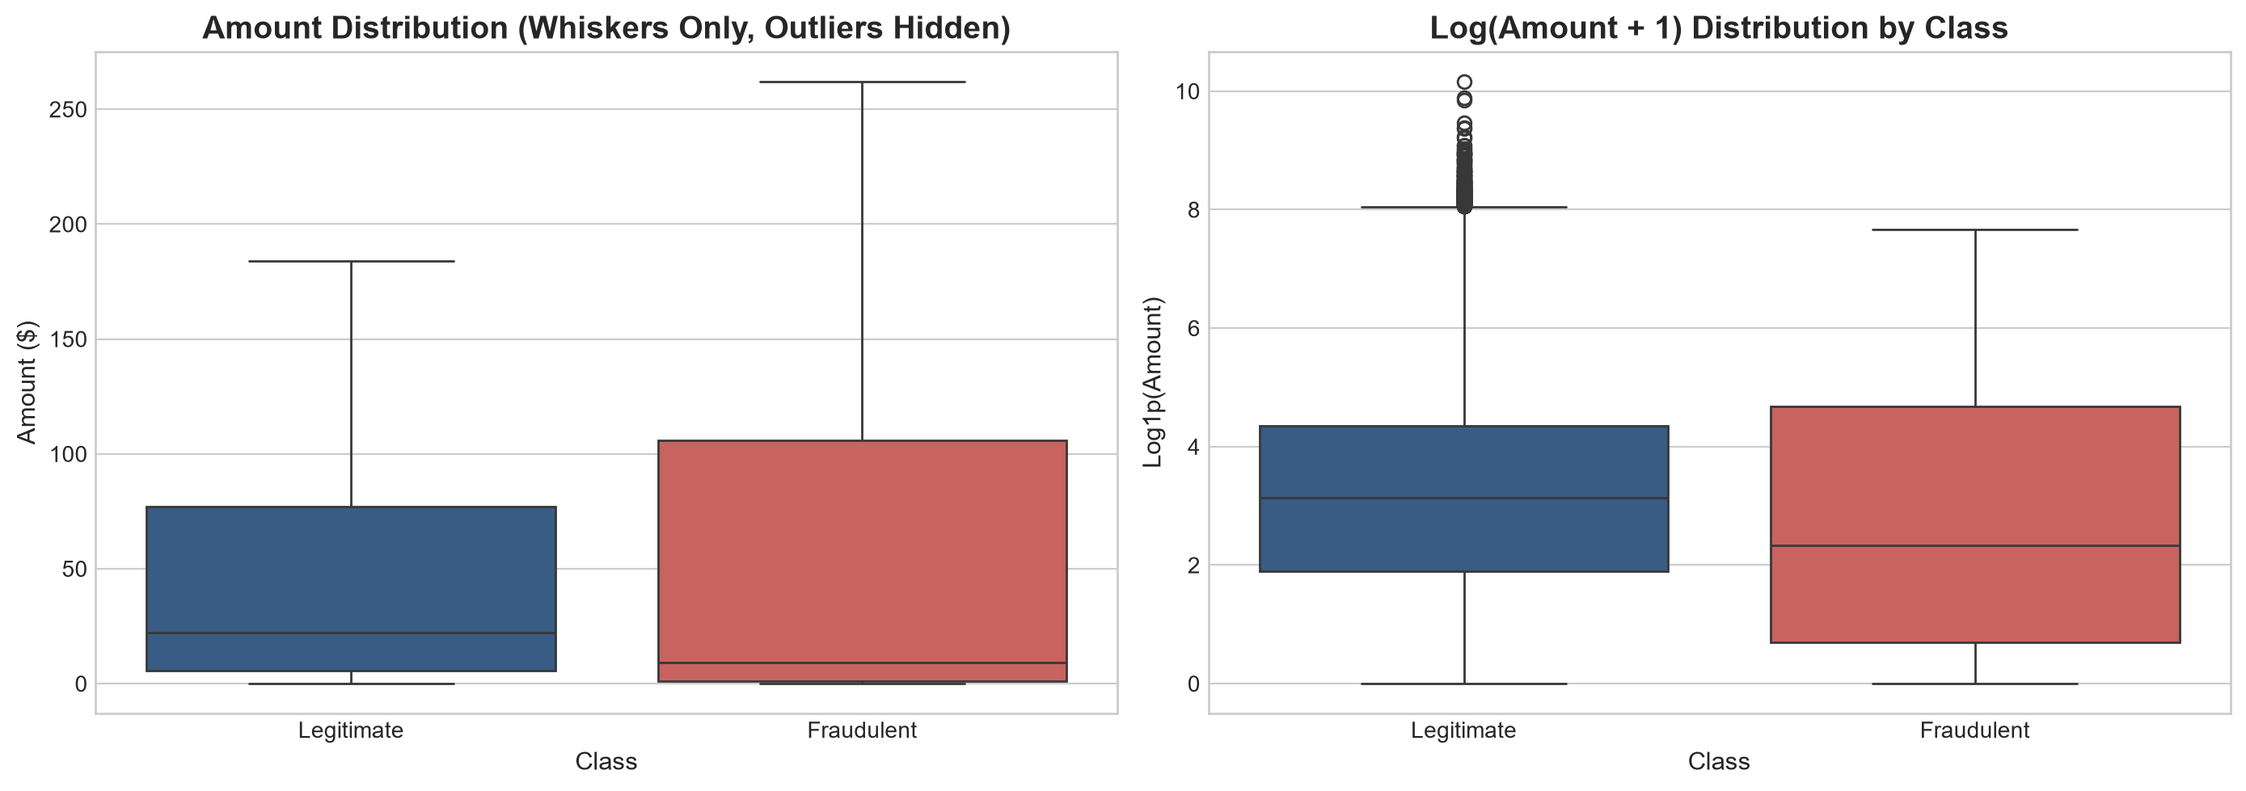
Amount Distribution by Class
FIGURE · AMOUNT BY CLASS
Monetary Comparison: Overall Average: $88.35; Fraud Mean: $122.21; Legit Mean: $88.29.

Slide 13
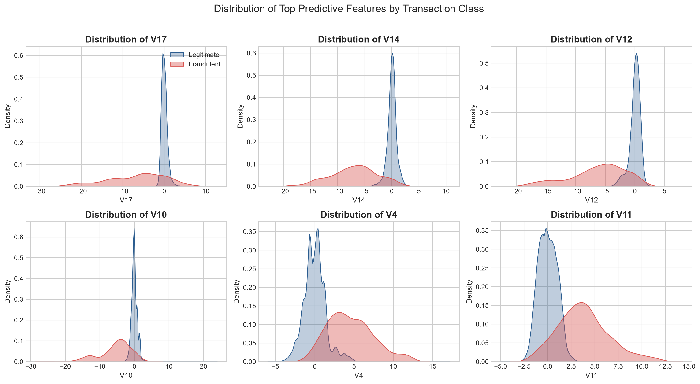

Top Predictive Features by Transaction Class
FIGURE · LATENT FEATURES
Top Discriminative Negative Signals: V17 (r = -⁠0.327), V14 (r = -⁠0.303), V12 (r = -⁠0.261).
Top Discriminative Positive Signals: V11 (r = +⁠0.155), V4 (r = +⁠0.133).

Slide 14
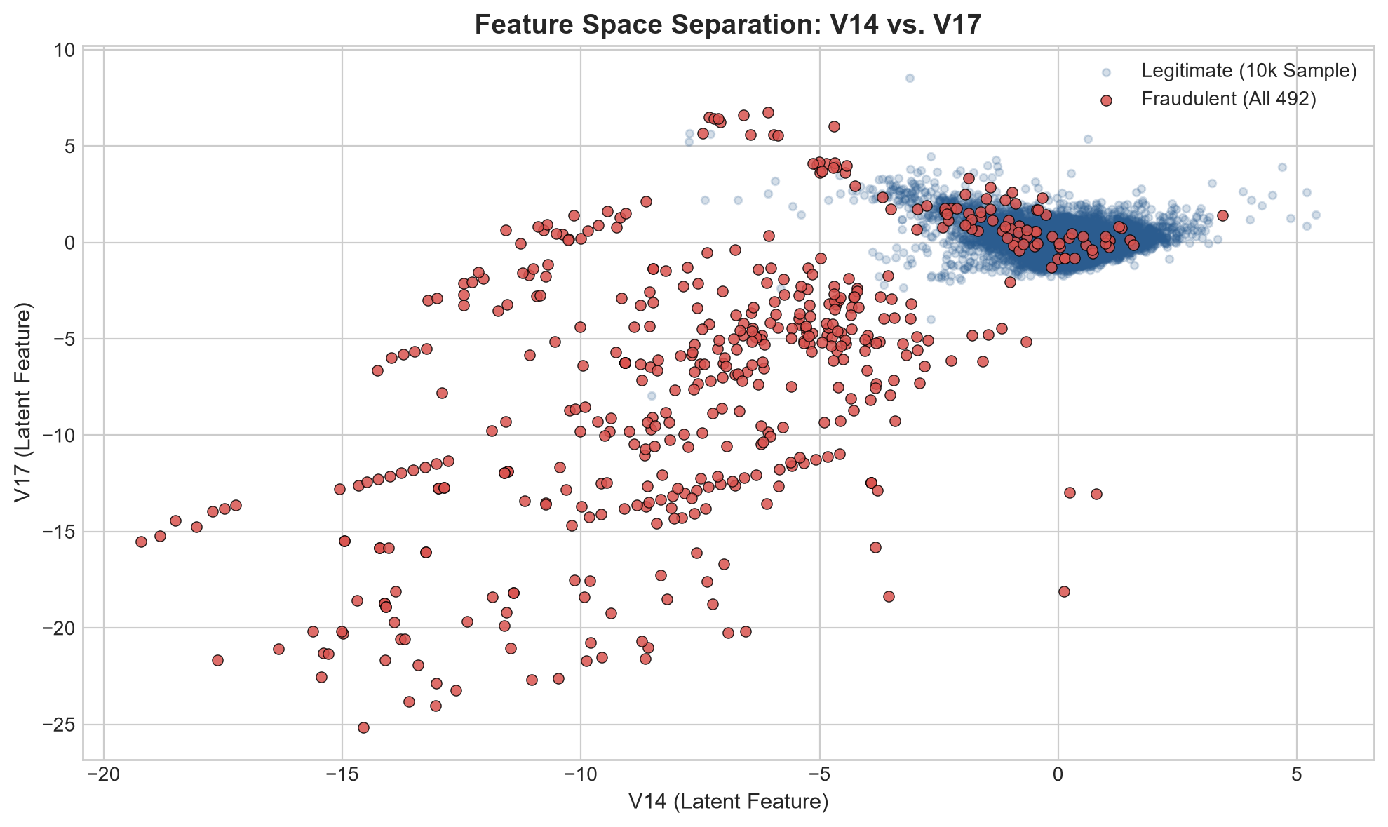
Feature Space Separation: V14 vs. V17
FIGURE · V14 VS V17
Top Discriminative Negative Signals: V17 (r = -⁠0.327), V14 (r = -⁠0.303), V12 (r = -⁠0.261).

Slide 15
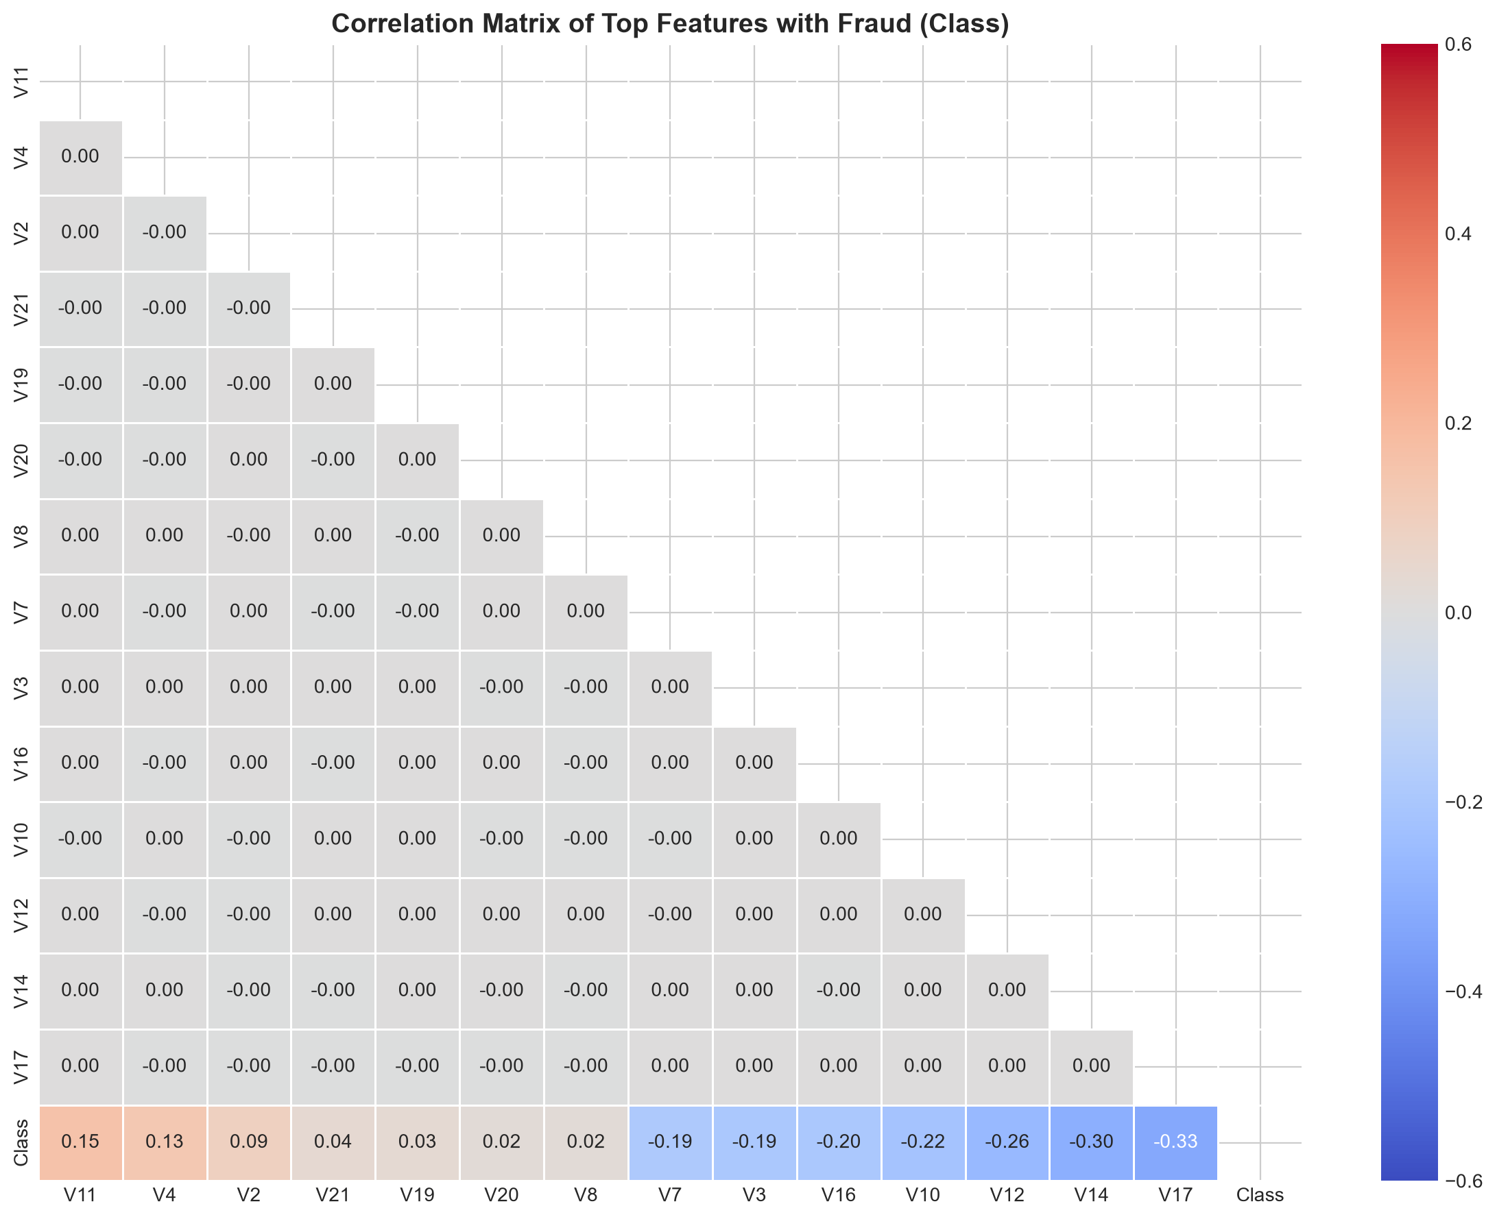

Correlation Matrix of Top Features with Fraud
FIGURE · CORRELATION MATRIX
Top Discriminative Negative Signals: V17 (r = -⁠0.327), V14 (r = -⁠0.303), V12 (r = -⁠0.261).
Top Discriminative Positive Signals: V11 (r = +⁠0.155), V4 (r = +⁠0.133).

Slide 16





Feature Engineering & Leak-Free Pipeline
MODELING · FEATURE ENGINEERING
Transforming Raw Temporal and Monetary Dimensions
Hour_of_Day Feature
Derived via (Time // 3600) % 24 to capture cyclical diurnal risk.
Log_Amount Feature
log1p(Amount) normalization to compress severe monetary skewness.
Scikit-Learn Pipeline
Strict Featurization Order
Customer Velocity Note
Integrated into unified ColumnTransformer with RobustScaler and StandardScaler.
Zero data leakage—all scalers fit exclusively on training split.
Explicitly avoided synthetic customer IDs to maintain data integrity.

Slide 17


Machine Learning Model Benchmarking
MODELING · BENCHMARKING
Evaluating Baseline Logistic Regression vs. Comparison Random Forest
Test Partition: 56,962 transactions (98 true frauds) evaluated on independent test split.
Baseline Logistic Regression
Comparison Random Forest
90.82%
5.63%
1,492
81.63%
75.47%
26
RECALL
PRECISION
FALSE ALARMS
RECALL
PRECISION
FALSE ALARMS
(caught 89/98)
(caught 80/98)
PR-AUC Benchmark: Random Forest achieved 0.8433 PR-AUC vs. 0.7225 for Logistic Regression.
Operational Trade-off: Random Forest eliminates 98.3% of false alarms, saving millions in review overhead.

Slide 18
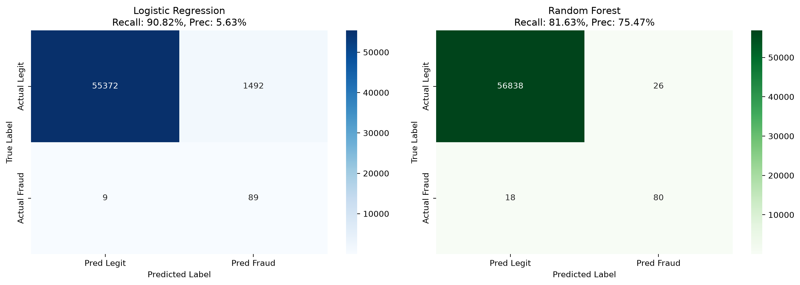
Confusion Matrices: Logistic Regression vs. Random Forest
FIGURE · CONFUSION MATRICES
Operational Trade-off: Random Forest eliminates 98.3% of false alarms, saving millions in review overhead.

Slide 19
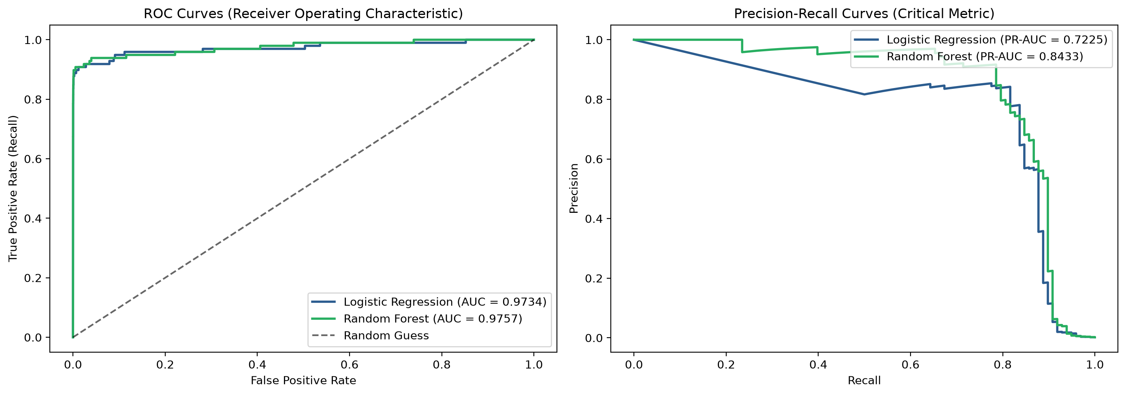
ROC Curves & Precision-Recall Curves
FIGURE · ROC / PR CURVES
PR-AUC Benchmark: Random Forest achieved 0.8433 PR-AUC vs. 0.7225 for Logistic Regression.

Slide 20
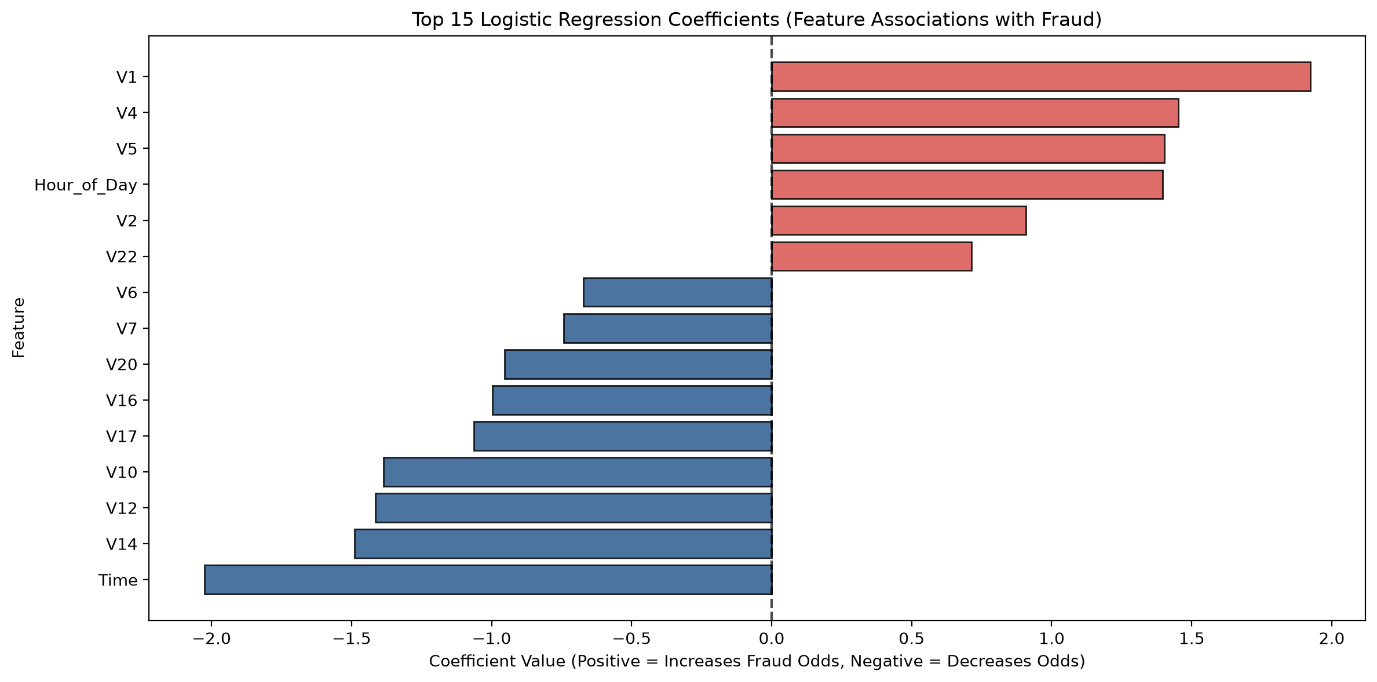
Top 15 Logistic Regression Coefficients
FIGURE · FEATURE ASSOCIATIONS
Hour_of_Day Feature: Derived via (Time // 3600) % 24 to capture cyclical diurnal risk.

Slide 21





Interactive Dashboard & Strategic Recommendations
DEPLOYMENT · LIVE OPERATIONS
Deploying Analytics into Live Operations
Streamlit Dashboard
Multi-page UI with Executive KPIs, Transaction Explorer, and Real-Time Scoring sandbox.
LIVE PROJECT
Open the link to try real-time scoring
https://transactional-fraud-detection-analysis.streamlit.app/
Three-Tier Risk Matrix
Tier 1 (<30%)
Tier 2 (30-70%)
Tier 3 (>=70%)
Auto-approve (99.5%)
Step-up SMS OTP
Auto-block
Dynamic Nighttime Scrutiny
Heighten threshold sensitivity between 2:00 AM and 4:00 AM for transactions >.
Operational Efficiency
Random Forest delivers high precision (75.5%) with only 26 false alarms across 57k transactions.

Slide 22



Conclusion, Quality Assurance & Future Work
CONCLUSION · MILESTONES
Complete Delivery of Internship Milestones
Full Reproducibility
Master script run_project.py executes all stages end-to-end.
Automated Testing
8 out of 8 pytest validation tests passing with 100% test coverage.
Key Competencies Demonstrated
Python, SQL/SQLite, Advanced EDA, Scikit-learn Pipelines, Streamlit UI.
Future Enhancements
Graph database integration for fraud ring detection and Kafka streaming integration.

Slide 23
Thank You
TEAM & LIVE DEMO
LIVE PROJECT
Transactional Fraud Detection Analysis
Streamlit Dashboard
PROJECT TEAM
Executive KPIs, Transaction Explorer, and Real-Time Scoring sandbox.
Aditya Kumar
Open the live project
Yash Bhankale
transactional-fraud-detection-analysis.streamlit.app
Anjali Krishna

