Slide 1
INTERNSHIP PROJECT PRESENTATION | OCTOBER 2026
Transactional Fraud
Detection Analysis
PROJECT TEAM
Aditya Kumar
Yash Bhankale
Anjali Krishna
Machine Learning, SQL Analytics & Real-Time Risk Intelligence
End-to-End Financial Transaction Security Framework
Full Pipeline: Data Profiling, SQLite Analytics, ML Modeling, and Streamlit Dashboard
LIVE PROJECT
Trained on 284,807 Real Transactions from Kaggle / ULB Dataset
Open Streamlit Dashboard ↗
DATA • DISCOVERY • DETECTION • DEPLOYMENT
01

Slide 2
01 | BUSINESS CONTEXT
The Business Problem & Industry Context
Balancing Financial Loss Prevention with Frictionless User Experience
01
Multi-Billion Dollar Impact: Financial fraud accounts for tens of billions in annual dispute & chargeback losses.
02
The Needle in the Haystack: Fraud comprises less than 0.2% of total transaction stream.
03
The False Decline Threat: Overly sensitive fraud rules cause false declines, embarrassing customers and losing revenue.
04
Project Goal: Engineer a high-precision, high-recall detection engine that minimizes friction while catching fraud.
TRANSACTIONAL FRAUD DETECTION ANALYSIS • ADITYA KUMAR | YASH BHANKALE | ANJALI KRISHNA
02

Slide 3
02 | PROJECT ARCHITECTURE
Project Objectives & Architecture
Five Core Technical Pillars
01
1. Data Profiling & Hygiene: Audit 284,807 transactions without data loss or target leakage.
02
2. SQL Analytics: Construct SQLite database for parameterized monetary and hourly queries.
03
3. Exploratory Data Analysis: Identify monetary, diurnal, and latent feature patterns.
04
4. Machine Learning Pipeline: Train Logistic Regression and Random Forest using balanced weighting.
05
5. Interactive Deployment: Deliver Streamlit monitoring dashboard with live transaction scoring demo.
TRANSACTIONAL FRAUD DETECTION ANALYSIS • ADITYA KUMAR | YASH BHANKALE | ANJALI KRISHNA
03

Slide 4
03 | DATASET
Dataset Overview & Class Imbalance
Understanding the Extreme Skewness in Real Financial Data
Corpus Size: 284,807 transactions spanning 48 hours (172,792 seconds).
Target Distribution: 284,315 Legitimate (99.827%) vs. 492 Fraudulent (0.173%).
Extreme Imbalance Ratio: Exactly 1 fraud for every 578 legitimate transactions.
Feature Set: 28 PCA-transformed latent components (V1-V28), plus Time and Amount.
Evaluation Requirement: Accuracy is meaningless (99.83% naive baseline); PR-AUC and Recall are paramount.
TRANSACTIONAL FRAUD DETECTION ANALYSIS • ADITYA KUMAR | YASH BHANKALE | ANJALI KRISHNA
04

Slide 5
04 | DATA QUALITY & SQL
Data Cleaning & SQLite Relational Analytics
Auditing Data Integrity and Querying Financial Tiers
01
Data Hygiene: Exactly 0 missing values and 0 infinite values across all 31 columns.
02
Duplicate Audit: 1,081 duplicate rows identified containing 32 fraud records—retained to preserve card swipe retry patterns.
03
Total Transaction Volume: ,162,590.01 across corpus; Total Fraud Loss: ,127.97.
04
Monetary Comparison: Overall Average: .35; Fraud Mean: .21; Legit Mean: .29.
05
High Value Risk: Transactions between - show highest fraud concentration (149 cases).
TRANSACTIONAL FRAUD DETECTION ANALYSIS • ADITYA KUMAR | YASH BHANKALE | ANJALI KRISHNA
05

Slide 6
05 | EXPLORATORY FINDINGS
Key Exploratory Findings & Behavioral Patterns
Uncovering When and How Fraud Occurs
01
Late-Night Diurnal Surge: Legitimate volume drops between 1 AM and 5 AM as users sleep.
02
Peak Fraud Rate: Spikes to 1.713% at 2:00 AM (an almost 10x multiplier above baseline!).
03
Monetary Bimodal Strategy: Micro-charges (.00) for balance testing, followed by large thefts up to ,125.87.
04
Top Discriminative Negative Signals: V17 (r = -0.327), V14 (r = -0.303), V12 (r = -0.261).
05
Top Discriminative Positive Signals: V11 (r = +0.155), V4 (r = +0.133).
TRANSACTIONAL FRAUD DETECTION ANALYSIS • ADITYA KUMAR | YASH BHANKALE | ANJALI KRISHNA
06

Slide 7
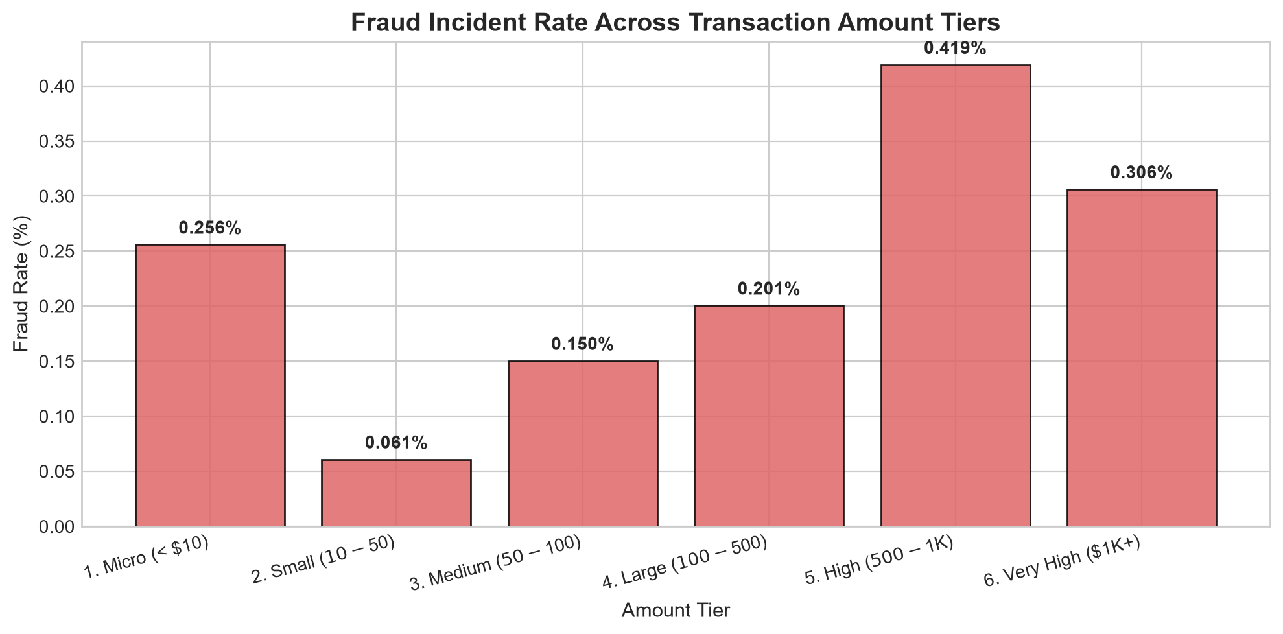
ANALYSIS & MODEL EVIDENCE
Exploratory Analysis | Fraud Rate by Transaction Amount
Transaction-value tiers reveal non-uniform fraud incidence.
TRANSACTIONAL FRAUD DETECTION ANALYSIS • ADITYA KUMAR | YASH BHANKALE | ANJALI KRISHNA
07

Slide 8
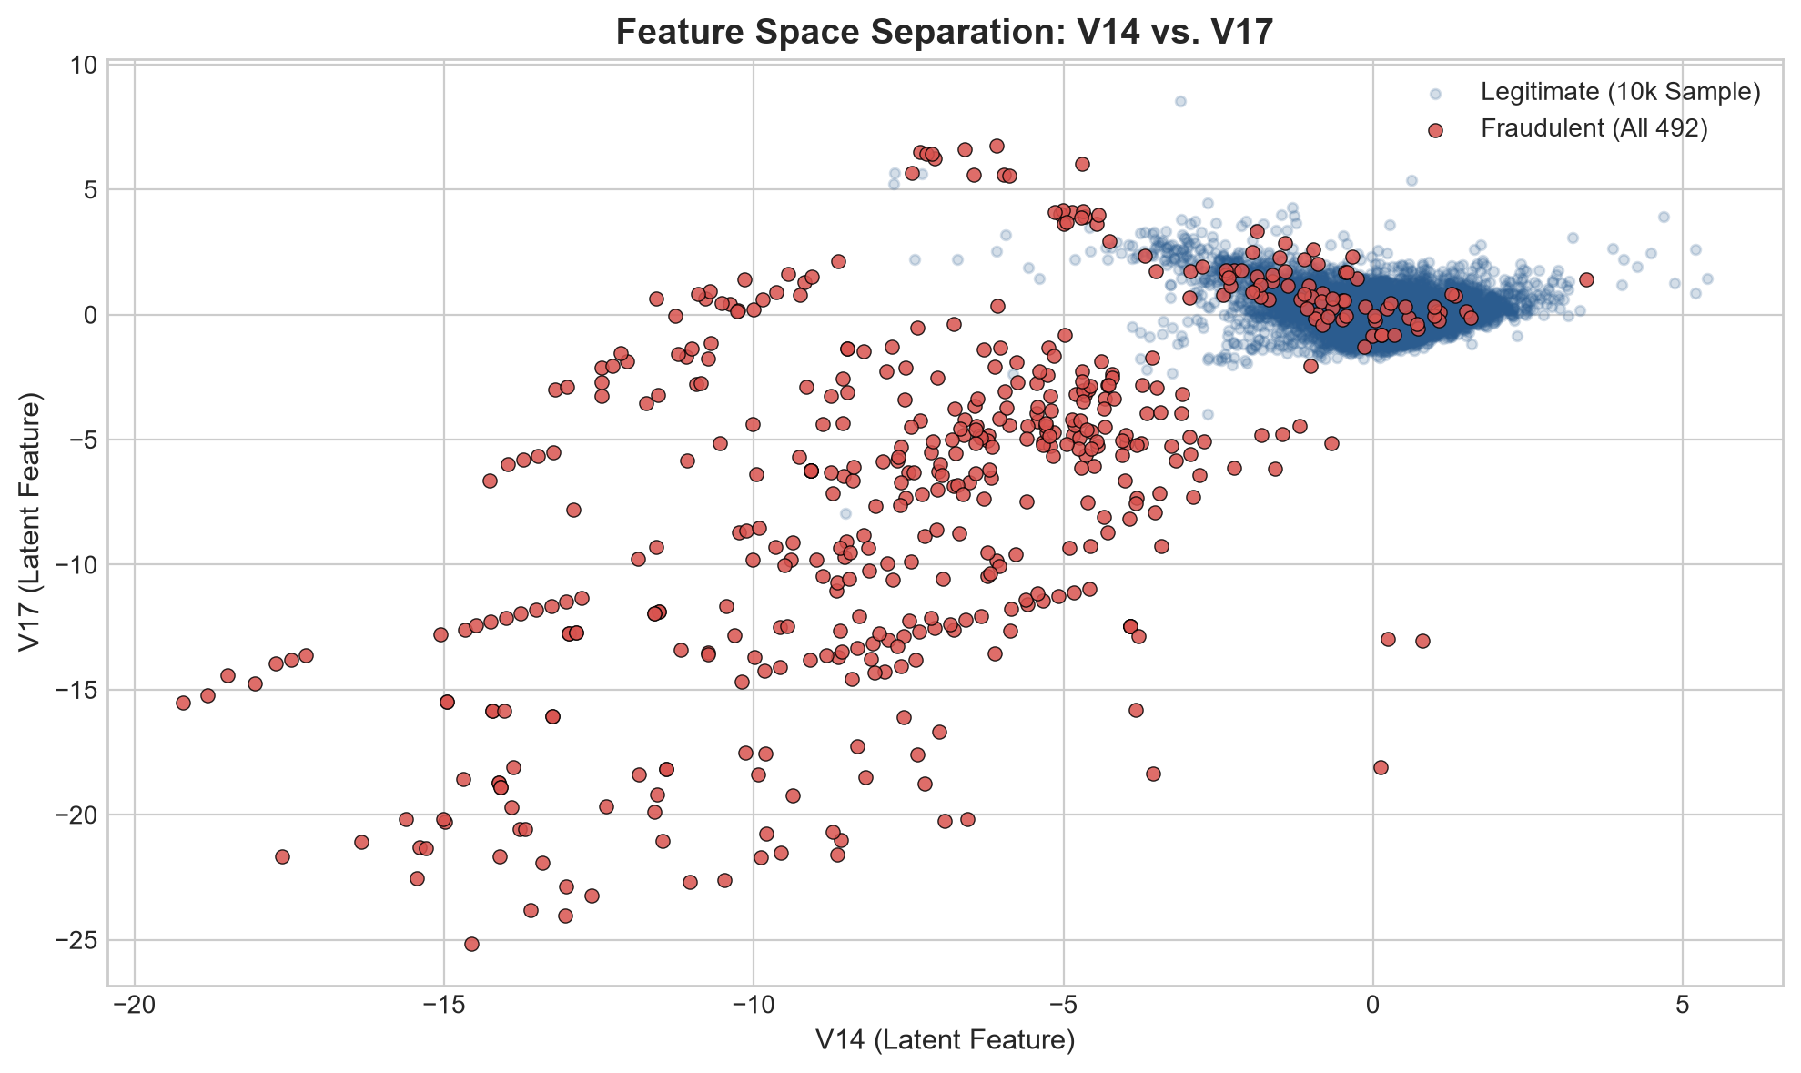
ANALYSIS & MODEL EVIDENCE
Exploratory Analysis | V14 vs. V17 Feature Space
Legitimate sample and all fraudulent observations shown.
TRANSACTIONAL FRAUD DETECTION ANALYSIS • ADITYA KUMAR | YASH BHANKALE | ANJALI KRISHNA
08

Slide 9
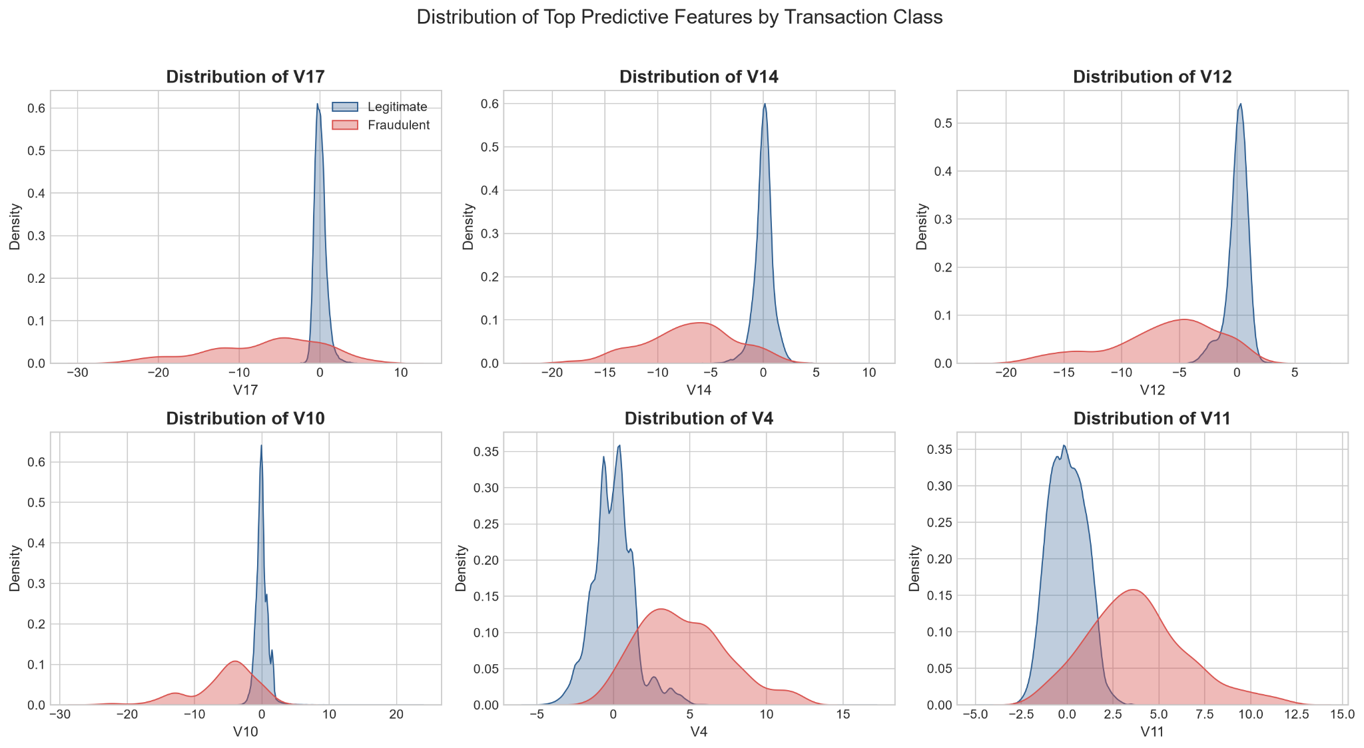
ANALYSIS & MODEL EVIDENCE
Exploratory Analysis | Predictive Feature Distributions
Class-wise distributions for the top predictive features.
TRANSACTIONAL FRAUD DETECTION ANALYSIS • ADITYA KUMAR | YASH BHANKALE | ANJALI KRISHNA
09

Slide 10
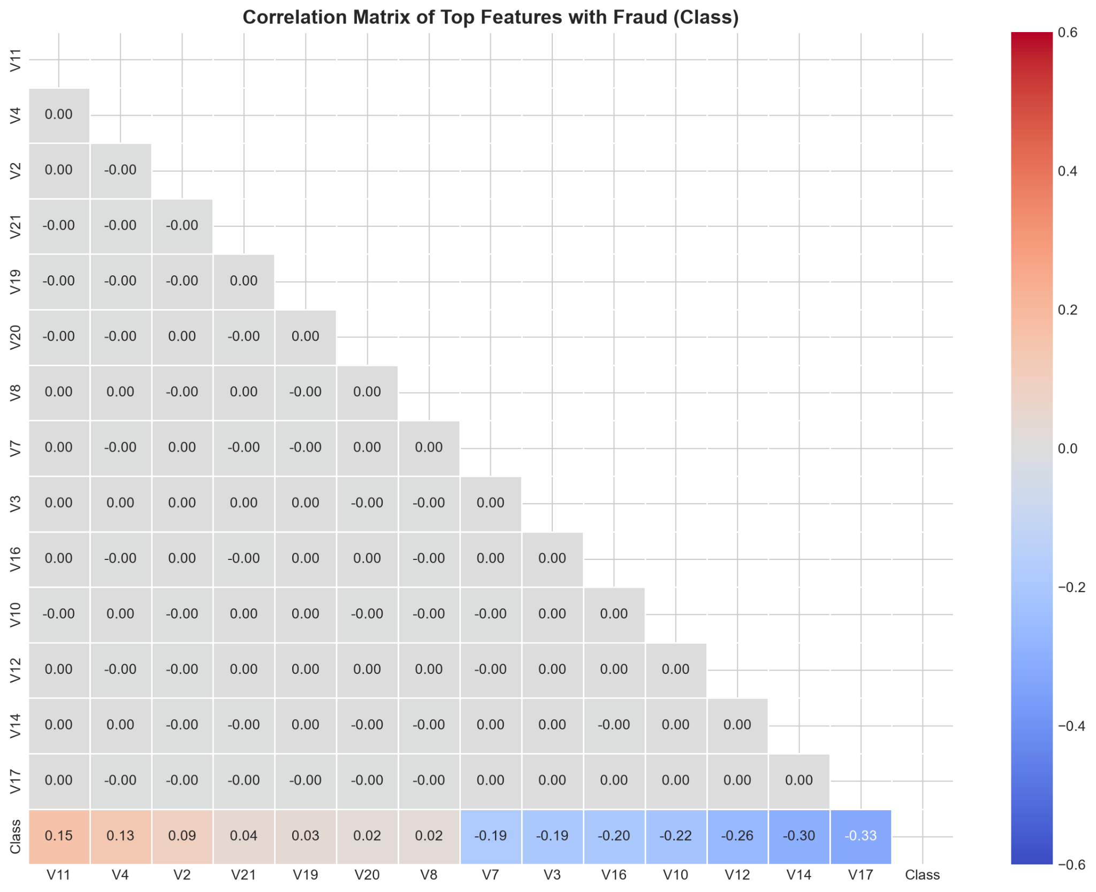
ANALYSIS & MODEL EVIDENCE
Exploratory Analysis | Correlation with Fraud Class
Correlation matrix of top features with the target class.
TRANSACTIONAL FRAUD DETECTION ANALYSIS • ADITYA KUMAR | YASH BHANKALE | ANJALI KRISHNA
10

Slide 11
06 | FEATURE ENGINEERING
Feature Engineering & Leak-Free Pipeline
Transforming Raw Temporal and Monetary Dimensions
01
Hour_of_Day Feature: Derived via (Time // 3600) % 24 to capture cyclical diurnal risk.
02
Log_Amount Feature: log1p(Amount) normalization to compress severe monetary skewness.
03
Scikit-Learn Pipeline: Integrated into unified ColumnTransformer with RobustScaler and StandardScaler.
04
Strict Featurization Order: Zero data leakage—all scalers fit exclusively on training split.
05
Customer Velocity Note: Explicitly avoided synthetic customer IDs to maintain data integrity.
TRANSACTIONAL FRAUD DETECTION ANALYSIS • ADITYA KUMAR | YASH BHANKALE | ANJALI KRISHNA
11

Slide 12
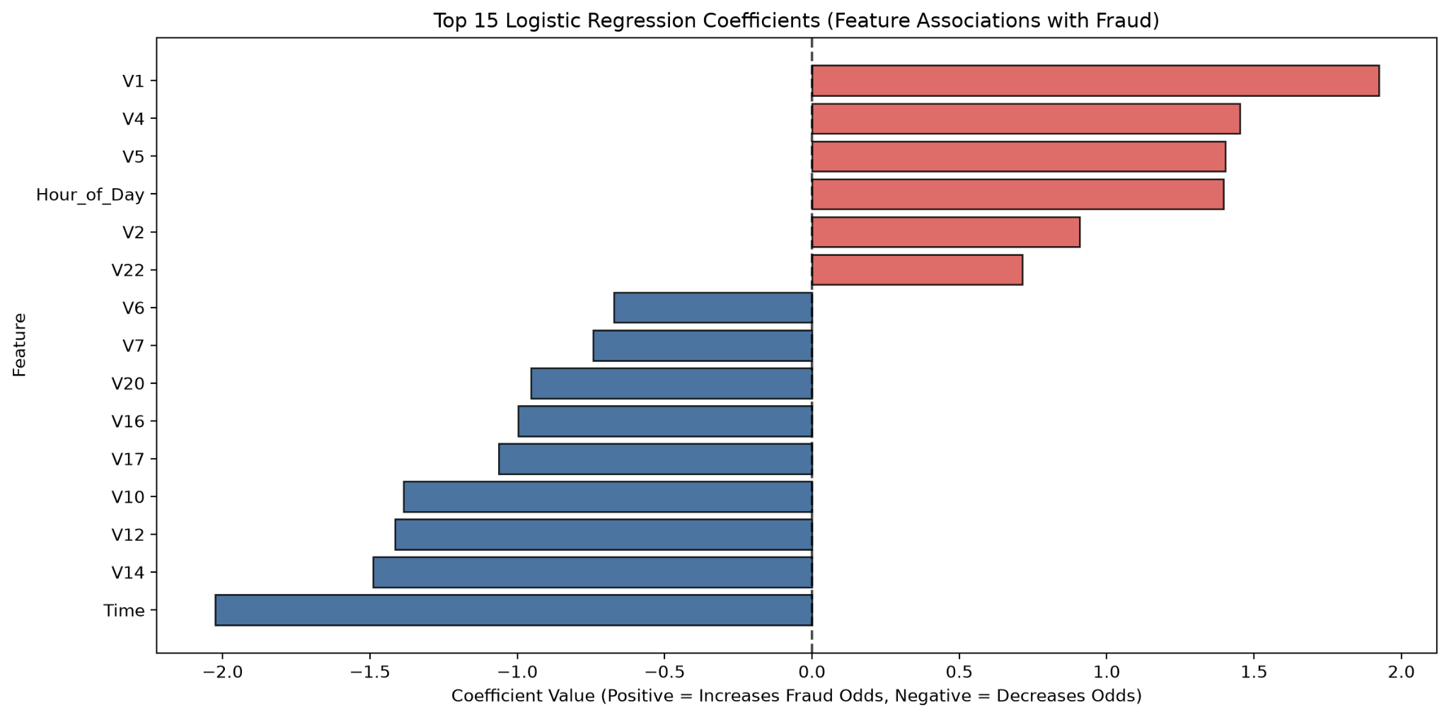
ANALYSIS & MODEL EVIDENCE
Model Interpretation | Logistic Regression Coefficients
Positive coefficients increase estimated fraud odds; negative coefficients decrease them.
TRANSACTIONAL FRAUD DETECTION ANALYSIS • ADITYA KUMAR | YASH BHANKALE | ANJALI KRISHNA
12

Slide 13
07 | MODEL BENCHMARKING
Machine Learning Model Benchmarking
Evaluating Baseline Logistic Regression vs. Comparison Random Forest
LOGISTIC REGRESSION
RANDOM FOREST
Baseline Logistic Regression: Recall: 90.82% (caught 89/98), Precision: 5.63%, False Alarms: 1,492.
Comparison Random Forest: Recall: 81.63% (caught 80/98), Precision: 75.47%, False Alarms: 26.
Test Partition: 56,962 transactions (98 true frauds) evaluated on independent test split.
PR-AUC Benchmark: Random Forest achieved 0.8433 PR-AUC vs. 0.7225 for Logistic Regression.
Operational Trade-off: Random Forest eliminates 98.3% of false alarms, saving millions in review overhead.
TRANSACTIONAL FRAUD DETECTION ANALYSIS • ADITYA KUMAR | YASH BHANKALE | ANJALI KRISHNA
13

Slide 14
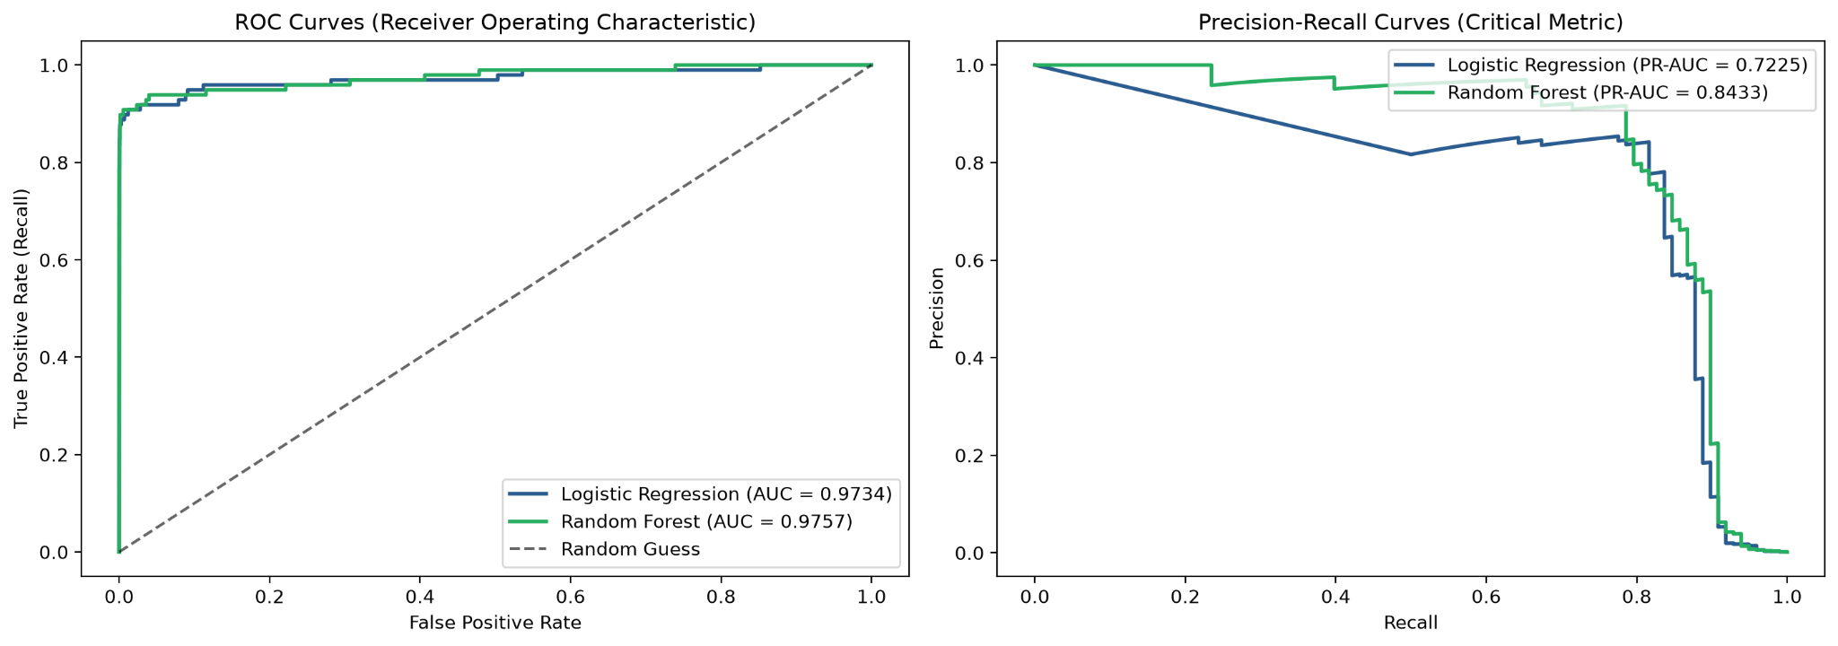
ANALYSIS & MODEL EVIDENCE
Model Evaluation | ROC and Precision–Recall Curves
ROC-AUC and PR-AUC comparison for Logistic Regression and Random Forest.
TRANSACTIONAL FRAUD DETECTION ANALYSIS • ADITYA KUMAR | YASH BHANKALE | ANJALI KRISHNA
14

Slide 15
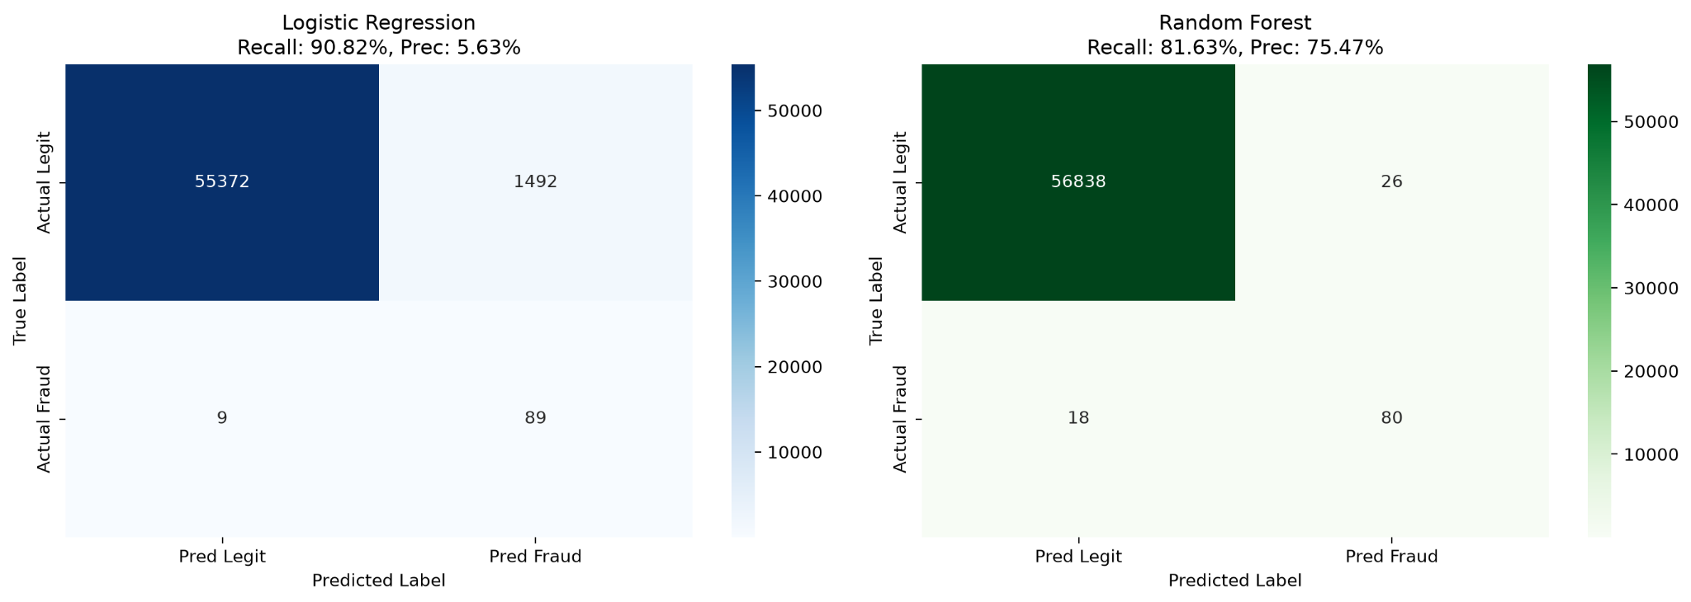
ANALYSIS & MODEL EVIDENCE
Model Evaluation | Confusion Matrices
Test-set classification outcomes at the displayed operating thresholds.
TRANSACTIONAL FRAUD DETECTION ANALYSIS • ADITYA KUMAR | YASH BHANKALE | ANJALI KRISHNA
15

Slide 16
08 | DEPLOYMENT & RECOMMENDATIONS
Interactive Dashboard & Strategic Recommendations
Deploying Analytics into Live Operations
01
Streamlit Dashboard: Multi-page UI with Executive KPIs, Transaction Explorer, and Real-Time Scoring sandbox.
02
Three-Tier Risk Matrix: Tier 1 (<30%): Auto-approve (99.5%); Tier 2 (30-70%): Step-up SMS OTP; Tier 3 (>=70%): Auto-block.
03
Dynamic Nighttime Scrutiny: Heighten threshold sensitivity between 2:00 AM and 4:00 AM for transactions >.
04
Operational Efficiency: Random Forest delivers high precision (75.5%) with only 26 false alarms across 57k transactions.
LIVE PROJECT
https://transactional-fraud-detection-analysis.streamlit.app/
TRANSACTIONAL FRAUD DETECTION ANALYSIS • ADITYA KUMAR | YASH BHANKALE | ANJALI KRISHNA
16

Slide 17
09 | CONCLUSION & NEXT STEPS
Conclusion, Quality Assurance & Future Work
Complete Delivery of Internship Milestones
01
Full Reproducibility: Master script run_project.py executes all stages end-to-end.
02
Automated Testing: 8 out of 8 pytest validation tests passing with 100% test coverage.
03
Key Competencies Demonstrated: Python, SQL/SQLite, Advanced EDA, Scikit-learn Pipelines, Streamlit UI.
04
Future Enhancements: Graph database integration for fraud ring detection and Kafka streaming integration.
TEAM | Aditya Kumar • Yash Bhankale • Anjali Krishna
https://transactional-fraud-detection-analysis.streamlit.app/
TRANSACTIONAL FRAUD DETECTION ANALYSIS • ADITYA KUMAR | YASH BHANKALE | ANJALI KRISHNA
17

