Slide 1
BROWNFIELD · SPEC-DRIVEN · ORCHESTRATED
The Brownfield Run
Changing software an agent didn't write — safely, with a full audit trail.
~/asset-tracking-dockerize — zsh
# project: Asset Decommission Approval · Spring Boot 3.2.3 / Java 17 / PostgreSQL
# task: turn an immediate soft-delete into a reviewed approval workflow
# method: archaeology → characterize → narrow change → prove (7 phase gates)
$ ./change.sh --reuse-not-replace --minimal-diff --prove-it
>>> a focused change, fully traceable, no regressions

Slide 2
FRAMING
Greenfield proved you can build.
Brownfield asks the harder question: can an agent safely change what it didn't write?
GREENFIELD
BROWNFIELD
Build a new app from a spec pack.
Make one change to a working app.
The risk is capability — can we build it?
Nothing exists to break. The spec flows forward into code.
The risk is hidden regressions — breaking what already works.
You must understand and characterize first.
Same discipline. Inverted risk. The spec governs what should be true after — the code wins on what's true today.

Slide 3
OVERVIEW
What we'll cover
§1
The Brownfield Workflow
§2
Archaeology
The fixed order, the five rules, and the audit layer that kept every change traceable.
Phase 0 — knowing the repo before touching it. Surfacing surprises, not coding around them.
§3
The Change
§4
Proof
One narrow, well-evidenced change that reuses the existing soft-delete instead of replacing it.
Characterization before, regression after. Full requirement-to-evidence traceability.

Slide 4
§1 · The Brownfield Workflow
§1
The Brownfield Workflow
Understand before you change. Characterize before you touch. Prove nothing else broke.

Slide 5
§1 · The Workflow
1 / 5
The fixed order — left to right, no skipping
You may loop back, but you never write business logic before the characterization tests are green.
1
2
3
4
5
6
Archaeology
→
Docker baseline
→
Characterization
→
Impact map
→
Narrow change
→
Regression
know
reproduce
lock current
plan
do
prove
CLAUDE.md §2 · the non-negotiable
"You may not modify business logic until the current behaviour is captured as a
passing, repeatable check. Docker baseline → characterization → impact map →
change → regression."
A change you cannot prove was safe is not done.

Slide 6
§1 · The Workflow
2 / 5
Five rules that made it safe
1
Read before you write.
docs/01, 02, 07 before any code; each phase re-read before it starts.
2
Characterize before you change.
Lock current behaviour as passing tests (C-01..05) before touching logic.
3
Reuse, don't replace.
Approval triggers the existing @SQLDelete soft-delete — not a new delete path.
4
Minimal diffs.
Add new classes/templates. No renames, reformatting, or dependency bumps.
5
Phase gates.
Stop at each of 7 phases, summarize, wait for human approval before continuing.

Slide 7
§1 · The Workflow
3 / 5
The audit layer — a living wiki
A separate Dev-Wiki agent owns wiki/ and never touches the code it documents. Updated at every phase gate.
wiki/
├ WIKI_SCHEMA.md how the wiki works
├ overview.md phase tracker
├ glossary.md soft-delete, pending…
├ log.md every ingest + lint
├ features/ crud, request, approve
├ components/ controllers, service…
├ data-models/ asset, request
└ decisions/ ADR-001 … ADR-007
31 pages · 7 ADRs · per-phase log
Independent
A separate agent owns the wiki — it documents the code, never edits it.
Traceable
Every page cites the spec doc, requirement ID, or ticket it came from.
Verified
Each phase a code-drift lint greps the real source. Drift is surfaced, never overwritten.

Slide 8
§1 · The Workflow
4 / 5
Every change is traceable
Commit → Phase gate → Requirement / spec ID → ADR + wiki → Test / lint.
Commit
→
Phase
→
Requirement
→
ADR + wiki
→
Test
191e07b
Gate 4
FA-05
ADR-001
N-03 ✓
wiki/log.md · excerpt
## [2026-06-02] ingest | Phase 4 (data & service) — DecommissionService
approve() reuses soft-delete (deleteById → @SQLDelete); N-01..N-07 green.
## [2026-06-02] lint | Phase 4 code-drift check
entity fields ↔ DecommissionRequest.java — match. service API ↔ code — match.
generated DDL matches entity. Tests: 13 green. Links clean. NO DRIFT.

Slide 9
§1 · The Workflow
5 / 5
Before the change — three numbers
What 'understand first' actually cost, and bought.
5
0
2
characterization tests green BEFORE any logic changed
structural changes to the Asset entity
ungated delete paths found — both closed
Next: §2 · Archaeology — knowing the repo before touching it.

Slide 10
§2 · Archaeology
§2
Archaeology
Phase 0 — produce a real map of the repo, verify the spec against the code, and surface what you can't answer.

Slide 11
§2 · Archaeology
1 / 2
Know it before you touch it
Phase 0 produced evidence from the real tree — no Docker, no business code yet.
repo-map.md
Every controller, endpoint, entity, repository, template — from the actual tree, not the spec.
as-is-behaviour.md
Current login / list / add / PATCH / delete behaviour, each verified and tied to a check.
archaeology-questions.md
The open questions the code can't answer — captured, not guessed.
Honesty on record: the original source repo was unreachable, so the baseline was reconstructed faithfully from docs/02 — recorded as ADR-007, flagged for reconciliation if the original appears.

Slide 12
§2 · Archaeology
2 / 2
Surface surprises — don't code around them
A finding the spec left open: how many ways can an asset actually be soft-deleted?
as-is finding · two delete paths
GET /assets-ui/delete/{id} AssetUIController ← the UI 'Delete' button uses this
DELETE /assets/{id} AssetController ← REST path, NOT referenced by any UI/JS
@SQLDelete → UPDATE assets SET is_deleted = true (both paths trigger this)
@SQLRestriction('is_deleted = false') → soft-deleted rows vanish from every read
The judgement call
Leaving a second, ungated path to soft-delete would let approval be bypassed. Recorded as ADR-004 and seeded into the impact map — to be resolved in code, not quietly ignored.

Slide 13
§3 · The Change
§3
The Change
One narrow, well-evidenced change that reuses the existing soft-delete instead of replacing it.

Slide 14
§3 · The Change
1 / 4
The change in one sentence
Clicking Delete used to soft-delete instantly. Now it creates a pending request an approver must approve or reject — with a full audit trail.
BEFORE
AFTER
Delete → immediate soft-delete
Asset vanishes from the dashboard.
No reason.
No approver.
No record of who or why.
Request Decommission (+reason)
→ PENDING; asset stays active, badge shown
Approve → reuses soft-delete; APPROVED
Reject → asset stays active; REJECTED
Every decision audited: who · when · why ·
decider · outcome · comment.

Slide 15
§3 · The Change
2 / 4
Impact map — minimal diff, planned first
Prefer adding new classes over editing many. All logic in one new service.
NEW (6)
EDITED (3)
DecommissionRequest entity
DecommissionStatus enum
DecommissionRequestRepository
DecommissionService (all rules)
DecommissionUIController
decommissions.html (approver view)
assets.html Delete → Request + badge
AssetUIController pending ids; retire route
AssetController REST DELETE → 405
Untouched: Asset entity, PATCH edit,
security, dependency versions.
Three decisions, recorded:
assetId as plain Long (ADR-002, history survives soft-delete) · pending derived from a PENDING request (ADR-003) · REST DELETE neutralized (ADR-004)

Slide 16
§3 · The Change
3 / 4
Reuse, don't replace — the one constraint
Approval ends up calling the existing soft-delete. No new UPDATE; no physical delete.
DecommissionService.approve(requestId, approver, comment)
req.setStatus(APPROVED); req.setDecidedBy(approver); req.setDecidedAt(now);
requestRepository.save(req);
assetRepository.deleteById(req.getAssetId()); // ← reuses the existing mechanism
@SQLDelete("UPDATE assets SET is_deleted = true WHERE id = ?") // entity-level, untouched
ADR-001 · the most important constraint
'Decommission' is the existing soft-delete — now gated behind approval. The characterization tests that locked that behaviour (C-01/C-02) keep covering it after the change.

Slide 17
§3 · The Change
4 / 4
Loose ends, named and closed
Brownfield judgement and environment surprises — handled without touching the deliverable.
# the second delete path (ADR-004)
AssetController DELETE /assets/{id} → 405 Method Not Allowed (no soft-delete)
UI GET /assets-ui/delete/{id} → removed (404)
⇒ after the change, NO ungated path to soft-delete remains.
# environment surprises (sandbox only — committed files unchanged)
TLS-intercepting proxy broke in-container Maven → trusted host CA in a tagged base image
Docker Engine 29 rejected docker-java API 1.32 → pinned api.version=1.44 (tests only)
Surfaced, diagnosed, and fixed in the open — the deliverable Dockerfile and compose files were never compromised.

Slide 18
§4 · Proof
§4
Proof
Characterization before, regression after, and every requirement mapped to evidence.

Slide 19
§4 · Proof
1 / 4
The safety net — tests as the contract
Characterization (C) passed BEFORE the change; new behaviour (N) after. Real Postgres, real soft-delete.
CHARACTERIZATION · before
NEW BEHAVIOUR · after
C-01 soft-delete hides, not removes
C-02 @SQLRestriction filters reads
C-03 PATCH partial update intact
C-04 create + list
C-05 auth gate
→ green on UNCHANGED code first
N-01..02 request / reason required
N-03..04 approve / reject
N-05..06 duplicate / soft-deleted guards
N-07 audit + history (FA-09)
N-08 dashboard pending badge
+ REST-405 · history-of-deleted
19 tests · 0 failures · 0 errors — Testcontainers PostgreSQL for true @SQLDelete fidelity (not H2). Characterization never went red.

Slide 20
§4 · Proof
2 / 4
Live regression in Docker — T-01..T-09
Run against the committed `docker compose up --build`. All pass.
T-01
up --build → app+db start (db-healthy gate)
✓
T-02
login admin/admin123
✓
T-03
create asset → appears
✓
9 / 9
T-04
PATCH partial update intact
✓
T-05
request → PENDING, NOT soft-deleted
✓
T-checks pass
T-06
reject → REJECTED, asset active
✓
before/after demo recorded
T-07
approve → APPROVED, soft-deleted
✓
T-08
duplicate pending → blocked
✓
T-09
down -v → DB cleared
✓

Slide 21
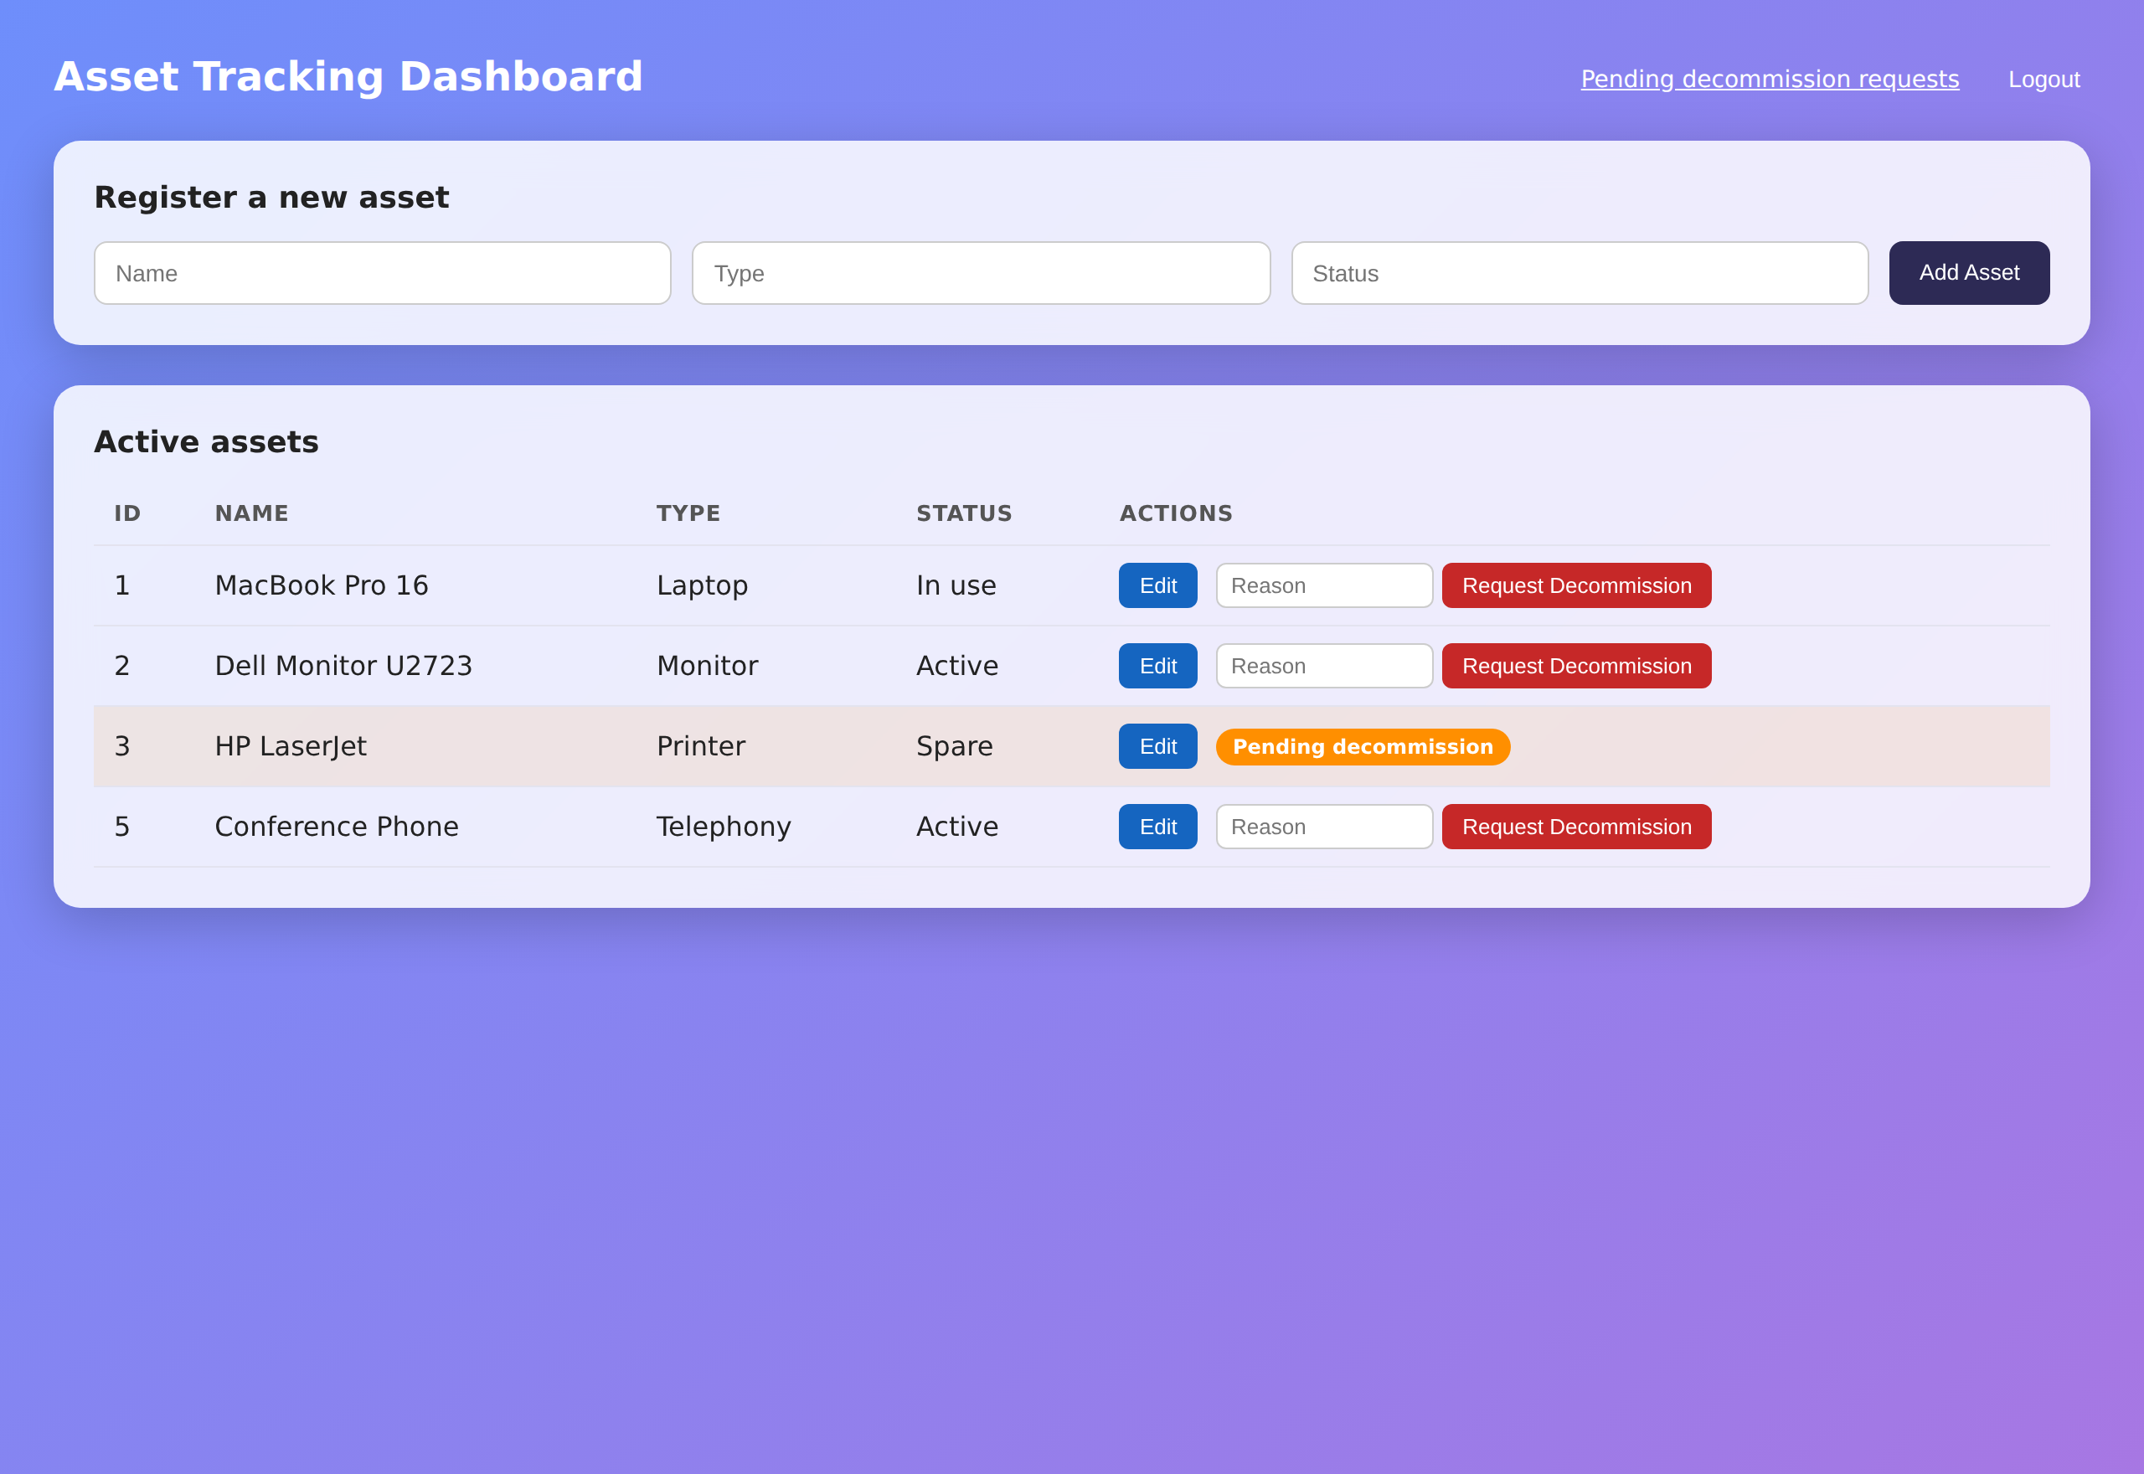
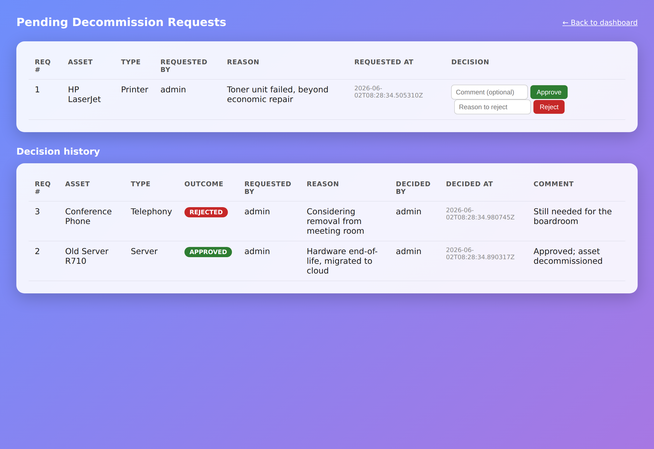
§4 · Proof
3 / 4
Evidence you can see — the running app
Captured from the live Dockerized app (headless Chromium).
Dashboard — pending badge + Request Decommission
Approver view — approve/reject + decision history (incl. soft-deleted)

Slide 22
§4 · Proof
4 / 4
Receipts
Locked at the final gate.
7
19
9/9
9/9
phase gates · all approved
tests · 0 fail / 0 error
success criteria (G-1..9) met
regression checks (T-01..09)
0
1
0
7
characterization regressions
new entity · Asset unchanged
ungated soft-delete paths left
artifacts + a 31-page wiki
Every requirement → evidence: artifacts/requirements-traceability.md

Slide 23
CLOSING
Same engine, adapted for brownfield
What carried over from the greenfield workflow — and what the brownfield risk demanded.
Spec pack precedes code
✓ carried over
Plus: verify the spec against the real code (it wins on 'today').
Living wiki + ADRs + lint
✓ carried over
Same independent agent; code-drift lint each phase gate.
Tests as the contract
adapted
Characterization FIRST — lock current behaviour before changing.
Phase gates / approval
adapted
7 gates; 'no logic before characterization is green'.
Smallest change wins
intensified
Reuse over rebuild; minimal diffs; one new service.
Traceability to evidence
✓ carried over
Requirement → code → test → live → doc, all mapped.

Slide 24
CLOSING
What this unlocks for brownfield work
Where the same approach pays off on code you already own.
Legacy modernization
Safe refactors
Wrap an old service in Docker + characterization tests, then change it with a net.
Lock behaviour as tests first; let drift checks catch anything you didn't intend.
Risky feature changes
Audit & compliance
Plan with an impact map; reuse existing mechanisms instead of rebuilding.
A living wiki + requirement-to-evidence matrix makes 'prove it' a one-pager.
Stop hand-editing legacy code. Start directing a safe, evidenced change.

Slide 25
Spec on top.
Characterization underneath.
A narrow change in between.
$ git clone -b claude/jolly-albattani-ZVz7K …/Asset-Tracking-Dockerize.git
$ mvn test # 19 green · Testcontainers Postgres
$ docker compose up --build # http://localhost:8080 (admin / admin123)

Slide 26
APPENDIX · artifacts/requirements-traceability.md
Requirement → evidence, every family ✓
The one page a reviewer reads to confirm done. All IDs mapped to code, test, live check, and doc.
G-1..G-9
Success criteria
live T-01..09 · N-tests · artifacts
✓
EB-01..06
Preserved behaviour
C-03/04/05 · live · untouched code
✓
FA-01..09
Functional reqs
N-01..08 · DecommissionService
✓
V-01..06
Validation rules
N-02/04/05/06 · guards
✓
UI-01..06
UI requirements
assets.html · decommissions.html · N-08
✓
DOCK-01..06
Dockerization
Dockerfile · compose · live T-01/T-09
✓

