Slide 1

CS60050: Machine Learning Term Project
Colorization of Grayscale Images
Team Name: SkyNet
Area: Computer Generated Art

Slide 2
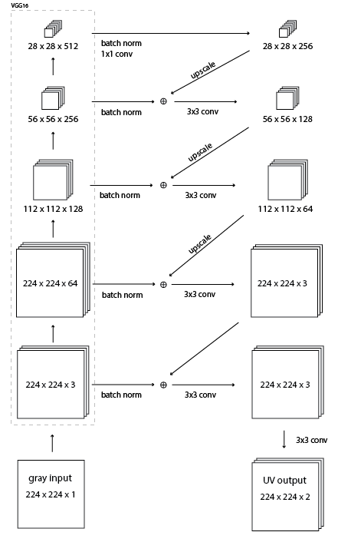

Slide 3
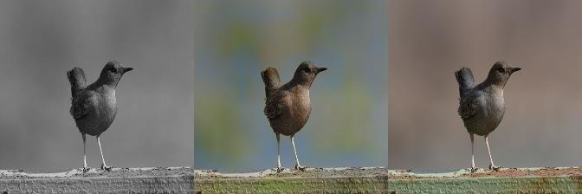
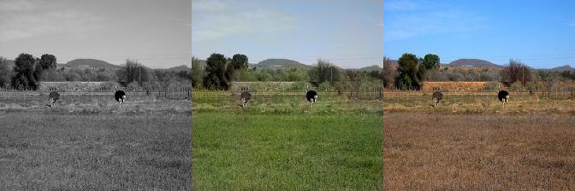
While our model seems to color these images pretty accurately

Slide 4
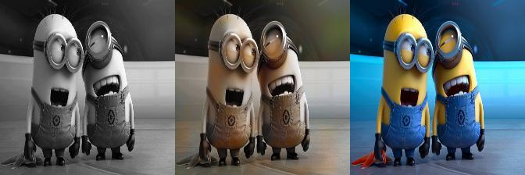
It had a hard time coloring these minions

Slide 5
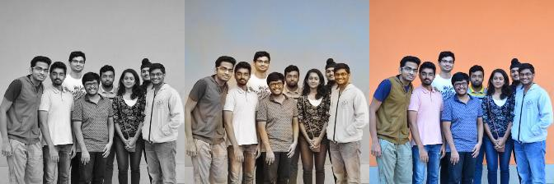
Thank You!
Website
https://cs60050.github.io/SkyNet/website/
Notes:
‹#›

