Slide 1
PALM PRINT RECOGNISATION
BY IMAGE PROCESSING
Submitted by
A.Nikhita
P.Vaishnavi Raman
M.Sirisha

Slide 2
INTRODUCTION :-
Today, in our daily life, we are often being asked for verification of our identity. Normally, this is done through the use of passwords when pursuing activities like domain accesses, single sign-on, application logon etc. In the process, the role of personal identification and verification becomes increasingly important in our society. With the onslaught of improved forgery and identity impersonation methods, previous ways of correct authentication are not sufficient. Therefore, new ways of efficiently proving the authenticity of an identity at a low cost are greatly needed. Various avenues have been explored to provide a solution and biometric-based identification is proved to be an accurate and efficient answer to the problem.
NEED FOR PALMPRINT TECHNOLOGY :-
Palmprint is preferred compared to other methods such as fingerprint or iris because it is distinctive, easily captured by low resolution devices as well as contains additional features such as principal lines.
Compared with face recognition palmprint is hardly affected by age and accessories.

Slide 3
Compared with fingerprint recognition palmprint images contain more information
and needs only low resolution image capturing devices which reduces the cost of the
system
Compared with iris recognition the palmprint images can be captured without
intrusiveness as people might fear of adverse effects on their eyes and cost effective.
Stored
Templates
Enrolment
Pre-processing
Feature
Extractor
Template
Generator
Test
Matcher
Sensors
Application
Device
General block diagram of biometric system

Slide 4
PRE-PROCESSING :-
Image Enhancement :- 1.SMQT
2.Histogram Equalisation
SMQT:- (Successive Mean Quantization Transform)
The basic unit of the SMQT is the MQU (Mean Quantization unit),
which consists in calculating the mean value of all the pixels in the image,
then the mean is used to quantize the value of data into 0 or 1, depending
if the value of the pixel is lower or higher than the mean. After doing this,
the input is splitted in two.
Code :-
function A = algh_a(RGBimage, n)
[row, column, d] = size(RGBimage);
%We get the size of the image
if (d==3)
%if the image has 3 dimensions, it's an rgb image
HSVimage = rgb2hsv(RGBimage);
%Transform from RGB to HSV
V = HSVimage(:,:,3);
%Get the component V (brightness) else
%if the image has 1 dimension, it is a gray-scale image

Slide 5
V =double(RGBimage)/255;
%In this case, we don't need to transform end
V=V(:);
%The matrix of brightness is now a vertical vector
[Vsorted, ix] = sort(V);
%Sorting the vector
s = (row*column)/n;
%size of the intervals
i=0;
%initializing i
h=[];
%initialaizing h
% now, there is a loop to process every interval
while (i < n)
i=i+1;
int = Vsorted(((floor(s*(i-1))+1)):floor(s*i));
%we define the interval
Vstart = (s*(i-1))/(row*column);
%We define the start and the end of the interval
Vstop = (s*i)/(row*column);
%linear transform for each segment
r=int-int(1);
f = (1/n)/(r(size(r,1)));
g = r*f;

Slide 6
if(isnan(g(1)))
g = r + Vstop;
else
g = g + Vstart;
end
h=vertcat(h,g);
%Bulding the transformed vector
end
m(ix)=h;
%We "reverse the sorting" of the vector, with the transformed values
m=m(:);
if(d==3)
%resizing the vector into a matrix and assigning the new V component
HSVimage(:,:,3) = reshape(m,row,column);
A=hsv2rgb(HSVimage);
else
A=reshape(m,row,column);
end
return;
end

Slide 7
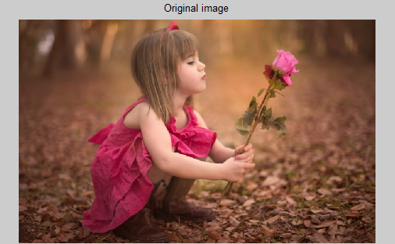
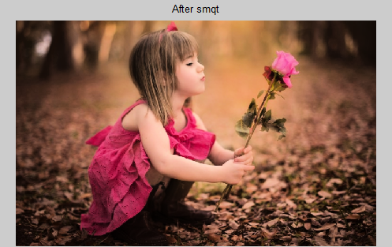

Slide 8
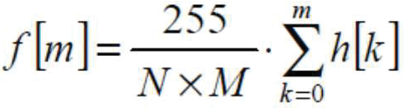
HISTOGRAM EQUALISATION :-
The histogram may be interpreted as a probability density function.
However, an image is a discrete function, then the cumulative distribution function is applied, so the accumulated histogram is obtained using the following approach.
Once the original histogram is known, the values of the pixels are changed, based on the original probability, so now all values are spread over the histogram.
Code :-
Input=imread('girl.jpg');
% function Output = alg_h(Input)
% To know number of row and column (total number of pixels)
[row, column, d] = size(Input);
i=0;
while(i<d) %note that the loop is for using with RGB images
i=i+1;
% Calculate of the histogram
histo=imhist(Input(:,:,i));

Slide 9
% Convert Input in double
Input(:,:,i) = double (Input(:,:,i));
% Calculate probability of grey level pixel
probability=histo./(row*column);
% Accumulated probability and weights
equalizer = cumsum(probability)*256;
%Replace grey level pixels in function of equalizer
Output(:,:,i)=equalizer(Input(:,:,i)+1);
end
%Convert to 8 bits unsigned intiger data
Input = uint8(Input); Output = uint8(Output);
[y1,x]=imhist(Input(:,:,1)); [y2,x]=imhist(Input(:,:,2)); [y3,x]=imhist(Input(:,:,3));
plot(x,y1,'r', x,y2,'g', x,y3,'b');
figure;
[y4,x]=imhist(Output(:,:,1)); [y5,x]=imhist(Output(:,:,2)); [y6,x]=imhist(Output(:,:,3));
plot(x,y4,'r', x,y5,'g', x,y6,'b');
figure;subplot(1,2,1);
imshow(Input);title('Original image');
subplot(1,2,2);imshow(Output);title('After histogram equalisation');
% end

Slide 10
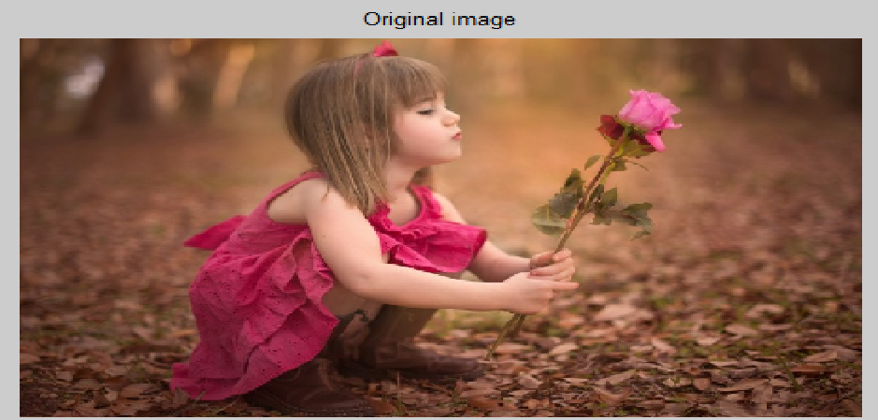
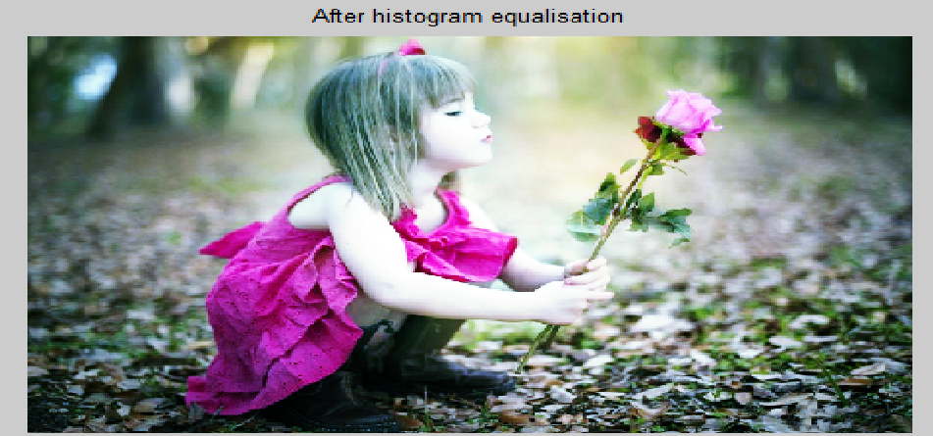

Slide 11
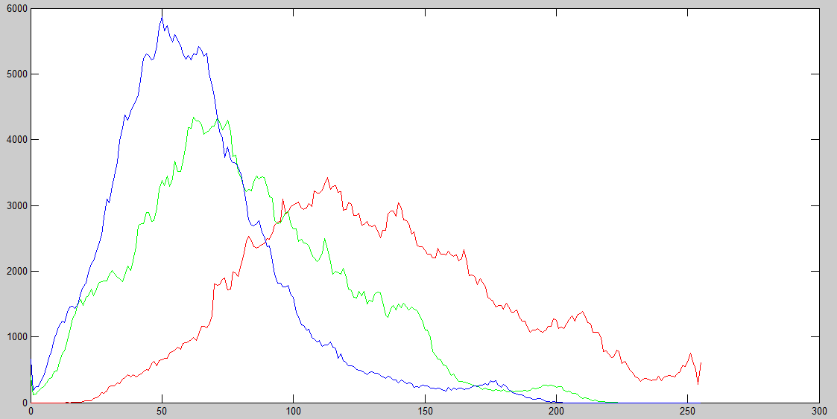
Histogram of Original Image

Slide 12
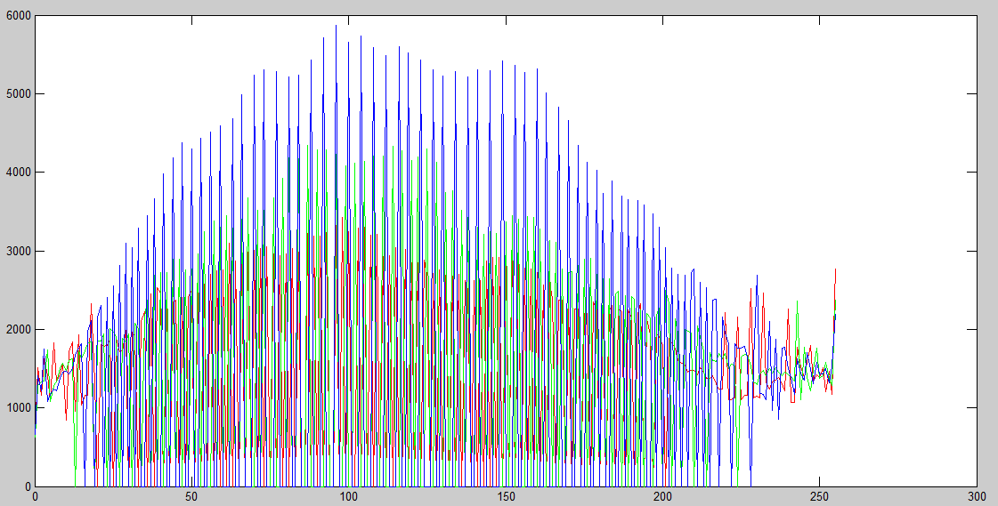
Histogram of image after histogram equalisation

Slide 13
FEATURE EXTRACTION :- (Edge Detection)
The points at which image brightness changes sharply are typically organized into a set of
curved line segments termed edges.
Discontinuities in image brightness are likely to correspond to:
discontinuities in depth,
discontinuities in surface orientation,
changes in material properties and
variations in scene illumination.
Horizontal Edge Detection :-
We detect horizontal edges by differencing vertically adjacent points
Code :-
function horizontal_edges=edge_y(image)
%Find edges by vertical differencing
%Usage: [new image]=edge(image)
%Parameters: image-array of points
%%get dimensions
[rows, cols]=size (image);
%set the output image to black

Slide 14
horizontal_edges=zeros(rows,cols);
%then form the difference between vertical successive points
for x=1:cols
%address all columns
for y=1:rows-1
%address all rows except border
horizontal_edges (y,x)= abs(image(y, x)-image(y+1,x));
end
end
Vertical Edge Detection :-
We detect vertical edges by differencing horizontally adjacent points .
Code :-
function vertical_edges=edge_x (image)
%Find edges by horizontal differencing
%Usage: [new image]=edge_x (image)
%Parameters: image-array of points
%%get dimensions
[rows, cols]=size (image);
%set the output image to black
vertical_edges=zeros (rows, cols);

Slide 15
%this is equivalent to
vertical_edges (1:rows, 1:cols)= 0
%then form the difference between horizontal successive points
for x=1: cols-1
%address all columns except border
for y=1: rows
%address all rows
vertical_edges (y,x)= abs (image (y, x)-image (y, x+1));
end
end
Overall Edge Detection :-
function edges=edge(image)
%Find all edges by first order differencing %Usage: [new image]=edge(image)
%Parameters: image-array of points %get dimensions
[rows, cols]=size (image); %set the output image to black
edges=zeros (rows, cols);
%then form the difference between horizontal and vertical points
for x=1: cols-1 %address all columns
for y=1: rows-1 %address all rows except border
edges (y,x)=abs(2*image(y,x)- image (y+1, x)-image (y, x+1));
end
end

Slide 16
Edge Detection by Prewitt Operator :-
function edges=prewitt(image)
%derive edges by 3*3 Prewitt operator
%Usage: [new image]=prewitt(image)
%Parameters: image-array of points
%get dimensions
[rows, cols]=size(image);
%set the output image to black(0)
edges(1: rows,1:cols)=0;
for x=2: cols-1
%address all columns except border
for y=2: rows-1
%address all rows except border
%apply Mx template
x_mag=image (y-1, x-1)+image(y-1,x)...
+image(y-1, x+1)-image(y+1,x-1)-...
image(y+1, x)-image(y+1, x+1);
%apply My template
y_mag=image(y-1,x-1)+image(y,x-1)...
+image(y+1,x-1)-image(y-1, x+1)-...
image(y,x+1)-image(y+1,x+1);
%evaluate edge magnitude

Slide 17
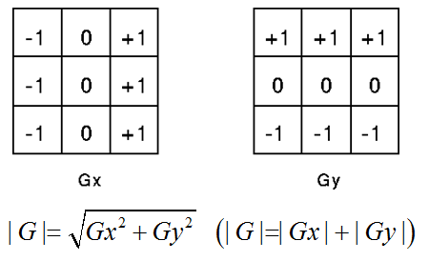
edges(y,x,1)=sqrt((x_mag*x_mag)+(y_mag*y_mag));
%evaluate edge direction
if x_mag==0
edges(y,x,2)=sign(y_mag)*1.5708;
else edges(y,x,2)=atan(y_mag/x_mag);
end
end
end
Edge detection with Prewitt operator
Gx – x filter
Gy – y filter

Slide 18
Edge Detection by Sobel operator:-
function edges=sobel33(image)
%derive edges by 3*3 Sobel operator
% Usage: [new image]=sobel33(image)
% Parameters: image-array of points
%get dimensions
[rows, cols]=size(image);
%set the output image to black(0)
edges (1:rows, 1:cols)= 0;
%it’s like Prewitt, but the central weights are doubled
for x=2:cols-1
%address all columns except border
for y=2: rows-1
%address all rows except border
%apply Mx template
x_mag=image(y-1, x-1)+2*image(y-1,x)...
+image(y+1, x-1)-image(y+1,x-1)-...
2*image(y+1, x)-image(y+1, x+1);
%apply My template
y_mag=image(y-1,x-1)+image(y,x-1)...
+image(y+1,x-1)-image(y-1, x+1)-...
2*image(y,x+1)-image(y+1,x+1);
%evaluate edge magnitude

Slide 19
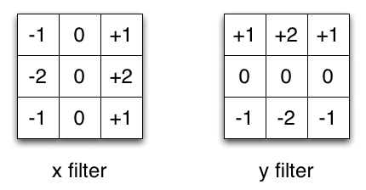
edges(y,x,1)=sqrt((x_mag*x_mag)+(y_mag*y_mag));
%evaluate edge direction
if x_mag==0
edges(y,x,2)=sign(y_mag)*1.5708;
else edges(y,x,2)=atan(y_mag/x_mag);
end
end
end
Edge detection with Sobel operator

Slide 20
FEATURE EXTRACTION CODE:-
I= imread('girl.jpg‘);
subplot(1,2,1);
imshow(I);title('Original image');
K=rgb2gray(I);
%images are stored as integers, so we need to double them for Matlab
%we also need to ensure we have a greyscale, not three colour planes
sample=double(K(:,:,:));
%so let’s display it
subplot(1,2,2), imagesc(sample);
plotedit on, title ('Image of sample'), plotedit off
pause;
disp(' ')
disp ('We detect vertical edges by differencing horizontally adjacent')
disp ('points. Note how clearly the edge of the face appears')
%so we’ll call the edge_x operator.
vertical=edge_x(sample);
imagesc(vertical);
plotedit on, title ('Vertical edges of sample'), plotedit off
pause;

Slide 21
disp (' ')
disp ('We detect horizontal edges by differencing vertically adjacent points')
disp ('Notice how the side of the face now disappears, wheras the')
disp ('eyebrows appear')
%so we’ll call the edge_y operator
figure;
horizontal=edge_y(sample);figure;
subplot(1,2,1), imagesc(horizontal);
plotedit on, title ('Horizontal edges of sample'), plotedit off
subplot(1,2,2), imagesc(vertical);
plotedit on, title ('Vertical edges of sample'), plotedit off
pause;
disp (' ')
disp ('We detect all edges by combining the vertical and horizontaledges')
%so we’ll call the edge operator
all_edges=edge(sample);
subplot(1,2,1), imagesc(all_edges);
plotedit on, title ('All edges of sample'), plotedit off
pause;
disp (' ')
disp ('The Prewitt operator includes smoothing in horizontal and vertical')

Slide 22
disp ('templates')
prewitt_edges=prewitt(sample);
disp ('From these, we calculate the magnitude and direction. The magnitude')
disp ('shows the amount of contrast, as revealed by its image')
pmagnitude=prewitt_edges(:,:,1);
subplot (1,2,2), imagesc(pmagnitude);
plotedit on, title ('Magnitude of sample edges by Prewitt operator'),
plotedit off
direction=prewitt_edges(:,:,2);
imagesc(direction);
plotedit on, title ('Direction of eye edges by Prewitt operator'),
plotedit off
pause;
disp (' ')
disp ('The Sobel operator includes better smoothing than the Prewitt')
disp ('operator.It is harder to see here, but is gereally experienced')
sobel_edges=sobel33(sample);
disp ('Again, we calculate the magnitude and direction. Again, The')
disp ('magnitude shows the amount of contrast, as shown in the image')
disp ('for a 3*3 Sobel operator.')
smagnitude=sobel_edges(:,:,1);
figure;

Slide 23
subplot(1,2,1), imagesc(smagnitude);
plotedit on, title ('Magnitude of sample edges by Sobel'), plotedit off
subplot(1,2,2), imagesc(pmagnitude);
plotedit on, title ('Magnitude of sample edges by Prewitt'), plotedit off
pause;

Slide 24
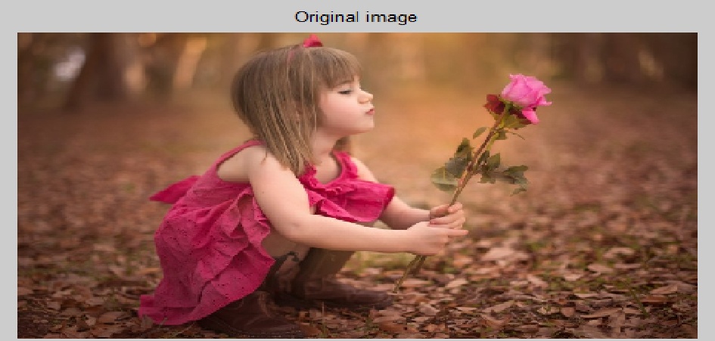
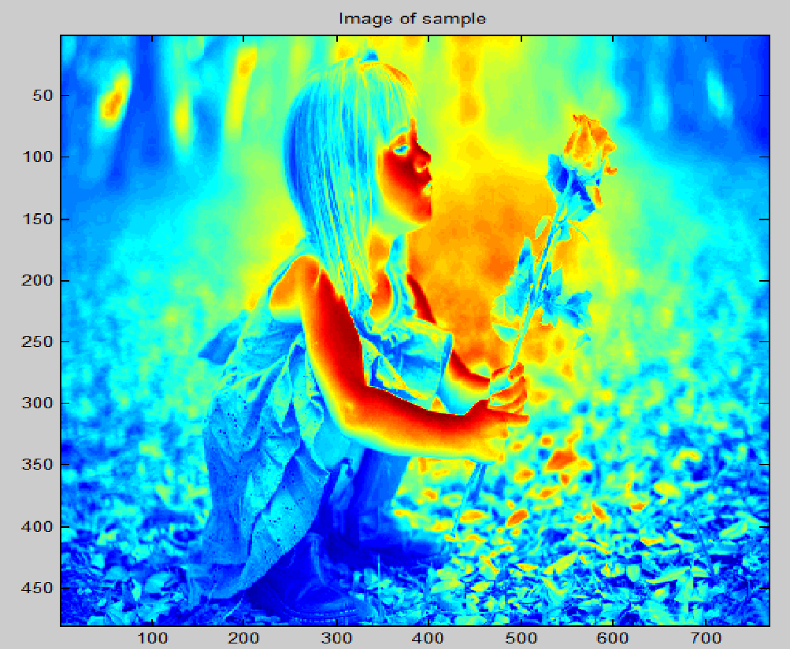

Slide 25
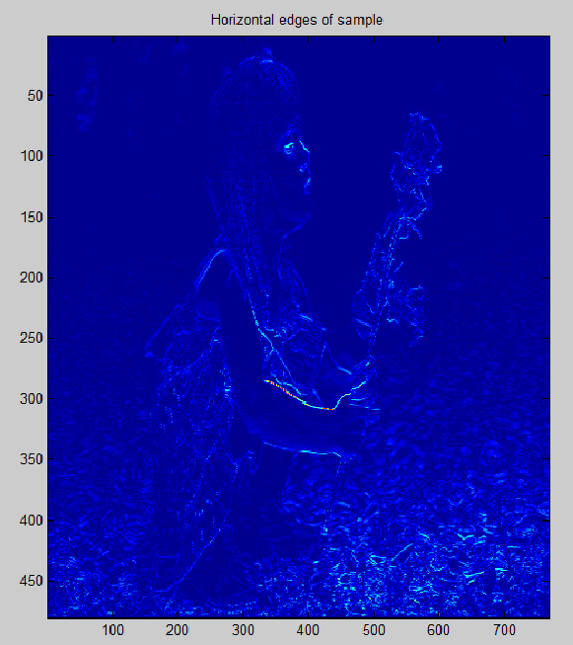
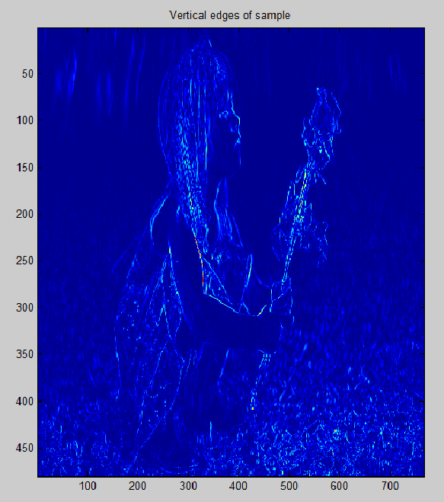

Slide 26
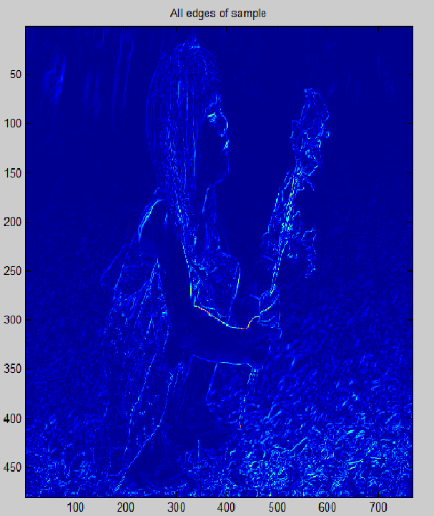
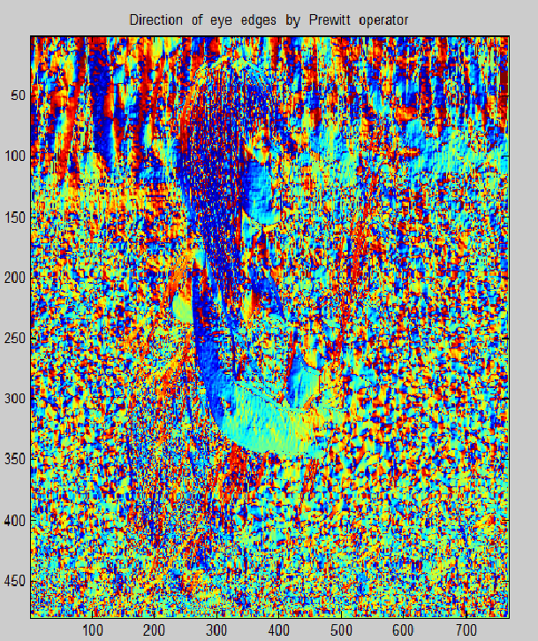

Slide 27
