Slide 1
My Work Experience
Aditya Sivaraj

Slide 2
Tespa Robotics
Developed Autonomous Mobile Robot (AMR) (differential) from scratch.
Worked independently on the software stack, oversaw the electrical circuit design and got help with the mechanical design.
Chose the third-party components like IMU, motors, etc., and oversaw their procurement.
Created the stack initially with ROS 1 (Noetic) and later switched to ROS 2 (Foxy) due issues in communication and latency.

Slide 3
Fused 2D LiDAR, optical rotary encoders, and a 9-axis IMU for localization, mapping and navigation.
Mapped a factory environment and auto-navigated the mobile robot throughout the factory floor.

Slide 4
Minus Zero Robotics
Developed the stack for localization, sensor fusion, path planning and control of an Autonomous Vehicle (AV).
Worked with cameras, 9-axis IMU and GNSS module (u-blox ZED-F9P) as part of the sensor stack.
Created global path planner. Worked on and created Frenet Frame based local path planner.
Fused 2 GNSS Modules (moving base and moving rover) along with IMU and wheel encoders for localization and heading.

Slide 5
Used one GNSS module as a moving base, which gives the global coordinates, and used the other GNSS module as a moving rover, which gives the heading of the vehicle.
Developed and tuned the PID control of the vehicle, with steer and throttle as control values. Overall created the robotics stack for the AV.
Created a Pure-Pursuit based tracking stack for the AV to track the local path using steering angle and velocity as control values.
Used OpenStreetMaps API to get the maps and nodes for path planning. Used A* algorithm for global path planning using the nodes from the API.

Slide 6
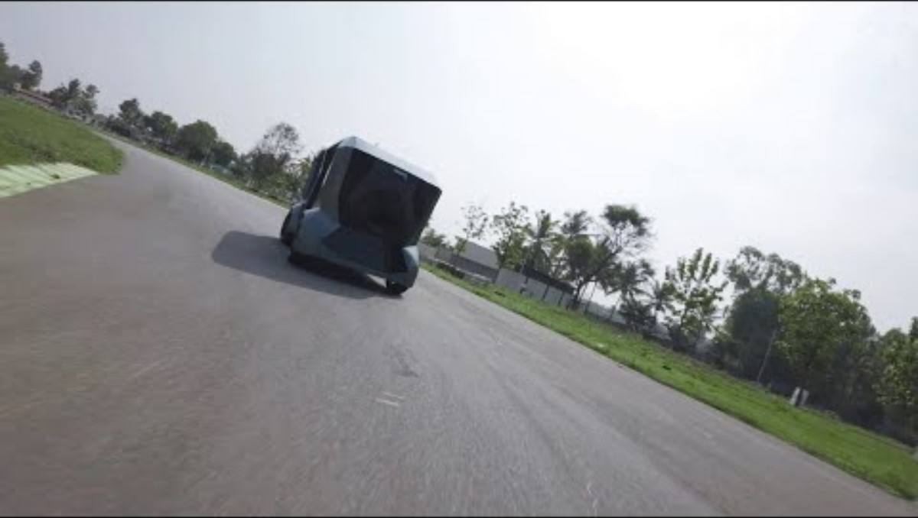

Slide 7
Seven Robotics
Responsible for the navigation stack of a warehousing AMR.
The navigation stack is completely backed by a behaviour tree (BehaviorTree.CPP).
Worked on Lattice Planner (global planner) and TEB planner (local planner).
Created a mathematical Dynamic Obstacle Avoidance stack.
Created a State Machine (Boost SML) based machine safety stack for the AMR.

Slide 8
Created a 2.5D simulation environment stack based on the MRPT simulator.
Recently created a Delayed Marginalization Visual Inertial Odometry stack.
Started working on a Model Predictive Control (MPC) based local planner.
Entire stack written in C++17 and Python.

Slide 9
