Slide 1




AMS – AI Driven Attendance Monitoring System
DATA SCIENCE PROJECT
Built for teachers
Mark and update attendance in a few clicks
A web app for university teachers to mark, update and store student attendance across departments.
Central data store
Records for all departments kept in PostgreSQL
Created By –
Anurag Kumar 202410101150135
Avanish Yadav 202410101150187
Aditya Singh Kushwaha 202410101150190
AI-powered insights
Risk alerts, summaries, notes and CSV export
Submitted To –
Mr. Raghav Sharma
Subject – Data Science, DS-55,56
720 students | 4 departments | 12 classes
https://lovable.dev/preview/OrKfPnSIOT4iwG70L46sx2hvHL3lEInJ
Notes:
Introduce AMS: an AI driven attendance monitoring system built as a data science project. Teachers use it to mark, update and store attendance for students across all departments. Data lives in PostgreSQL and AI features help teachers spot at-risk students.

Slide 2
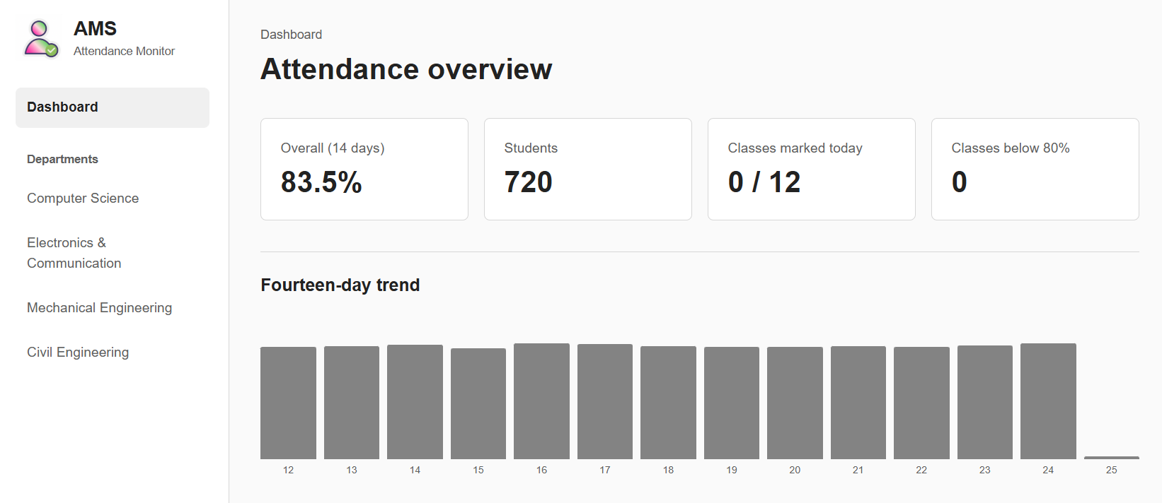




Attendance Overview
Overall attendance
83.5% averaged over the last 14 days.
Fourteen-day trend
Daily bars for all departments combined; today stays empty until marked.
Live marking tracker
Shows classes marked today and classes below 80%.
83.5%
14-day overall
720
Students
0 / 12
Marked today
0
Below 80%
Sidebar navigation
Jump to Computer Science, Electronics, Mechanical or Civil.
Notes:
The dashboard gives the whole university picture: 83.5% overall attendance over 14 days, 720 students, 0 of 12 classes marked today, and no classes below 80%. The bar chart shows the daily trend from 12 to 25 October across all departments. The sidebar links to each department.

Slide 3
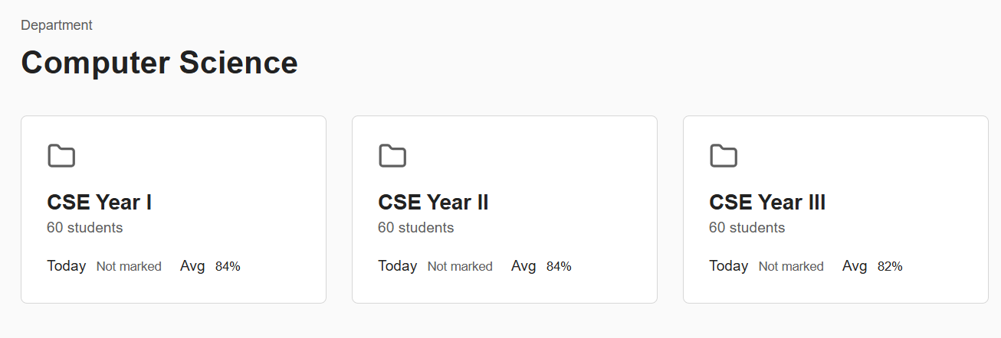

Departments & Classes
Stored in PostgreSQL
Relational DBMS holds all records
3 classes x 60 students
180 students in this department
Average attendance
84% | 84% | 82%
Notes:
Opening a department shows its classes. Computer Science has CSE Year I, II and III with 60 students each. Each folder shows whether today is marked and the average attendance (84%, 84%, 82%). All student and attendance data is preserved in a PostgreSQL database.

Slide 4
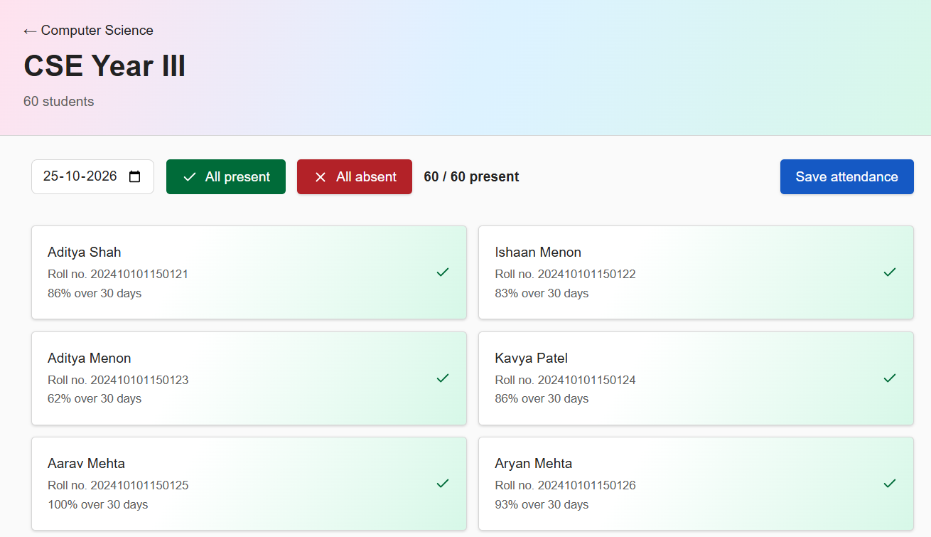
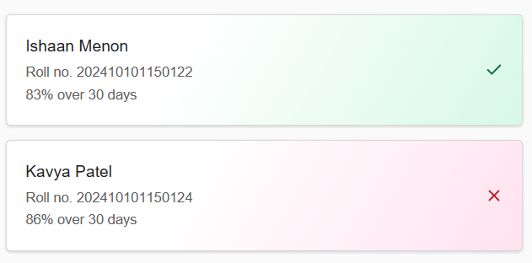



Student List & Quick Marking
Click once: absent
The card turns red and the present count drops.
Every student at a glance
Each card shows name, roll no. and 30-day attendance %.
Click again: present
Back to green. No reload needed, so mistakes are easy to undo.
Notes:
Each student has a card with name, roll number and the 30-day attendance percentage. Cards start green (present). Click a card once and it turns red (absent). Click again and it returns to green. There is no page reload, so marking is fast and easy to correct.

Slide 5
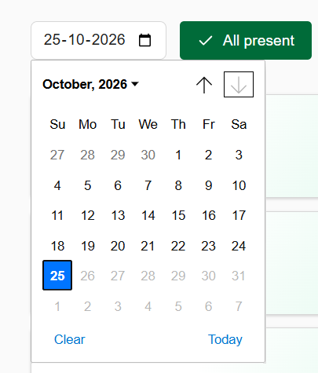



Calendar & Quick Actions
Date picker
Pick any date; Today and Clear shortcuts are built in.
All present / All absent
Mark the whole class in one click, then fix exceptions.
Live counter
Shows how many are present, for example 59 / 60.
Save attendance
Stores the day's record to the database.
Notes:
Everything is on one toolbar so teachers can navigate easily. The calendar picks the date, All present and All absent mark the whole class instantly, the counter shows the live total (for example 59 / 60), and Save attendance writes the record to the database.

Slide 6
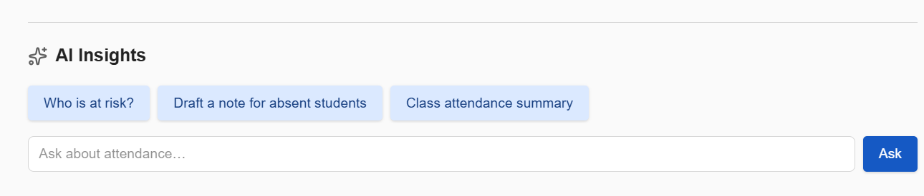


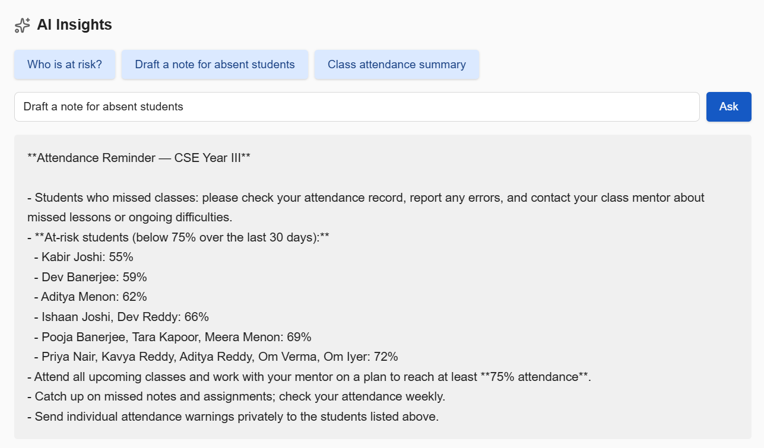



AI Insights & CSV Export
Who is at risk?
Lists students below the 75% threshold with their 30-day %.
Draft a note for absent students
Generates a ready-to-send reminder for the class.
Class attendance summary
One-click overview of how the class is doing.
Ask anything
Type a free-text question about attendance and press Ask.
Export to CSV
All attendance data is fully exportable.
Notes:
AI Insights sits under each class. Three quick prompts: Who is at risk, Draft a note for absent students, and Class attendance summary. Teachers can also type their own question. The generated note lists students under 75% so they can be warned privately. All data can be exported in CSV format.

