Slide 1
IMPACT - Phase 1 SQL
Topics Done | Exit Criteria
Data Models and its Types ,Entites and Relationships & Attributes | Data Models- define how data is connected to each other and how they are processed and stored in DBM. Entites- object which can be tangible or non-tangible
Bus Matrix | Dimension Business Process
Data Modelling - Logical | Logical Data Model For Hospital Data Management created in draw.io which invloves, entites its attributes and Relationship between them.
Data Modelling - Physical | Physical Model has been created in Vertabelo in which Data types and Keys are being done.
SQL Server | 5 - SQL Queries for DB Patient Types in the Hospital Patient Undergone Operation Bill Summary of All Patients Patient Scan Details Patient Details on a particular Date

Slide 2
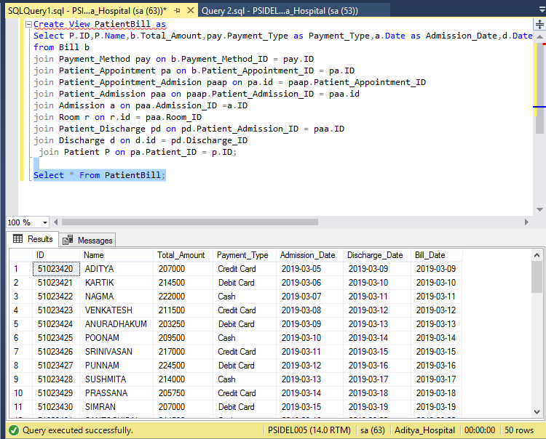
Sample Query

