Slide 1
Tree_Area_Stacked_Step_Charts
File created on: 6/22/2021 4:12:06 PM

Slide 2
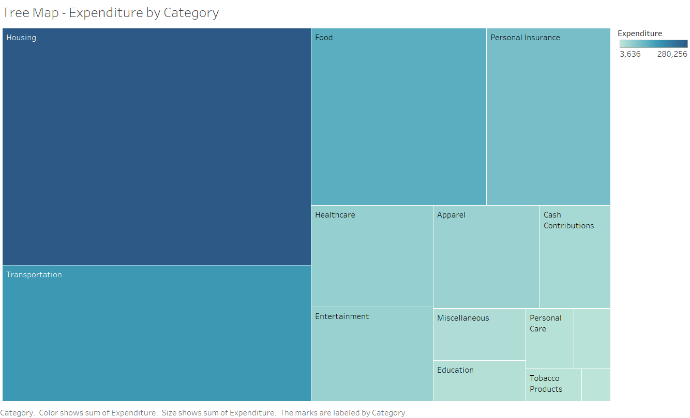

Slide 3
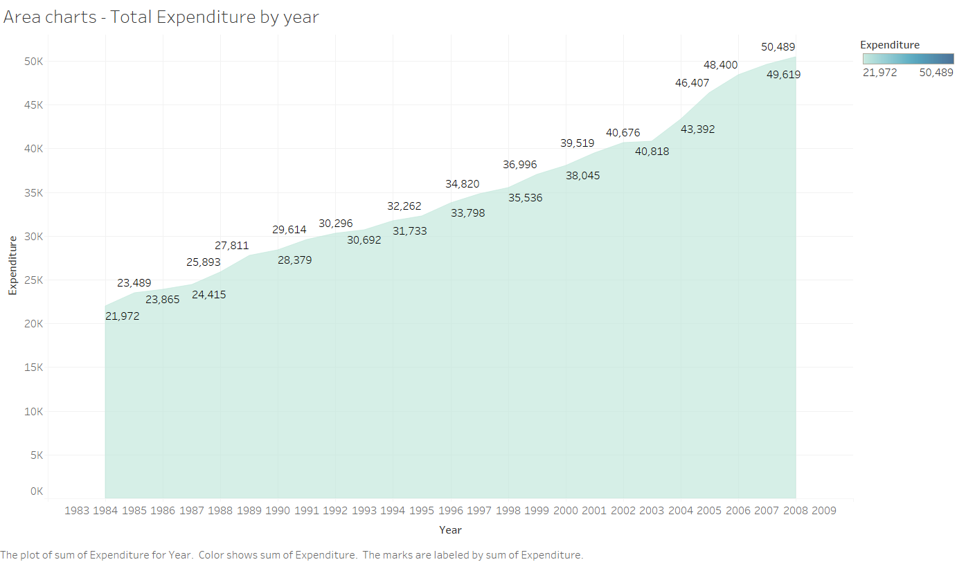

Slide 4
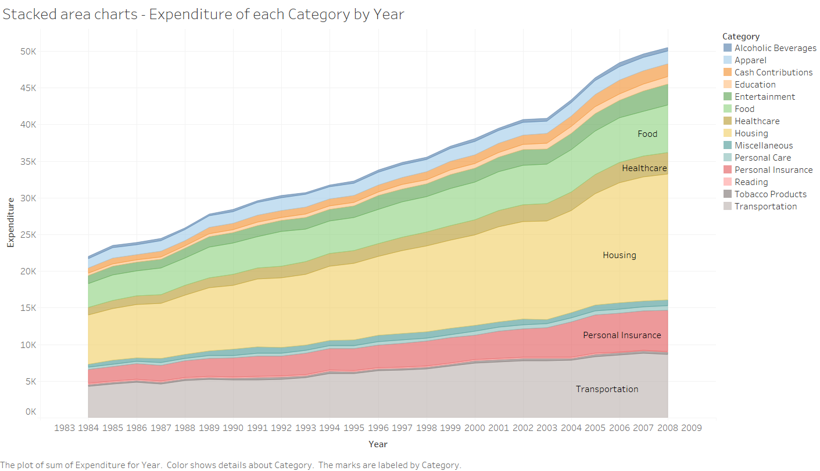

Slide 5
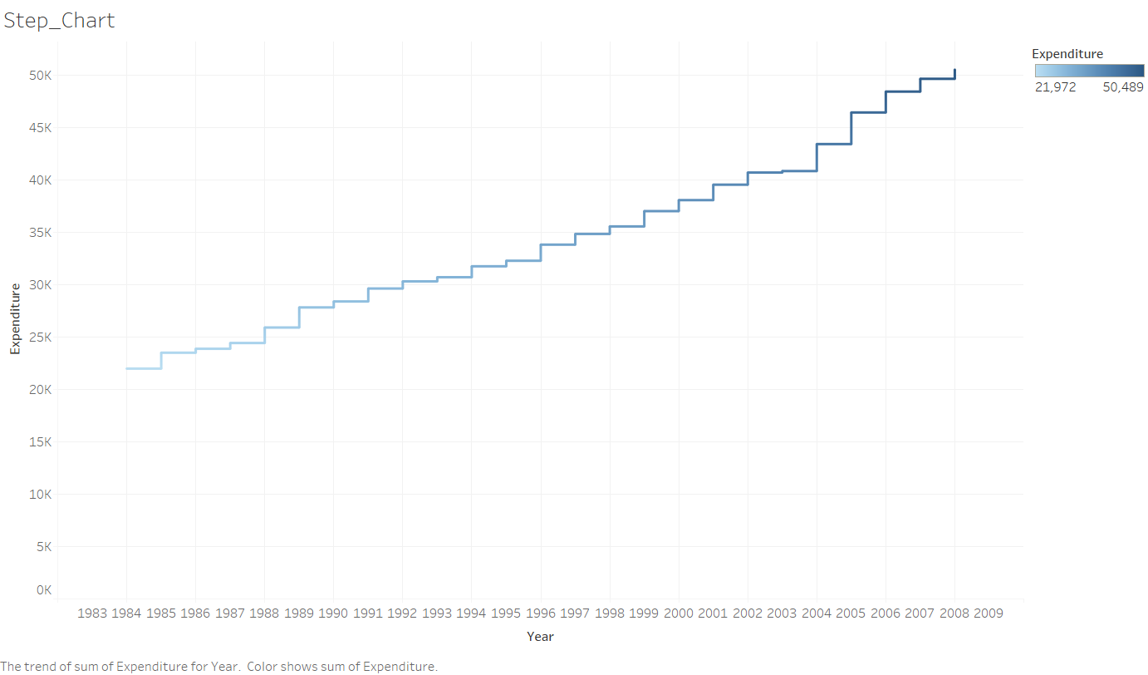

Slide 6
