Slide 1


DSC 530 Final Project Presentation
Aditya Sumbaraju
DSC530 Data Exploration and Analysis
Shankar Parajulee, Ph.D.
June 05, 2021

Slide 2
Table of Contents
Topic
Statistical Question
Dataset Variables (Chapter 1)
Histograms (Chapter 2)
Bar charts
Probability Mass Function (Chapter 3)
Cumulative Density Function (Chapter 4)
Analytical Distribution (Chapter 5)
Scatter Plots (Chapter 7)
Hypothesis Test (Chapter 9)
Regression Analysis (Chapter 10-11)
Boxplots

Slide 3
Topic
Factors in increasing a vehicle’s emissions - EDA

Slide 4
Statistical Question
What vehicle mechanical demographics affects an increase in CO2 emissions?
Vehicle mobility using gasoline and unleaded gas accounts for about significant percentage of greenhouse gas emissions depending on the country.
I would be considering below three questions to start EDA:
Premium cars get better fuel economy compared to cars using base unleaded gasoline?
Does the cylinder engines varients carry a continuous variable transmission?
Does Automobile manufacturers are ranked first to pollute the environment?
To address these questions I would be using the Co2 Emission data available in kaggle.

Slide 5
Dataset Variables
Make: The manufacturer of each car
Vehicle Class: The overall shape of the vehicle, such as sedan, SUV, station wagon, etc. This variable factors in weight.
Engine Size: The displacement of the engine, or the volume swept by all the pistons, measured in liters.
Cylinders: The number of pistons within the engine.
Transmission: The mechanism used to transfer engine power to the wheels. Five transmission types currently exist: Automatic (A), Manual (M), Automated Manual (AM), Automatic Hybrid (AS), and Continuously Variable (AV).
Combined Fuel Consumption: An estimate of the real-world fuel economy from the car. The mass of carbon dioxide emitted by each vehicle, measured as grams CO₂ per Miles traveled.
Fuel Type: The fuel used to power the engine. Five fuels currently exist: gasoline (X), premium gasoline (Z), diesel (D), natural gas (N), and ethanol (E).
City Fuel Consumption: The estimated fuel consumed using city driving habits, measured in Gallons per 100 Miles.
Highway Fuel Consumption: The estimated fuel consumed using highway driving habits, measured in Gallons per 100 Miles.

Slide 6
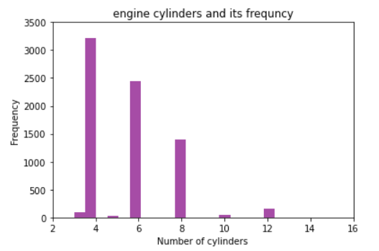
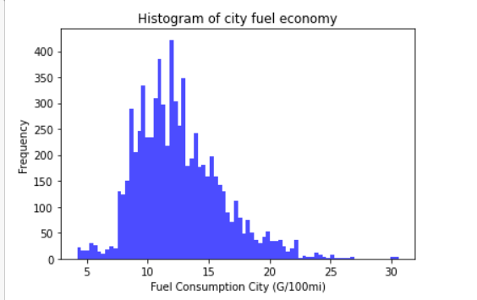

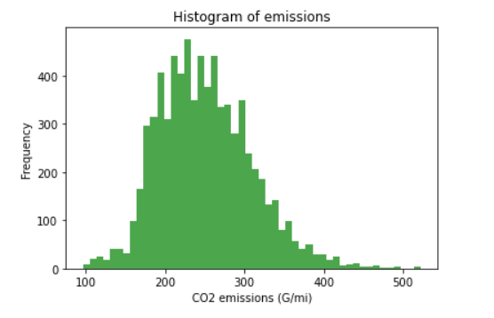

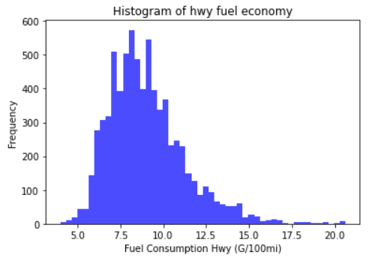
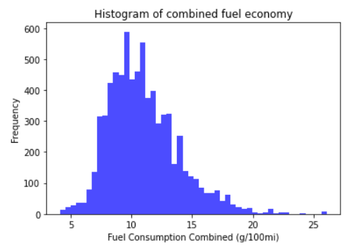



Histograms

Slide 7
Histograms explanation
Engine Displacement: The average number of cylinders may be near 6, but 4-cylinder engines are the most common due to their fuel economy.
City Fuel Economy: For all three fuel consumption distributions, the higher values come from larger capacity engines, while the small values come from small capacity engines and hybrid vehicles.
Highway Fuel Economy: Due to steady speeds on highways the stats are pretty significant across vehicles. Mean 9.0; Mode 7.8; skew 1.07

Slide 8
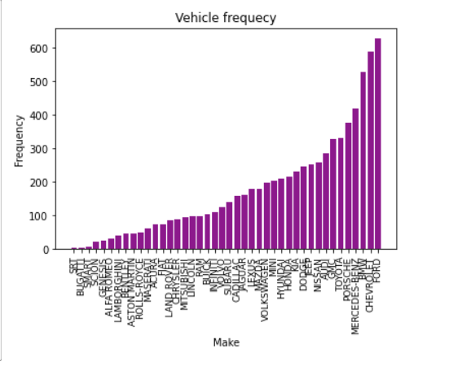
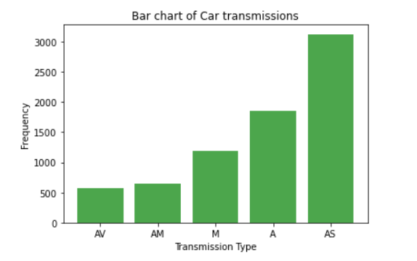
Barcharts
Transmission
A = Automatic AM = Automated manual AS = Automatic with select shift AV = Continuously variable M = Manual
Automatic with select shift are more infrequency when compared to Manual and others

Slide 9
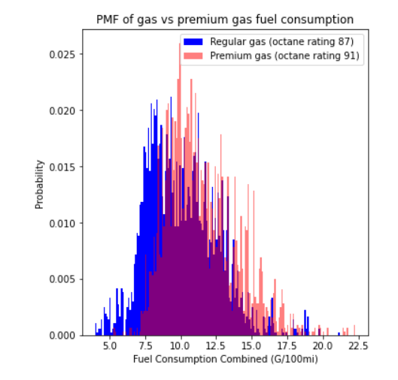
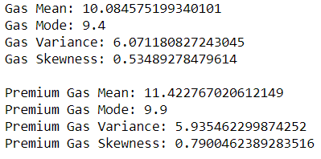
Probability Mass Function

Slide 10
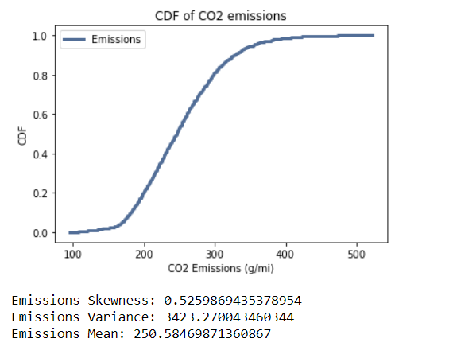
Cumulative Density Function

Slide 11
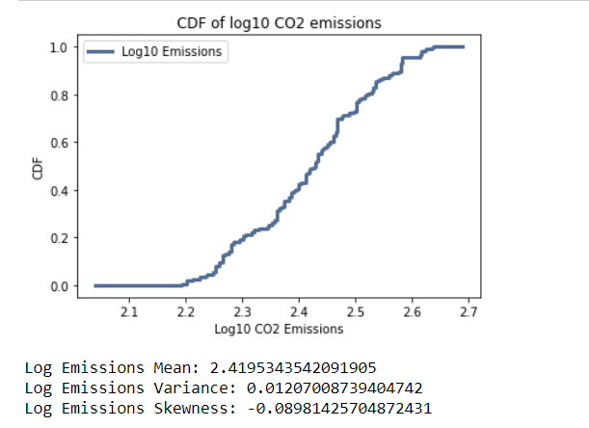
Analytical Distribution
We can see that the distribution is approximately lognormal
All the emissions are within half an order of magnitude of each other

Slide 12
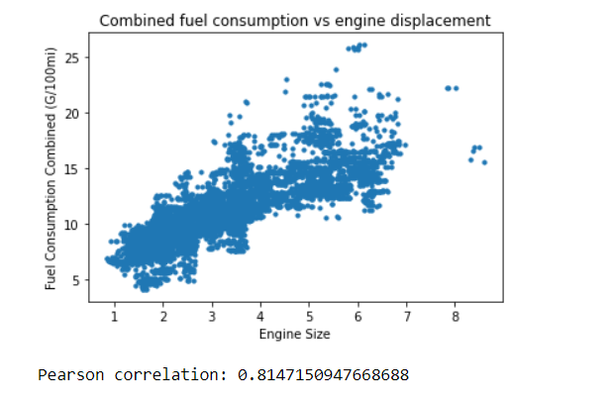
Scatter plots

Slide 13
Hypothesis Test
The p-value was found to be very close to 0, hence it is significant that that there is a statistically different between the fuel consumptions of gas and high end premium gas cars.
The difference in means between the fuel consumption of gas and premium gas cars is tested.
This confirms the difference seen in the earlier PMF slide.

Slide 14
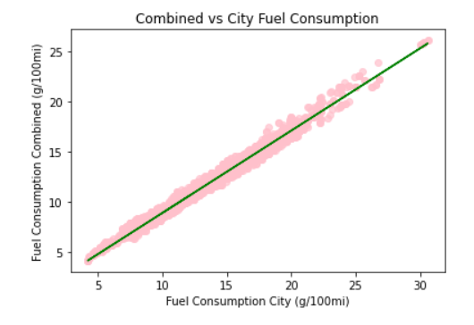
Regression Analysis

Slide 15
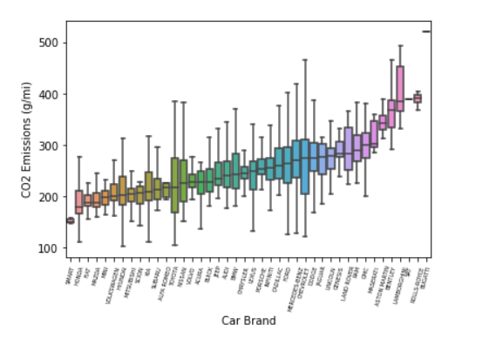
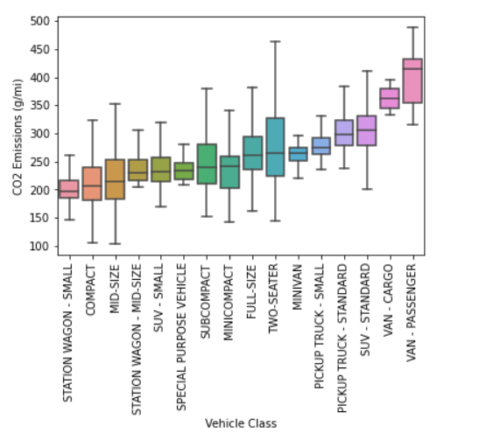
Box plots

