Slide 1
How To Find KOL Ranking

Slide 2
STEPS To Follow While Using KOL Tool
Step 1: Go through “setup.txt”.
Step 2: Get the specified format data saved up with the name : “raw_data.xlsx”
Step 3: Enter the particulars in the “input_raw_data.txt” as - column_name,attributeofcolumn,weightage from the raw data file
Note : column_name and attributeofcolumn can be entered as many as you want, eg: Project_Data_Point,CONGRESS,4 <-here 1 columns and it’s attribute given can give more than 1,
like: Project_Data_Point,CONGRESS,Project_Type,CLINICAL
Entry in “input_fileformat” can be like:-
Project_Data_Point,CONGRESS,4
Project_Data_Point,PATIENT GROUP,2
For every weightage entry should be line separated

Slide 3
Step 4: To get the ranking and output file from raw data, upload the files then click “Run For Raw Data” Button, Then press Download Raw Data Results.
Step 5: Deep Profiling data should be Uploaded with name and
format as “profiling_data.xlsx”.
Step 6: Enter the particulars in the “input_profiling.txt” as- sheetname,column_name,attributeofcolumn,weightage from the profiling data file.
Step 7: To get the ranking and output file from profiling data, upload the files then click “Run For Profiling Data” Button, Then press Download Profiling Results.

Slide 4
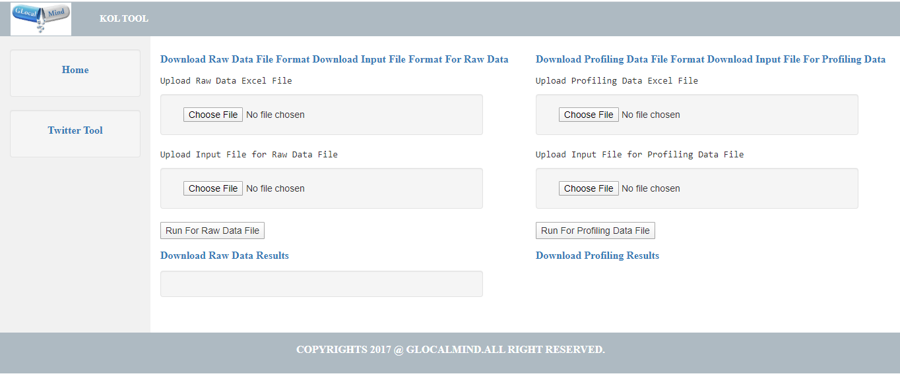
Home page

Slide 5
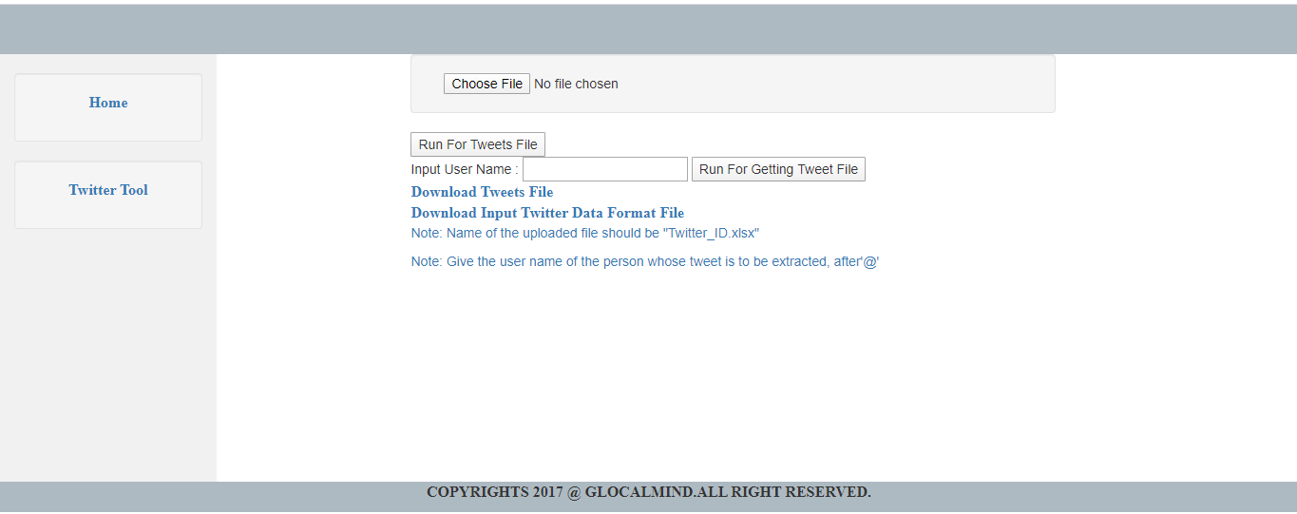
Twitter Tool page

Slide 6
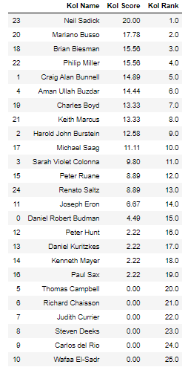
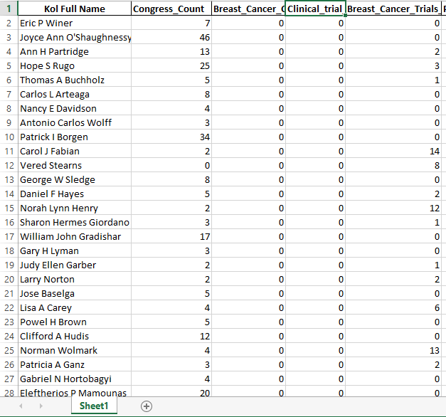
Result For Kol Tool

Slide 7
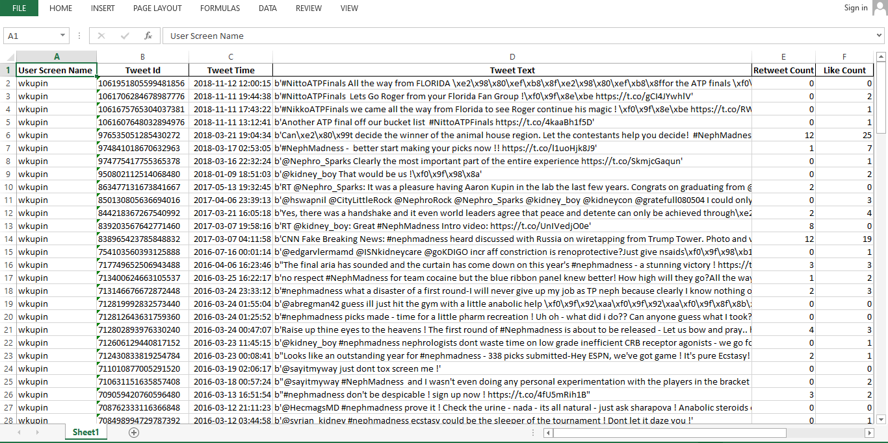
Result For Twitter Tool

