Slide 1
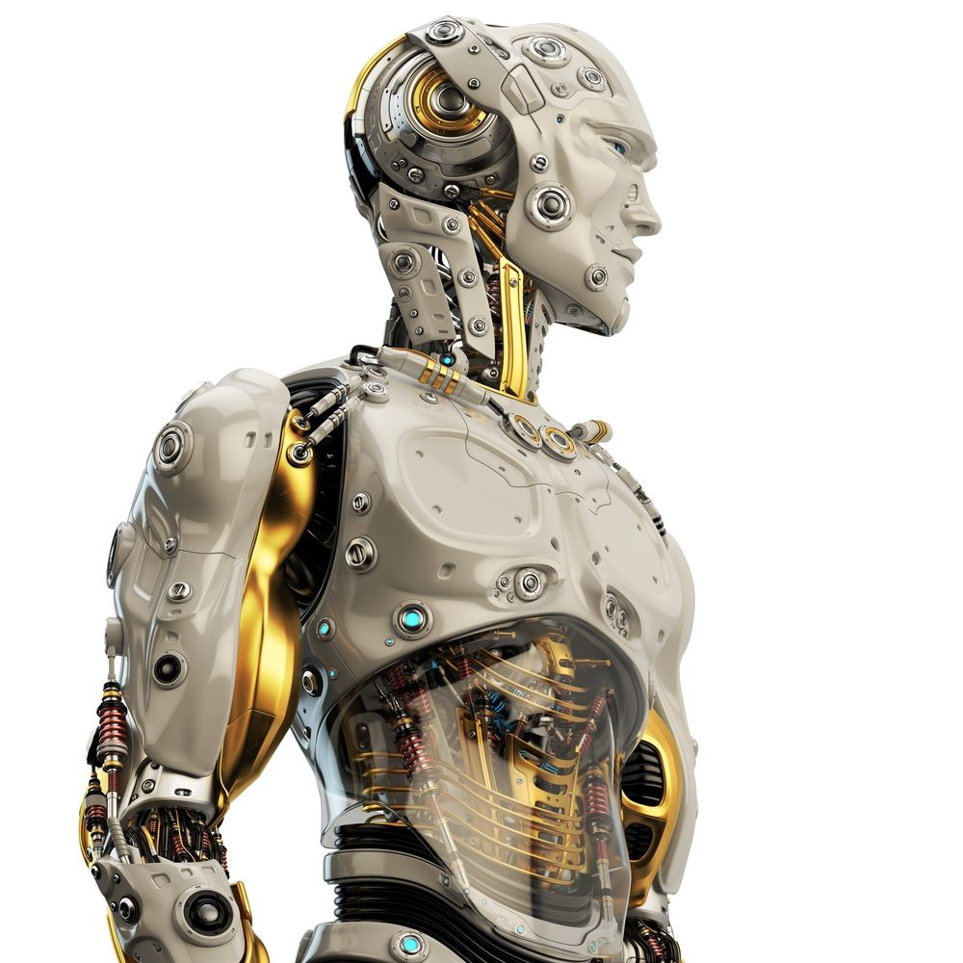
Humanoid Robots
- Aditya Surana

Slide 2
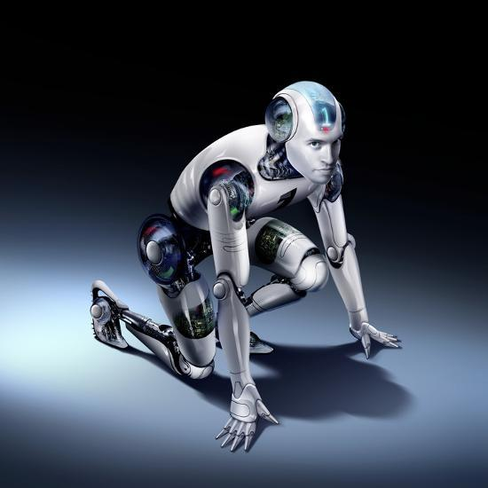
Overview
What is a Robot ?
What is a Humanoid Robot ?
Why Humanoid Robots ?
Previously developed Humanoid Robots
Future of Humanoid Robots
Hardware Used in Gyani2.0
Work Done on Gyani2.0 (Software Approach)
Process Flow of Gyani2.0

Slide 3
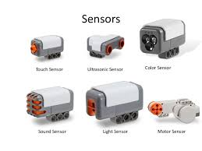
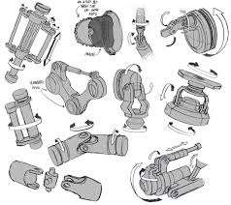
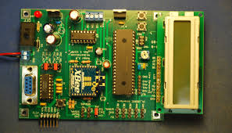
What is a Robot ?
A machine that can automatically do tasks normally controlled by humans and mostly is used to perform repetitive tasks on an assembly line.
Robots can be made from a variety of materials including metals and plastics. Most robots are composed of 3 main parts: Controller (Brain), Mechanical Parts and Sensors.

Slide 4
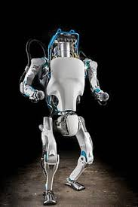
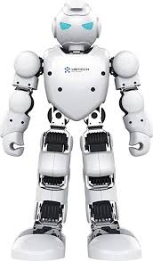
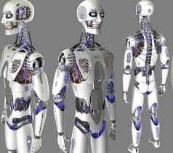
What is a Humanoid Robot ?
A humanoid robot is a robot with its overall appearance based on that of human body.
The design is for functional purposes, such as interacting with human tools and environments, for experimental purposes, etc.

Slide 5
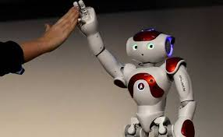
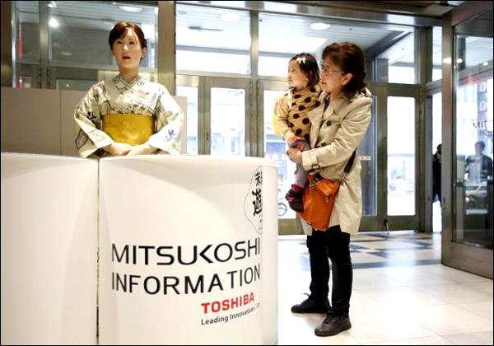
Why Humanoid Robots ?
Humans wanted a machine to rely on, because robots never get tired and help the human by different tasks all the time.
Humanoid Robots can be used with the children, they can be used to teach the children or read to them, can help children with autism immensely, They can assist the sick & elderly.
They can be used in dirty or dangerous jobs, they are suitable for some procedurally-based vocations, such as reception-desk administrators etc..

Slide 6
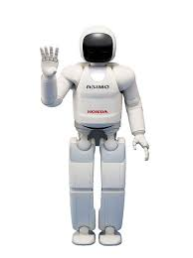
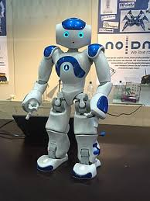
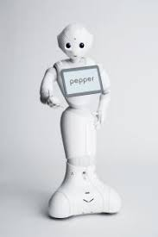
Previously Developed Humanoids
In 2000, Honda developed “Asimo” as a multi-functional mobile assistant that could help people with poor mobility. It could recognize objects, gestures, sounds, and faces, allowing it to interact with humans.
“Nao” is an autonomous, programmable humanoid robot developed in by SoftBank Robotics for research and education purposes.
“Pepper” is a semi-humanoid robot manufactured by SoftBank Robotics designed with the ability to read emotions. It was introduced in a conference on 5 June 2014.

Slide 7
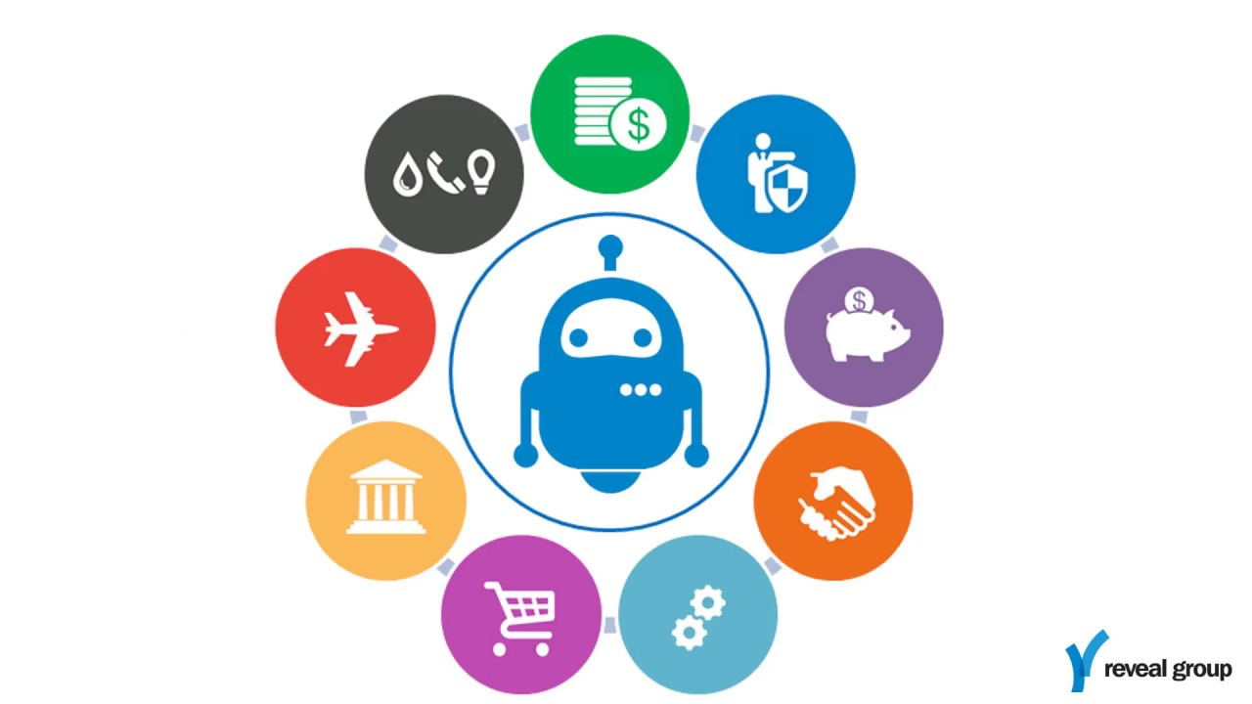
Future of Humanoid Robots
Top tech companies are in a constant race to change the way robotics are implemented in people’s everyday lives – which will lead us to a really exciting future.
“Robots will take our jobs!” is perhaps the most common fear surrounding robotics development. In the near future, however artificial intelligence will most likely replace tasks, not jobs. The good news is that it will also create new markets and jobs.

Slide 8
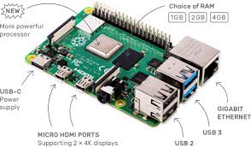
Hardware Used in Gyani2.0
Raspberry Pi: is a low cost, credit-card sized computer that plugs into a computer monitor or TV, and uses a standard keyboard and mouse.
It will be used as “Brain of the Humanoid Robot”. It will contain all scripts for processing, will help in sending and receiving signal through ARDUINO and other devices.
A 1.5GHz quad-core 64-bit ARM
1GB, 2GB, or 4GB of LPDDR4 SDRAM
Full-throughput Gigabit Ethernet
Dual-band 802.11ac wireless networking
Bluetooth 5.0
Two USB 3.0 and two USB 2.0 ports
Dual monitor support, at resolutions up to 4K

Slide 9
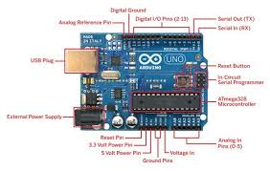
ARDUINO: Arduino boards are able to read inputs - light on a sensor, a finger on a button, or a Twitter message - and turn it into an output - activating a motor, turning on an LED, publishing something online.
It will be used to receive signals from Raspberry Pi, then process it and send the
output signal (giving instructions to move at some degree) to Servo Motor.
Microcontroller: ATmega328.
Operating Voltage: 5V.
Input Voltage (recommended): 7-12V.
Input Voltage (limits): 6-20V.
Digital I/O Pins: 14
Analog Input Pins: 6.
DC Current per I/O Pin: 40 mA.
DC Current for 3.3V Pin: 50 mA.

Slide 10
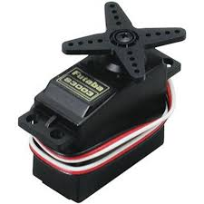
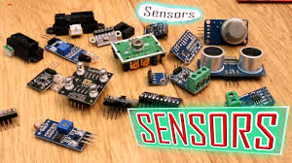
Servo Motor: A servo motor is an electrical device which can push or rotate an object with great precision. To rotate an object at some specific angles or distance, then we use servo motor.
It will be used for transmitting instructions from ARDUINO to move the parts of the body by some degree.
Sensors: a sensor is a device, module, or subsystem whose purpose is to detect events or changes in its environment and send the information to other electronics, frequently a computer processor.
It will help in detecting whether an object is coming in its
path or any other change occurs in environment.

Slide 11
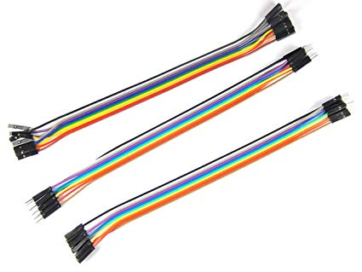
Jumper Wires: Jumper wires are simply wires that have connector pins at each end, allowing them to be used to connect two points to each other without soldering.
It will be used to transmit signals from one device to another
It resemble “nerves” in the Humanoid Robot.
Camera: It can be used for face recognition, human tracking and for many other purposes.
Microphone: It will be used to convert sound signal into electrical signal and make Humanoid Robot hear surrounding noise.
We can use Logitech HD Webcam for both camera and microphone.
Speaker: It will convert electrical signal into sound signal and help Humanoid Robot to speak. Can you JBL GO speaker.

Slide 12
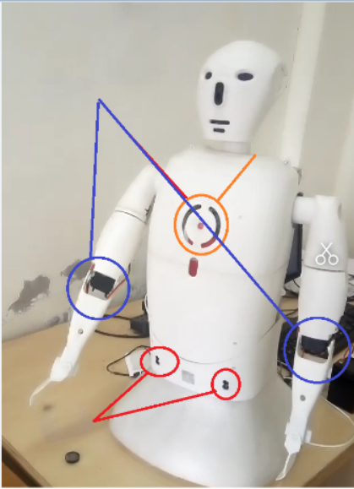
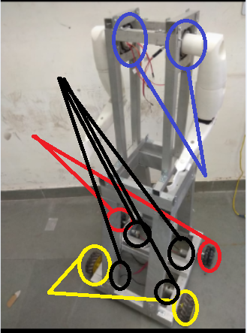
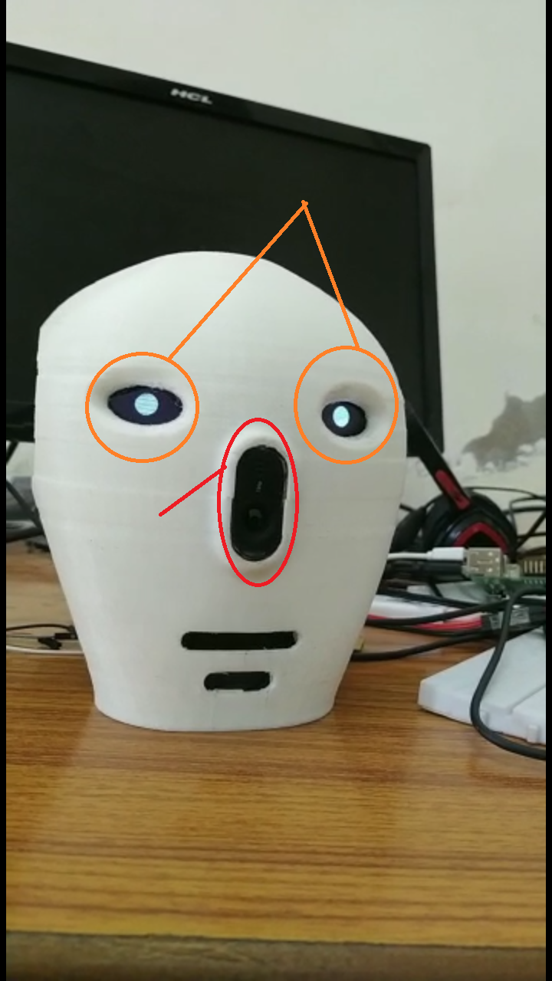
Gyani2.0 Body Structure
Servo Motors
4 DC Motors
2 Oled Displays
Touch Sensor
2 Omni Wheels
Bearings
Camera with Microphone
2 Regular Wheels
Lidar Sensors

Slide 13
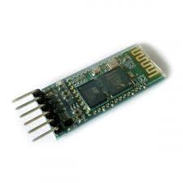
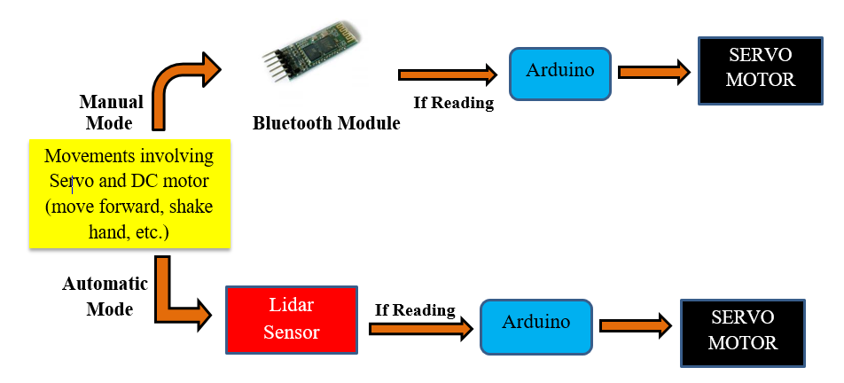
Gyani 2.0 movements can be controlled both manually and automatically.
By manually we mean using Bluetooth.
Bluetooth Module was also used in controlling Gyani2.0 movements( using Bluetooth)

Slide 14
Work Done On Gyani2.0 (Software Approach)
Firstly we installed all the packages, libraries like cv2, face_recognition, dialogflow, etc. on our raspberry pi.
PLEASE ONCE GO THROUGH ‘mindmapperz_maincode.py’ BEFORE MOVING FORWARD (it is self explanatory).

Slide 15
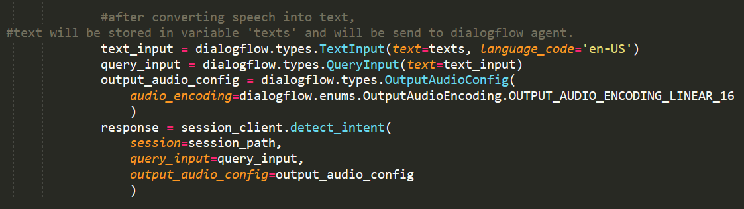
Google’s Speech To Text Converter: used to convert speech into text. We will be converting our query(in speech format i.e. sound) to text.
Now this text will be sent to dialogflow as described in ‘mindmapperz_maincode.py’.

Slide 16
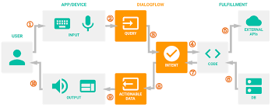
Dialogflow: Google’s apiai to is an end-to-end, build-once deploy-everywhere development suite for creating conversational interfaces for websites, mobile applications, popular messaging platforms, and IoT devices.
Working of Dialogflow

Slide 17
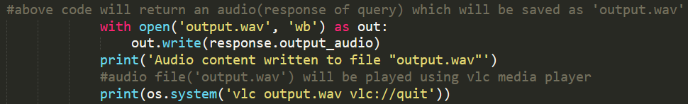
Raspberry Pi to Speaker: After saving the audio file on Raspberry Pi, we can play this file using any audio player for example VLC media player, etc..
Dialogflow will take that text (text came after converting speech into text) as query, after processing an appropriate response comes in the form of audio and we will save that to our device (Raspberry Pi).

Slide 18
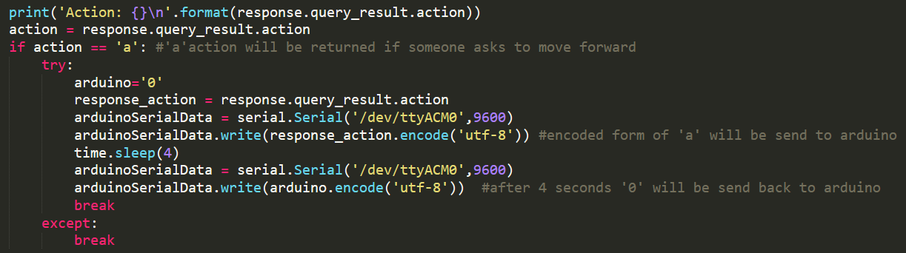
Now if there are some actions defined in dialogflow, then it will return actions and that actions will be encoded from raspberry pi and sent through serial communication to Arduino.

Slide 19
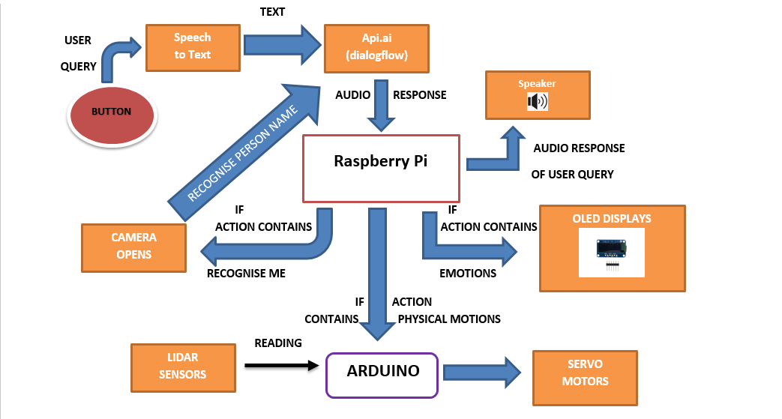
Process flow of Gyani2.0

Slide 20
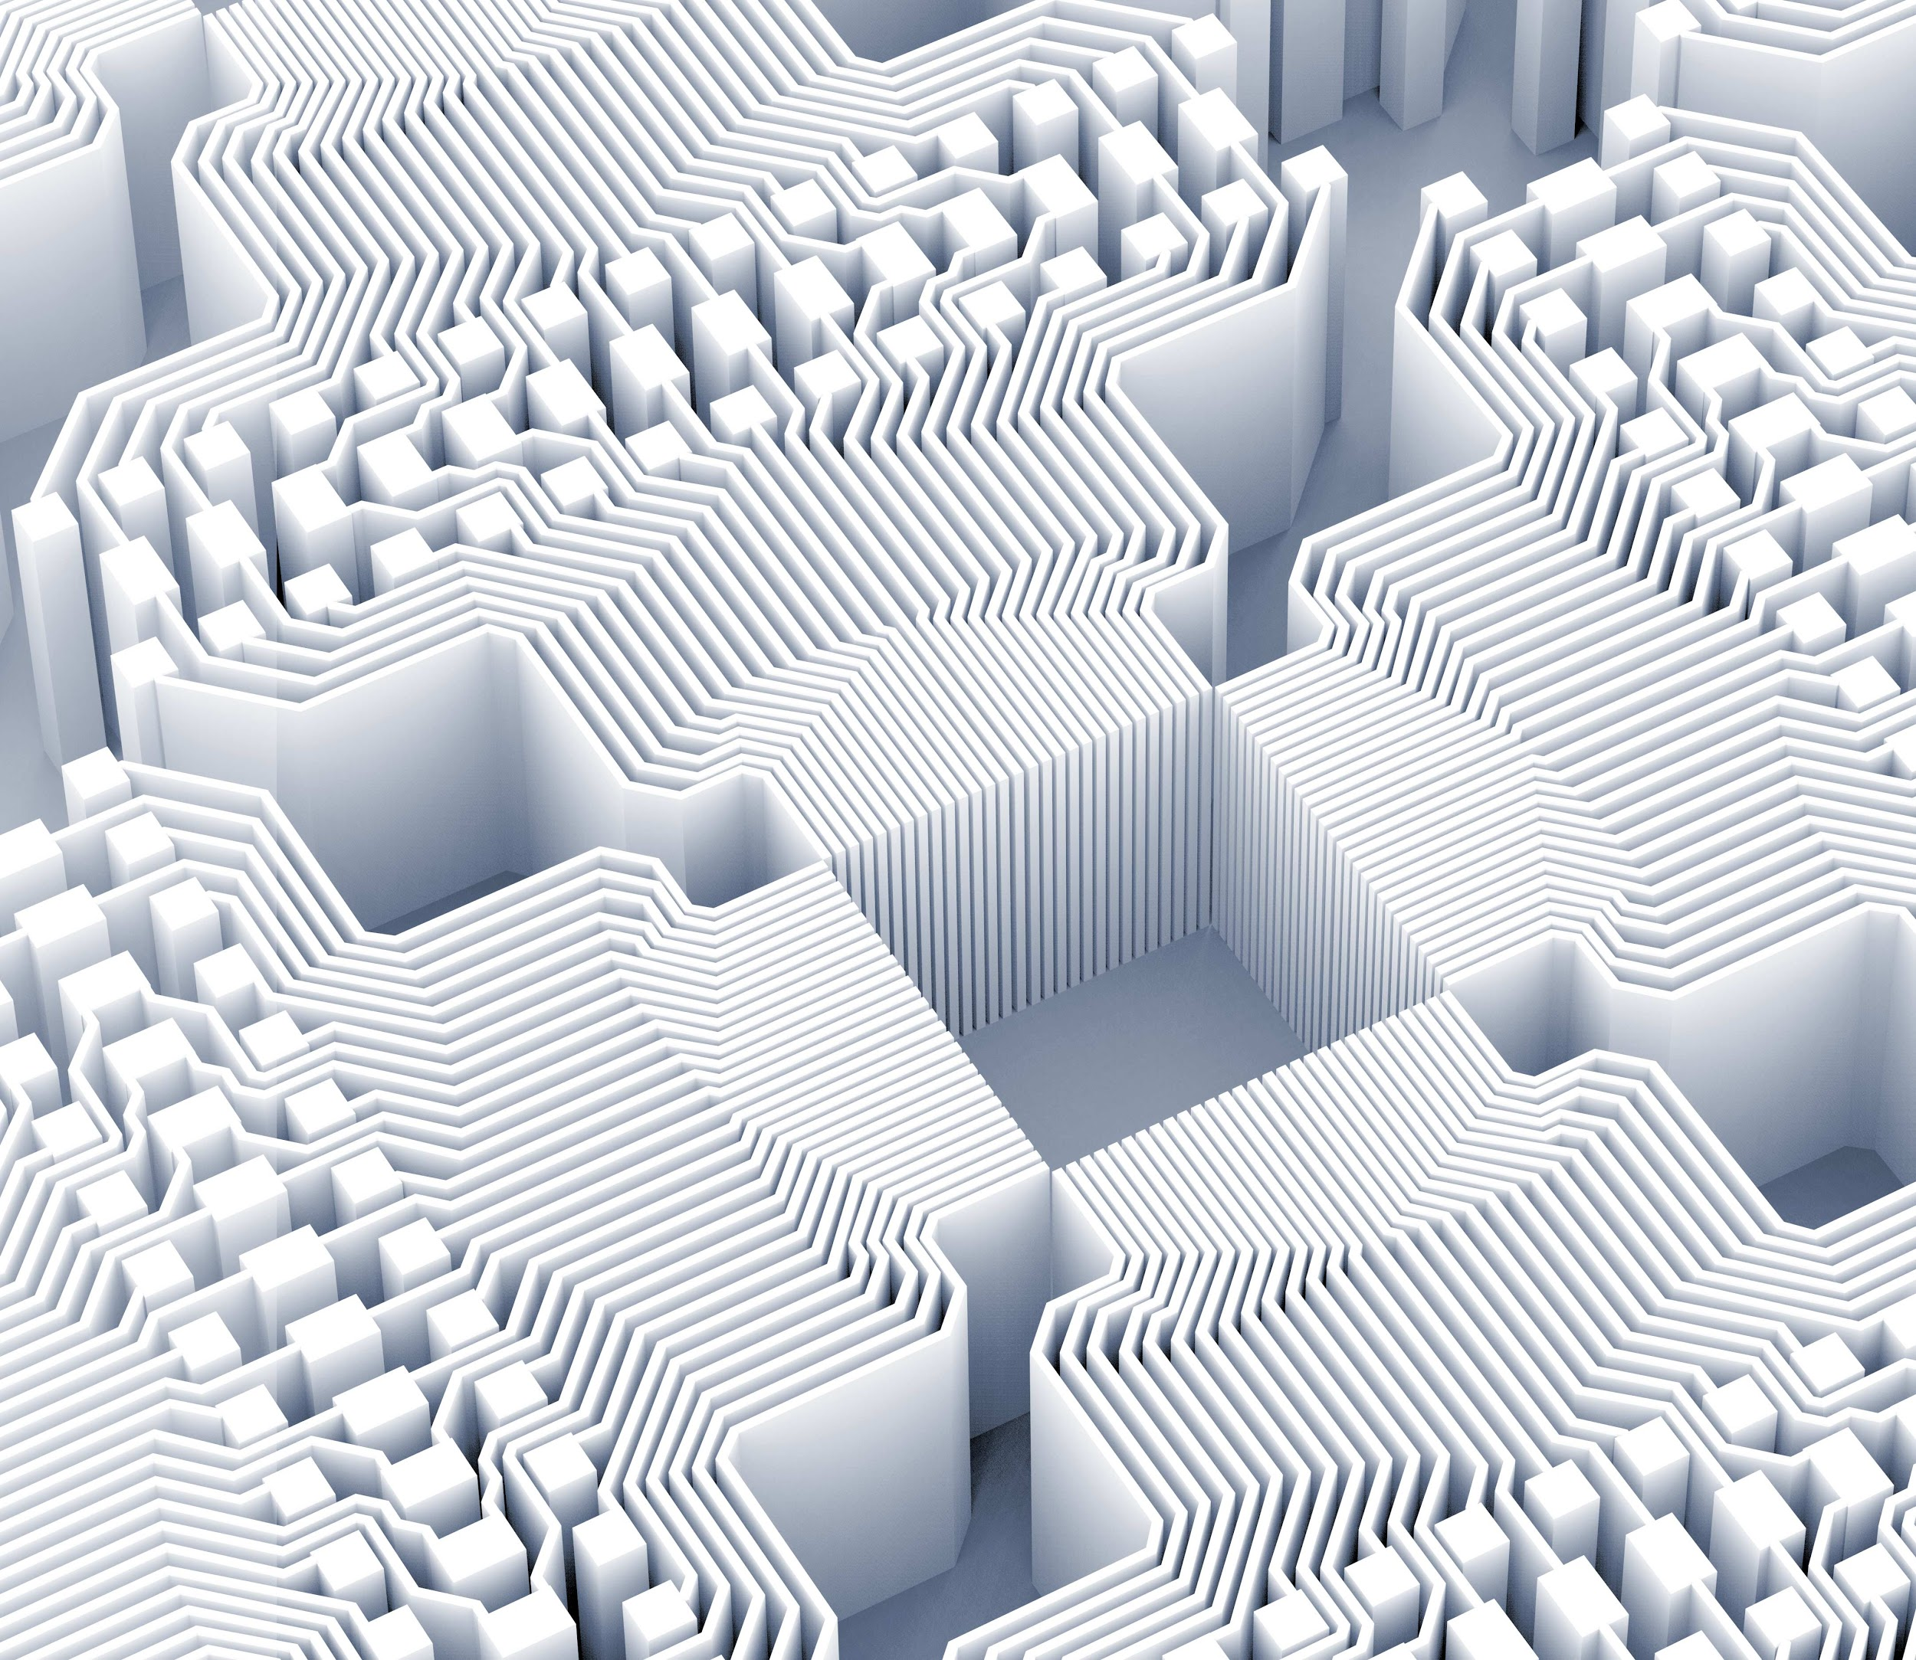
Thank you!

