Slide 1





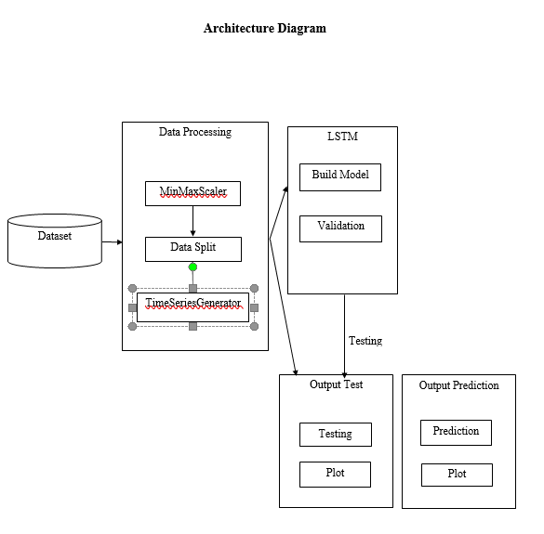
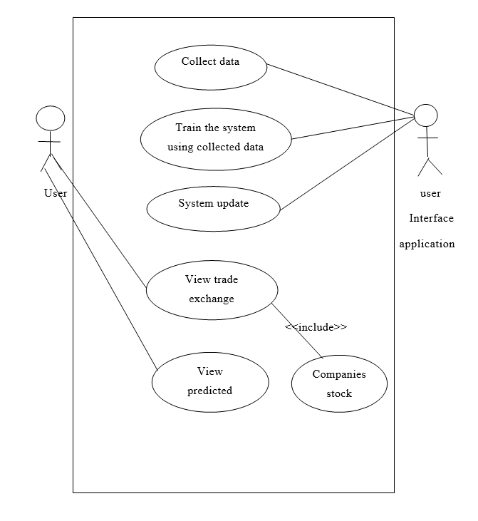
Fold or cut poster here
Fold or cut poster here
Batch Number:3
Department of Information Science and Engineering
Final Year Project Poster Presentation (UG - B.Tech)
Stock Price Prediction
Introduction
System Architecture
Methodology used
Abstract:
Stock Market is considered the primary indicator of a country’s economic strength and development and it is popular and important topic in financial and academic studies. Stock Market is volatile place since there are no significant to estimate price. Stock price are affected by factor like inflation, economic, growth, etc. It is highly depending upon demand and supply. High demanded stock will increase in price whereas heavily sold stock will decrease in price. Many methods like technical analysis, fundamental analysis, time series analysis and statical analysis are used to predict the price of stock market but none of this method are proved as a consistently acceptable to predict stock price. In this paper, we implemented Long short-term memory (LSTM) model to predict stock price. .
The stock market refers to public markets that exist for issuing, buying and selling stocks that trade on a stock exchange or over-the-counter. It involves trading between two investors and it is also known as secondary market. In stock market prediction, the aim is to predict the future value of the financial stocks of a company. Predicting how the stock market will perform is one of the most difficult things to do. Intrinsic volatility in the stock market across the globe makes the task of prediction challenging. There are so many factors involved in the prediction physical factors vs. technical, rational and irrational behavior, etc. All these aspects combine to make share prices volatile and very difficult to predict with a high degree of accuracy. Using features like the latest announcements about an organization, their quarterly revenue results, etc.
LSTM: LSTM’s are widely used for sequence prediction problems and have proven to be extremely effective. The reason they work so well is because LSTM is able to store past information that is important, and forget the information that is not.
Linear Regression: Linear Regression is the most basic supervised machine learning algorithm. Supervise in the sense that the algorithm can answer your question based on labeled data that you feed to the algorithm. The most basic machine learning algorithm that can be implemented on this data is linear regression. The linear regression model returns an equation that determines the relationship between the independent variables and the dependent variable.
Design and Implementation
We have used MinMaxScaler and TimeSeriesGenerator as the preprocessing techniques. MinMaxScaler is a data transformation technique which is used to transform feature by scaling each feature to a given range. In our project we used this technique to scale the open feature between [-1,1]. TimeSeriesGenerator is used to transform the univariant or multivariant dataset into smaller part which can be trained easily. As there are a lot of TimeSeries data is present so it will take a lot of time to do it manually. Feature Reduction is done through the drop function which is present in the pandas data frame library it is used to remove feature or attribute that is to be reduced. We are comparing our dataset with two classifiers for better accuracy which includes LSTM and Linear Regression.
Objectives
To calculate the estimated price of stock based on the historical data.
To create a system which will notify the up or down of the stock price movement.
To implement and develop different methods of stock market forecasting techniques.
Conclusion
Paper Publication Details
We made an attempt to evaluate different methods of forecasting the stock market trends by which any investor can find the best method by which they can predict the stock value much more accurately through which he/she makes correct decision for buy or sell the stocks.
Our paper is communicated to “International Journal of Computer Sciences and Engineering” and it is under the reviewing process
Results
References
Contact information
In this project we successfully build the stock price prediction model using Machine Learning technique. We took the data from Yahoo Finance API of a particular company. We have also shown the result on the graph which include actual price, predicted price which model predicted and future price of a company which our model predicted. We have also predicted the future price of company like TataPower and SBI.
[1] Ishita Parmar, Navanshu Agarwal, Himanshu Dhiman, Shikhin Gupta “Stock market prediction using machine learning” , IEEE 2018.
[2] Rachna Sable, Dr. Shivani Goel, Dr. Pradeep Chatterjee “Empirical study on stock market prediction using machine learning”, IEEE 2018
[3] Jae Won Lee “Stock price prediction using reinforcement learning “, IEEE 2010
Under the guidance of Assistant Prof: Mathiyalagan R
Student Name 1. Aditya Surana 2.Mohit Kumar 3.Anish Shrestha 4.Prabin Bishwokarma | USN 1.17BTRIS036 2.17BTRIS022 3.17BTRIS031 4. 17BTRIS025
Fold or cut poster here
Fold or cut poster here
Notes:
1

