Slide 1
AI AGENT HACKATHON 2026 • PROBLEM STATEMENT 2
WAYPOINT
Know your next move.
The decision engine for your money.
Waypoint doesn't show you your money. It tells you what to do with it.
⚡ LIVE: waypoint-flame.vercel.app

Slide 2
CURRENT REALITY
You can see your money. You just don't know what to do with it.
THE REARVIEW MIRROR SICKNESS
THE CORE BREAKTHROUGH
📊 47 transactions logged across 6 categories
💳 3 subscriptions silently auto-debiting
📈 Colorful pie charts & budget progress bars
🚪 You open the app, stare at it for 20s, and close it
❓ Still zero idea what action to actually take today
The real problem isn’t data.
It’s decision paralysis.
Users do not suffer from a lack of analytics.
They suffer from an absence of prioritized agency.
Every dashboard shows the past.
Nobody was calculating the next move.

Slide 3
THE STRATEGIC SHIFT
Nobody needs more information. They need one clear decision.
❌ EVERY COMPETING TEAM
✅ WAYPOINT ARCHITECTURE
Builds a Rearview Mirror:
Upload ➔ Categorize ➔ Dashboard ➔ Chatbot
Answers only:
"Where did my money go last month?"
Builds a Forward Decision Loop:
Patterns ➔ 90d Forecast ➔ One Move ➔ Action
Answers:
"What is the single decision I should make this week to be financially safer in 90 days?"

Slide 4
THE PRODUCT PHILOSOPHY
"Waypoint doesn't show you your money.
It tells you what to do with it."
Deterministic Math • Zero Cloud Latency • Action-Oriented Decision Support

Slide 5
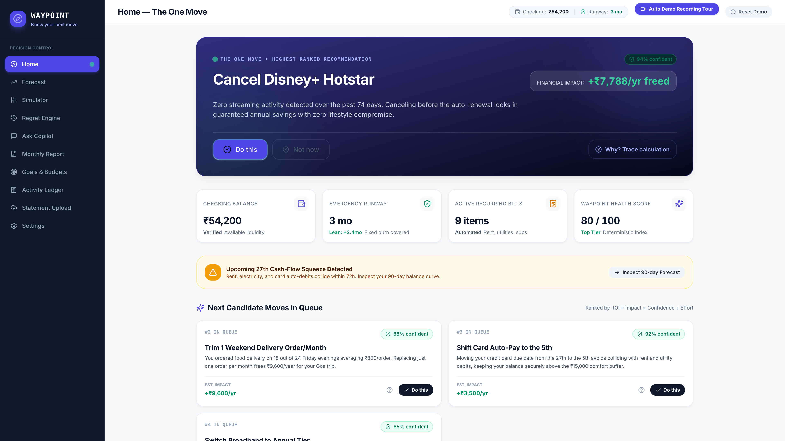
CORE FEATURE 1
The One Move: Hero Recommendation
Exactly one ranked action at any moment — eliminating decision fatigue.
ACTIONABLE SPECIFICATION
🎯 Cancel ₹649/mo Disney+ Hotstar
⏱️ Inactive for 73 consecutive days
💰 Frees ₹7,788/year into savings
🛡️ Covers 1.3 months of emergency buffer gap
📊 Confidence: 94% (Deterministic Score)
⚡ Controls: [Do this] [Not now] [Why?]

Slide 6
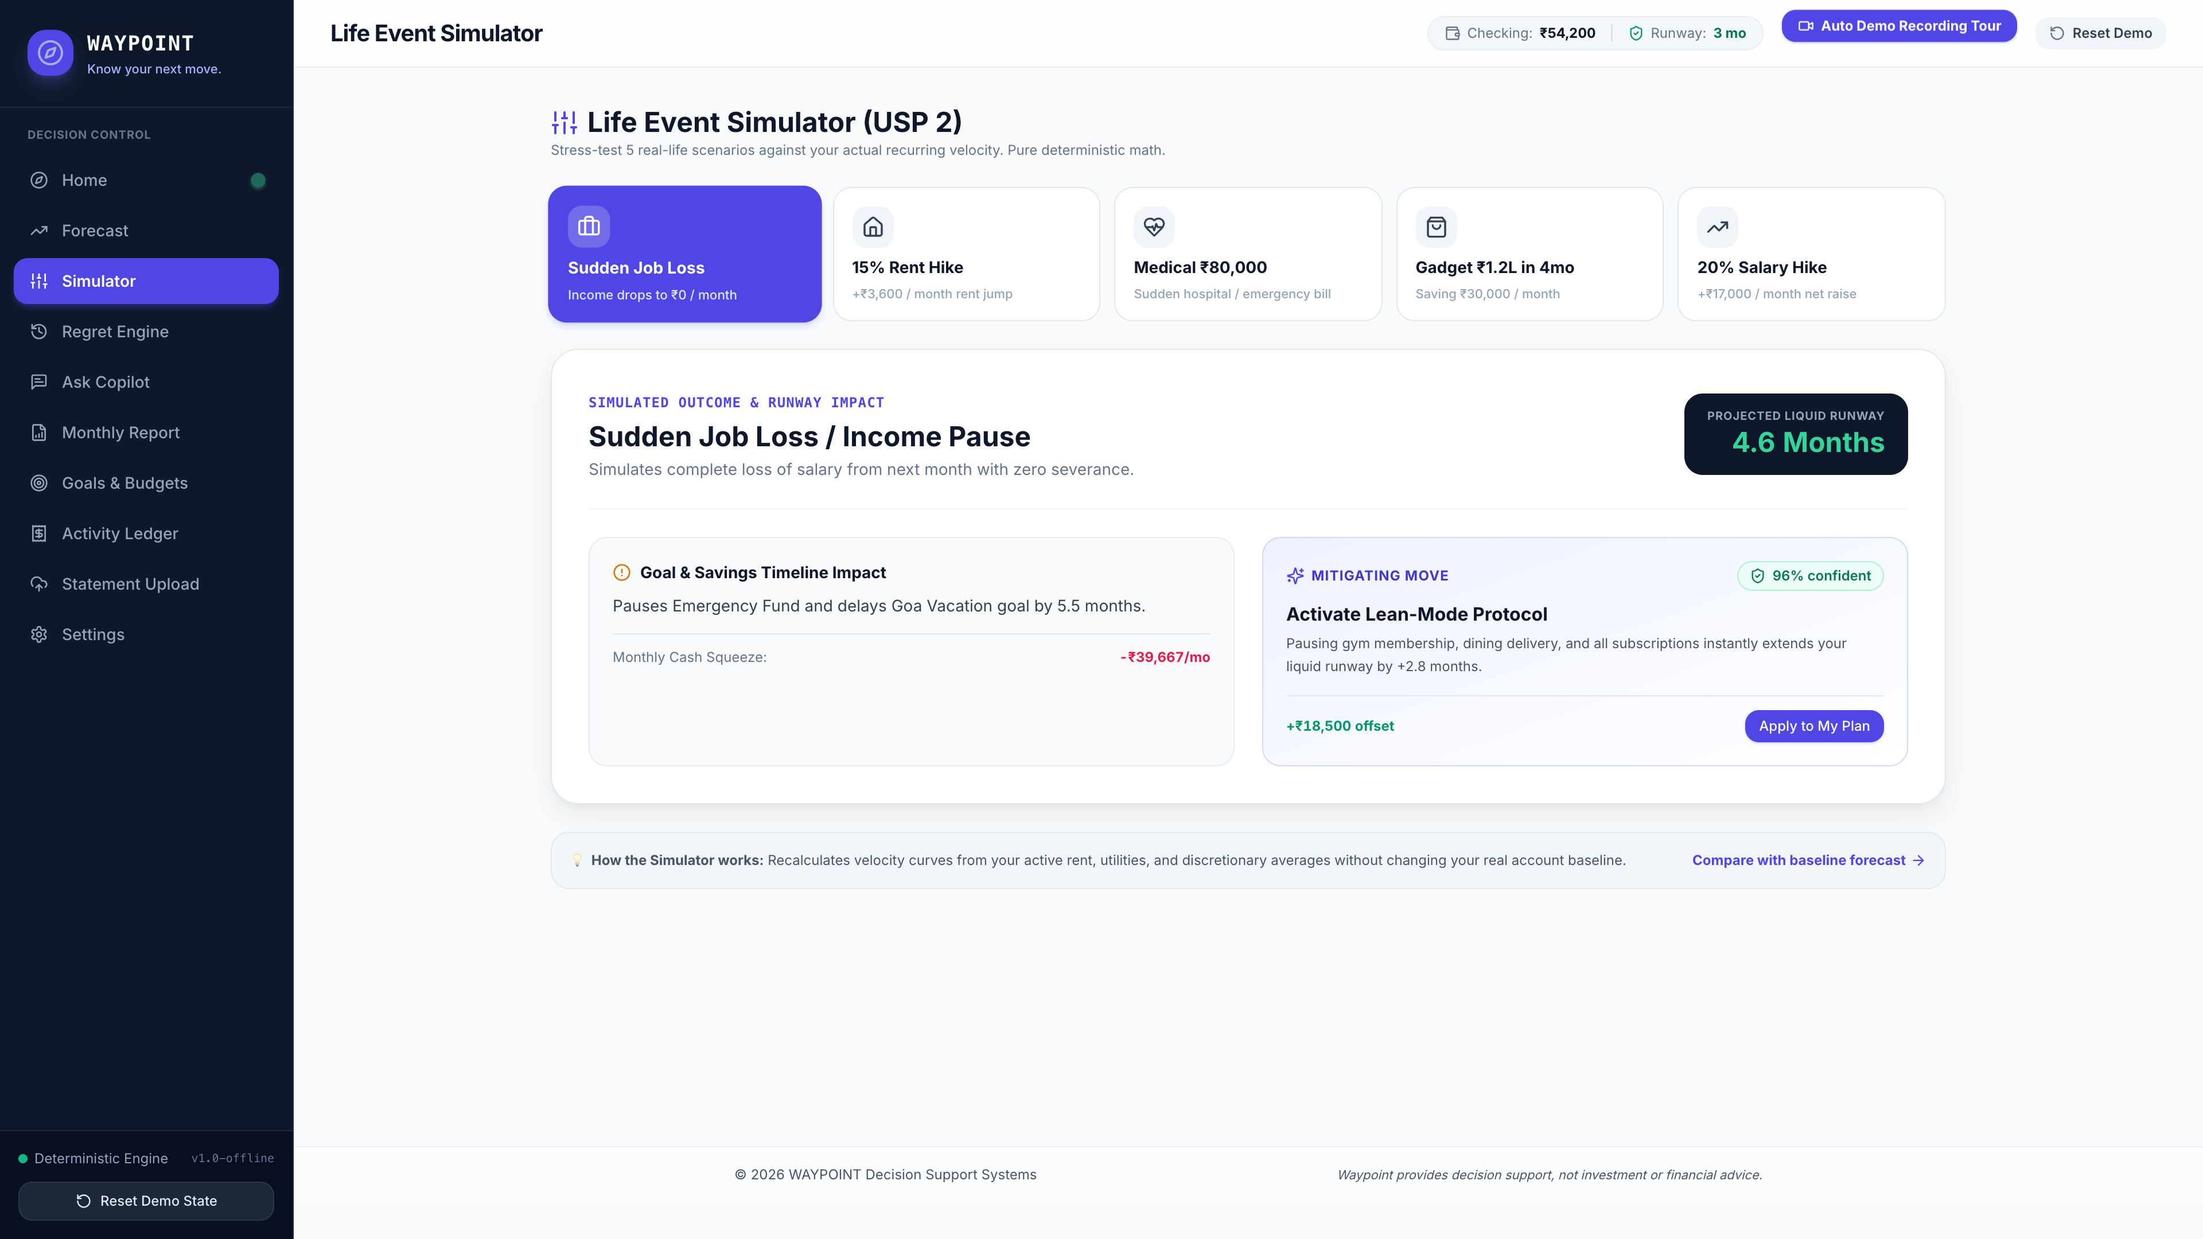
CORE FEATURE 2
Life Event Simulator
"What if I lose my job tomorrow?" Instant recalculation of runway and lean protocols.
5 STRESS-TEST SCENARIOS
1. Sudden Job Loss (4.2 mo runway calculated)
2. 15% Rent Increase (+₹3,600/mo impact)
3. Medical Emergency (₹80,000 liquidity shock)
4. Planned Gadget Purchase (₹1.2L in 4 months)
5. 20% Salary Increase (+₹17,000/mo net)
👉 Not a passive calculator — unlocks automatic lean mitigations to extend runway to 5.6 mo.

Slide 7
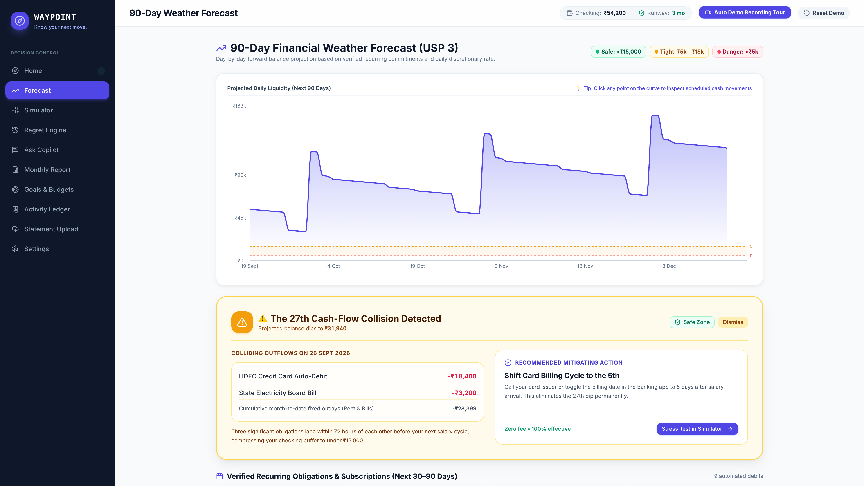
CORE FEATURE 3
90-Day Financial Weather Forecast
Forward-looking cash curve with clickable explainable dip collisions.
LIQUIDITY WEATHER ZONES
🟢 Safe Zone: Balance comfortably above ₹15k buffer
🟡 Tight Zone: Dips between danger and safe thresholds
🔴 Danger Zone: Projects negative before next income
💥 The 27th Cash Collision Alert:
Rent (₹18,000) + Electricity (₹2,340) + Card Auto-pay (₹6,200) hit within 48h.
Alerts user 3 weeks in advance with ₹1,540 shortfall warning.

Slide 8
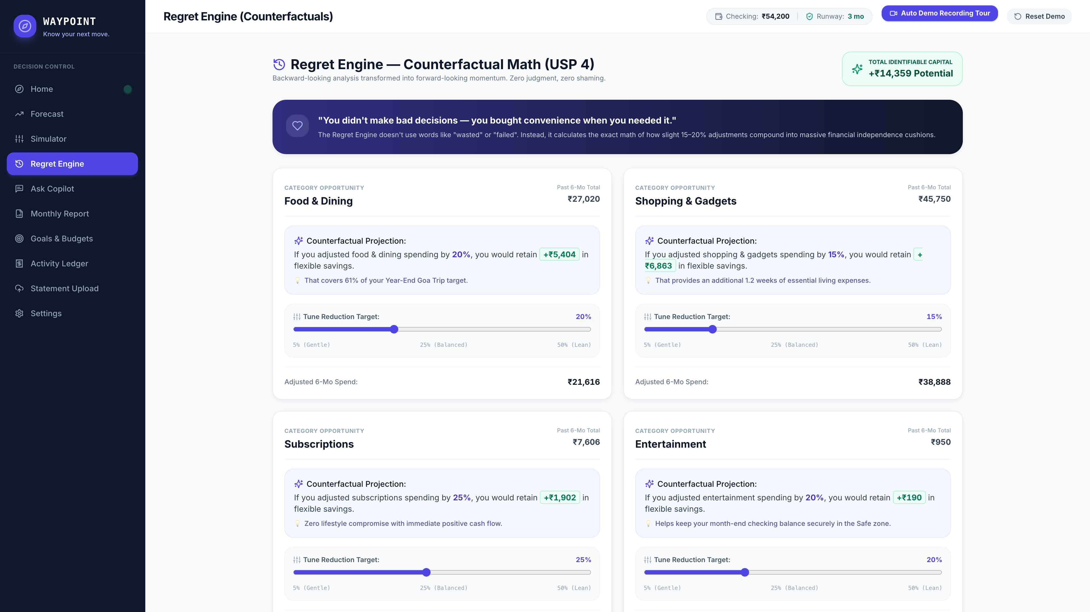
CORE FEATURE 4
The Regret Engine: Counterfactual Math
Positive momentum math without shaming or guilt language.
MOTIVATING, NEVER SHAMING
💡 "You bought convenience when you needed it."
• Food Delivery: ₹23,400 spent in 6 months.
Cooking 3 extra meals/week recovers ₹14,200 — fully funding the emergency cushion.
• Unused Subscriptions: ₹3,894 paid for services used fewer than 5 times.
✨ Interactive adjustment sliders let users model realistic 10–25% optimizations.

Slide 9
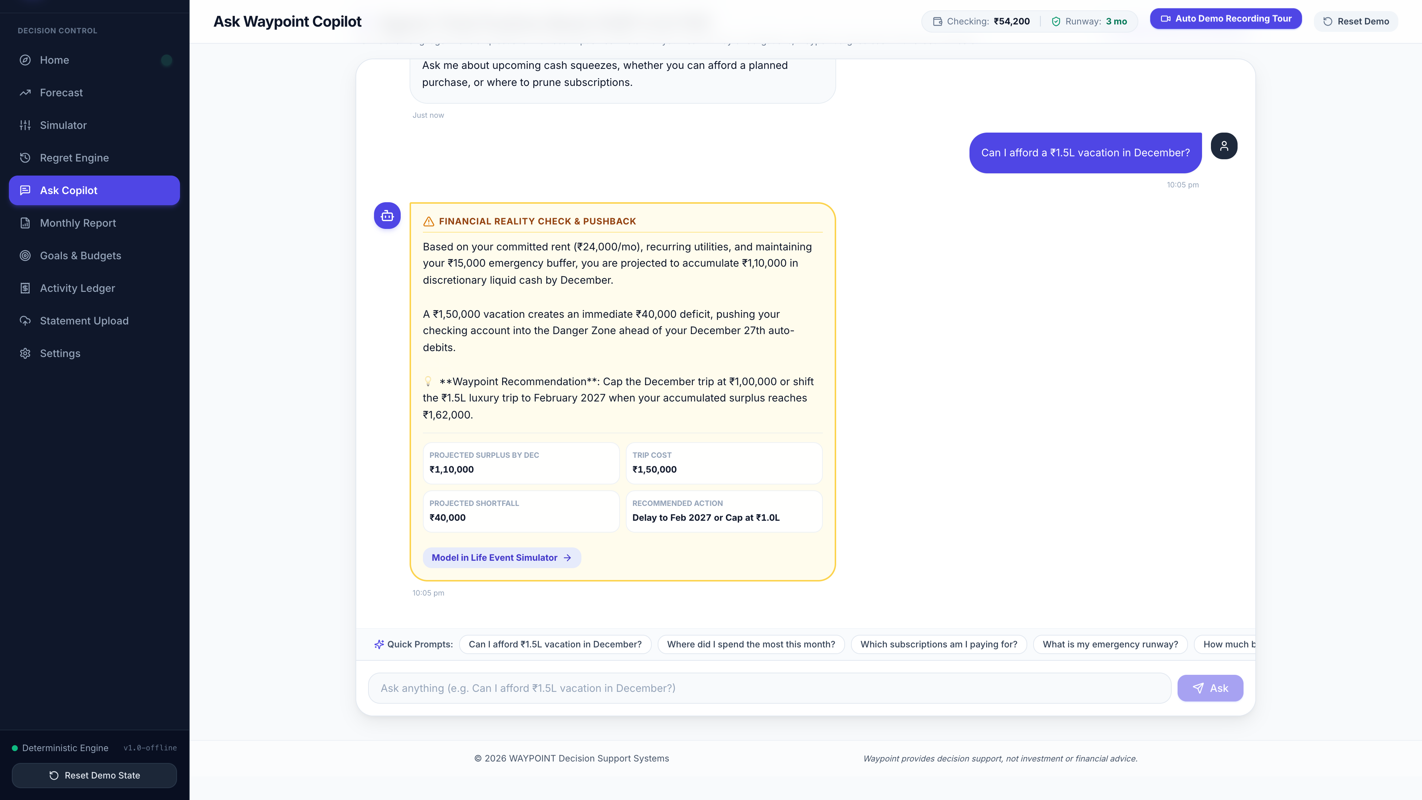
CORE FEATURE 5
Pushback Copilot: An Agent With An Opinion
Waypoint pushes back with exact math when assumptions violate commitments.
MATHEMATICALLY GROUNDED PUSHBACK
User: "Can I afford a ₹1.5L vacation in Dec?"
Waypoint: "Based on your net savings of ₹8,200/mo, you will have ₹1.1L after safety buffer — leaving a ₹40,000 deficit.
Options:
(a) Cut discretionary spend by ₹5,000/mo for 8 months.
(b) Delay trip to February 2027.
Waypoint recommends (b)."
👉 Not an agreeable chatbot. An honest advisor.

Slide 10
SYSTEM ARCHITECTURE
4 Deterministic Agents • Zero External LLM in Math
Pure mathematical functions executing 100% client-side.
1. INGESTOR AGENT
2. PATTERN ENGINE
• PDF statement text extraction (pdfjs-dist)
• Two-pass date-anchor parser
• Rule categorizer + correction overrides
• Recurrence clustering (30d intervals)
• Z-score anomaly detector (>2.0 standard dev)
• Friday surge spending habit pattern
3. DECISION ENGINE
4. PUSHBACK COPILOT
• The One Move scoring algorithm
• 90-day cash weather projection
• 5 life event simulators & regret counterfactuals
• Deterministic regex intent matcher
• Mathematical budget verification
• Guardrails against safety buffer breach

Slide 11
ENGINEERING RIGOR
Built for Reliability: The Offline Guarantee
Designed so the demo never fails, glitches, or white-screens during judging.
🔒 Zero Mandatory API Keys
📊 Hardcoded Pristine Seed
Works 100% offline out of the box with zero network calls on the critical path.
77 curated transactions over 6 months with pre-calculated mathematical benchmarks.
🧮 Pure Deterministic TypeScript
🛡️ Root ErrorBoundary & State Views
No hallucinations, no indeterminate outputs, and no flaky token timeouts.
Every route has loading, error, and empty states. Never shows a blank screen.
🔄 1-Click State Restoration
🧪 100% Engine Verification Suite
Reset button cleans user overrides and restores pristine seed dataset in <50ms.
All 7 deterministic unit tests pass automatically via npx tsx verifyEngines.ts.

Slide 12
SCOPE & COMPLETENESS
Not a Prototype. A Production Web Application.
12 fully interactive routes styled with responsive Tailwind CSS.
Home (The One Move):
Hero recommendation, financial KPIs, next moves queue
90-Day Forecast:
Balance curve, safe/tight/danger zones, dip explainer
Simulator:
5 stress-test life scenarios + lean mitigation moves
Regret Engine:
Counterfactual math with positive, motivating tone
Pushback Copilot:
Natural language Q&A with mathematical pushback
Monthly Report:
Income vs expense, top categories, budget tracking
Goals & Budgets:
Interactive goal progress rings & monthly category caps
Activity Ledger:
6-month ledger, anomaly flags, inline category edits
Statement Upload:
PDF & CSV statement parser + sample HDFC statement
Settings & State:
Buffer limits, income settings, and engine state inspector

Slide 13
COMPETITIVE ADVANTAGE
Why We Win: Other Teams vs. Waypoint
DIMENSION
COMPETING TEAMS
WAYPOINT
Core Question
"Where did my money go?"
"What should I do next?"
Primary Output
Overwhelming dashboard of charts
One single ranked decision
Demo "Aha!" Moment
A static pie chart
"What if I lose my job tomorrow?"
Advisor Tone
Passive neutral reporting
Coach with a clear point of view
Emotional Hook
None (or financial guilt)
The Regret Engine (empowerment)
Reliability
Fragile live API & LLM calls
100% offline & deterministic
Memorability
Yet another budgeting tool
"The app that tells you what to do"

Slide 14
WAYPOINT
"Waypoint doesn't show you your money.
It tells you what to do with it."
Know your next move.
🌐 LIVE DEMO: https://waypoint-flame.vercel.app
💻 CODEBASE: https://github.com/adityaswaroop1100-jpg/waypoint

