Slide 1
MOBILE PHONE
PRICE PREDICTION
Exploratory Data Analysis • Feature Engineering • Machine Learning
Nexthikes IT Solutions
Presented by Aditya Tambe

Slide 2
What this project does
The project analyses mobile phone specifications and builds a regression model to estimate a phone’s price.
01 Understand the data
02 Explore patterns
Inspect rows, columns, data types, missing values, duplicates and summary statistics.
Compare price with brand, RAM, memory, processor, camera and other specifications.
02

Slide 3
Project workflow
01
02
03
04
05
06
Load data
Inspect & clean
EDA
Feature work
Train model
Evaluate & use
CSV dataset
Quality checks
Charts & patterns
New variables
Random Forest
Metrics + interface
Each stage prepares the next: reliable inputs → useful patterns → model predictions.
03

Slide 4
Dataset inspection
Read the processed mobile dataset from a CSV file.
Preview the first and last five records.
Check dataset shape, column names and data types.
Review missing values, duplicate rows and unique values.
Use descriptive statistics to understand numeric and categorical columns.
Core inspection tools
head() • tail() • info() • shape • describe()
Why it matters
These checks reveal the dataset structure before cleaning or analysis.
04

Slide 5
Data cleaning and preprocessing
Remove irrelevant index
Standardise price
Handle invalid target
Drop the “Unnamed: 0” column when it exists.
Remove commas and spaces, then convert Prize to numeric.
Remove rows where the target price is missing or invalid.
Remove exact duplicates
Recheck data quality
Inspect price range
Check duplicate rows and remove them if present.
Review missing values and data types after cleaning.
Print minimum, maximum, mean and median price.
05

Slide 6
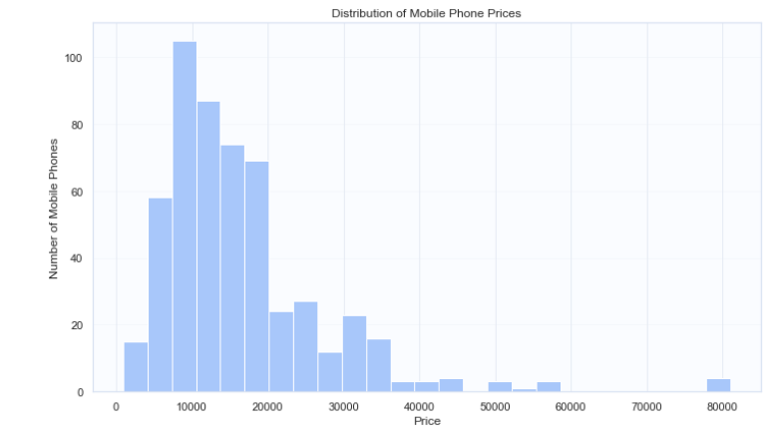
Mobile price distribution
Price histogram
Shows how mobile prices are distributed across the dataset.
Helps identify common price ranges and possible skewness.
Can reveal whether a small number of phones occupy the high-price range.
06

Slide 7
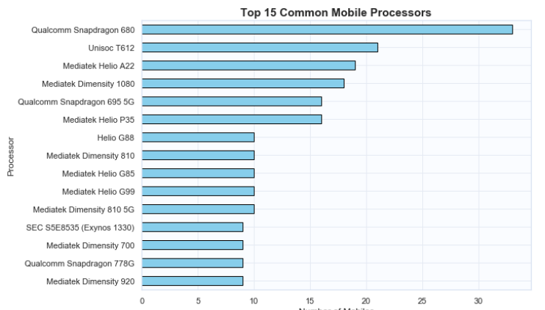
Most common mobile processors
Top 15 processors
Counts the 15 most frequent processor labels.
Highlights which processor types are most represented.
Shows dataset coverage, not processor performance.
Processor price averages are also explored separately in the notebook.
08

Slide 8
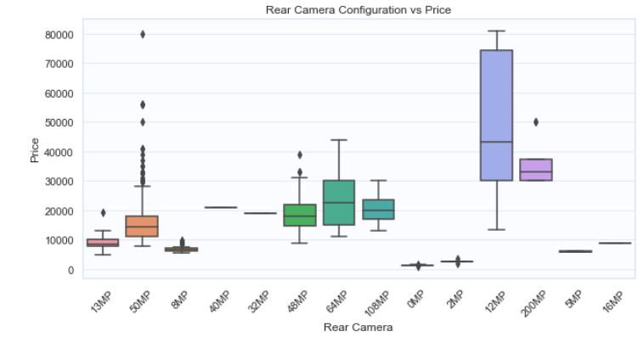
Rear camera configuration vs price
Camera configuration boxplot
Compares price distributions across rear camera configurations.
Median lines show typical prices within each category.
Box height indicates price variation within a category.
Overlapping ranges suggest camera configuration is not the only pricing factor.
09

Slide 9
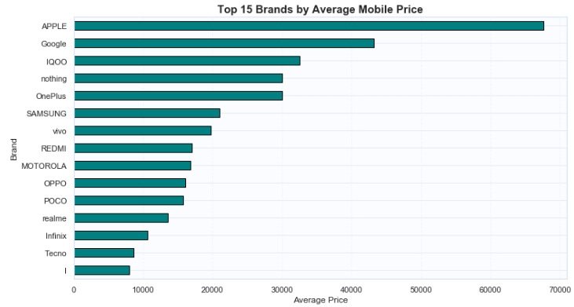
Brand-wise mobile price analysis
Top 15 brands by average price
Extracts the first word of Model as the Brand label.
Calculates mobile count, average price, maximum and minimum price.
Sorts brands by average price and displays the top 15.
Useful for comparing brand-level pricing patterns.
10

Slide 10
RAM and internal memory vs price
Average price by internal memory
Average price by RAM
The notebook groups records by Memory, calculates mean Prize for each category and plots a horizontal bar chart.
The notebook groups records by RAM, calculates mean Prize for each category and plots a horizontal bar chart.
11

Slide 11
Correlation and additional comparisons
Correlation heatmap
Processor vs price
AI Lens vs price
Uses numeric columns and pairwise correlation coefficients to show linear relationships.
Calculates average price by processor and displays the top 10.
Compares average price for each AI Lens category.
Correlation ranges from −1 to +1. A relationship in the heatmap does not by itself prove cause and effect.
12

Slide 12
Convert specifications into numeric features
RAM_GB
Memory_GB
Extracts the numeric RAM value from the RAM text.
Extracts storage capacity; TB values are converted to GB (× 1024).
Battery_mAh
Mobile_Height_Num
Extracts the numeric battery capacity from Battery_.
Extracts the numeric mobile height value.
13

Slide 13
Create combined and ratio-based features
Camera megapixels
Total_Camera_MP
RAM_Memory_Product
Rear_Camera_MP and Front_Camera_MP sum megapixel values extracted from camera text.
Adds the rear and front camera megapixel features.
Multiplies RAM_GB by Memory_GB.
Storage_RAM_Ratio
Battery_RAM_Ratio
Divides Memory_GB by RAM_GB; zero RAM is replaced with NaN.
Divides Battery_mAh by RAM_GB; zero RAM is replaced with NaN.
14

Slide 14
Train, predict and evaluate
Prepare features
Split the data
Train model
Separate Prize as the target; one-hot encode categorical columns with get_dummies().
80% training and 20% testing; random_state = 42.
RandomForestRegressor with 100 estimators.
MAE
RMSE
R² score
Average absolute difference between actual and predicted prices. Lower is better.
Penalises larger prediction errors more strongly. Lower is better.
Measures performance relative to predicting the test-set mean. Closer to 1 is generally better.
16

Slide 15
Brand and AI Lens availability
Brand
AI_Lens_Available
Extracts the first word from Model after trimming spaces. This separates manufacturer information from the full model name.
Converts AI Lens values into a binary indicator: 1 when available and 0 for values such as no, false, 0 or missing text.
15

Slide 16
Prediction interface & conclusion
User input
Price estimate
Saved files
Enter or select mobile specifications through input prompts or an ipywidgets interface.
The trained model returns an estimated price for the supplied specifications.
Model pickle, feature-column list, prediction CSV and project summary text file.
Project takeaways
The workflow combines data cleaning, EDA, feature preparation and Random Forest regression.
The notebook includes charts, an interactive prediction form and saved model artefacts.
Next improvement: pass the engineered features consistently into training and prediction, then compare model performance.
THANK YOU
Aditya Tambe • Mobile Price Prediction

