Slide 1
A Homomorphic Searching Scheme For Sensitive Data In NoSQL Database
Baohua Huang, Sheng Liang, Dongdong Xu, Zhuohao Wan
Aditya Tawade 1911126 B4

Slide 2
Abstract
NoSQL database system is widely used in Big Data environment for its high performance and scalability. Due to the width of usage of NoSQL database, it is inevitable to store sensitive data in it.
Utilizing homomorphic encryption, sensitive data can be encrypted and calculated in the form of ciphertext to preserve privacy. Although calculating on homomorphically encrypted data is possible, searching on these data is not simple for the calculating results are encrypted and the search engine doesn’t know what data should be sent back to the requester.

Slide 3
A homomorphic searching scheme is proposed to handle this problem. In this scheme, the searching function is divided into two parts named homomorphic comparing and homomorphic decryption.
The homomorphic comparing is executed by the encrypted data holder, and the homomorphic decryption is executed by the key holder. With this scheme, encrypted data holder can only get encrypted data and calculate the encrypted differences of these data, and the key holder can only get the encrypted differences and decrypt them

Slide 4
Introduction
When it is running in shared mode, there is no authentication and authorization supported, so MongoDB in shared mode is incapable to store sensitive data.
When it is running in standalone or replica-set mode, authentication and authorization are enabled.
Even if authentication has been enabled, then the Mongo databases supports only two types of users: read-only and read-write. Read-only users can query everything in the database, while read-write users have full access to all the data in the database on which they are defined

Slide 5
Introduction
Because NoSQL database systems generally focus on improving performance and scalability to fulfill the requirements of Big Data environment, they pay less attention on the security.
The homomorphic encryption function is used to encrypt sensitive data into calculatable ciphertext. In order to preserve privacy of sensitive data, calculating of searching procedure and calculating results decryption are done by two different parts.

Slide 6
Homomorphic Encryption
The main idea of homomorphic encryption is to encrypt plain data into ciphertext, calculate on ciphertext directly to get result in ciphertext, and decrypt the result ciphertext to get plain result finally.

Slide 7
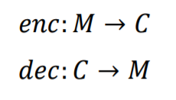
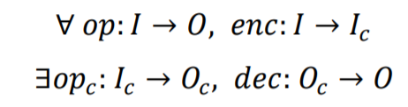
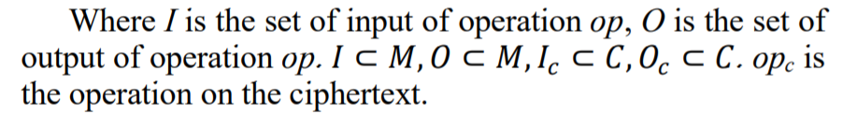
Homomorphic Encryption
Formally, if encryption algorithm enc and decryption algorithm dec,
enc : M→ C ,
dec: C→M
Where M is the set of plain data, C is the set of ciphertext data.
Then enc with dec can be called homomorphic encryption.

Slide 8
Homomorphic Encryption
There are various types of homomorphic encryption algorithm, e.g partial homomorphic encryption, somewhat homomorphic and full homomorphic encryption, etc.
The partial homomorphic encryption algorithm can only support limited operations on the ciphertext, e.g multiplication or addition. The somewhat homomorphic encryption algorithm can support all necessary operations but the operation steps are limited.
The full homomorphic encryption algorithm can support all operations and unlimited operation steps.
To support searching on ciphertext, the full homomorphic is not necessary for the operation and operation steps are both limited

Slide 9

Privacy Preserving Searching
Privacy preserving searching can based on homomorphic encryption supporting subtraction.
Formally, dc is the ciphertext of data in database, qc is the ciphertext of query data, the ciphertext of difference between dc and qc is
Where -c is subtraction on ciphertext, rc is the ciphertext of difference, and r is the plaintext of rc. If r equals zero, then the query data is found in database and vice versa.
In the searching procedure, if dc and qc both are not decrypted, the data searching is privacy preserving even if rc, the ciphertext of the difference between them needs to be decrypted.

Slide 10
The Problem of Searching with Homomorphic Encryption
In the procedure of searching described in previous section, if rc can be decrypted, then dc and qc can be decrypted also for rc is calculated from dc and qc, and these data are encrypted with the same key.
To tackle this problem, we need to separate the calculating and decryption of the searching procedure to executing on two host in different domain, so as to separate the key from the ciphertext from NoSQL database and ciphertext from the user’s query.

Slide 11
HOMOMORPHIC SEARCHING SCHEME
The homomorphic searching scheme tries to apply homomorphic encryption to encrypt plain data into calculatable ciphertext, and to deploy calculating on Search Engine, and to place decryption on Decrypter.

Slide 12
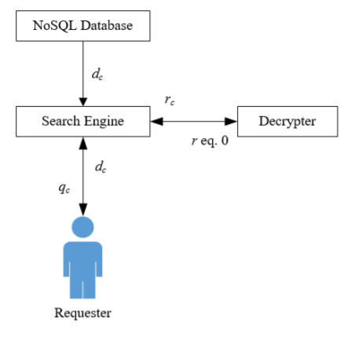
Structure of the Scheme
In order to separate calculating and decryption of searching procedure, we can design the structure of the scheme as shown:
Sensitive data were encrypted with homomorphic encryption and stored in NoSQL database. The Search Engine and Decrypter are two services running separately on two hosts in different security domain. Thus, the ciphertext data and its decryption key are separated. None of Search Engine and Decrypter has both ciphertext data and key, so the data privacy is preserved.

Slide 13
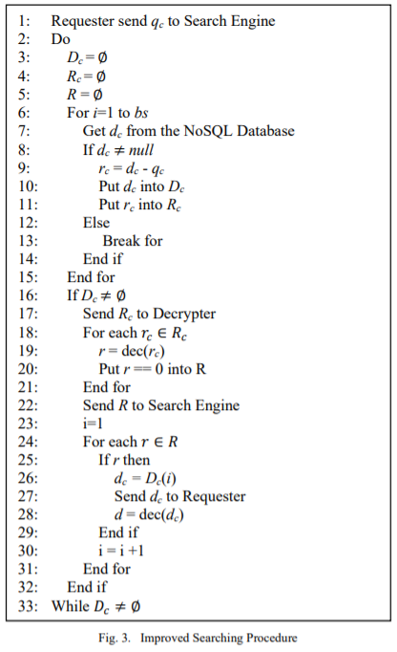
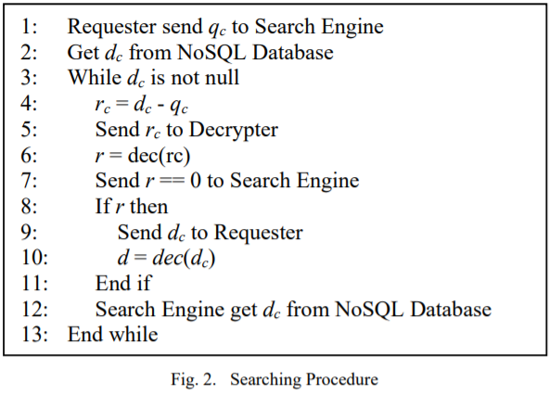
Searching procedure
The searching procedure consists of two main phases: calculating and decryption. The calculating phase gets the ciphertext of difference between database data and user’s query; the decryption phase gets the plaintext difference.

Slide 14
SAMPLE IMPLEMENTATION WITH MONGODB

Slide 15
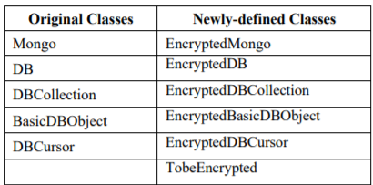
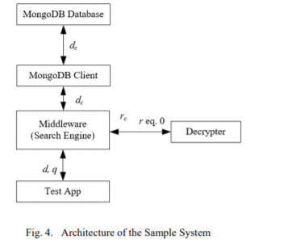
MongoDB Access and System Architecture
Classes in the middleware are
These newly-defined classes are modified to encrypt data with homomorphic encryption algorithm and to support searching over encrypted data.

Slide 16

Homomorphic Encryption Algorithm
The key is an odd integer p > 2N. An encryption of a bit b is simply a random multiple of p, plus a random integer with the same parity as b. Formally, The ciphertext of b is
where x is a random integer in (-n/2, n/2), and k is an integer chosen from some range. In decryption,
b = (c mod p) mod 2
where (c mod p) is the number in (-p/2, p/2) that equals c modulo p. Actually, (c mod p), which is the noise parameter in this scheme, will be in [-n, n], since b + 2x is in that range. The decryption would have worked correctly as long as

Slide 17
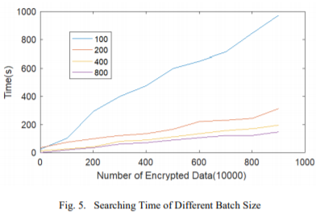
Experimental Result
The test is running on a PC with 16GB Ram, one Intel i7 CPU with 8 cores. The operating system is Fedora 24.
Time needed in searching under various conditions is tested. According to the searching scheme, the searching time must relate to number of encrypted data in database and the size of batch.
The searching time and number of encrypted data have a linear correlation. The searching time linearly increase with the number of encrypted data.
The batch size affect the rate of increase. The small the batch size is, the high the rate of increase will be.
There is a upper limitation of batch size, to outnumber it will not get lower increase rate of time.

Slide 18
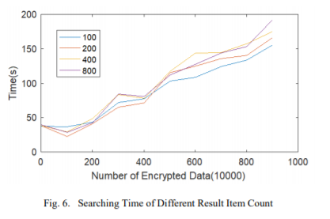
Experimental Result
The searching time may be related to the number of query result item count.
Searching time is not very closely related to the result item count

Slide 19
RELATED WORKS
There are works focus on power efficiency , Scalable and Cost-efficient of low level data storage, etc. There are also a lot of works focus on high level data management. NoSQL database is a kind of data management system running at the high level, which directly support application.
NoSQL database is widely used in Big Data and Cloud Computing environment.
For example, Sarkar et al use Hadoop to manage personal health record .
Zhang et al propose HBaseSpatial, a scalable spatial data storage based on HBase. Jeong et al propose a NoSQL-based method to collect and integrate security logs using MapReduce
Lehmann et al design a data structure for storing time-series data in a MongoDB document for optimal query performance of large datasets, and implement Office Analysis as a Service using MongoDB. Obviously , there are a lot of sensitive data managed by NoSQL database.

Slide 20
RELATED WORKS
Although NoSQL database is widely used in Big Data environment and stores a lot of sensitive data that must be manipulated under more attentions, there are not much mechanism to provide security guarantees. HBase and MongoDB are two typical example.

Slide 21
HBase
HBase is an open source project of Apache, and is built on Hadoop and HDFS.
In HBase, the granularity of access is column.
Although Apache Accumulo project says it can ensure cell control and provide the key-value pair of security, the deployment and configuration for Apache Accumulo is not very convenient. Additionally, permissions of HBase is 578 coarse-grained.
It only has 5 different permissions, such as READ, WRITE, CREATE, EXEC and ADMIN

Slide 22
MongoDB
MongoDB is a document database managing collections of JSON-like documents.
In MongoDB, data-files are unencrypted.
It heavily utilizes JavaScript as an internal scripting language. Internal commands available to the developer are actually short JavaScript scripts. It is even possible to store JavaScript functions in the database in the db.system.js collection that are made available to the database users. This makes MongoDB potential for injection attacks.
Mongo databases supports only two types of users: read-only and read-write. Read-only users can query everything in the database, while read-write users have full access to all the data in the database on which they are defined.
As for auditing, MongoDB doesn’t provide any facilities for auditing actions performed in the database

Slide 23
Lai et al propose a fine grained access control framework which extends the access control permissions according to the atomic operations of HBase.
Hou et al analyze MongoDB security and design injection defense solution.
In their previous work, they developed a transparent middleware for encrypting data in MongoDB.
Xu et al propose CryptMDB, a practical encrypted MongoDB over Big Data. It utilizes an additive homomorphic asymmetric cryptosystem to encrypt user’s data and achieve strong privacy protection. These existing works don’t discuss searching over encrypted data in NoSQL database

Slide 24
Conculsion
Homomorphic encryption makes it possible to calculate on ciphertext and get encrypted result.
Searching need to know the calculating result in plaintext to decide if the compared data should send to requester.
The proposed homomorphic searching scheme separates the calculation and decryption to achieve privacy preserving of sensitive data.
For NoSQL database and search engine, they only have encrypted data; for Decrypter, even if it has the key of encrypted data, it can only access the encrypted difference of database data and query data and decrypt this difference into plaintext.

Slide 25
Bibliography
https://www.microsoft.com/en-us/research/project/homomorphic-encryption/
https://www.makeuseof.com/what-is-homomorphic-encryption/
https://ieeexplore.ieee.org/document/8726827/

Slide 26
Implementation Details
Since, the sample implementation in this paper is performed on MongoDb, MongoDb will be the database which will be used in my implementation
Python language will be used in the implementation of the research paper.
Algorithms which will be studied for the purpose of implementation of this paper ideas :
Paillier cryptosystem
BFV scheme
CKKS scheme

Slide 27
Aditya Tawade
Roll No:1911126 Batch:B-4

