Slide 1
Artificial Intelligent System for Automatic Depression Level Analysis Through Visual and Vocal Expressions
Under the Guidance of Presented by
Dr. Sanjit Kumar Dash Aditya Prasad Tripathy
1701106508

Slide 2
Content
Introduction
Related Works
Framework
Experimental Results
Conclusion
References

Slide 3
Abbreviations
MDD – Major Depressive Disorder
FACS – Facial Action Coding System
EEG – Electroencephalogram
ECG – Electrocardiogram
FDHH – Feature Dynamic History Histogram
PLS – Partial Least Square
LR – Linear Regression
BDI – Beck Depression Inventory
PCA – Principal Component Analysis
LBP – Local Binary Pattern
EOH – Edge Orientation Histogram
LPQ – Local Phase Quantization
VGG – Visual Geometry Group
LLD – Low Level Depression
MFCC – mel-frequency cepstral co-efficient
MAE – Mean Absolute Error
RMSE – Root Mean Square Error
AVEC2014 – Audio-Visual Emotion Recognition Challenge 2014
APP1 – Approach 1
APP2 – An Alternate Approach i.e. Approach 2
MHH – Motion History Histogram

Slide 4
Introduction (About Depression and use of AI in this field )
Mental health issues such as depression have been linked to deficits of cognitive control. It affects one in four citizens of working age, which can cause significant losses and burdens to the economic, social, educational, as well as justice systems.
Depression is defined as “a common mental disorder that presents with depressed mood, loss of interest or pleasure, decreased energy, feelings of guilt or low self-worth, disturbed sleep or appetite, and poor concentration”.
Among all psychiatric disorders, major depressive disorder (MDD) commonly occurs and heavily threatens the mental health of human beings. Recent study indicates that having a low income shows an increased chance of having MDDs.
Artificial intelligence and mathematical modelling techniques are being progressively introduced in mental health research to try and solve this matter. Recent artificial modelling and methods of automatic emotion analysis for depression related issues are extensive.

Slide 5
Introduction (Use of AI in the field of depression detection)
The approach to classify emotion through facial expressions is using local and holistic feature descriptors. These techniques treat the whole face the same and look for patterns throughout, and not just for certain muscles.
However, the depression disorder is not limited to be expressed by the face. The perception of emotional body movements and gestures has shown it can be observed through a series of controlled experiments using patients with and without MDD.
In order to create a practical and efficient artificial system for depression recognition, visual and vocal data are key as they are easily obtainable for a system using a camera and microphone.
Deep learning is also a research topic that has been adopted toward visual modality, especially in the form of a convolutional neural network (CNN).

Slide 6
Introduction (Available CNN Models in the field of depression detection)
Recently, the effectiveness of deep networks have been portrayed in different tasks such as face identification, image detection, segmentation and classification and many other tasks.
The majority of these applications have only become achievable due to the processing movement from CPU to GPU. The GPU is able to provide a significantly higher amount of computational resources versus a CPU, to handle multiple complex tasks in a shorter amount of time.
Now there are a variety of deep networks available such as AlexNet and the VGG networks. These pretrained CNN models such as VGGFace provide good features at the frame level of videos, as they are designed for still images.
The aim of this paper is to build an artificial intelligent system that can automatically predict the depression level from a user’s visual and vocal expression.

Slide 7
Related Works
Recent years have witnessed an increase of research for clinical and mental health analysis from facial and vocal expressions. There is a significant progress on emotion recognition from facial expressions.
In depression analysis, Cohn et al., who is a pioneer in the affective computing area, performed an experiment where he fused both visual and audio modality together in an attempt to incorporate behavioural observations, from which are strongly related to psychological disorders. Their findings suggest that building an automatic depression recognition system is possible, which will benefit clinical theory and practice.
Girard et al. analysed both manual and automatic facial expressions during semi structured clinical interviews of clinically depressed patients. They concluded that participants with high symptom severity tend to express more emotions associated with contempt, and smile less.
Scherer et al. studied the correlation between the properties of gaze, head pose, and smile of three mental disorders (i.e., depression, post-traumatic stress disorder, and anxiety). They discovered that there was a distinct difference between the highest and lowest distressed participants, in terms of automatically detected behaviours.
Recently, deep learning techniques have made significant progress on visual object recognition, using deep neural networks that simulate the humans vision-processing procedure that occurs in the mind. These neural networks can provide global visual features that describe the content of the facial expression.

Slide 8
Framework
Human facial expressions and voices in depression are theoretically different from those under normal mental states. Depression scale prediction is achieved by combining dynamic descriptions within naturalistic facial and vocal expressions.
A novel method is developed that comprehensively models the variations in visual and vocal cues, to automatically predict the BDI-II scale of depression.
The proposed framework is an extension of the previous method by replacing the hand-crafted techniques with deep face representations as a base feature to the system.
System Overview
Visual Feature Extraction
Audio Feature Extraction
Feature Dynamic History Histogram
Feature Combination and Fusion
Alternate Feature Extraction Approach
Regression

Slide 9
Framework (System Overview)
Dynamic pattern variations are captured across the feature vector, which is reduced in dimensionality and used with regression techniques for depression analysis.
For the deep feature process, the temporal data for each sample is broken down into static image frames which are pre-processed by scaling and subtracting the given mean image.
These are propagated forward into the deep network for high level feature extraction. Once the deep features are extracted for a video sample, it is rank normalized between 0 and 1 before the FDHH algorithm is applied across each set of features per video.
The audio is split into segments and two sets of features are extracted from these segments. Then one of these sets are reduced in dimensionality and used with regression techniques to predict the depression scale.
Both frameworks are unimodal approaches. The efforts are combined at feature level by concatenating the features produced by each framework just before principal component analysis (PCA) is applied. This gives a bimodal feature vector, which is reduced in dimensionality using PCA and is rank normalized again between 0 and 1.

Slide 10
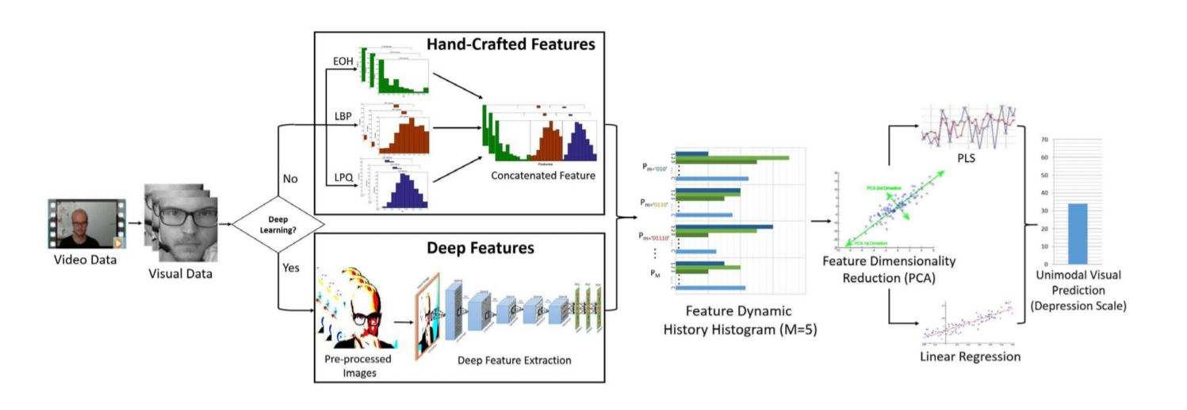
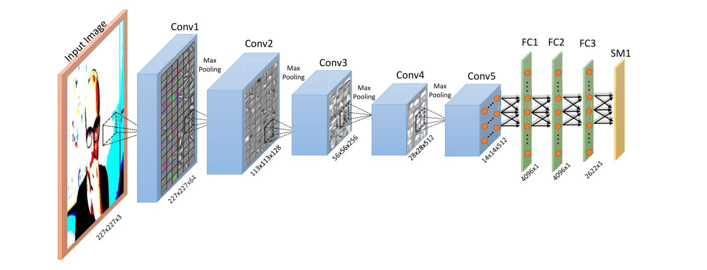
Framework (Visual Feature Extraction)

Slide 11
Framework (Visual Feature Extraction cont.)
This section looks at the different techniques and algorithms used to extract visual features from the data.
Hand-Crafted Image Feature Extraction: Previously, the approach was based on investing in handcrafted techniques to represent the base features. These were applied on each frame, similar to the deep face representation, with three different texture features LBP; edge orientation histogram (EOH) and LPQ.
Architectures for Deep Face Representation: In this section, different pretrained CNN models are introduced, detailing the architectures and its designated application.
VGG-Face: Visual Geometry Group have created a few pretrained deep models, including their very deep networks. These networks are VGG-S, VGG-F, and VGG-M networks which represent slow, fast, and medium, respectively. The VGG-Face pretrained CNN contains a total of 36 layers, where 16 are convolution layers and 3 are fully connected layers.
AlexNet: AlexNet, created by Krizhevsky et al., is another popular network, which was one of the first successful deep networks used in the ImageNet challenge. This pretrained CNN contains 21 layers in total.

Slide 12
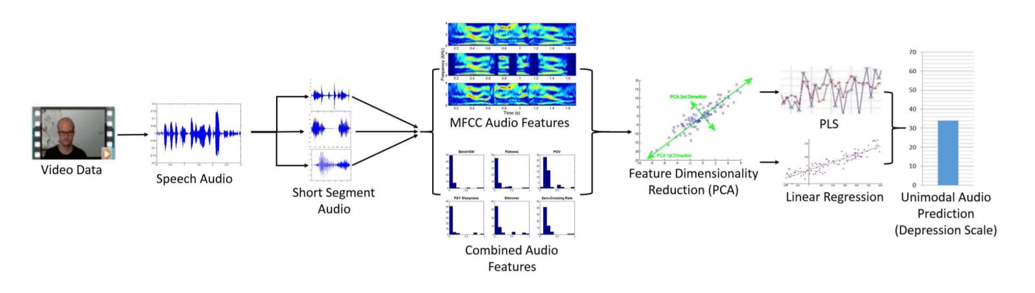
Framework (Audio Feature Extraction)

Slide 13
Framework (Audio Feature Extraction cont.)
For audio features, the descriptors are derived from the set provided.
They include spectral LLDs and MFCCs 11–16. There are a total of 2268 features, with more details in. These features are further investigated to select the most dominant set by comparing the performance with the provided audio baseline result.
The process includes testing each individual feature vector with the development dataset, where the top eight performing descriptors are kept.
Then, each descriptor is paired with every other in a thorough test to find the best combination.
This showed Flatness, Band1000, PSY Sharpness, POV, Shimmer, and ZCR to be the best combination, with MFCC being the best individual descriptor.

Slide 14
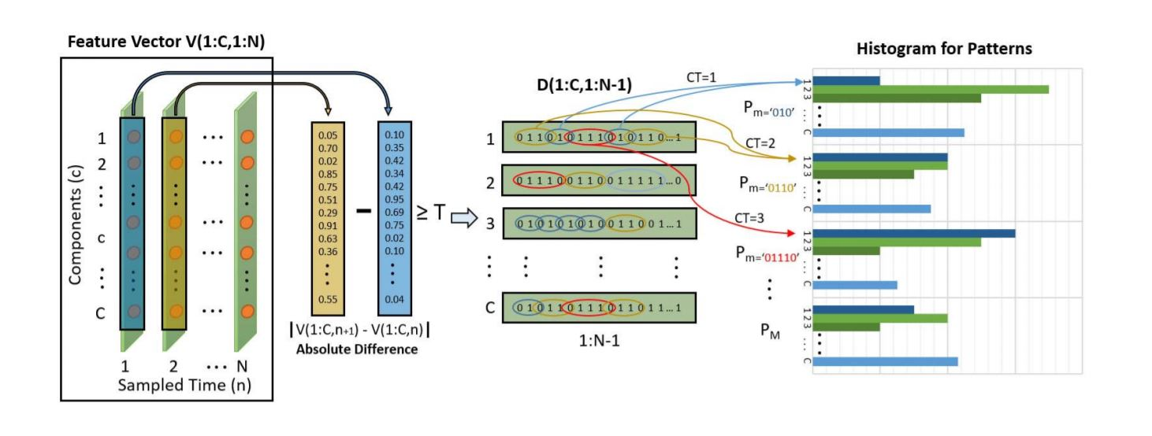
Framework (Feature Dynamic History Histogram)

Slide 15
Framework (Feature Dynamic History Histogram cont.)
To obtain the benefits of using hand-crafted techniques on the spatial images, along with applying the principals of temporal-based motion techniques.
This was achieved by capturing the motion patterns in terms of dynamic variations across the feature space.
This involves extracting the changes on each component in a feature vector sequence (instead of one pixel from an image sequence), so the dynamic of facial/object movements are replaced by the feature movements.
Pattern occurrences are observed in these variations, from which histograms are created.

Slide 16
Framework (Feature Combination and Fusion)
Once the deep features are extracted, FDHH is applied on top to create M feature variation patterns for each deep feature sequence.
The resulting histograms provide a feature vector that contains the information of the dynamic variations that occur throughout the features.
The audio features are then fused with the dynamic deep features by concatenating them together, producing one joint representational vector per sample, which is normalized between [0, 1].
Doing this reduces the computational time and memory for some regression techniques such as LR.
PCA is performed on the fused feature vector to reduce the dimensionality and decorrelate the features.
After PCA is applied, the feature is once again normalized between [0, 1] using the training data.

Slide 17
Framework (Alternate Feature Extraction Approach)
For comparison purposes, another approach (APP2) is undergone to apply the original motion history histogram MHH on the visual sequences, that was used similarly by Meng et al.. Their approach has been extended here by using deep features.
The frames are treated as individual image inputs for the deep CNNs and are forward propagated until the SoftMax layer. This approach closely resembles the main approach to allow for fair testing when evaluating and comparing them together.
The 4096-dimensional features are extracted from similar layers to the main approach, resulting in a deep feature vector of M × 4096 per video sample.
These features are then transformed to a single vector row from which it is fused with the same audio features used in the main approach.
They are then rank normalized between [0, 1] using the training data range before the dimensionality is reduced using PCA to L = 49, and finally the reduced feature vector is rank normalized again between [0, 1] using the training data range.

Slide 18
Framework (Regression)
There are two techniques adopted for regression.
Partial Least Square (PLS) regression is a statistical algorithm which constructs predictive models that generalize and manipulates features into a low-dimensional space. This is based on the analysis of relationship between observations and response variables. In its simplest form, a linear model specifies the linear relationship between a dependent (response) variable, and a set of predictor variables. PLS regression fits multiple response variables in a single model. PLS regression models the response variables in a multivariate way. This can produce results that can differ significantly from those calculated for the response variables individually.
Linear Regression (LR) is another approach for modelling the relationship between a scalar dependent variable and one or more explanatory variables in statistics. It was also used in the system along with PLS regression for decision fusion. The prediction level fusion stage aims to combine multiple decisions into a single and consensus one.
The predictions from PLS and LR are combined using prediction level fusion based on the weighted sum rule.

Slide 19
Experimental Results (About the dataset)
The dataset contains 300 video clips with each person performing the two human– computer interaction tasks separately whilst being recorded by a web-cam and microphone in a number of quiet settings.
All the participants are recorded between one and four times, with a period of two weeks between each recording.
The length of these clips are between 6 s to 4 min and 8 s.
The mean age of subjects is 31.5 years, with a standard deviation of 12.3 years and a range of 18–63 years.
The range of the BDI-II depression scale is [0, 63],
where 0–10 is considered normal, as ups and downs;
11–16 is mild mood disturbance;
17–20 is borderline clinical depression;
21–30 is moderate depression;
31-40 is severe depression;
and over 40 is extreme depression.
The highest recorded score within the AVEC14 dataset is 45, which indicates there are subjects with extreme depression included.

Slide 20
Experimental Results (Experimental Setting)
The results for each test are evaluated by its the mean absolute error (MAE) and root mean squared error (RMSE) against the ground-truth labels.
The MatConvNet toolbox has been used to extract the deep features. This tool has been opted for the experiments as it allows full control over deep networks with access to data across any layer along with easy visualization. They also provide both AlexNet and VGG-FACE pretrained networks.
Data Pre-processing: Using the meta information, the frames were resized to 227×227×3 representing the image height, width, and color channels.
Feature Extraction: With AlexNet, the 4096-dimensional feature vector is retained from the 16th and 18th fully connected layers. The decision to take the features at the 16th layer is in order to observe if the first 4096 dimension fully connected layer produces better features than the second (layer 18). For the VGG-Face network, the 4096-dimensional feature vectors are extracted at the 35th, 34th, and 32nd layers. The 34th layer is the output directly from the fully connected layer, the 35th is the output from the following rectified linear unit (ReLU) activation function layer and the 32nd layer is the output from the first fully connected layer.

Slide 21
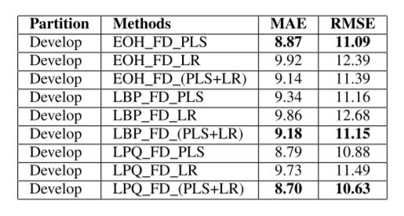
Experimental Results (Experimental Setting cont.)
Table : Performance of Depression Scale Prediction Using the FDHH measured both in MAE and RMSE
Starting with the hand-crafted features LBP, LPQ, and EOH, this table demonstrates the individual performance of the three hand-crafted feature extraction methods that are combined with FDHH.
The depression scales were predicted using the two regression techniques separately and fused. It is clear that using PLS for regression was better than LR in all tests.
However, when they were fused with a weighting more toward PLS, the results were improved further.
LBP was shown to be the weakest amongst the three and LPQ the strongest.

Slide 22
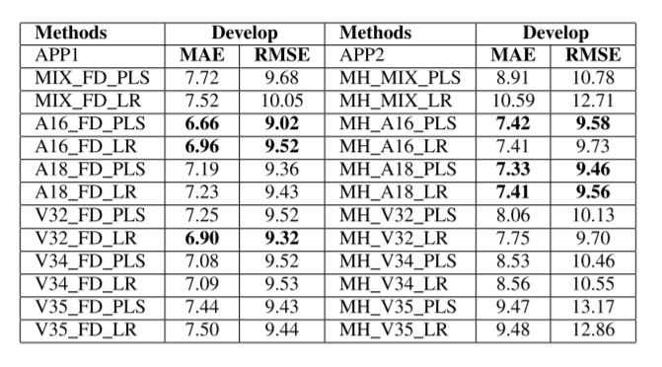
Experimental Results (Experimental Setting cont.)
Table : Performance of Depression Scale Prediction using FDHH (FD) after mix and before mix (EOH, LBP, LPQ, AND DEEP)
This table contains results of both approaches, with APP1 combining the efforts of the individual hand-crafted features, and demonstrates the effectiveness of the deep features using the FDHH algorithm.
MIX_FD has shown a significant improvement over the individual performances.
However, it is clear from this that the deep features perform consistently better than the individual and combined hand-crafted features.
Second, we can see that the deep learning approaches have performed better than hand-crafted features using both approaches.

Slide 23
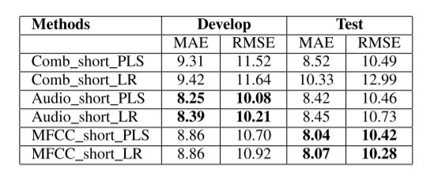
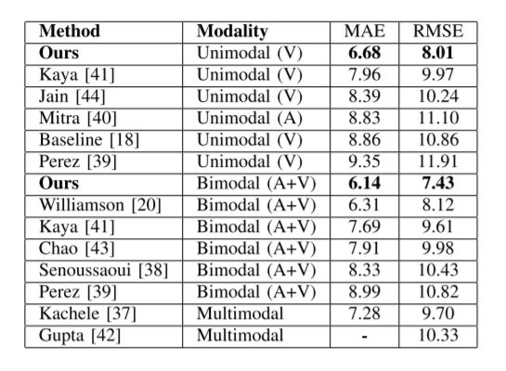
Experimental Results (Experimental Setting cont.)
Table : Performance of Depression Scale Prediction using Complete Audio, Comb Features, and MFCC.
In this first table, the audio features for short segments were tested. From the 2268 audio features (audio), the combined features (Comb) and MFCC features have been taken out to be tested separately.
The best overall feature uses the fusion of the audio and visual modalities, along with the weighted fusion of the regression techniques.
Performance comparisons against other techniques including the baseline can be seen in this last table.
Table : Performance Comparison against other approaches

Slide 24
Conclusion (Results)
This artificial intelligent system is based on facial and vocal expression in naturalistic video recordings for automatic depression scale prediction.
Based on the idea of MHH for 2-D video motion feature, FDHH was proposed that can be applied to feature vector sequences to provide a dynamic feature for the video. Finally, PLS regression and LR are adopted to capture the correlation between the feature space and depression scales.
The experimental results indicate that the proposed method achieved good state-of-the-art results on the AVEC2014 dataset.
There are three main contributions from this paper.
The first one is the general framework that can be used for automatically predicting depression scales from facial and vocal expressions.
The second contribution is the FDHH dynamic feature, that uses the idea of MHH on the deep learning image feature and hand-crafted feature space.
The third one is the feature fusion of different descriptors from facial images.

Slide 25
References
[1] M. F. Valstar et al., “AVEC 2013: The continuous audio/visual emotion and depression recognition challenge,” in Proc. Int. Conf. ACM Multimedia Audio/Vis. Emotion Challenge Workshop, 2013, pp. 3–10.
[2] “Mental health in the EU,” Health Consum. Protect. Directorate Gener., Brussels, Belgium, Tech. Rep., 2008.
[3] M. Marcus et al., “Depression: A global public health concern,” WHO Dept. Mental Health Substance Abuse, vol. 1, pp. 6–8, 2012.
[4] “Depression and other common mental disorders: Global health estimates,” World Health Org., Geneva, Switzerland, Tech. Rep. WHO/MSD/MER/2017.2, 2017.
[5] R. C. Kessler and E. J. Bromet, “The epidemiology of depression across cultures,” Annu. Rev. Public Health, vol. 34, pp. 119–138, Mar. 2013. [Online]. Available: http://www.annualreviews.org/doi/ 10.1146/annurev-publhealth-031912-114409
[6] E. Jenkins and E. M. Goldner, “Approaches to understanding and addressing treatment-resistant depression: A scoping review,” Depression Res. Treat., vol. 2012, pp. 1–7, Feb. 2012, doi: 10.1155/2012/469680.
[7] D. D. Luxton, Artificial Intelligence in Behavioural and Mental Health Care. London, U.K.: Academic Press, 2015.
[8] J. F. Cohn et al., “Detecting depression from facial actions and vocal prosody,” in Proc. 3rd Int. Conf. Affective Comput. Intell. Interact. Workshops (ACII), Amsterdam, The Netherlands, 2009, pp. 1–7.
[9] H. Davies et al., “Facial expression to emotional stimuli in non-psychotic disorders: A systematic review and meta-analysis,” Neurosci. Biobehav. Rev., vol. 64, pp. 252–271, May 2016.
[10] A. Jan, H. Meng, Y. F. A. Gaus, F. Zhang, and S. Turabzadeh, “Automatic depression scale prediction using facial expression dynamics and regression,” in Proc. 4th Int. Workshop Audio/Vis. Emotion Challenge (AVEC), Orlando, FL, USA, 2014, pp. 73–80.

Slide 26
Thank You!

