Slide 1
PDF to XML
Conversión
Eshita Shukla - VJTI
Jui Pitale - VJTI
Aditya Tumarada - IIT Guwahati

Slide 2
Introduction

Slide 3
Problem Statement
Write a PDF to XML utility (tool) by leveraging the pdfbox library so that we can use this tool to compare .pdf files to DB tables.
We have a framework, which can compare the XML data with database tables and reports the data differences.
However, the system does not support the data comparison between PDF and table data due to which data is compared manually and leads to error-prone.
So that once we convert the PDF file to the XML file, it can be injected into the existing Framework to compare the data and find the root cause the data discrepancy in the PDF files.

Slide 4
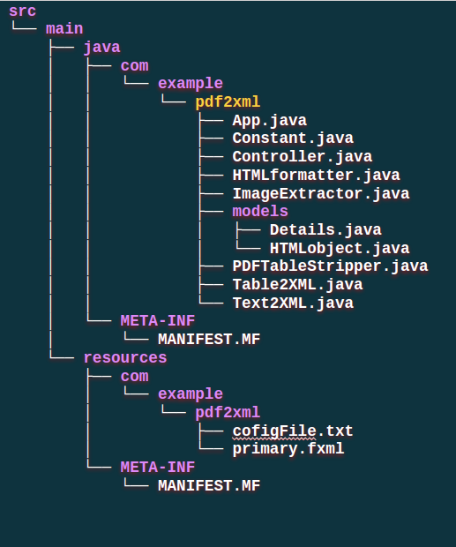
Project Structure
Location of all classes
main Class
Classes for generation of .xml

Slide 5
Demo

Slide 6
Approach

Slide 7
01
02
03
04
Our Target
Table Extraction
Implementation with GUI
Text Extraction
Image Extraction
Saved in a folder
XML Generation

Slide 8
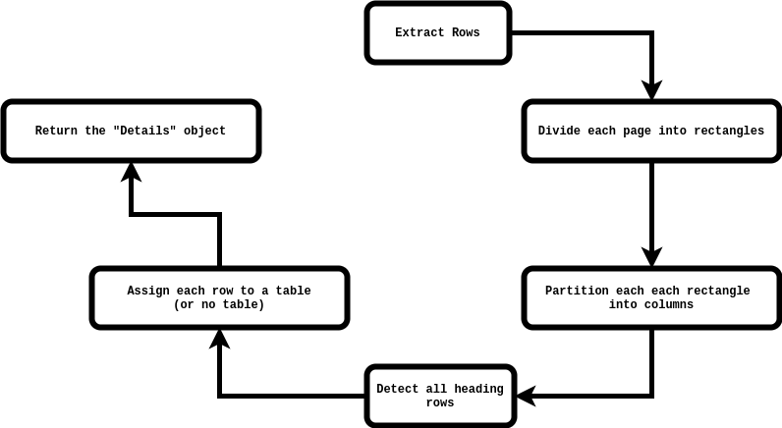
Table Extraction
Extract rows & their coordinates
Group all rows into table (some in no tables)
Divide each page into rectangles
Group all rows into table (some in no tables)
Divide each rectangle (row) into columns
Classify each row ad “normal” or “heading”

Slide 9
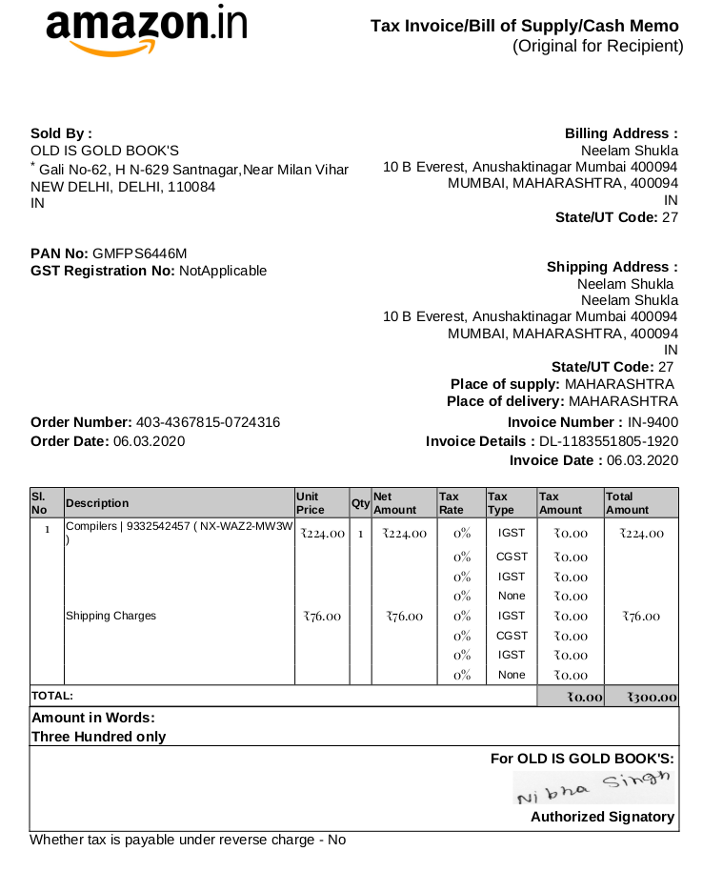
Dividing into rectangles

Slide 10
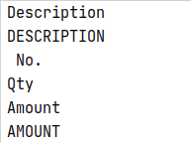
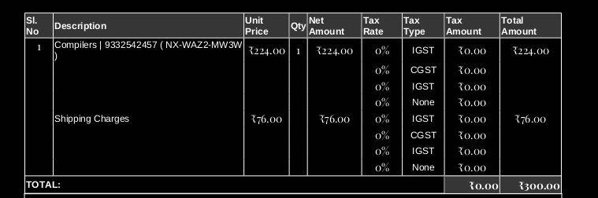
Classifying
into “heading”
or not
Probability = 6/9
configFile
Without probability calculation:
if the keyword “Description” is present in the name of the book that has been bought by the customer, the algo fails

Slide 11
Probability Calculation for Consecutive rows

Slide 12


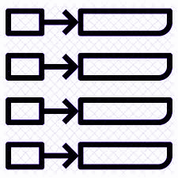


Text Extraction
(page-wise extraction in key value pair form)
APPROACH
Convert .pdf to .html
Remove Table data from extracted text
Convert to key-value pairs

Slide 13


XML Generation
APPROACH
(Text)
key-value pairs
Table
DOM
document
XML
String
XML
String
DOM
document
Transform to XML File

Slide 14
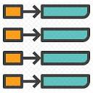

Limitations of the S/W
At least some of the words in the heading should be known
Recognition of the
“key”-”value” pairs
Change in text styles
Line-spacing
Could be difficult to handle

Slide 15
Conclusión
Our team has been working on this problem statement for the last 5 weeks.
We have been able to process almost all types of PDFs and successfully extracted all data into an xml, to ensure which we changed our algorithm thrice.
On the basis of only the alignment(left/right/center) of the text in each column of the table, we are able to successfully get the desired XML output.
The project is made as flexible as possible. The user can add more keywords if they want

Slide 16
THANKS!

Slide 17
Questions ??

