Slide 1
Project :
Unit Converter
Project by :
Aditya Ujeniya
Dheeraj Tambare
Shubham Shingade
Guided by : Prof. S. S. Raskar

Slide 2
Requirement Analysis
Need to analyze and convert the various contents including units.
A person working in Civil field needs length conversions.
A person working in Mechanical field needs speed, energy, power conversion.
A person working in Software field needs digital storage conversion.
Need for metric as well as imperial units conversion.
ON-THE-GO offline portability.

Slide 3
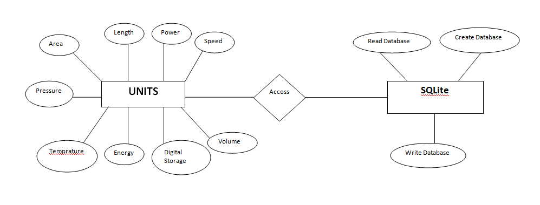
ER Diagram

Slide 4
Problem Statement
Problem Statement :
A portable Android application that provides various conversion units category wise with a simple interface and online facility. Accuracy should be maintained while providing various units. The ambiguity between units of ToUnits and FromUnits should be reduced. The categorized units should be able to provide organized and simple interface.
Explanation :
Unit Converter allows user to choose from variety of unit conversion categories. Online availability and accurate results are the specialty of the applications. Various units are available that are used on daily basis as well as on professional level. The categorized units allow easy searching of a specific unit.

Slide 5
Requirements
Software Requirements :
Android Studio 2.3.3
Android SDK 24+
API Level 20+ (Lollipop) on Android Device
SQLite database
Hardware Requirements :
Dual Core Processor
Min 10Mb Ram
Min 10Mb of storage space

Slide 6
Content
The application contains various units to be converted with a imple material design.
A quantity generally accepted as a standard for exchange. Available unit con-
versions include:
Temperature (celsius, fahrenheit, kelvin, etc)
Length (kilometer, miles, meter, yard, feet, etc)
Mass/Weight (kilogram, pound, ounce, ton, stone, etc)
Speed (km/h, mph, knot, etc)
Area (square kilometer, square mile, hectare, acre, etc)
Cooking Volume (teaspoon, tablespoon, cup, pint, quart, ounce, etc)
Pressure (kilopascal, bar, PSI, etc)
Power (watt, kilowatt, horsepower, etc)
Energy (joule, calorie, BTU, etc)
Fuel Consumption (miles per gallon, liters per 100km, etc)
Digital Storage (bit, byte, megabytes, gigabytes, etc)

Slide 7
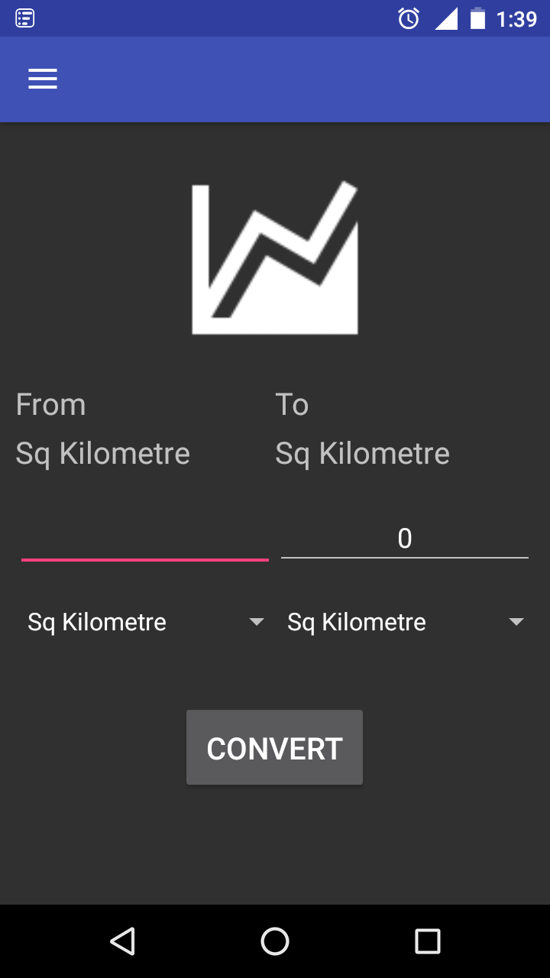
Screenshots
Fig : Layout of application

Slide 8
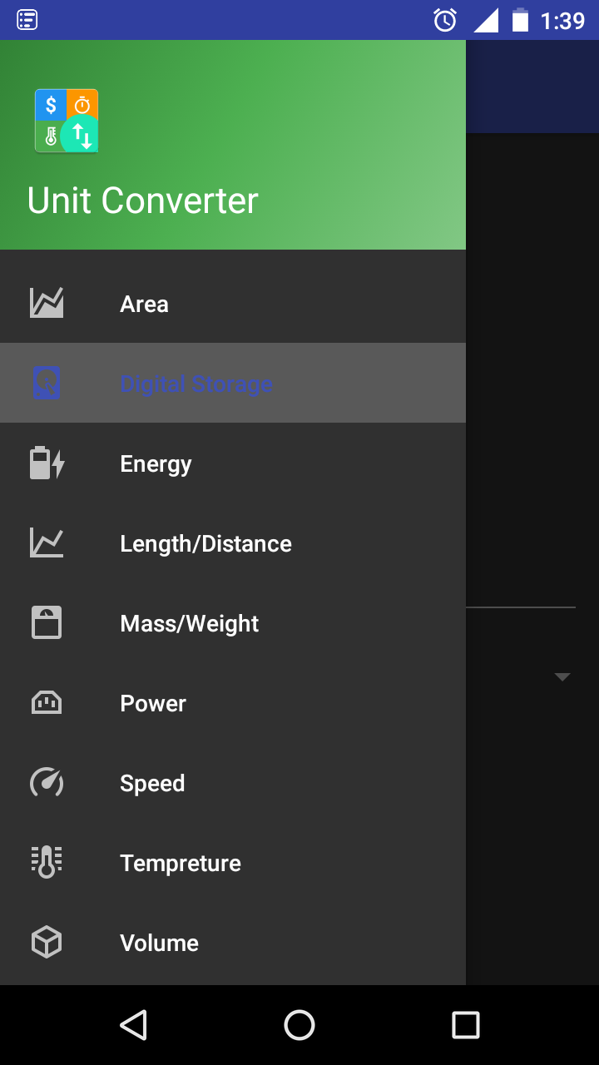
Screenshots
Fig : Various Unit categories in Navigation Drawer

Slide 9
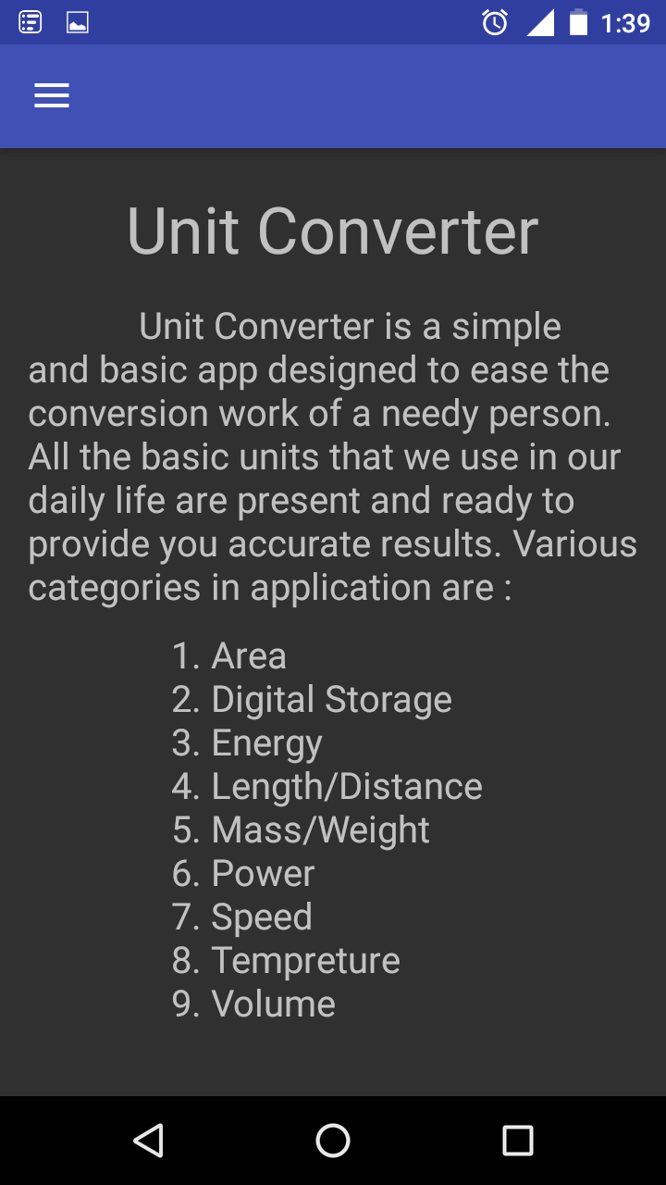
Screenshots
Fig : About application

Slide 10
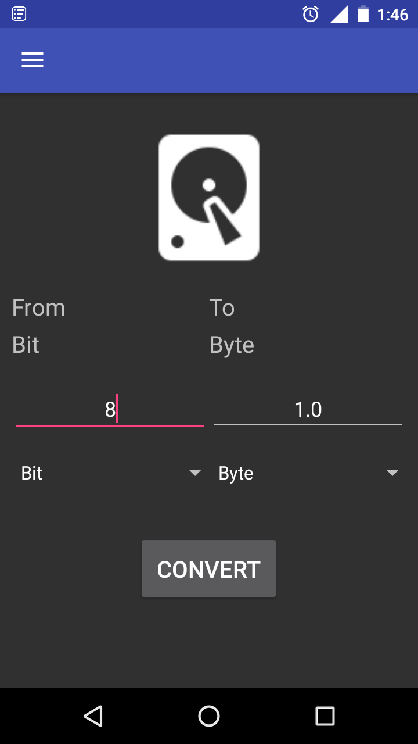
Screenshots
Fig : Example of a converted value

Slide 11
Conclusion
Various rigorous exercises learnt.
Recognizing essential skillsets needed in industry.
Implementing offline application.
Learnt various units used on daily basis as well at professional level.
Using SQLite database for faster fetching of values.

Slide 12
Thank you !!

