Slide 1


BOSCH's Route Optimization Algorithm
Presented by:-
1) Ankush Ramesh Kamthane*
2)Aditya Singh
Notes:
Good morning sir , I am ankush Kamthane and he is Aditya singh, we are from iit bhu, now
We are going to present a solution approach on BOSCH’s Route Optimization algorithm
So lets start, with problem statement

Slide 2
Problem Statement
Objective:- To develop a route optimization algorithm considering following constraints,
Minimize operational cost.
Number of buses
Vehicle occupancy should be at least 85%.
Time window
Notes:
After having group discussion of our team, we have concluded the problem statement as, we have to develop……
1)We have to start the route from Yelachenahalli metro Station and end it at Bosch Bidadi for pickup route
For solving this problem,
2)We have to fetch data of distance and time

Slide 3
Solution Approach
This problem is very much similar to standard Vehicle Routing Problem(VRP), therefore we have developed mathematical model to solve it.
We have formulated a mixed integer linear programming model to solve it.
Standard Capacitated VRP Vs Our model
Vehicle hiring decision
Distance limitation
Time limitation
Notes:
Going towards our mathematical model
We have use Gurobi optimization solver using python interface
system specification : $i5 8^{th }generation$processor and 4GB RAM system

Slide 4
Scalability of our solution
Does not matter if we have 1 or 100 buses our algorithm can adapt to the requirement
Our solution does not depend on geography of city or number of passengers to handle
Our solution is easy to use for any non technical person
Our solution can be develop as a user friendly app

Slide 5
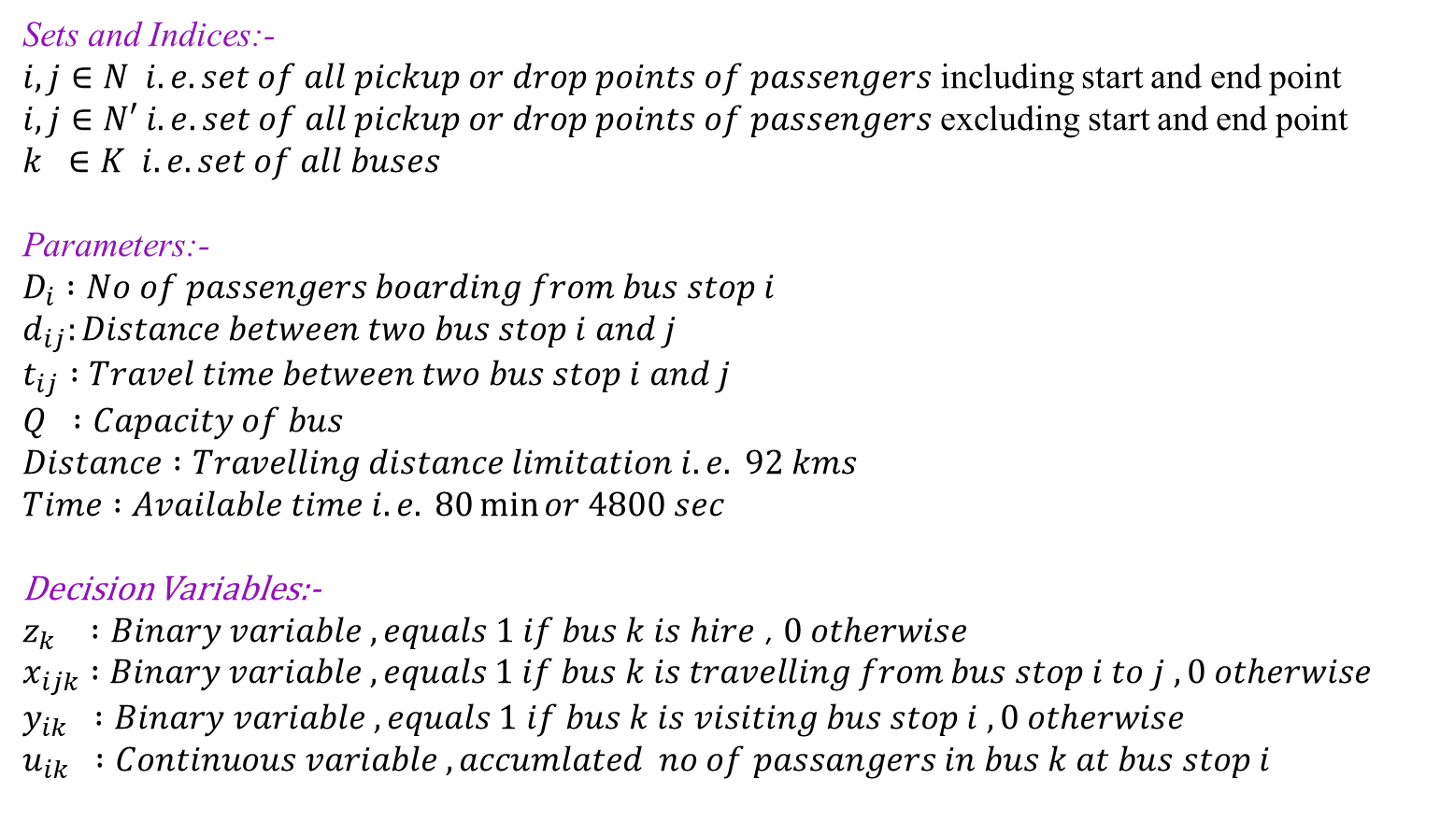
Mathematical Model
Sets and Indices:-
$i,j∈N i.e. set of all pickup or drop points of passengers$ including start and end point
$i,j∈N′ i.e. set of all pickup or drop points of passengers$ excluding start and end point
$k ∈K i.e. set of all buses$
Parameters:-
$$D_{i} :No of passengers boarding from bus stop i$$
$$d_{ij}:Distance between two bus stop i and j$$
$$t_{ij} :Travel time between two bus stop i and j$$
$$Q :Capacity of bus$$
$$Distance :Travelling distance limitation i.e. 92 kms$$
$$Time :Available time i.e. 80\min{or 4800 sec}$$
Decision Variables:-
$z_{k} :Binary variable ,equals 1 if bus k is hire$ , $0 otherwise$
$$x_{ijk} :Binary variable , equals 1 if bus k is travelling from bus stop i to j , 0 otherwise$$
$$y_{ik} :Binary variable , equals 1 if bus k is visiting bus stop i , 0 otherwise$$
$$u_{ik} :Continuous variable , accumlated no of passangers in bus k at bus stop i$$

Slide 6
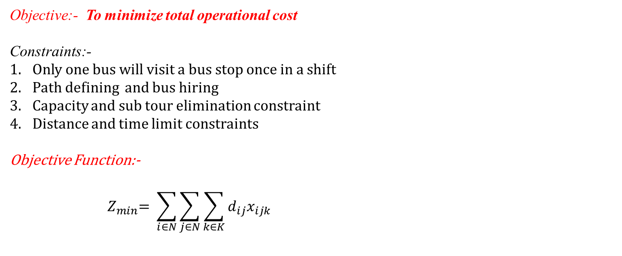
Mathematical Model
Objective:- To minimize total operational cost
Constraints:-
Only one bus will visit a bus stop once in a shift
Path defining and bus hiring
Capacity and sub tour elimination constraint
Distance and time limit constraints
Objective Function:-
$${ Z}_{min}= \sum_{i∈N}{\sum_{j∈N}{\sum_{k∈K}{d_{ij}x_{ijk}}}}$$

Slide 7
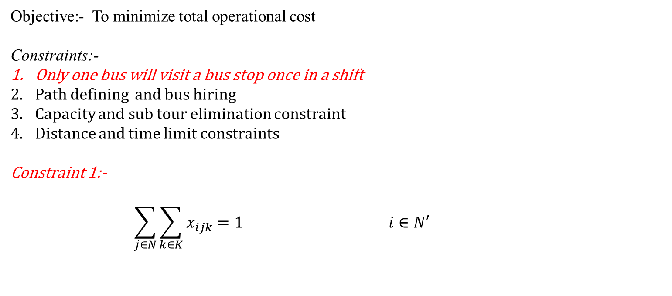
Mathematical Model
Objective:- To minimize total operational cost
Constraints:-
Only one bus will visit a bus stop once in a shift
Path defining and bus hiring
Capacity and sub tour elimination constraint
Distance and time limit constraints
Constraint 1:-
$$\sum_{j∈N}{\sum_{k∈K}{x_{ijk}=1 i∈N′}}$$
Notes:
This Constraint ensures that, only one bus will visit a bus stop once in a shift

Slide 8
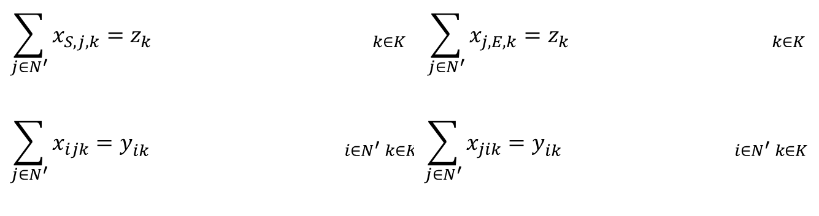
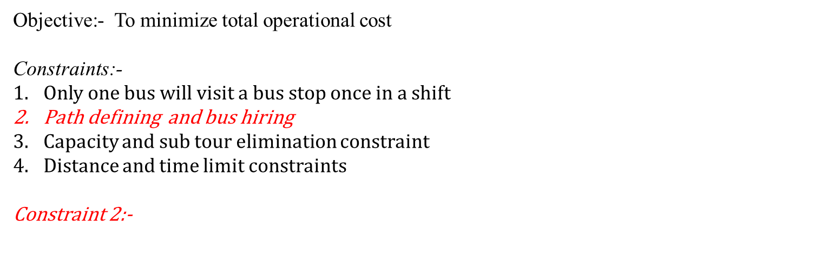

Mathematical Model
Objective:- To minimize total operational cost
Constraints:-
Only one bus will visit a bus stop once in a shift
Path defining and bus hiring
Capacity and sub tour elimination constraint
Distance and time limit constraints
Constraint 2:-
$$\sum_{j∈N^{′}}{x_{S,j,k}=z_{k k∈K}}$$ | $$\sum_{j∈N^{′}}{x_{j,E,k}=z_{k k∈K}}$$
$$\sum_{j∈N^{′}}{x_{ijk}=y_{ik i∈N^{′} k∈K}}$$ | $$\sum_{j∈N^{′}}{x_{jik}=y_{ik i∈N^{′} k∈K}}$$
$$y_{ik}≤z_{k} i∈N^{′} k∈K$$
$$S^{∗ }:Start Point,E^{∗}:End Point$$

Slide 9
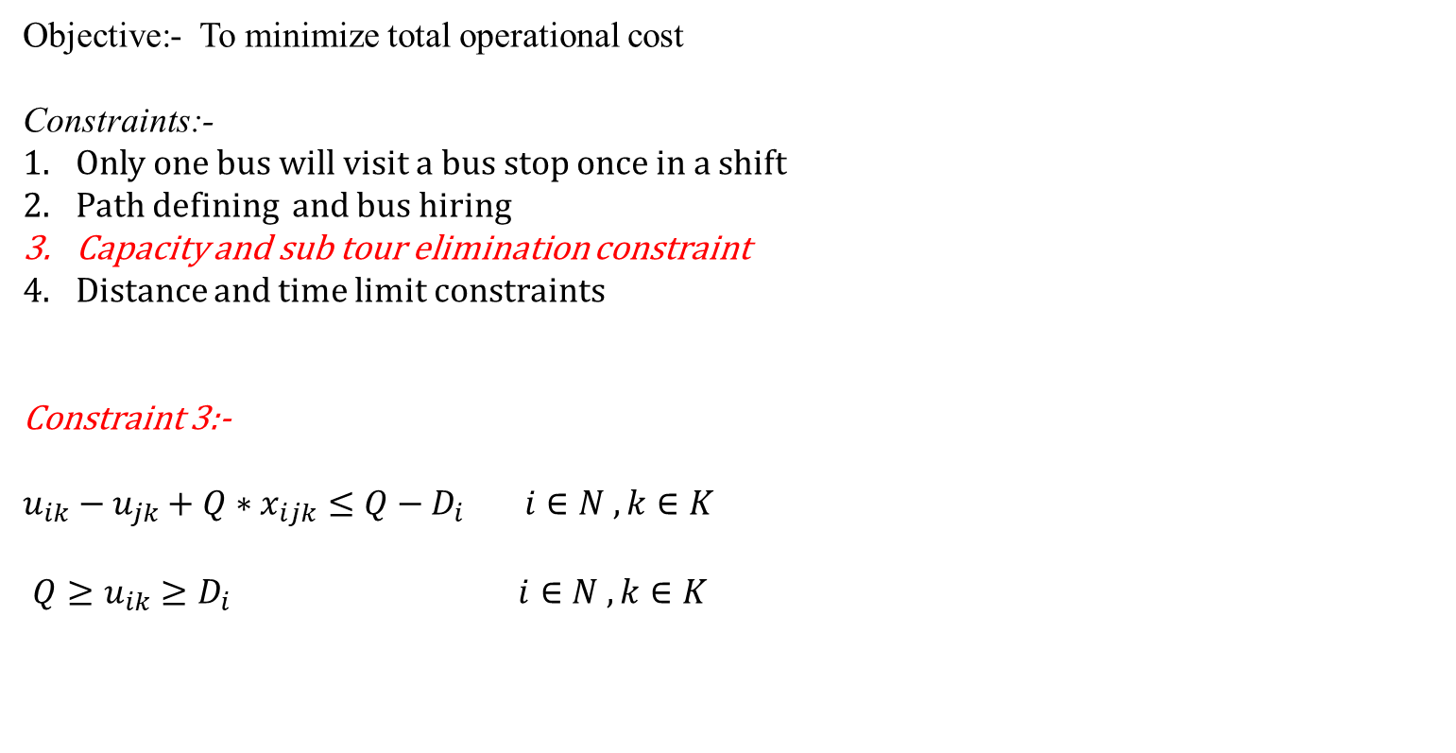
Mathematical Model
Objective:- To minimize total operational cost
Constraints:-
Only one bus will visit a bus stop once in a shift
Path defining and bus hiring
Capacity and sub tour elimination constraint
Distance and time limit constraints
Constraint 3:-
$u_{ik}−u_{jk}+Q∗x_{ijk}≤Q−D_{i}$ $i∈N , k∈K$
$Q≥u_{ik}≥D_{i}$ $i∈N , k∈K$
Notes:
This constraint will eliminate sub tour and also put capacity restriction on vehicle

Slide 10
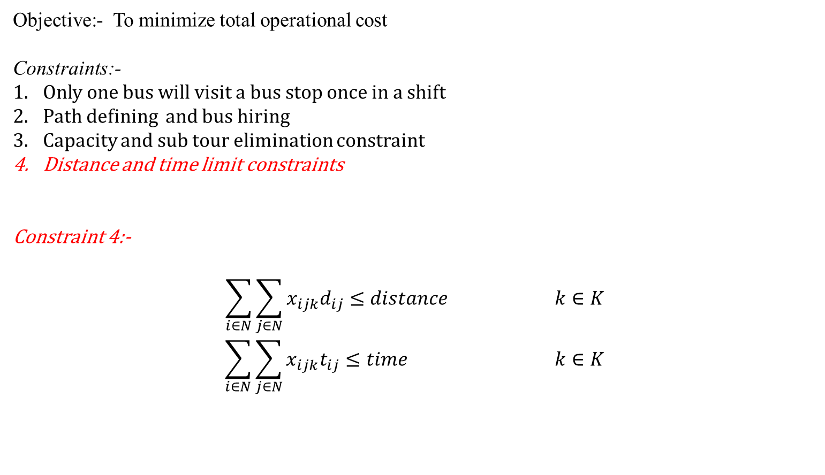
Mathematical Model
Objective:- To minimize total operational cost
Constraints:-
Only one bus will visit a bus stop once in a shift
Path defining and bus hiring
Capacity and sub tour elimination constraint
Distance and time limit constraints
Constraint 4:-
$$\sum_{i∈N}{\sum_{j∈N}{x_{ijk}d_{ij}≤distance k∈K}}$$
$$\sum_{i∈N}{\sum_{j∈N}{x_{ijk}t_{ij}≤time k∈K}}$$
Notes:
By Solving this model we come to this solution
If any doubts regarding to mathematical model, we can discuss it during q & a

Slide 11
Results
Pick Up Route | Drop Route
Yelachenahalli metro Station | Bosch Bidadi
Kadarenahalli, Banashankari | Uttarahalli Main Rd
Jayanagar | Kodipalya
Mantri Sarovar Apartment Rd | RNS INSTITUTE OF TECHNOLOGY
Double Rd | Kanti Sweets
Bata Showroom | Jnanakshi Rajarajeshwari temple
Kathreguppe, Banashankari 3rd Stage | PES University
Sri Kamakya Theatre | Hoskerehalli, Hosakerehalli Main Road
Kathriguppe Circle | Hosakerehalli
Janatha Bazar | Ittamadu, Banashankari
Ittamadu, Banashankari | Janatha Bazar
Hosakerehalli | Kathriguppe Circle
Hoskerehalli, Hosakerehalli Main Road | Sri Kamakya Theatre
PES University | Kathreguppe, Banashankari 3rd Stage
Jnanakshi Rajarajeshwari temple | Bata Showroom
Kanti Sweets | Double Rd
RNS INSTITUTE OF TECHNOLOGY | Mantri Sarovar Apartment Rd
Kodipalya | Jayanagar
Uttarahalli Main Rd | Kadarenahalli, Banashankari
Bosch Bidadi | Yelachenahalli metro Station
Total distance:77078.0
Notes:
Our algorithm gives an optimal value of the net distance travelled by all the buses i.e. 77kms for this case

Slide 12
BUS 1 Route | BUS 2 Route
Austin Town | Austin Town
Mico Signal | Austin Town
Mico Signal | Viveknagar
Dairy Circle | Viveknagar
Lakkasandra Bus Stop | Koramangala Police Station
Vijaya Bank Adugodi | Koramangala Depot
Lakkasandra Bus Stop | Koramangala
Spar Stop | Silk Board
Ashram HDFC Bank | Udupi Guarden
Arakere Layout | Koramangala
Ashram | Adugodi Signal
Thilaknagar | Adugodi
Jayadeva Hospital Junction | Adugodi Signal
BTM 2nd stage | Aneypalya
Bannerghatta Road | Canara Bank
BTM | Bosch Bidadi
Mico Layout
Arekere Gate
Hulimavu Gate
BPL Stop
Gottigere
Bosch Bidadi
BUS 1 : 74.24 kms
BUS 2 : 56.42 kms
Total = 130.66 kms

Slide 13
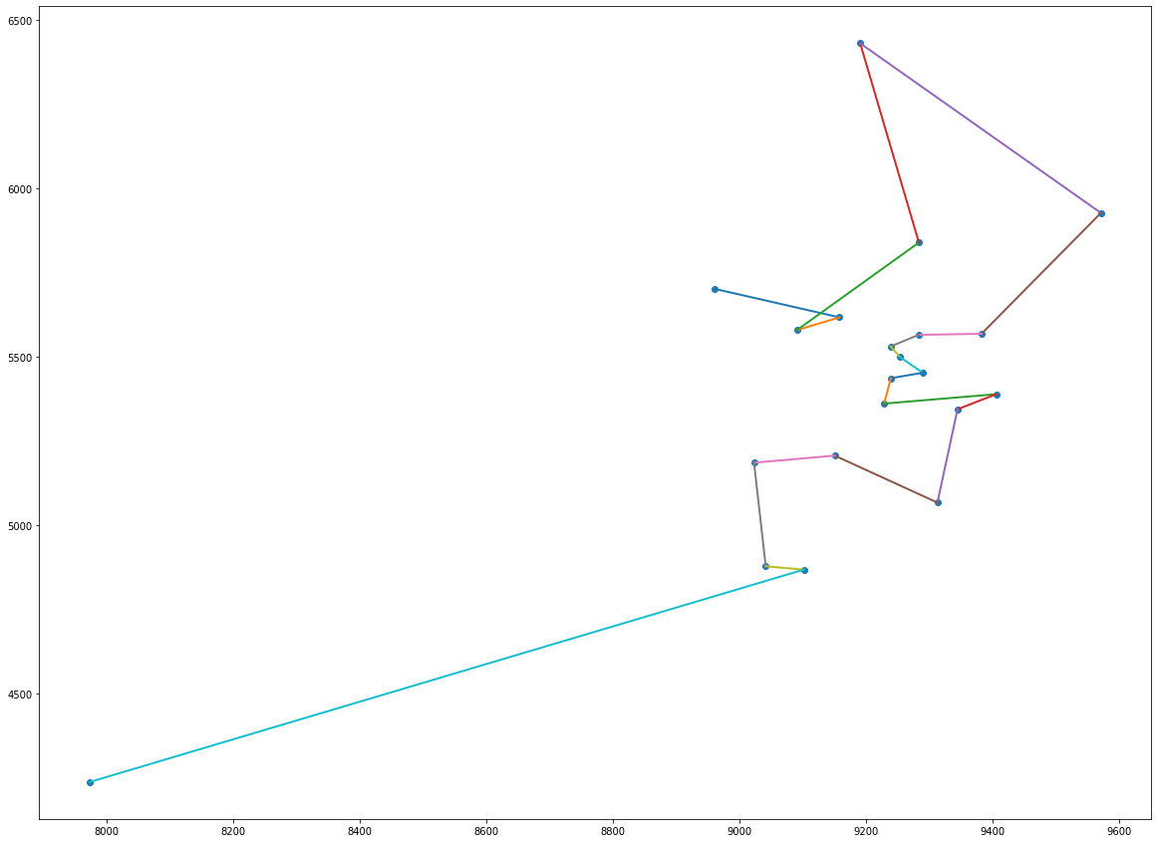
Graphical Visualization

Slide 14
Challenges Faced
To get input data i.e. distance matrix and time matrix
In understanding the given constraints
In developing mathematical model
Developing visualization

Slide 15
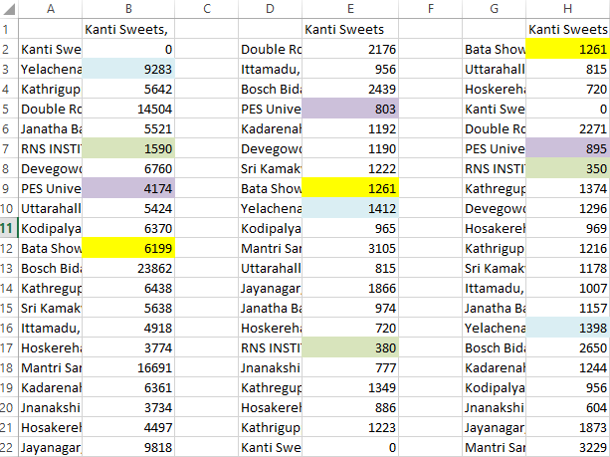
Variation in Time Data (Because of Traffic)

Slide 16
Vehicle Occupancy Constraint
As mentioned in given data, bus capacity is 32.
According to Vehicle Occupancy Constraint, each vehicle should have to carry minimum 0.85*Bus Capacity numbers of passengers i.e. 27.2 implies 28
In the given data set there are only 29 passengers, therefore we have to use only one bus to carry all the passengers
Therefore, we consider this constraint as a redundant constraint.

Slide 17


