Slide 1

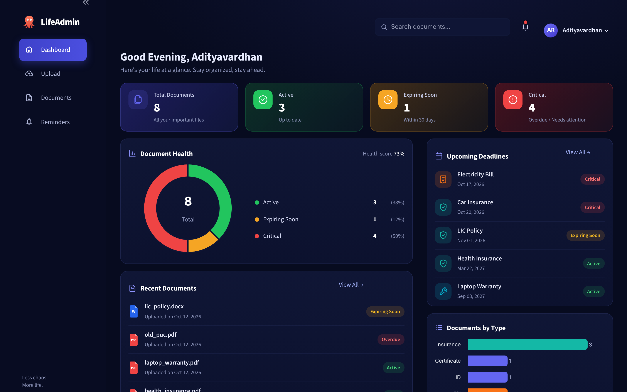

Smart Personal Document & Deadline Manager
LifeAdmin
PROJECT REVIEW 2
Upload a document. LifeAdmin finds the dates, tracks the deadline and warns you before it expires.
Car Insurance
A. Adityavardhan Reddy
Critical · expires in 6 days
Reg. No. 23MID0186 · 15 October 2026
Notes:
Introduce LifeAdmin in one line: it reads personal documents, pulls out the expiry date and reminds you before it lapses. This review covers three things the panel asked for: the architecture, the website roadmap, and the backend and frontend Python files. Everything shown is running code.

Slide 2








Important documents expire silently
THE PROBLEM
Scattered everywhere
THE SOLUTION
IDs, insurance, PUC, warranties and bills sit in folders, inboxes and drawers.
LifeAdmin reads the document for you
Dates hidden in the fine print
The one date that matters is buried inside a PDF.
Upload once. It extracts the key details, stores them on your computer and warns you 30 and 7 days before anything expires.
Missed renewals cost money
Lapsed insurance cover, fines for an expired PUC, refused warranty claims.
Reminder apps can't read documents
Upload
Extract
Track
Remind
Every date still has to be typed in by hand.
100% local · no paid AI · no API keys
Notes:
The pain: documents with deadlines are scattered, the date is buried inside the file, and generic reminder apps make you type the date yourself. LifeAdmin closes that gap: upload, it extracts, it tracks, it reminds. All of it runs locally with no paid services.

Slide 3






What's built and working today
STATUS AT REVIEW 2
2,412
12
28/28
lines of Python
application files
tests passing
across the app, modules, tests and scripts
app.py + 11 modules in the lifeadmin package
pytest suite + headless check of every screen
4
6
₹0
screens
file formats
running cost
Dashboard · Upload · Documents · Reminders
PDF, JPG, PNG, DOCX, XLSX and TXT
runs offline: no paid AI, no API keys
Notes:
Quick status. The application is about 2,400 lines of Python across 12 application files. All 28 tests pass, and a headless test opens all four screens. Six file formats are supported. It costs nothing to run because there are no paid APIs.

Slide 4
Architecture
01
How a document travels from upload to reminder
IN THIS SECTION
System layers
Pipeline
Database
Reminder rules
Notes:
Section one: architecture. Four slides: the layers, the processing pipeline, the database, and the rules that decide when you get reminded.

Slide 5



Five layers, each with one job
01 · ARCHITECTURE
Presentation
app.py
style.py
config.toml
Streamlit UI
4 screens, navigation, forms
theme, icons, components
dark theme, 10 MB limit
Application
pipeline.py
validate → extract → classify → parse
orchestration
analyse_upload() → store_upload()
one call per uploaded file
Processing
extractor.py
classifier.py
parser.py
preview.py
read & understand
PDF, DOCX, XLSX, OCR
keyword scoring → type
regex → dates, IDs, ₹
thumbnails, masking
Intelligence
reminders.py
health.py
export.py
rules & output
30 / 7-day status rules
completeness + timeliness
CSV + .ics calendar
Data
database.py
models.py
data/uploads/
storage
SQLite · 4 tables
Document dataclass
original files on disk
Notes:
The system is layered so each file has one responsibility. The Streamlit UI only calls the application layer. pipeline.py runs validate, extract, classify, parse. The processing modules read files and pull out fields. The intelligence layer turns dates into statuses, health scores and calendar exports. The data layer is a single SQLite file plus the original uploads on disk.

Slide 6
From upload to reminder in five steps
01 · ARCHITECTURE
1
2
3
4
5
Validate & save
Extract text
Classify
Extract fields
Status & save
Checks type and size (≤ 10 MB); keeps the original in data/uploads/
pypdf, python-docx, openpyxl; optional OCR for scanned files
Keyword scoring picks one of 8 types, with a confidence score
Regex finds dates, policy numbers, names, vehicle no. and ₹ amounts
Rules assign Active / Expiring / Critical; user reviews, then SQLite
extractor.validate_file
extractor.py
classifier.py
parser.py
reminders · database
INPUT · car_insurance.pdf
OUTPUT · pre-filled form, saved to SQLite
Sundaram General Insurance Company Ltd
Policy No: INS784521
Insured Name: Arun Kumar
Vehicle Registration No: TN 63 AB 1234
Period of Insurance: 20/10/2025 to 20/10/2026
Total Premium: Rs. 14,250.00
Type
Policy No
Holder
Insurance (90%)
INS784521
Arun Kumar
Vehicle
Valid till
Premium
TN 63 AB 1234
20 Oct 2026
₹14,250.00
Notes:
Every upload goes through the same five steps. Validate, extract text, classify the document type, pull out the fields with regular expressions, then compute the status. Below is a real run on one of the sample PDFs: the left box is the raw text, the right is what LifeAdmin pre-fills into the review form. The user can correct anything before saving.

Slide 7


Database: one SQLite file, four tables
01 · ARCHITECTURE
documents
reminders
activity_logs
id
INTEGER PK
id
INTEGER PK
id
INTEGER PK
filename
TEXT
document_id
FK → documents
action
TEXT
doc_type
TEXT
dismissed_at
TEXT
detail
TEXT
holder_name
TEXT
ON DELETE CASCADE
created_at
TEXT
doc_number
TEXT
users
organization
TEXT
vehicle_no
TEXT
id
INTEGER PK
Why SQLite
amount
TEXT
name
TEXT
created_at
TEXT
One file: data/lifeadmin.db
Ships with Python, zero setup
Foreign keys + cascade delete
Every add, edit, delete and completion is logged
start_date
TEXT (ISO)
expiry_date
TEXT (ISO)
notes
TEXT
Files on disk
stored_path
TEXT
data/uploads/ keeps every original, renamed safely with a timestamp
uploaded_at
TEXT
Notes:
Storage is a single SQLite file. documents holds every extracted field; dates are stored as ISO strings. reminders records which deadlines the user marked as completed and cascades when a document is deleted. users stores the profile name, and activity_logs is the audit trail for every add, edit, delete and completion.

Slide 8




The rules behind every reminder
01 · ARCHITECTURE
TODAY
DAYS UNTIL EXPIRY
Expired
Critical
Expiring soon
Active
fewer than 0 days
0 – 7 days
8 – 30 days
more than 30 days
Overdue · renew now
Shown in red · renew this week
Amber · plan the renewal
Green · nothing to do
Document Health Score
Where reminders reach the user
Health = (Completeness + Timeliness) ÷ 2
Bell + Critical card on every screen, the moment a date gets close
Reminders page Upcoming / Overdue tabs and a deadline calendar
Completeness
Timeliness
5 checks × 20%: type, organization, holder, number, expiry date
Active 100 · Expiring 60 · Critical 25 · Expired 0
.ics export alarms 30 and 7 days before, in Google / Apple / Outlook
Mark as completed renewed items move to the Completed tab
Notes:
Two rule sets. First, status: more than 30 days is Active, 8 to 30 is Expiring soon, 7 or fewer is Critical, and past the date is Expired. Second, the health score averages completeness (five fields captured) and timeliness (how close to expiry). Reminders show up in the bell, the dashboard, the Reminders page and the user's own calendar.

Slide 9
Website Roadmap
02
The screens a user moves through, and how the build has progressed
IN THIS SECTION
Site map
User journey
Build timeline
Notes:
Section two: the website roadmap. First the site map and user journey, then the build timeline: what's done and what comes after approval.

Slide 10
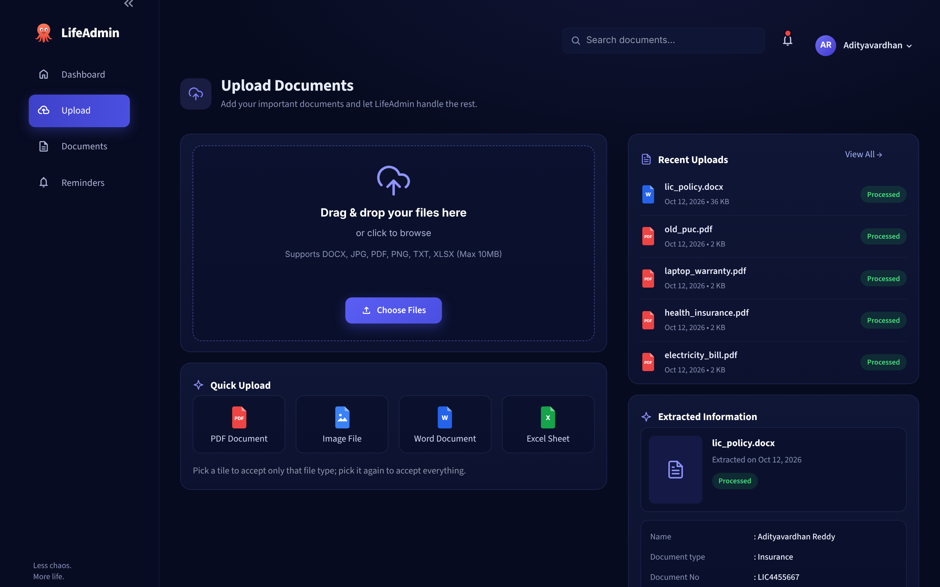
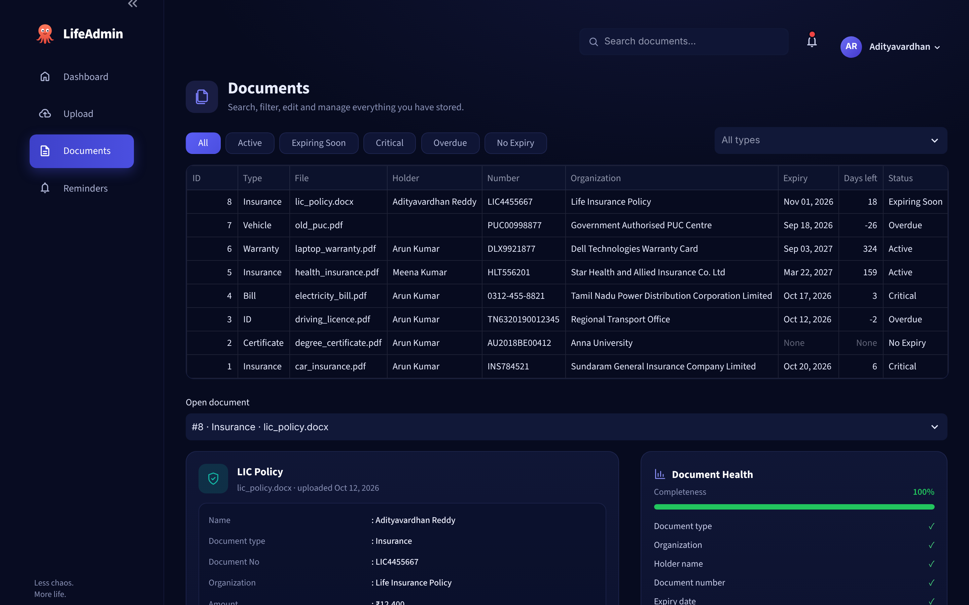
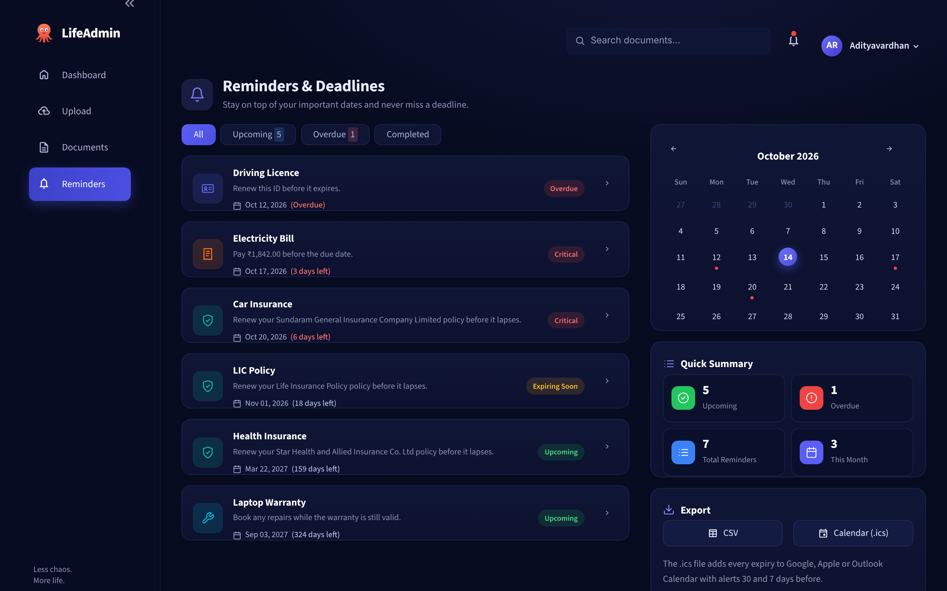
Four screens, one simple journey
02 · WEBSITE ROADMAP
ON EVERY SCREEN
Sidebar navigation
Search documents
Notification bell
Profile menu
1
Upload
2
Documents
3
Dashboard
4
Reminders
Drag & drop files, auto-extract, review and save
Search, filter, edit fields and check health
KPI cards, health donut, upcoming deadlines
Upcoming / Overdue tabs, calendar, .ics export
CODE
CODE
CODE
CODE
page_upload()
page_documents()
page_dashboard()
page_reminders()
Notes:
The website has four screens, and every screen shares the sidebar, search, notification bell and profile menu. The user journey: upload a document, check and edit it in Documents, monitor everything on the Dashboard, and act on deadlines from Reminders.

Slide 11
Build roadmap: done, today, and next
02 · WEBSITE ROADMAP
DONE · 8 OCT
DONE · 12 OCT
TODAY · 15 OCT
NEXT
LATER
Core engine
UI to design
Review 2
Publish
Extend
6 core modules
SQLite schema, 4 tables
Regex extraction + classifier
21 automated tests
4 screens matching the mockups
Word & Excel uploads
Thumbnails + health score
28 tests, Streamlit 1.50+
Architecture walkthrough
Code + live demo
Approval to upload files
Upload approved source
Push to GitHub
Deploy on Streamlit Community Cloud
Email / WhatsApp alerts
Multi-user login
ML classifier (scikit-learn)
OCR for scanned files
Notes:
Phase one, finished on the 8th: the core engine. Phase two, finished on the 12th: the full user interface matching the design mockups, plus Word and Excel support. Today is Review 2. After approval: upload the source, push it to GitHub and deploy a public demo on Streamlit Community Cloud. Later: email or WhatsApp alerts, multi-user login, and a trained classifier.

Slide 12
Code: backend & frontend
03
The Python files behind every screen, ready to upload after approval
IN THIS SECTION
10 backend modules
3 frontend files
Code spotlight
Live screens
Notes:
Section three: the code. The backend modules, the frontend files, and two pieces of logic worth showing in detail.

Slide 13




Backend: 10 Python modules in lifeadmin/
03 · CODE · BACKEND
models.py
database.py
Document dataclass shared by every module
SQLite CRUD, reminders, activity log
extractor.py
classifier.py
File checks + text from PDF/DOCX/XLSX
Keyword scoring → type + confidence
parser.py
preview.py
Regex: dates, numbers, names, vehicle, ₹
PDF thumbnails, Aadhaar masking, titles
pipeline.py
reminders.py
Glue: uploaded file → text → Document
Active / Expiring / Critical / Expired rules
health.py
export.py
Completeness + timeliness health score
CSV and .ics calendar with 30 / 7-day alarms
Data
Processing
Application
Intelligence
Notes:
The backend is ten modules inside the lifeadmin package, colour-coded by layer. The biggest are database.py and parser.py: storage and the regex extraction. Each module can be tested on its own, which is how the 28 tests are organised.

Slide 14



Frontend: the Streamlit UI in three files
03 · CODE · FRONTEND
app.py
624 lines
Entry point (streamlit run app.py): sidebar and top bar, then one function per screen.
page_dashboard()
page_upload()
page_documents()
page_reminders()
lifeadmin/style.py
496 lines
Design system: colour palette, CSS theme, SVG icons and HTML components (KPI cards, pills, calendar).
.streamlit/config.toml
SUPPORTING FILES
tests/test_lifeadmin.py
scripts/smoke_ui.py
scripts/make_samples.py
Dark theme colours, 10 MB upload limit, minimal toolbar.
28 unit tests
opens all 4 screens
builds demo PDFs
Notes:
The frontend is plain Python with Streamlit, so there's no separate JavaScript build. app.py is the entry point and has one function per screen. style.py holds the whole visual design: colours, CSS, icons and reusable HTML components. config.toml sets the dark theme and the 10 MB upload limit.

Slide 15
Two pieces of logic that do the heavy lifting
03 · CODE · SPOTLIGHT
reminders.py
simplified
parser.py
policy period
WARNING_DAYS, CRITICAL_DAYS = 30, 7
def evaluate(expiry, today):
if expiry is None:
return NO_EXPIRY
days = (expiry - today).days
if days < 0: return EXPIRED
if days <= CRITICAL_DAYS:
return CRITICAL
if days <= WARNING_DAYS:
return EXPIRING_SOON
return ACTIVE
# matches 12/04/2026, 2026-04-12, 12 Apr 2026 …
PERIOD = r"period\s*of\s*insurance|policy\s*period"
def find_period(text):
m = re.search(
rf"(?:{PERIOD})[^\d\n]{{0,30}}?({DATE})"
rf"[^\d\n]{{0,25}}?"
rf"(?:to|till|until)\s*({DATE})",
text, re.I)
if m:
return parse_date(m[1]), parse_date(m[2])
expiry in 20 days → EXPIRING SOON
expiry in 5 days → CRITICAL
expired 24 days ago → EXPIRED
IN Period of Insurance: 12/04/2026 to 11/04/2027
OUT start = 12 Apr 2026, expiry = 11 Apr 2027
Notes:
Two snippets, simplified from the real files. Left: the reminder rule. Four comparisons turn any date into a status, with 30 and 7 days as named constants so they can be tuned. Right: the regular expression that reads an insurance policy period. It finds the label, then two dates joined by 'to', 'till' or 'until', and parses both. Both are covered by unit tests.

Slide 16
The dashboard at a glance
LIVE DEMO
5
1
KPI cards
Total, Active, Expiring Soon and Critical update as soon as a file is saved
1
2
Document Health
2
3
Status donut plus one health score for the whole vault
3
Upcoming Deadlines
The next five expiries, colour-coded by urgency
4
Recent Documents
4
Latest uploads with their current status
5
Top bar
Search any document; the bell lists what needs attention
Notes:
Switch to the live app here if possible. Point out the four KPI cards, the health donut, upcoming deadlines sorted by urgency, recent documents and the top bar. The numbers update as soon as a document is saved.

Slide 17

Upload, review, and never miss a date
LIVE DEMO
Upload & review
Reminders
Drop PDF, image, Word or Excel files. Fields arrive pre-filled from the document; correct anything before saving.
Upcoming, Overdue and Completed tabs, a calendar with deadline dots, and a one-click calendar export.
Notes:
Demo flow: upload a sample PDF, show the pre-filled fields and the thumbnail, save it, then open Reminders to show it on the calendar and mark one deadline as completed.

Slide 18
Tested, lightweight, and fully offline
QUALITY & STACK
28 / 28
Python
Streamlit
SQLite
language
web UI
database
unit tests passing
pytest · parser, rules, database, exports
Pandas
Plotly
pypdf
4 / 4
tables & CSV
charts
PDF text
screens pass the smoke test
python-docx
openpyxl
pypdfium2
headless Streamlit AppTest, no errors
Word files
Excel files
thumbnails
2
Tesseract
pytest
reportlab
Streamlit versions verified
1.50 and 1.65
OCR (optional)
testing
demo PDFs
Notes:
Quality: all 28 unit tests pass, a headless test opens all four screens without errors, and the app was checked on two Streamlit versions. The stack is entirely free and open source; OCR is optional for scanned images.

Slide 19

Ready to upload once approved
AFTER APPROVAL
Upload the approved source
Run it locally
1
READY
lifeadmin_source.zip: app, 11 modules, tests, scripts, samples
$ pip install -r requirements.txt
$ streamlit run app.py
Local URL: http://localhost:8501
$ python -m pytest -q tests
28 passed
2
Push to GitHub
NEXT
README with setup steps; personal data/ folder stays git-ignored
3
Deploy a public demo
NEXT
Streamlit Community Cloud from GitHub → shareable link
Hosting
4
Extend reminders
LATER
One Streamlit app, no separate frontend server: local on :8501 today, Streamlit Community Cloud next.
Email / WhatsApp alerts for deadlines within 7 days
Notes:
What I'm asking for today: approval to upload the files. The source zip is ready. After that: push to GitHub, deploy a public demo on Streamlit Community Cloud, then add email or WhatsApp alerts. To run it locally takes two commands, shown on the right.

Slide 20

Thank you
Questions, feedback, and approval to upload
Less chaos. More life.
A. Adityavardhan Reddy · 23MID0186
Notes:
Close by asking for questions, then explicitly request approval to upload the source files.

