Slide 1

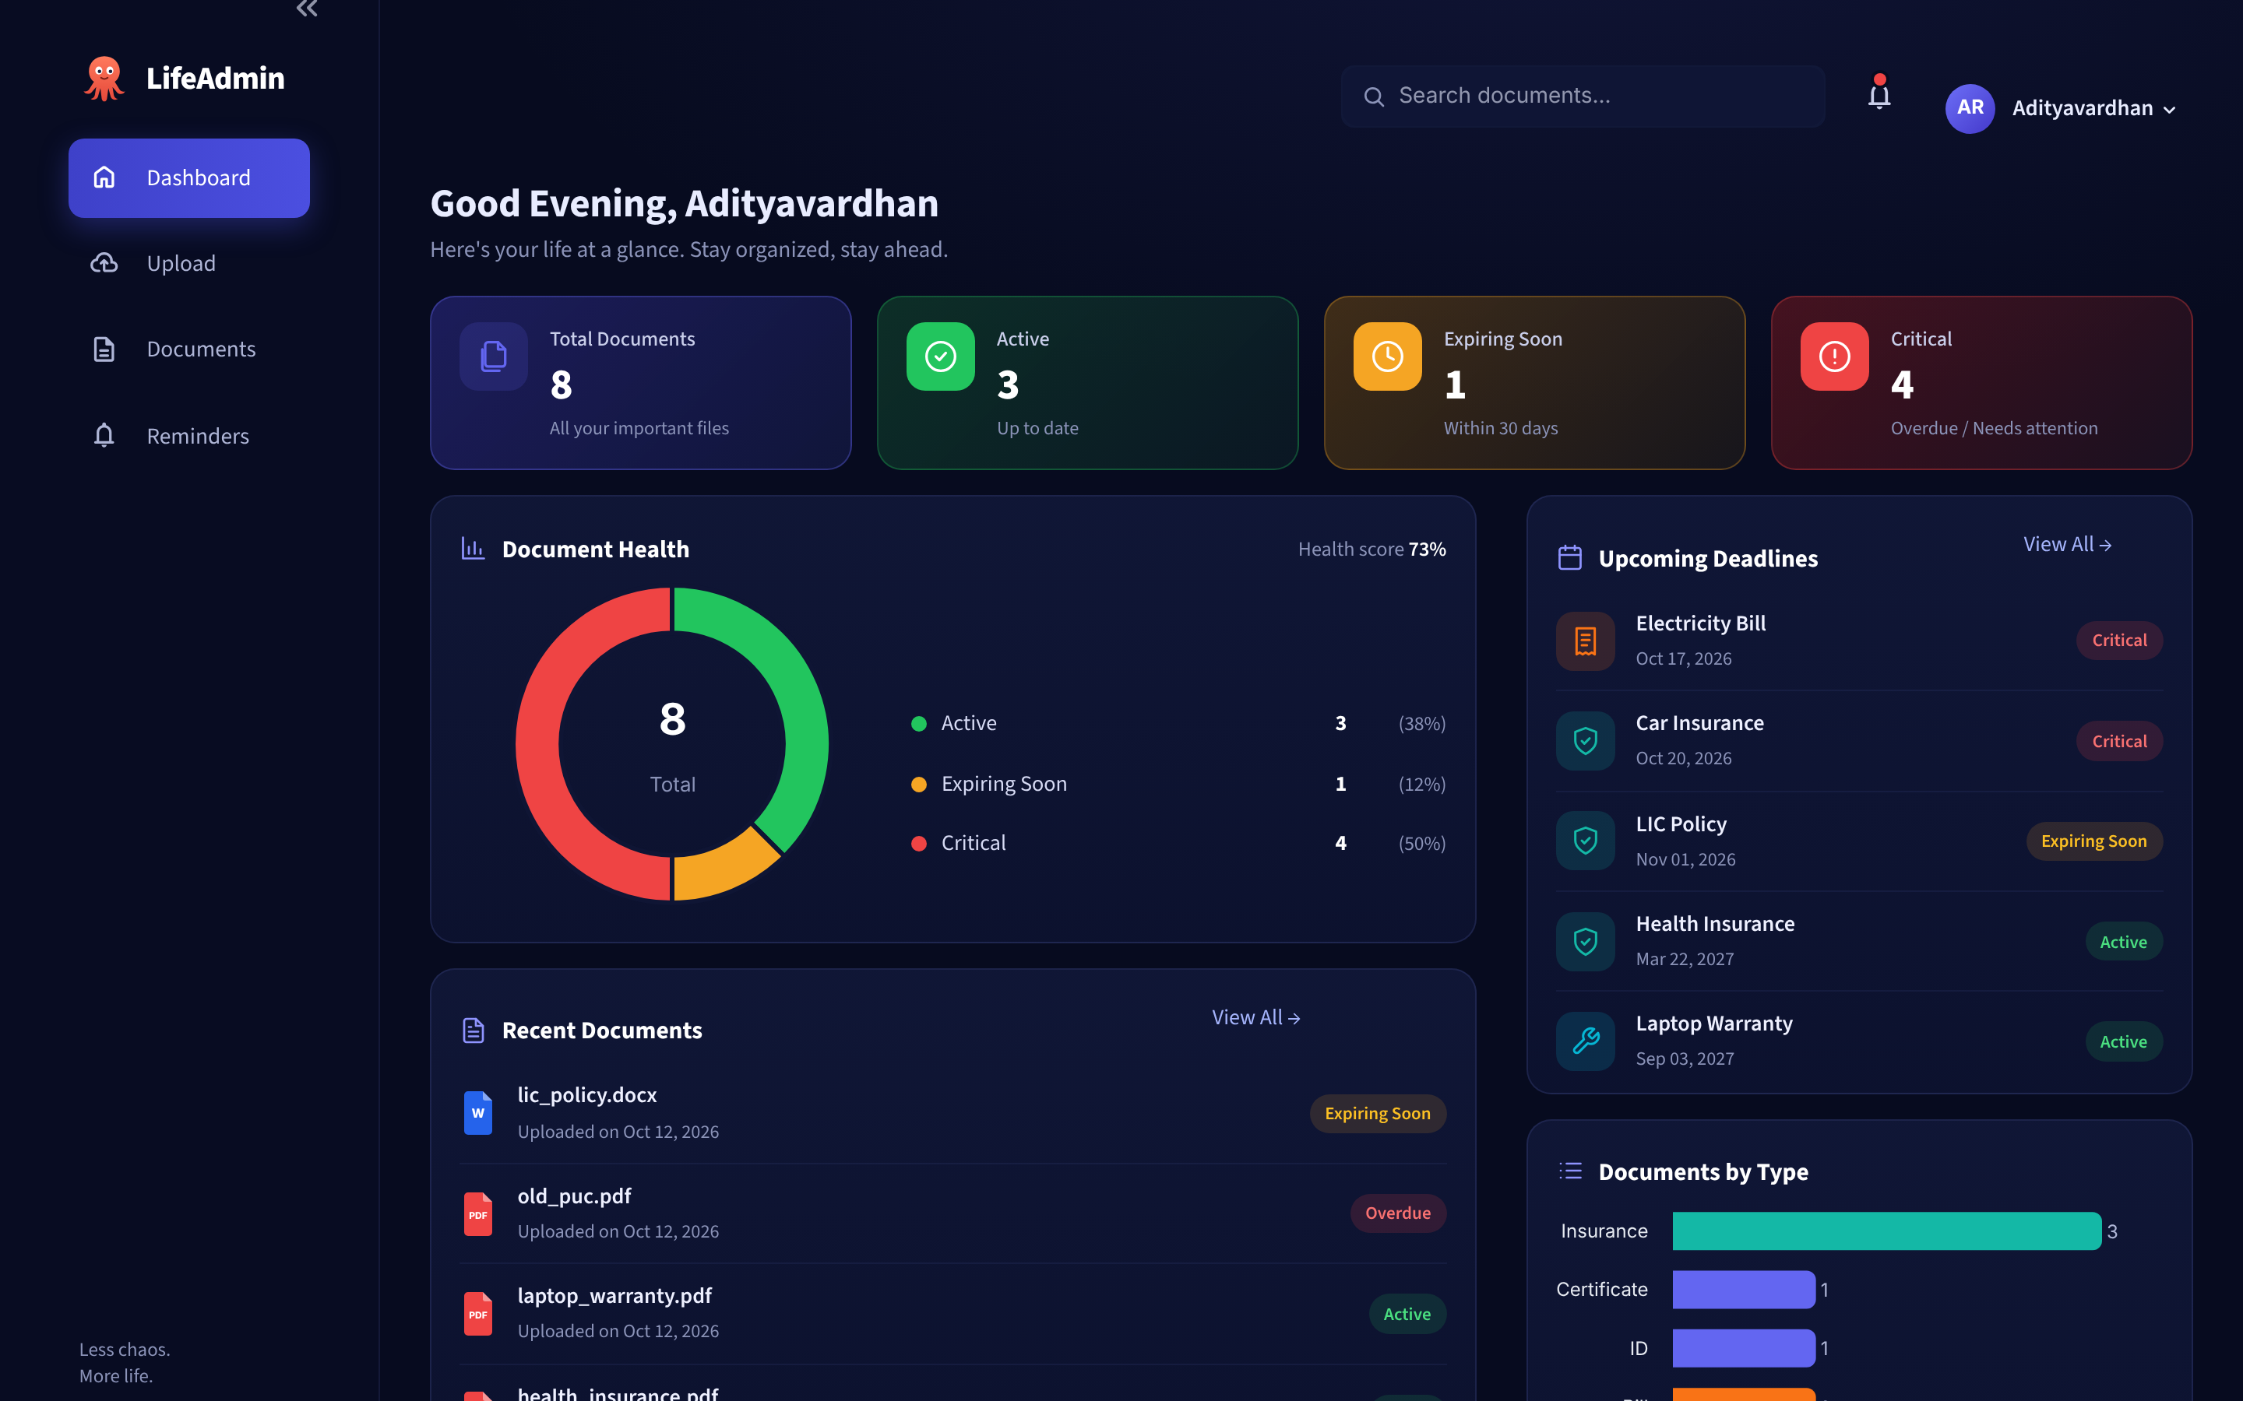

Smart Personal Document & Deadline Manager
LifeAdmin
PROJECT REVIEW 2
A Python web app that reads your documents, finds the expiry dates and reminds you before they lapse.
Car Insurance
A. Adityavardhan Reddy
Critical · expires in 6 days
Reg. No. 23MID0186 · 15 October 2026
Notes:
LifeAdmin is a Python web app. You upload a document such as an ID, insurance policy, PUC, bill or warranty; it reads the file, pulls out the expiry date and other details, stores them, and warns you before anything expires. Today: what it does, the tech used, the architecture, the files, the screens and the roadmap.

Slide 2





Upload a document. LifeAdmin does the rest
WHAT THE PROJECT DOES
Important documents expire silently: the date is buried inside a PDF and nobody remembers to renew. LifeAdmin reads the document for you and keeps watch.
STEP 1
STEP 2
STEP 3
STEP 4
Upload
Read & extract
Store & track
Remind
Drop a PDF, photo, Word or Excel file (max 10 MB)
Finds the type, holder, number, amount and expiry date
Saves everything in a local SQLite database
Warns 30 and 7 days before expiry: dashboard, bell, calendar
WORKS WITH
ID cards
Insurance
Vehicle RC / PUC
Bills
Warranties
Certificates
Subscriptions
Notes:
In one line: upload, extract, store, remind. The user never types a date by hand; the app reads it from the document. It handles seven kinds of personal documents, and everything stays on the user's own computer.

Slide 3






Six things LifeAdmin does automatically
KEY FEATURES
Multi-format upload
Automatic extraction
Auto classification
PDF, JPG, PNG, DOCX, XLSX and TXT; validated for type and size before processing.
Regex finds dates, policy / ID numbers, names, vehicle numbers and ₹ amounts.
Keyword scoring sorts each file into one of 8 types, with a confidence %.
Smart reminders
Health score
Dashboard & export
Active > 30 days · Expiring ≤ 30 · Critical ≤ 7 · Expired after the date.
Rates each document on completeness (5 fields) and timeliness (days left).
Live charts, search, CSV export and an .ics calendar with 30 / 7-day alarms.
Notes:
Six features. The two that matter most are automatic extraction and smart reminders: the regular expressions pull out the expiry date, and the reminder rules turn that date into Active, Expiring, Critical or Expired. The review form lets the user correct anything before saving.

Slide 4

No paid API: open-source Python libraries only
TECHNOLOGY & APIs USED
No external web API, no API keys, ₹0 cost. Every feature uses a free Python library running locally on the user's computer.
Streamlit
app.py
SQLite (sqlite3)
database.py
pypdf
extractor.py
Web UI framework: pages, forms, upload
Built-in database for documents and logs
Reads text from PDF files
python-docx
extractor.py
openpyxl
extractor.py
re (regex)
parser.py
Reads text from Word files
Reads text from Excel sheets
Finds dates, numbers, names, ₹ amounts
Pandas
export.py
Plotly
app.py
pypdfium2 + Pillow
preview.py
Document tables and CSV export
Donut and bar charts on the dashboard
Page thumbnails of uploaded files
Optional: Tesseract OCR (pytesseract) for scanned images · Testing: pytest · Language: Python 3.10+
Notes:
If asked which API was used: there is no third-party web API. The app calls the APIs of open-source Python libraries. Streamlit for the web interface, SQLite for storage, pypdf, python-docx and openpyxl to read files, regular expressions to find the fields, Pandas and Plotly for tables and charts. Because nothing calls the internet, it is free to run and the user's personal documents never leave their machine.

Slide 5



How the pieces connect
SYSTEM ARCHITECTURE
FRONTEND
BACKEND
Streamlit UI
upload
Processing engine
save
DATA
SQLite
User
app.py · style.py
pipeline.py
web browser
Dashboard · Upload · Documents · Reminders
Python modules, called directly
database.py
INSIDE THE BACKEND ENGINE
Read text
Detect type
Find fields
Set status
Score health
extractor.py
classifier.py
parser.py
reminders.py
health.py
pypdf · docx · openpyxl · OCR
keyword scoring
regex: dates, IDs, ₹
30 / 7-day rules
completeness + timeliness
OUTPUTS · read back from SQLite and shown in the frontend
Dashboard
Reminders
Export
File store
Plotly charts + KPIs
tabs, bell, calendar
CSV + .ics (export.py)
originals in data/uploads/
Notes:
Read it left to right. The user works in the browser; the Streamlit frontend sends the uploaded file to the backend engine, pipeline.py, which runs five modules in order: read the text, detect the type, find the fields, set the status, score the health. The result is saved in SQLite. Every screen then reads from SQLite to show the dashboard, reminders and exports. Frontend and backend are Python modules in one app, so no separate API server is needed.

Slide 6
What happens to one uploaded document
DATA FLOW · REAL EXAMPLE
INPUT · car_insurance.pdf
1
pypdf reads the text
OUTPUT · saved to SQLite
Sundaram General Insurance
Company Limited
MOTOR INSURANCE POLICY SCHEDULE
Policy No: INS784521
Insured Name: Arun Kumar
Vehicle Registration No:
TN 63 AB 1234
Period of Insurance:
20/10/2025 to 20/10/2026
Total Premium: Rs. 14,250.00
Type
Insurance (90% sure)
Policy No
INS784521
2
classifier → Insurance
Holder
Arun Kumar
Organization
Sundaram General Insurance
3
regex extracts fields
Vehicle
TN 63 AB 1234
Valid till
20 Oct 2026
4
rules → Critical
Premium
₹14,250.00
CRITICAL · expires within 7 days
Notes:
A real run on one of the sample PDFs. On the left is the raw text pypdf reads. The classifier decides it's an insurance document with 90 percent confidence, the regular expressions pull out each field, and the reminder rules mark it Critical because it expires within seven days. The user sees these values pre-filled in a form and can correct them before saving.

Slide 7


One SQLite file, four tables
DATABASE DESIGN
documents
reminders
activity_logs
id
INTEGER PK
id
INTEGER PK
id
INTEGER PK
filename
TEXT
document_id
FK → documents
action
TEXT
doc_type
TEXT
dismissed_at
TEXT
detail
TEXT
holder_name
TEXT
reminders marked as completed
created_at
TEXT
doc_number
TEXT
audit trail of every change
organization
TEXT
users
vehicle_no
TEXT
id
INTEGER PK
Why SQLite
amount
TEXT
start_date
TEXT (ISO)
name
TEXT
One file: data/lifeadmin.db
Built into Python, zero setup
Foreign key with cascade delete
Works fully offline
expiry_date
TEXT (ISO)
created_at
TEXT
notes
TEXT
profile name shown in the app
stored_path
TEXT
uploaded_at
TEXT
Notes:
All data is in one SQLite file. documents holds every extracted field. reminders stores which deadlines the user marked as completed and is linked to documents with a foreign key, so deleting a document removes its reminders. users holds the profile name, and activity_logs records every add, edit, delete and completion.

Slide 8


Frontend and backend files
PYTHON FILES
FRONTEND
BACKEND · lifeadmin/ package
What the user sees
Reads, understands and stores documents
app.py
624 lines
pipeline.py
extractor.py
Runs the 5 steps for each upload
Checks file; reads PDF/Word/Excel
Entry point; the 4 screens, sidebar, search, forms
classifier.py
parser.py
Detects document type
Regex: dates, numbers, names, ₹
lifeadmin/style.py
496 lines
reminders.py
health.py
Theme, CSS, icons and UI components
Active / Expiring / Critical rules
Document health score
database.py
models.py
.streamlit/config.toml
SQLite tables and queries
Document data class
Dark theme colours, 10 MB upload limit
export.py
preview.py
CSV and .ics calendar export
Thumbnails, Aadhaar masking
Also: tests/test_lifeadmin.py (28 tests) · scripts/smoke_ui.py · scripts/make_samples.py
Notes:
The frontend is three files: app.py with the four screens, style.py with the visual design, and config.toml with theme settings. The backend is ten modules in the lifeadmin package; pipeline.py calls the others in order. All of them are in the source zip ready to upload after approval.

Slide 9
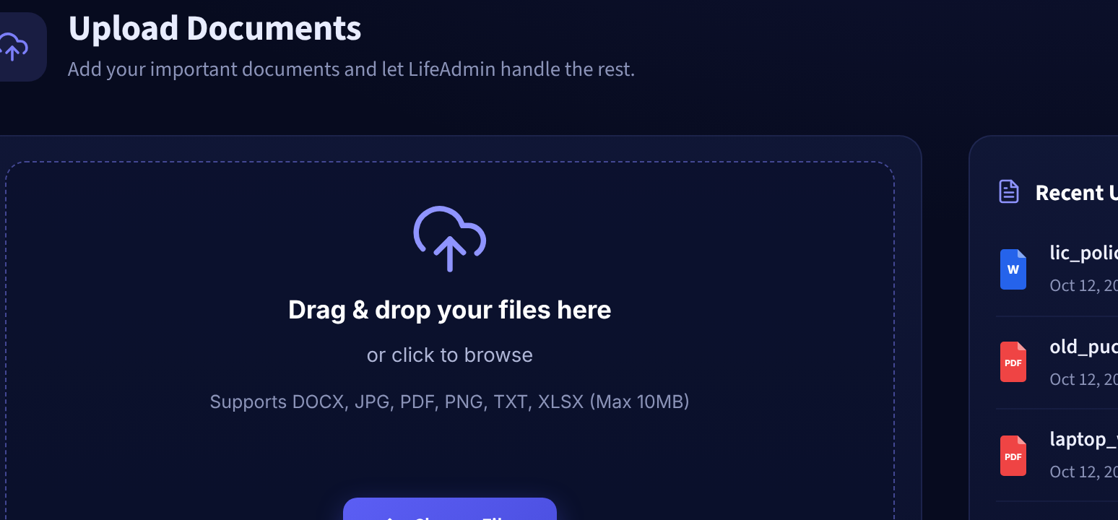
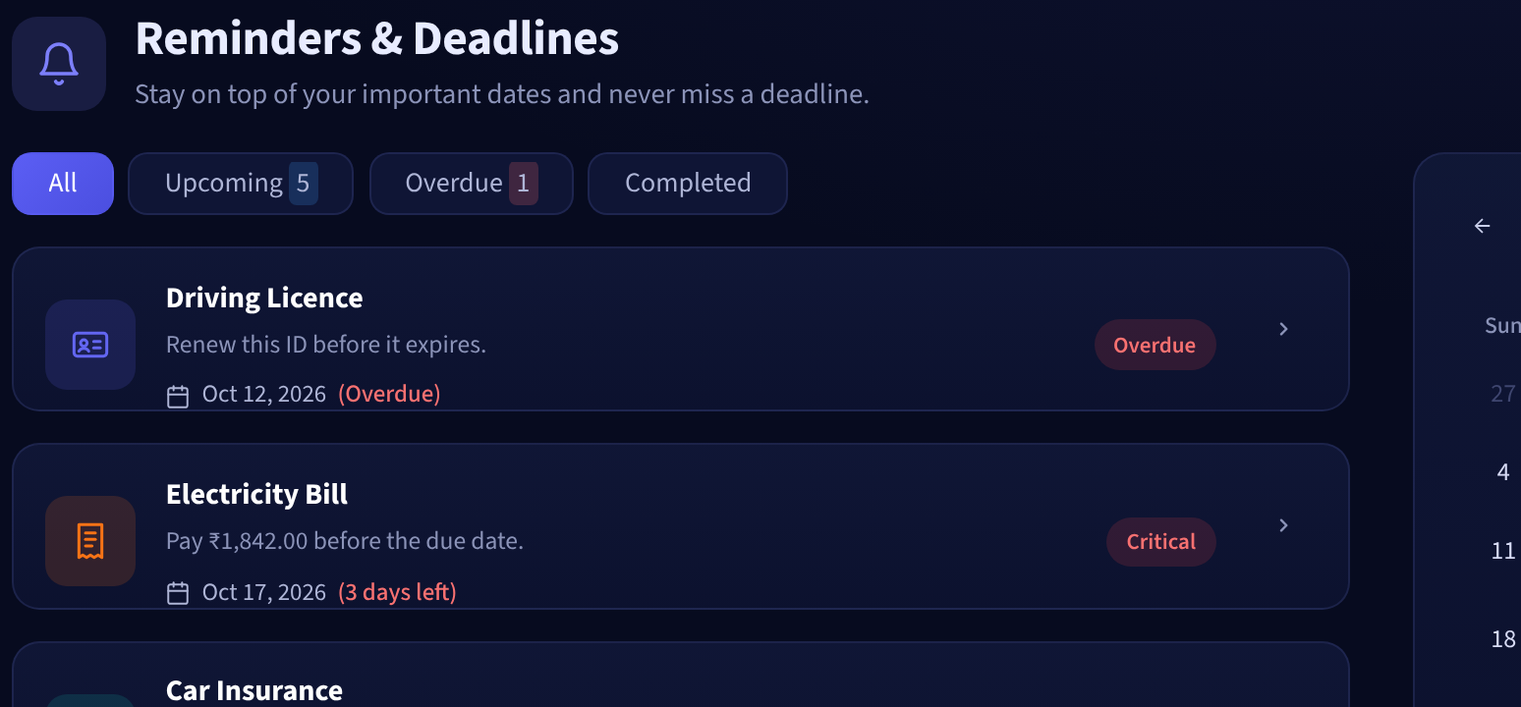
The website in action
THE WEBSITE
Upload: drag & drop, auto-filled review form
Dashboard: KPI cards, health donut, upcoming deadlines
Reminders: tabs, deadline calendar, export
Notes:
Live demo if possible: upload a sample PDF, show the pre-filled fields, save it, and show it on the dashboard and the reminders calendar. The fourth screen, Documents, lets the user search, edit and delete.

Slide 10

Done, today, and what's next
WEBSITE ROADMAP
DONE · 8 OCT
DONE · 12 OCT
TODAY · 15 OCT
NEXT
LATER
Core engine
Full website
Review 2
Publish
Extend
Extraction + classifier
SQLite database
21 tests
4 screens
Word & Excel upload
28 tests
Architecture + demo
Approval to upload
Upload source files
GitHub + live demo link
Email / WhatsApp alerts
Multi-user login
Thank you · Questions?
Run it: streamlit run app.py
Less chaos. More life.
Notes:
Phases one and two are done; today is Review 2. After approval: upload the source files, push to GitHub and share a live demo link. Later: email or WhatsApp alerts and multi-user login. Thank the panel and ask for questions and approval.

