Slide 1




Fast Fashion - Fashion Delivery Application
Team 5
Hiba Farag,
Aditya Gorakh Velapurkar,
Keerthana Gantla,
Naveen Kumar Reddy Kalluri,
Tarun Nagasiddappa Somashekar
Notes:
A

Slide 2
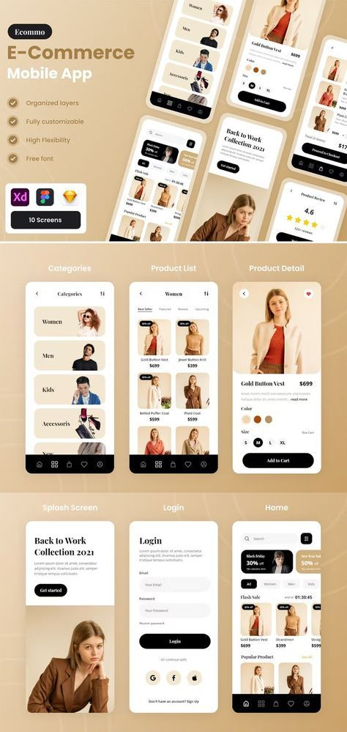
PROJECT OBJECTIVES
Develop a user-friendly mobile application that provides customers with a seamless shopping experience
Offer personalized recommendations and curated collections tailored to individual preferences
Provide fast and reliable delivery of fashion items
Maximize brand visibility and reach by integrating the app to expand our audience & market preferences
2
EPM – SPRING 2024
Notes:
A

Slide 3
Project organization
GENERAL MANAGER
VP OF PRODUCTS & TECHNOLOGY
PROJECT MANAGER
VP OF MARKETING & GROWTH
VP OF OPERATIONS & PARTNERSHIP
DIRCTOR OF FINANCE & LEGAL
PROJECT MANAGER
DIRECTOR OF DEVELOPMENT
DIRECTOR OF BUSINESS DEVELOPMENT
MARKETING MANAGER
OPERATIONS MANAGER
FINANCE & ACCOUNTING
LEGAL AND COUNSEL TEAM
3
EPM – SPRING 2024
Notes:
A

Slide 4
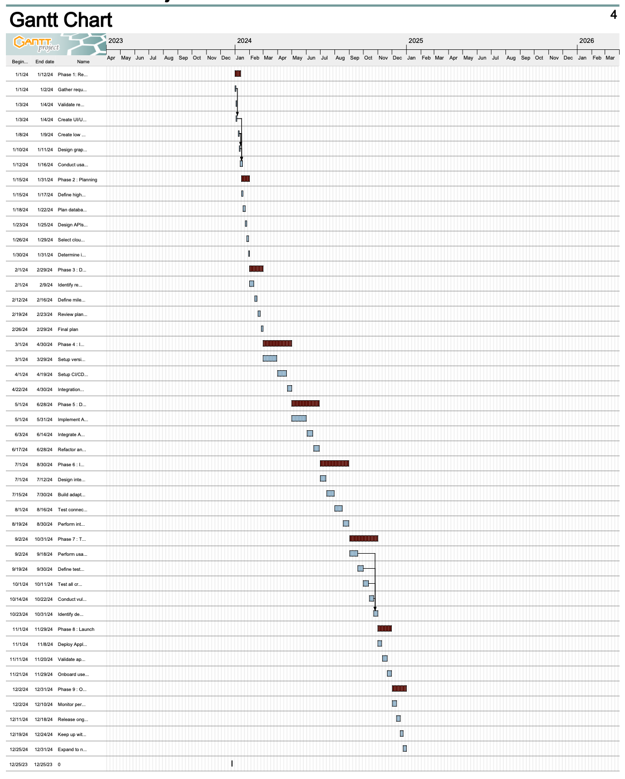
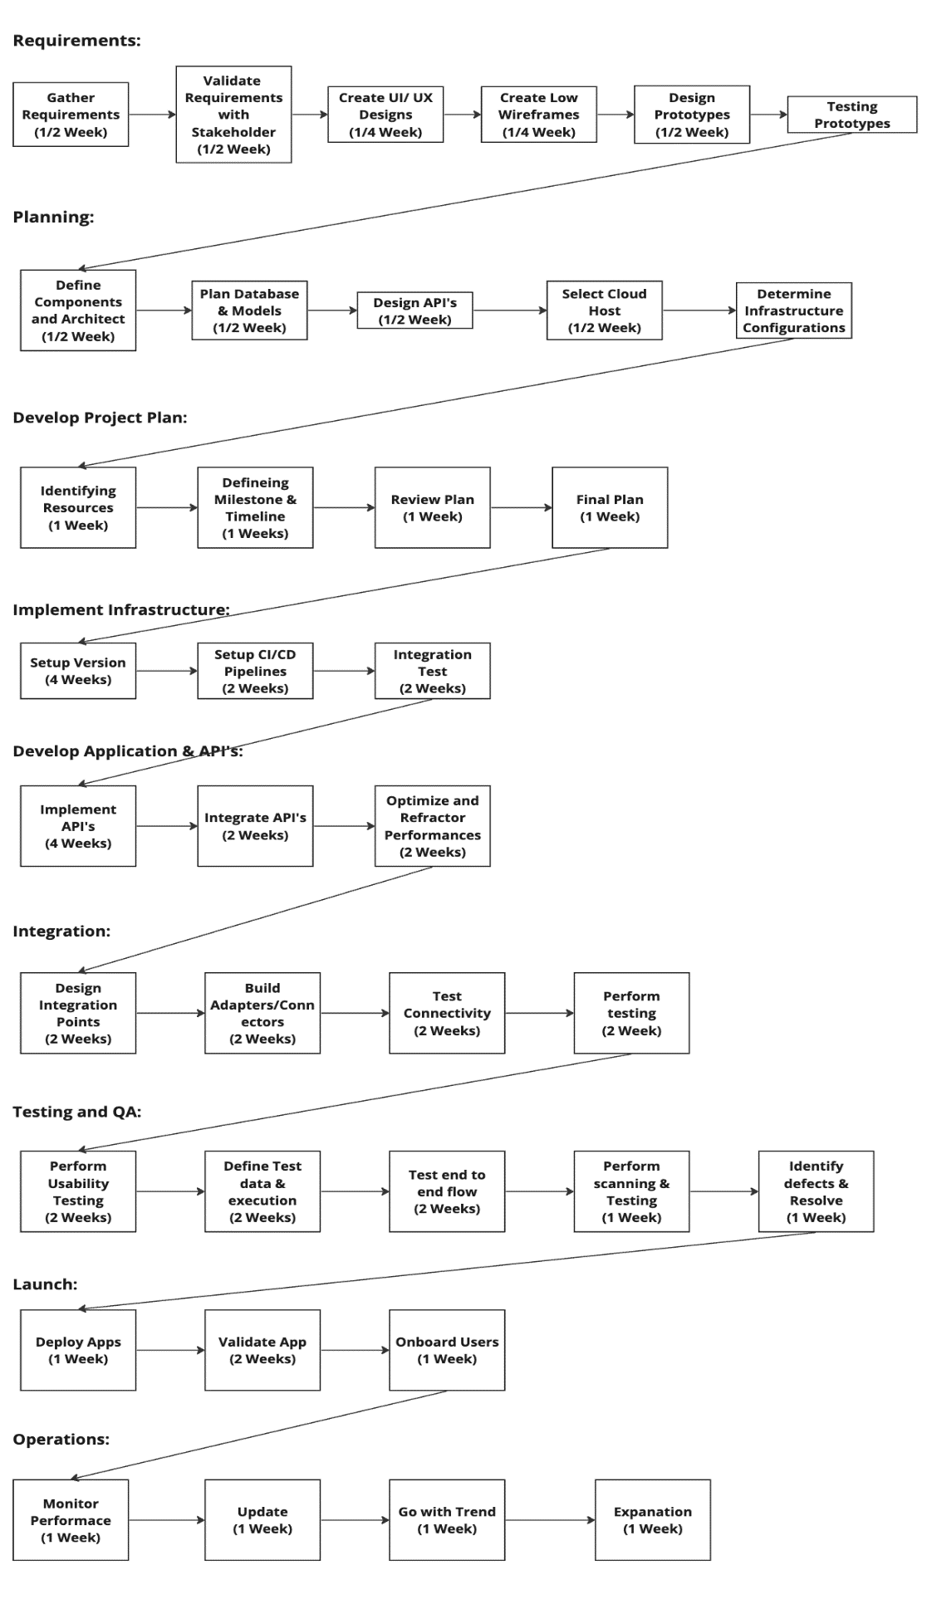
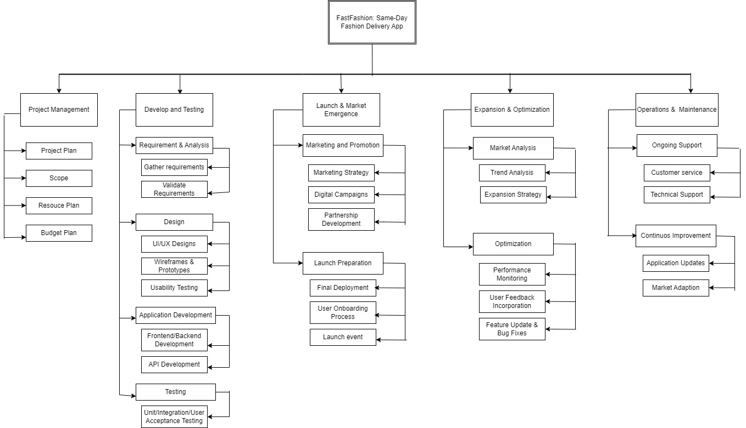
IMPLEMENTATION PLAN
PERT ANALYSIS
GNATT CHART
RESPONSIBILITY CHART
WORK BREAKDOWN STRUCTURE
RESPONSIBILITY CHART
GNATT CHART
PERT ANALYSIS
EPM – SPRING 2024
Notes:
N

Slide 5
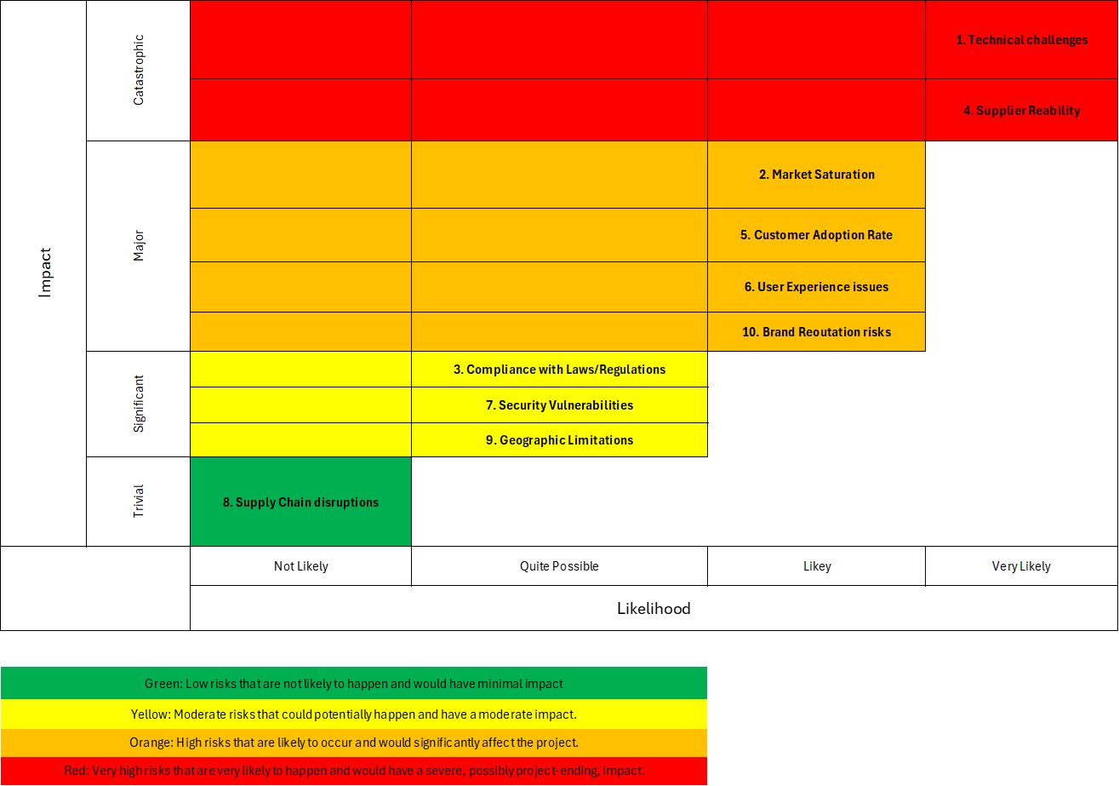
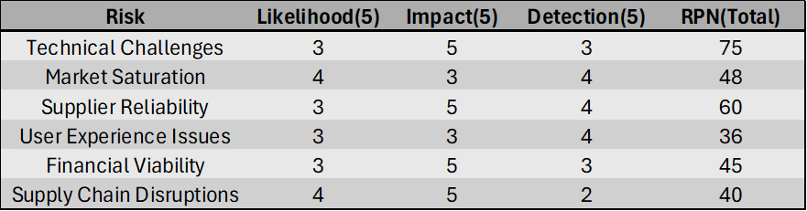
RISK ANALYSIS
RISK
QUALITATIVE ANALYSIS
QUANITATIVE ANALYSIS
Qualitative Risk Analysis
Risk Assessment Matrix
Quantitative Risk Analysis
Risk Matrix Analysis
EPM – SPRING 2024
Notes:
K

Slide 6

Monitoring and control
Outline of Plan:
Dictate the project leadership functions
Monitoring approaches
Reporting strategy
Risk mitigation
Market introduction strategies
Purpose of Monitoring and Control Plan:
Track progress
Identify potential issues or risks
Take corrective actions
EPM – SPRING 2024
Notes:
K

Slide 7
Financial planning
Key Assumptions:
Financial projections based on market demand and pricing strategy analysis
Initial funding to be secured through a combination of investment and grants
Expansion plans into new markets expected to contribute an additional revenue
ALLOCATED PHASES
Total Budget: $591,500
DEVELOPMENT & TESTING
$272,000
LAUNCH & MARKET EMERGENCE
$99,000
EXPANSION & OPTIMIZATION
$220,500
EPM – SPRING 2024
Notes:
T

Slide 8
Resource allocation
EPM – SPRING 2024
Notes:
T

Slide 9



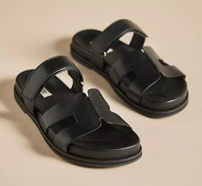


Conclusion
FastFashion
An innovative mobile application that brings the convenience of same-day delivery to the world of fashion
Fashion delivered fast
9
EPM – SPRING 2024
Notes:
T

