Slide 1

EXPLORATORY DATA ANALYSIS OF CRIMES AGAINST WOMEN IN INDIA – (2001-2012)
Project Curator:
Aditya Vardhan Gopaldas Pawan

Slide 2
Introduction
The history of violence against women remains vague in scientific literature. This is in part because many kinds of violence against women (specifically rape, sexual assault, and domestic violence) are under-reported, often due to societal norms, taboos, stigma, and the sensitive nature of the subject. It is widely recognized that even today, a lack of reliable and continuous data is an obstacle to forming a clear picture of violence against women. In this EDA we try to get some insights from the data available between 2001 and 2012 and find out the patterns in the data.

Slide 3
Data Description
The Data Set used has the following characteristics:
Columns
STATE/UT
DISTRICT
Year
Rape
Kidnapping and Abduction
Dowry Deaths
Assault on women with intent to outrage her modesty
Insult to modesty of Women
Cruelty by Husband or his Relatives
Importation of Girls
Rows
9017
Additional Columns
Total_Crimes

Slide 4
Problem Statement and Methodologies used
This analysis focuses on Exploratory Data Analysis(EDA) of CAW(Crimes Against Women between 2001 and 2012) Data Set to derive meaningful insights from data, which includes cleaning, reshaping, slicing, manipulating and transforming the data.
Exploratory Data Analysis: EDA refers to critical process of performing initial investigation on data, we will have a closer look of CAW(Crimes Against Women) data to resolve data ambiguities and analyze data by using the below strategies:
Finding Patterns in Data
Checking Assumptions
Handling missing Values if any
Determining Relationship between Variables in Data
Introducing new dimensions

Slide 5
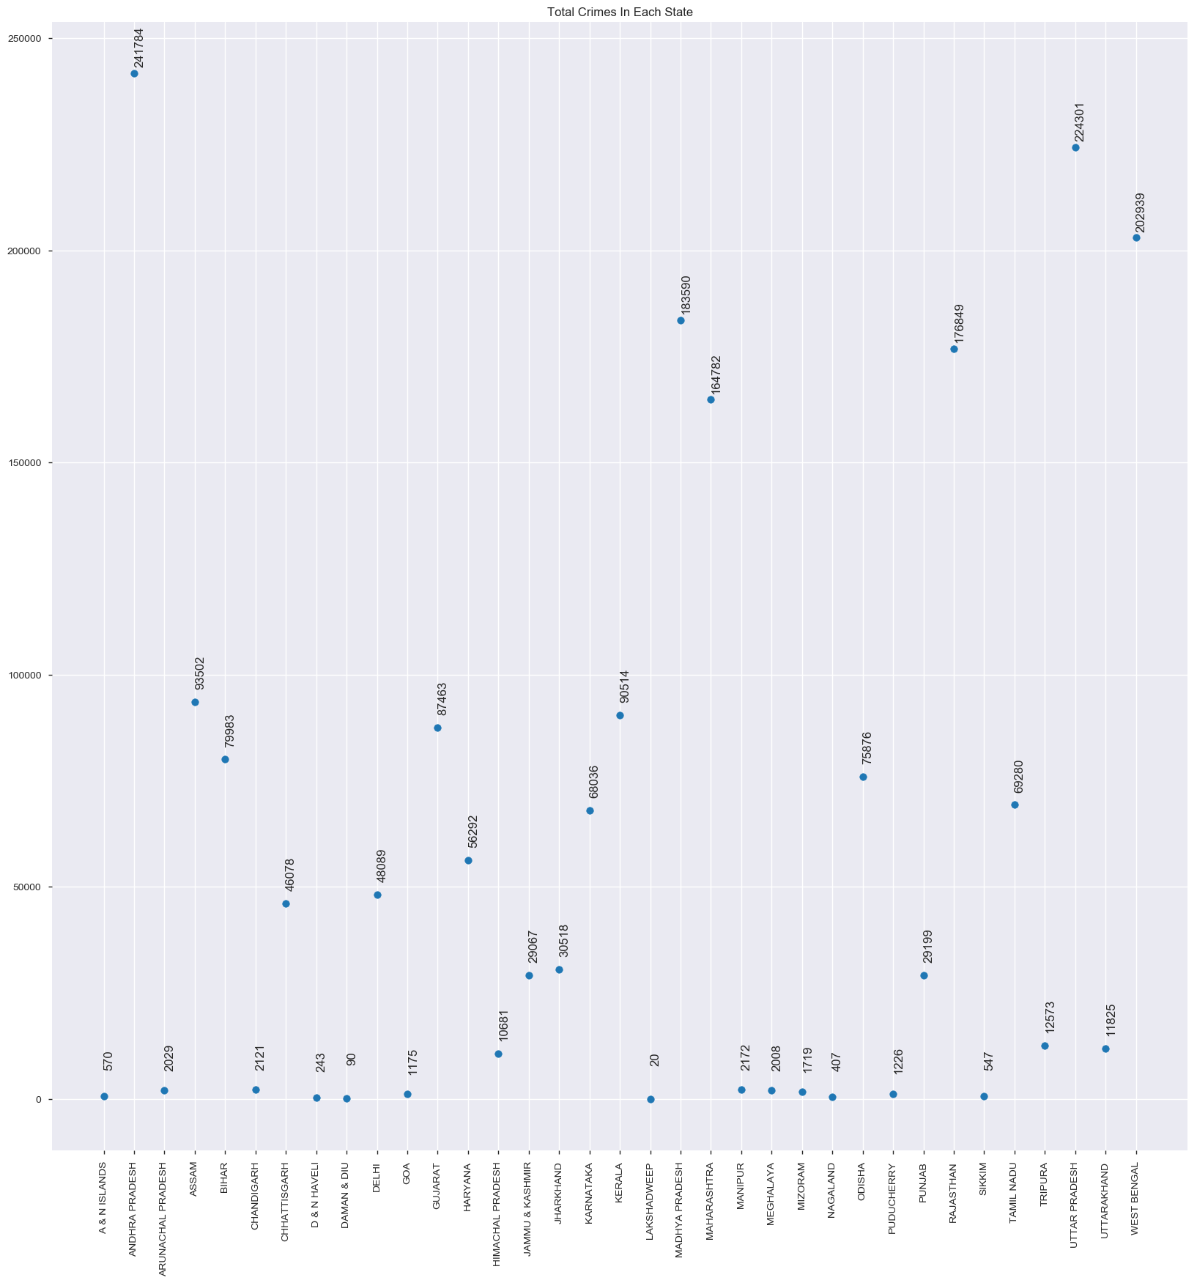
TOTAL CRIMES IN EACH STATE
The adjacent plot displays the total crimes against women in each State in India between 2001 to 2012.
From the plot, we observe that the Highest Crimes against women occurred in ANDHRA PRADESH and the Lowest Crimes against women occurred in LAKSHADWEEP between 2001 and 2012.

Slide 6
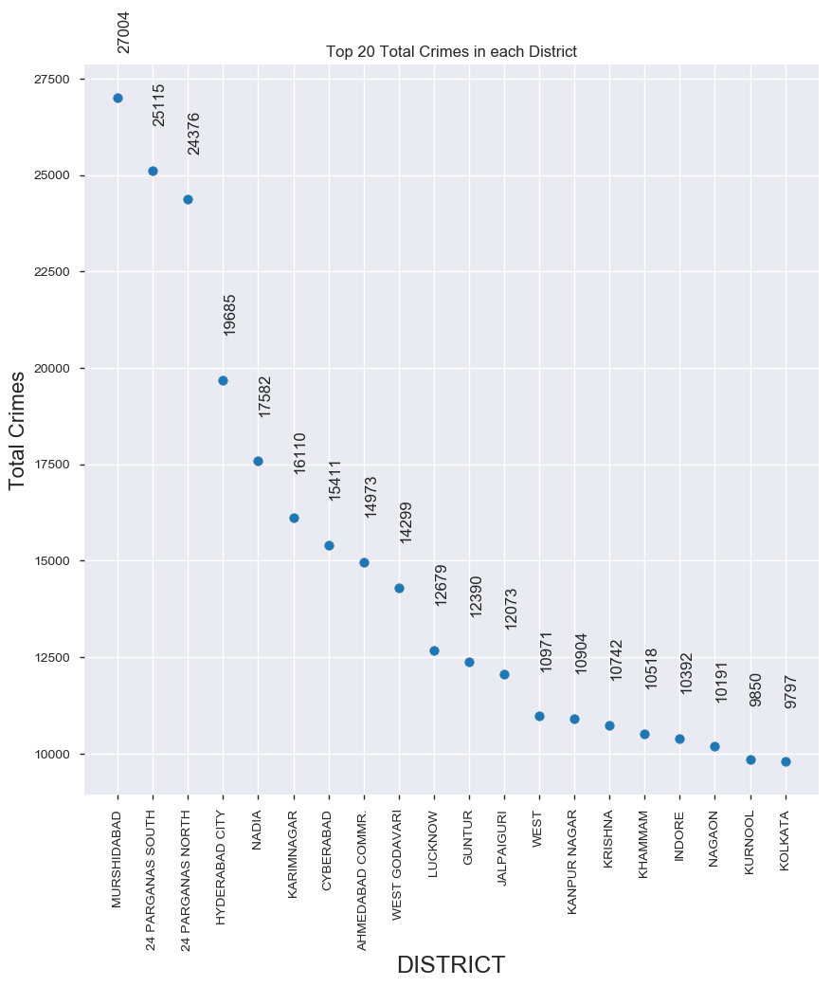
TOP 20 TOTAL CRIMES IN EACH DISTRICT
The adjacent graph displays the total crimes against women in Top 20 Districts in India between 2001 to 2012.
From the graph, we see that MURSHIDABAD has Highest Crimes Against Women followed by 24 PARGANAS SOUTH between 2001-2012.

Slide 7
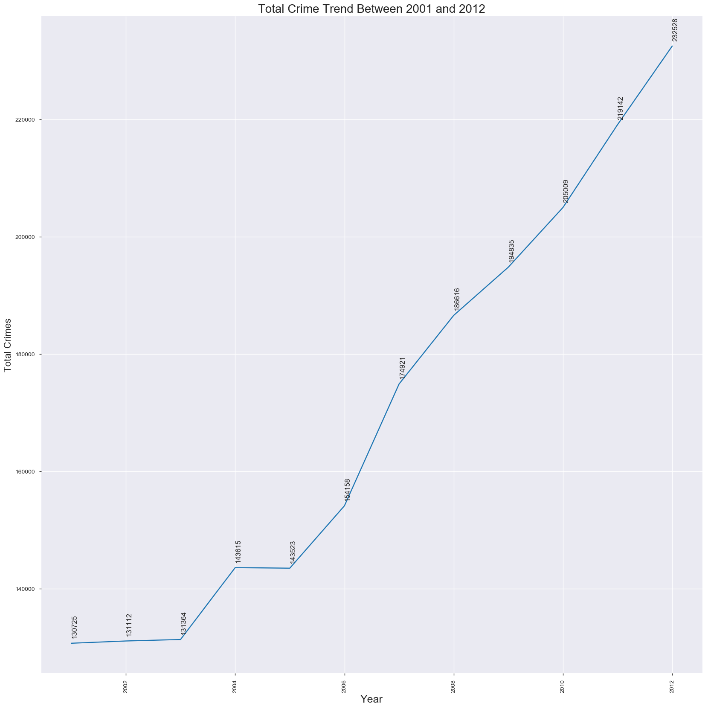
TOTAL CRIME TREND BETWEEN 2001 AND 2012
The adjacent plot displays the total crime trend against women in India between 2001 to 2012.
From the adjacent plot, we see that there has been a gradual increase in Crimes Against Women with negligible change between 2001-2003 and 2004-2005.

Slide 8
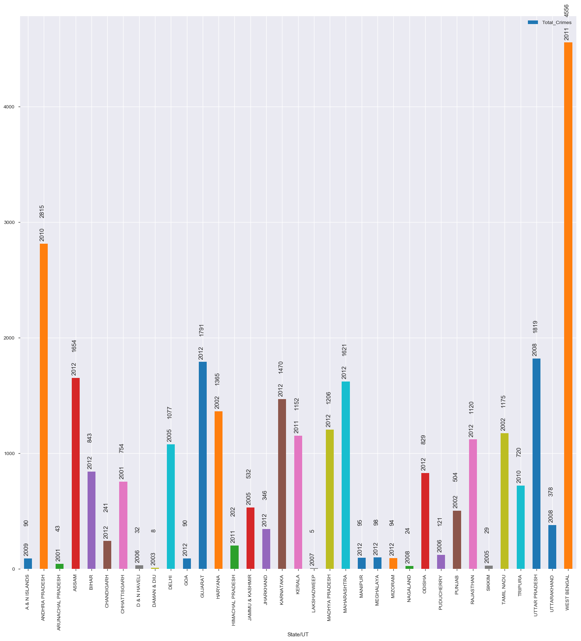
MAX CRIME FOR A STATE AND THE YEAR
The adjacent plot displays the maximum total crime for a State and the Year.
We see from the adjacent plot that WEST BENGAL has the highest crime rate in 2011 followed by ANDHRA PRADESH in 2010.

Slide 9
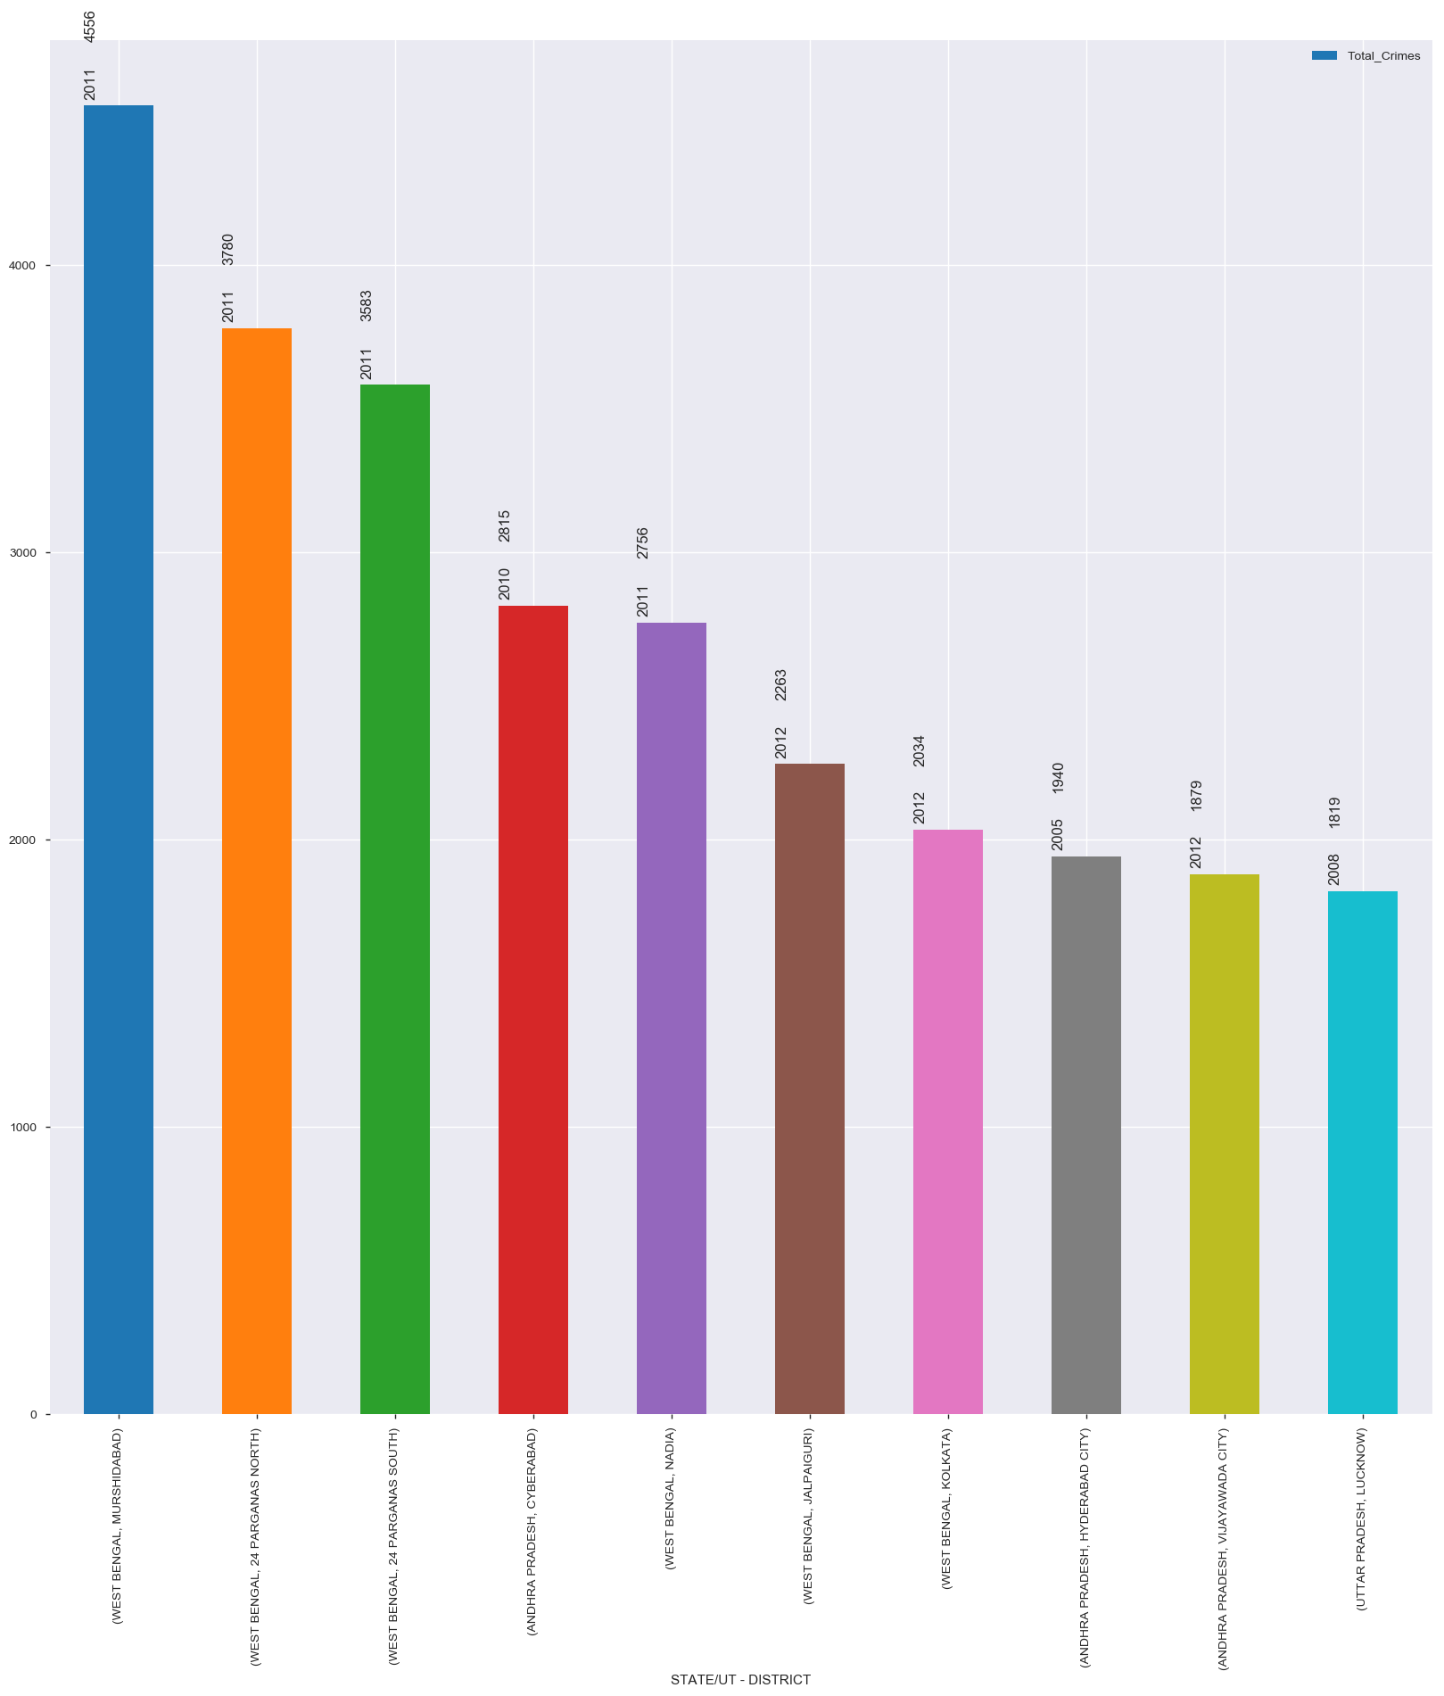
TOP 10 CRIME COUNT PER DISTRICT AND THE YEAR
The adjacent graph displays the Top 10 crime count for a District and the Year.
From the adjacent graph, we see that MURSHIDABAD has Highest Crimes Against Women in 2011 followed by 24 PARGANAS SOUTH in the same year.

Slide 10
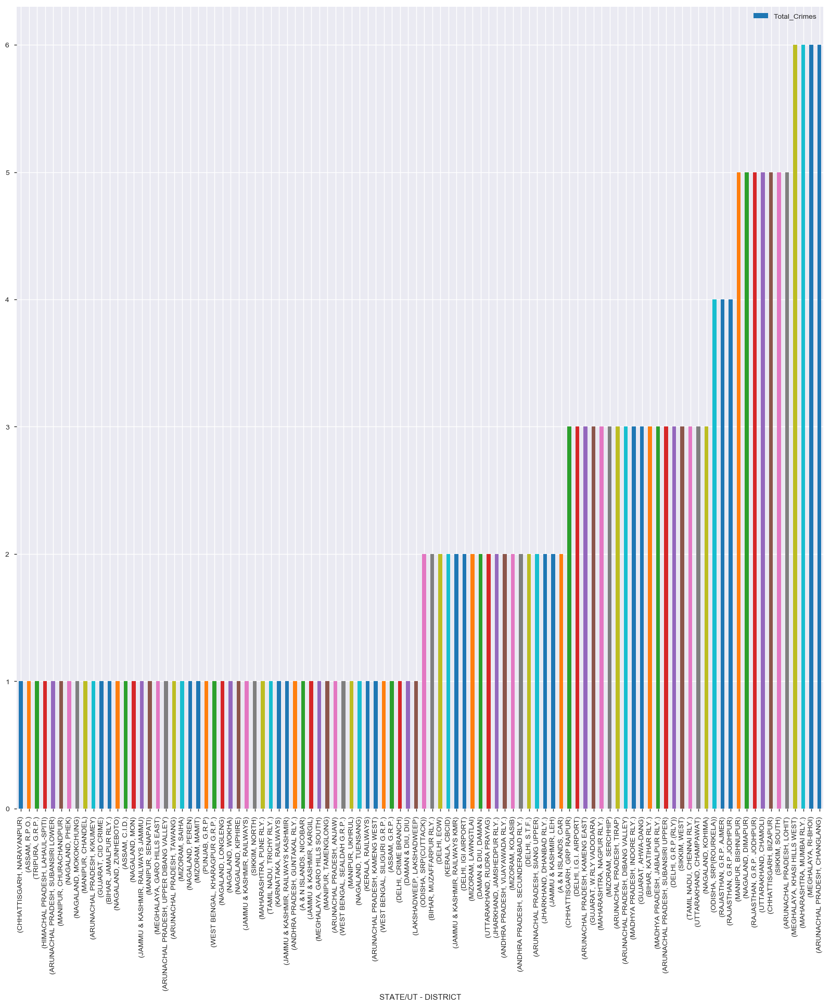
100 DISTRICTS WITH LOWEST CRIMES
The adjacent graph displays the 100 Districts with Lowest Crime Rates between 2001 and 2012.

Slide 11
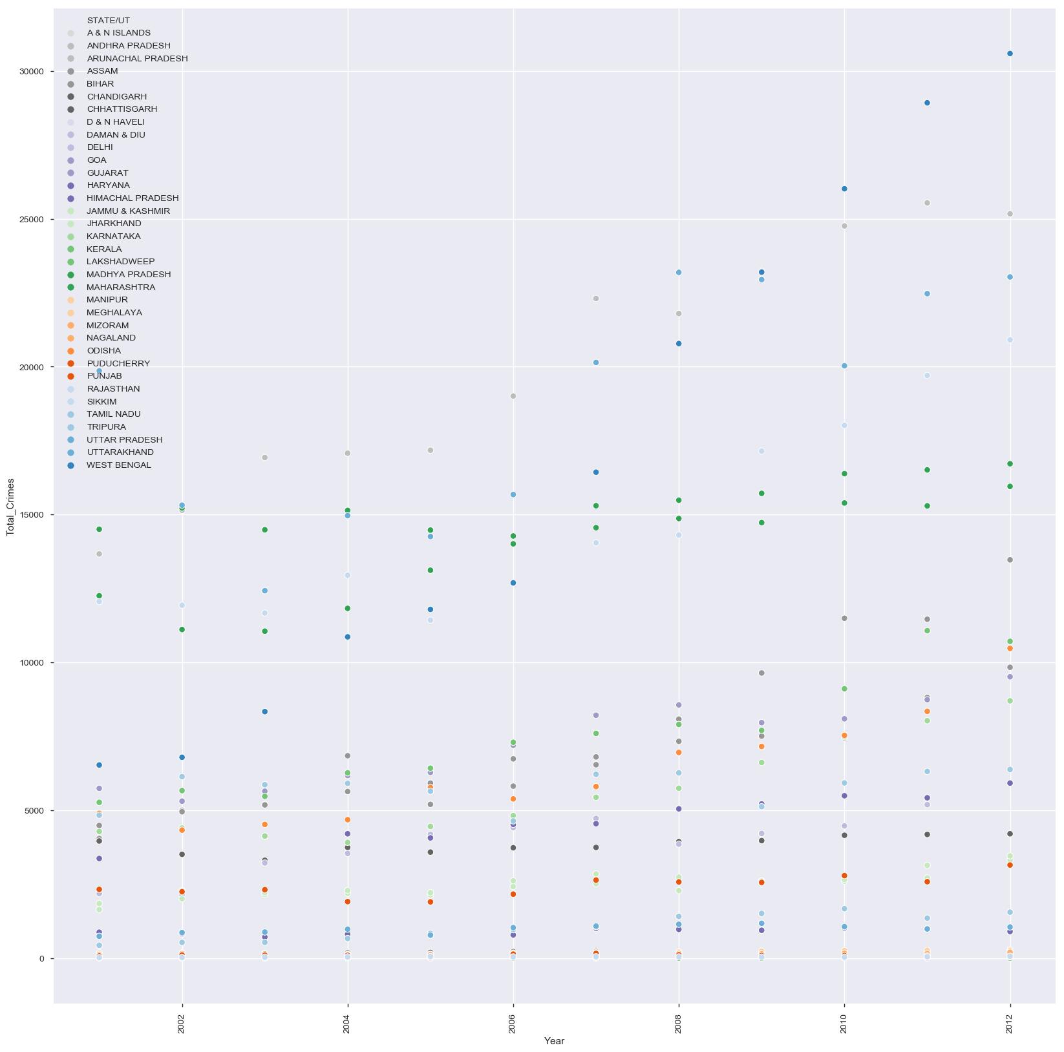
TOTAL CRIMES BY STATE AND YEAR-WISE
The adjacent plot displays the total crime count by State and Year-wise.
From the adjacent plot, we see that the highest crime state is WEST BENGAL in 2012 and the lowest crime state is LAKSHADWEEP in 2006.

Slide 12
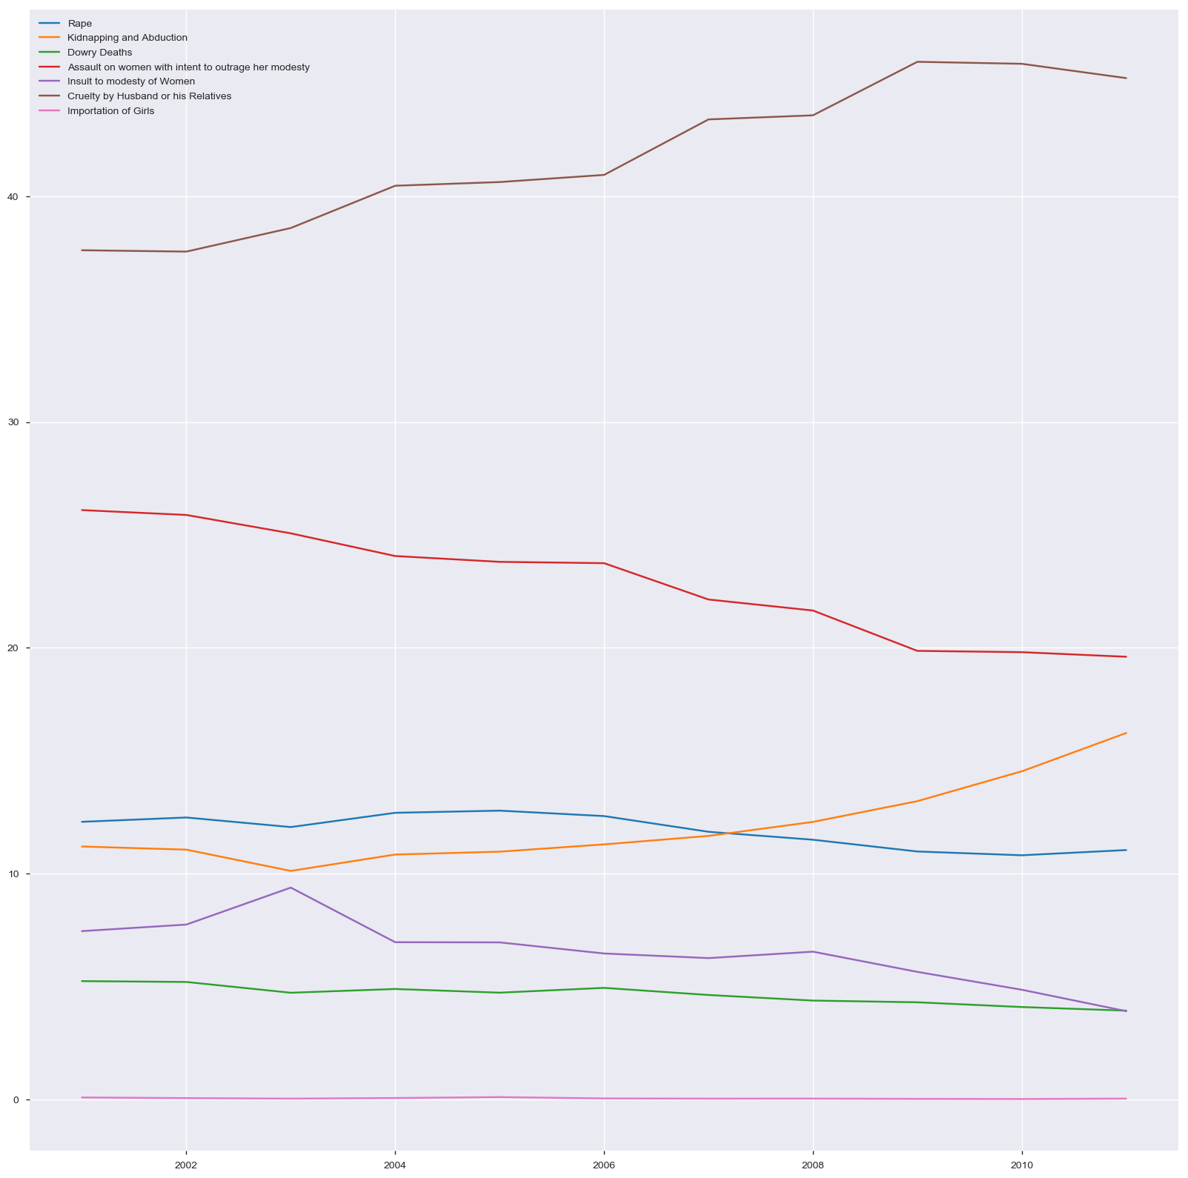
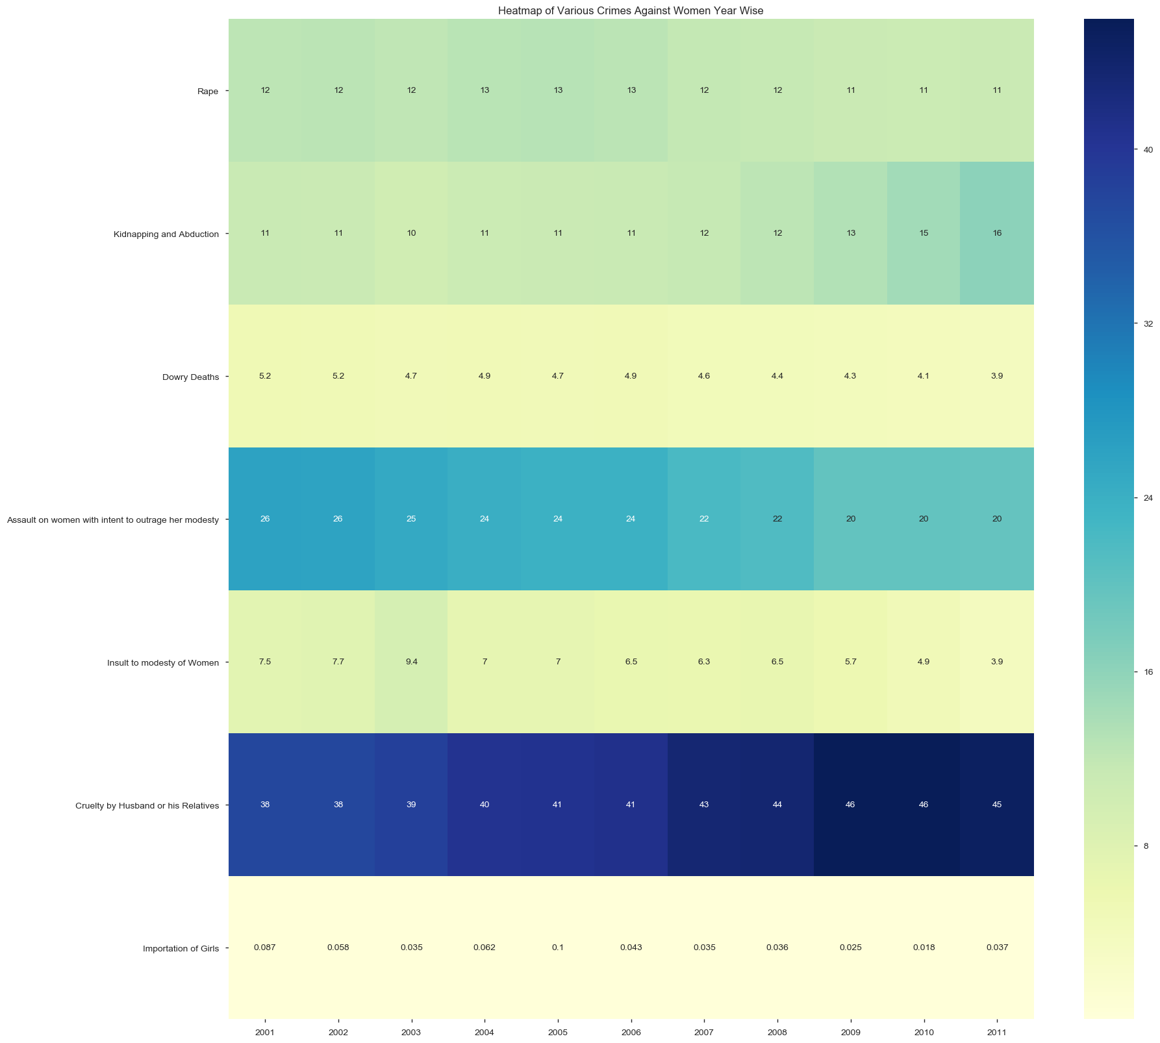
TYPES OF CRIMES YEAR-WISE
From the above two plots, we see that:
Cruelty by Husband or his Relatives shows an increasing trend
Assault on women with intent to outrage her modesty shows a decreasing trend
Kidnapping and Abduction decreased till 2003, then it gradually increased
Insult to modesty of Women increased till 2003, then it gradually decreased
Importation of Girls has been constant for most of the time

Slide 13
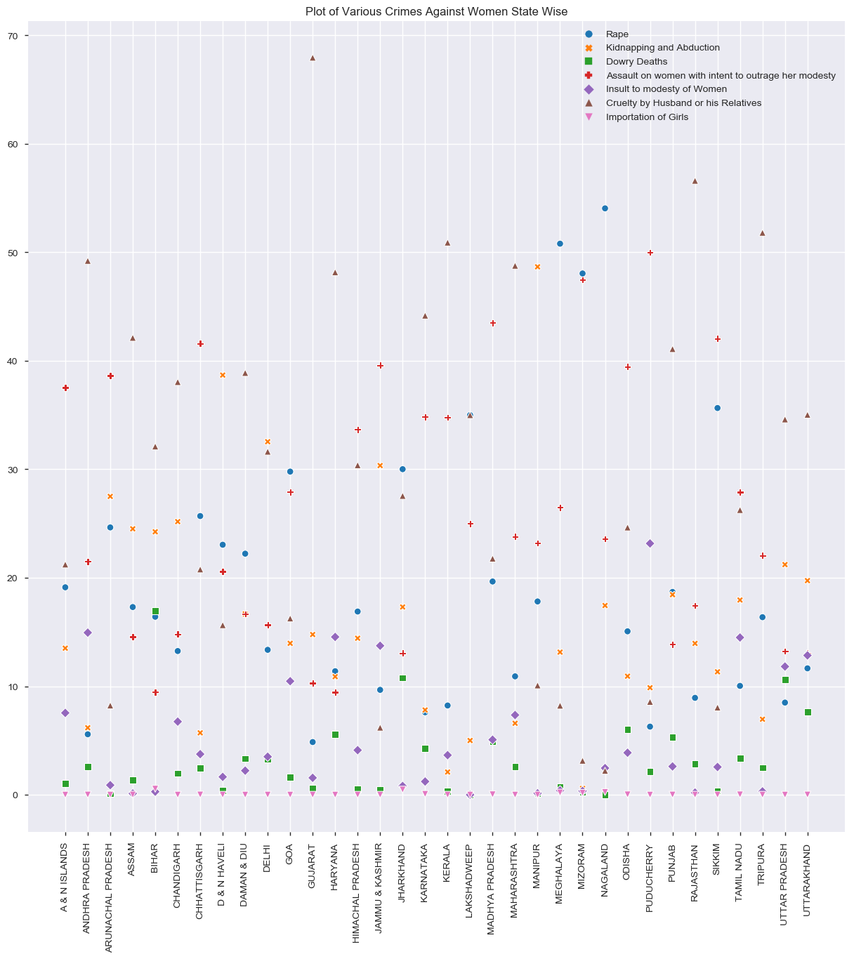
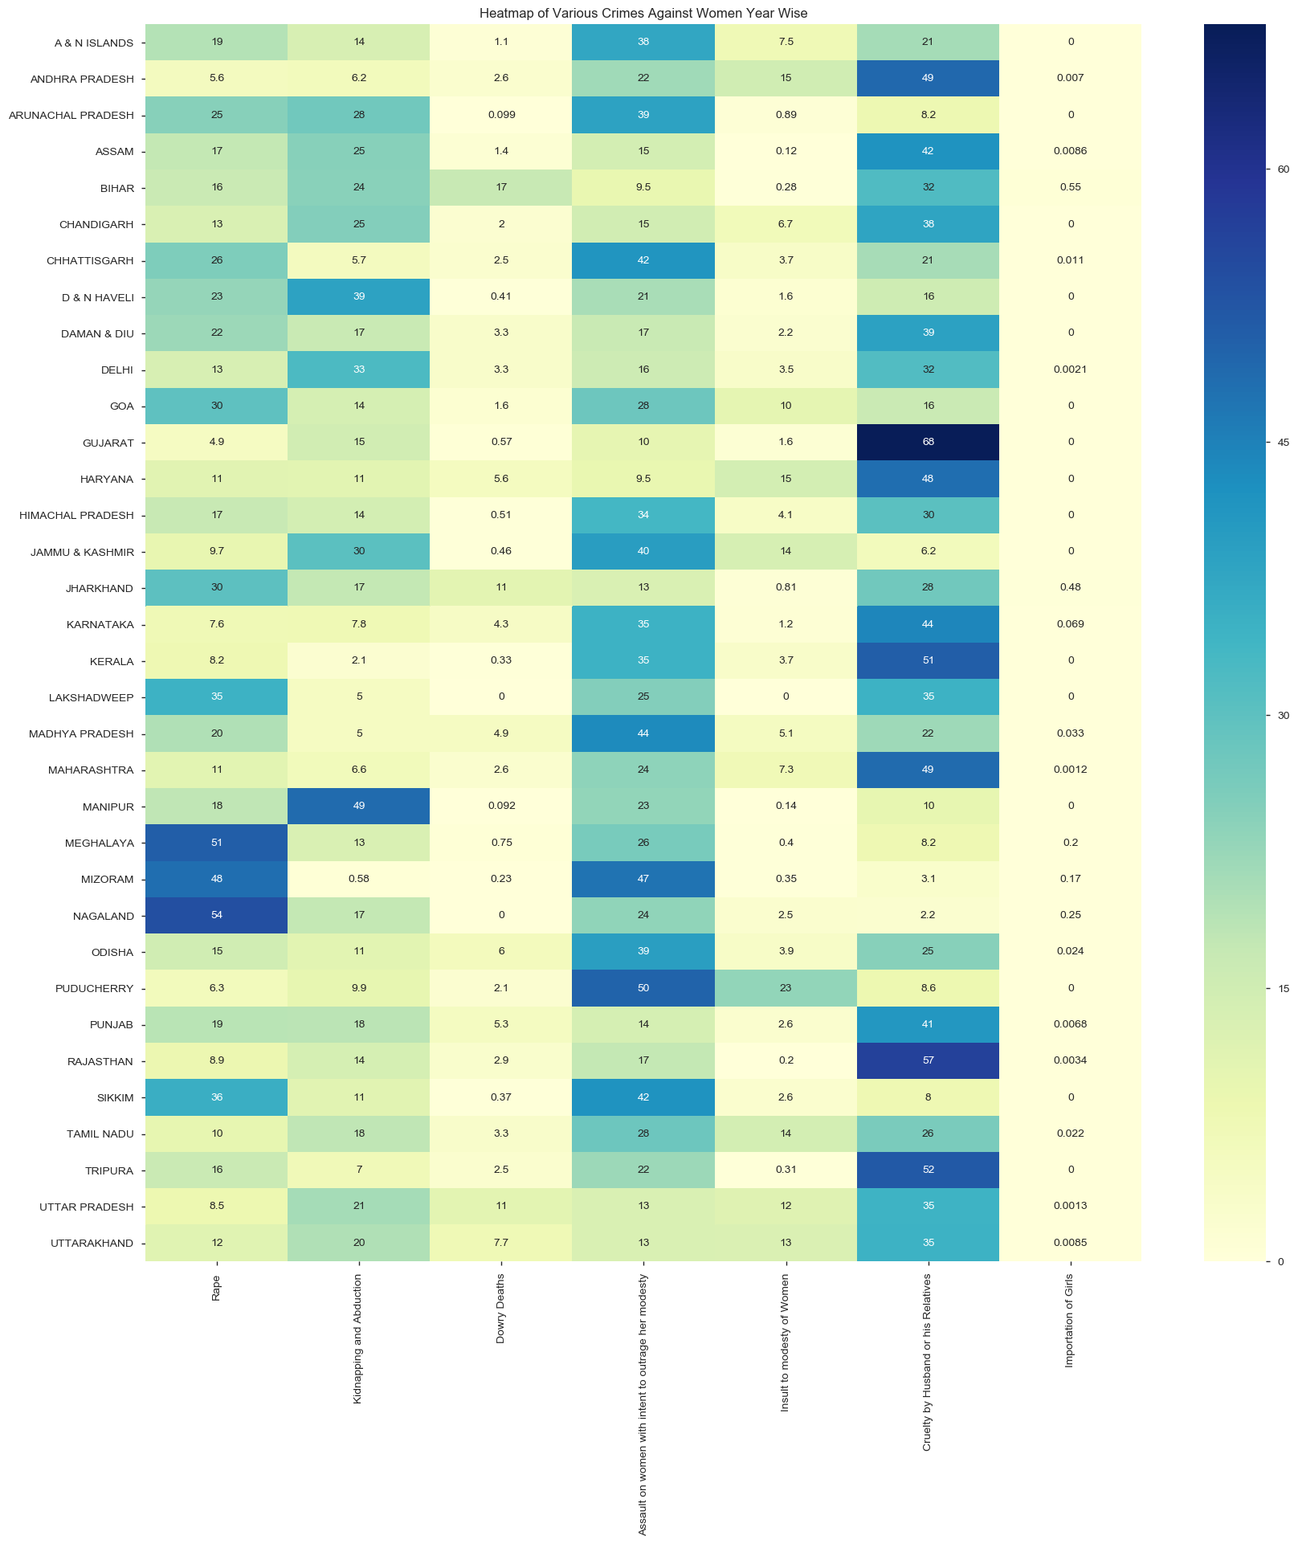
TYPES OF CRIMES STATE-WISE
From above two plots, we see that:
Cruelty by Husband or his Relatives is mostly higher for most of the states.
Rape dominates in three States.
Importation of Girls is lowest in most of the states.

Slide 14
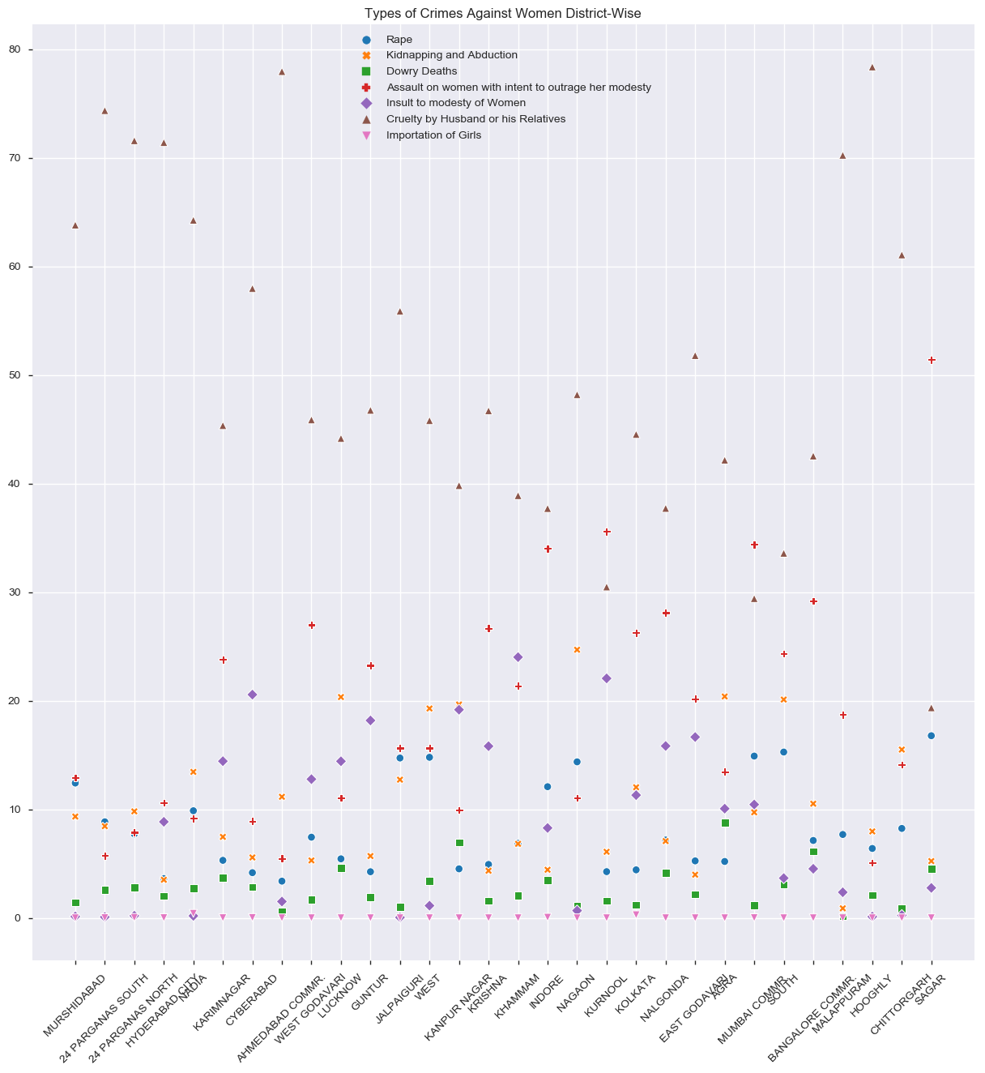
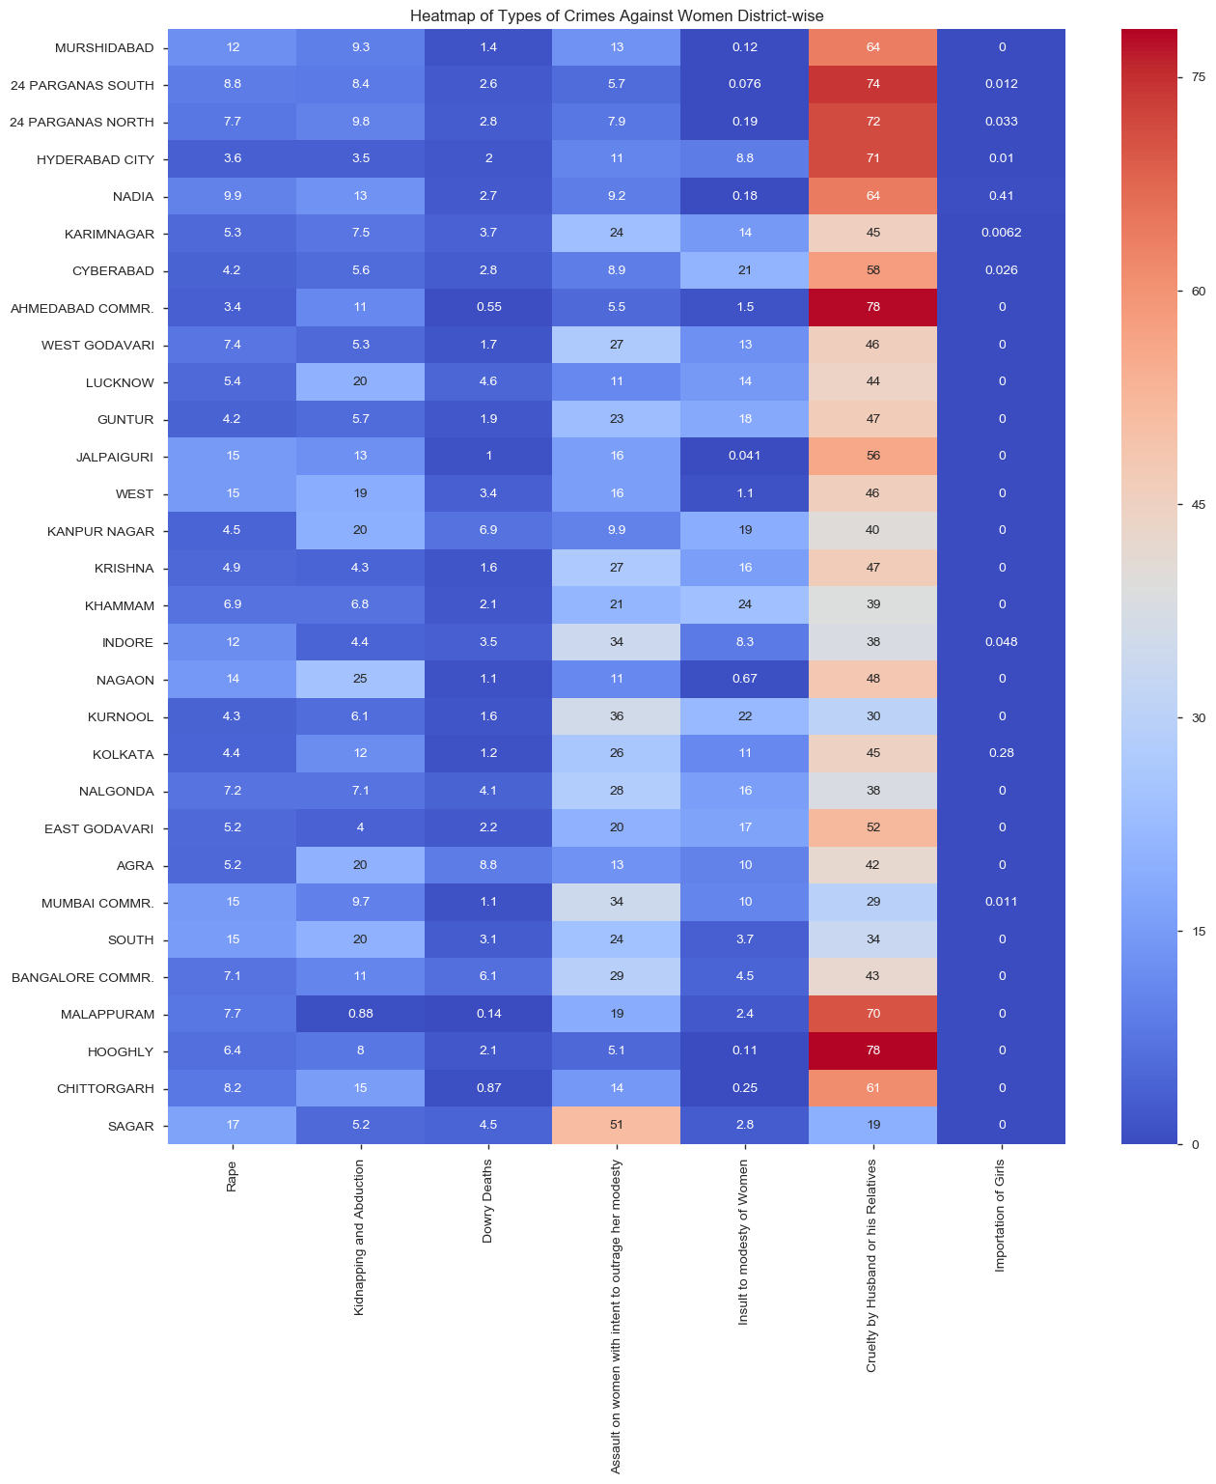
TYPES OF CRIMES DISTRICT-WISE
From the above two plots, we see that Rape, Dowry Deaths and Insult to Modesty of Women show similar trends for a sample of Districts, but Cruelty by Husband or his Relatives are higher in the set.

Slide 15
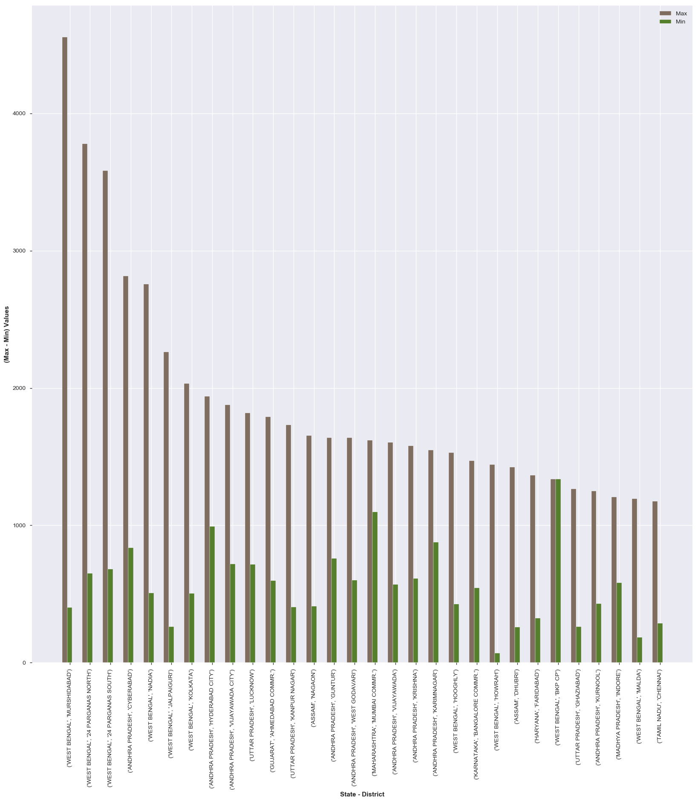
TOP 30 MAX AND MIN CRIMES COUNT FOR YEAR, PER STATE AND DISTRICT
The adjacent plot displays the Top 30 Maximum and Minimum crime count for year, per State and District.
From the plot, we see that 3 of West Bengal's Districts show higher rates of crime from the selected sample.

Slide 16
Conclusion
From the above analysis we can conclude that:
Highest Crimes against women occurred in ANDHRA PRADESH between 2001 and 2012.
Lowest Crimes against women occurred in LAKSHADWEEP between 2001 and 2012.
There has been a gradual increase in Crimes Against Women with negligible change between 2001-2003 and 2004-2005.
WEST BENGAL has the highest crime rate in 2011 followed by ANDHRA PRADESH in 2010.
MURSHIDABAD has Highest Crimes Against Women in 2011 followed by 24 PARGANAS SOUTH in the same year.
Highest crime state is WEST BENGAL in 2012 and the lowest crime state is LAKSHADWEEP in 2006.
Cruelty by Husband or his Relatives show an increasing trend.
Assault on women with intent to outrage her modesty show a decreasing trend.
Kidnapping and Abduction decreased till 2003 then it gradually increased
Insult to modesty of Women increased till 2003 then it gradually decreased
Importation of Girls had been constant most of the time
Cruelty by Husband or his Relatives is mostly higher for most of the states.
Rape dominates in three States namely Nagaland, Meghalaya and Mizoram.
Importation of Girls is lowest in most of the states.
Rape, Dowry Deaths and Insult to Modesty of Women show a similar trend for a sample of Districts, with Cruelty by Husband or his Relatives being higher in the set.
3 of West Bengal's Districts show higher rates of crime.

Slide 17
THANK YOU!

