Slide 1
BMI(BODY MASS INDEX) PREDICTION USING FACE IMAGE
Presented By: -
Aditya Viswabhusan

Slide 2
CONTENTS
Introduction
Motivation
Objective
Proposed Technique
Advantages
Disadvantages
Applications
Result Analysis
Conclusion
Future Work
References

Slide 3
INTRODUCTION
BMI is a value predicted using weight and height of a person.
BMI helps to categorize a person is underweight, normal weight, overweight or obese based on tissue mass.

Slide 4
MOTIVATION
Obesity is an important public health concern.
Limited attention has been given to the connection between the human facial features to predict BMI.

Slide 5
OBJECTIVE
To apply Data Cleaning and Image Pre-processing Operations.
To apply Facial Recognition algorithms.
To Predict BMI, Gender of an individual using his/her face photograph.

Slide 6
PROPOSED TECHNIQUE
1.Image preprocessing
2.Data augmentation
3.Use of pre-trained model(Vggface2)
4.Use of Transfer learning in our model
5.Training the model(80%-20% ratio)
6.Predicting BMI using image capturing to evaluate.

Slide 7

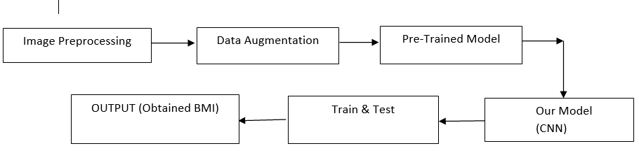
Fig 1:Block diagram

Slide 8
PROPOSED TECHNIQUE
Image preprocessing-:
To normalize the images before training, each image was cropped to the subject’s face, excluding the area surrounding the face.

Slide 9
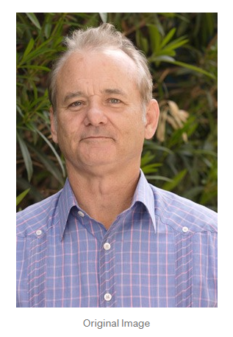
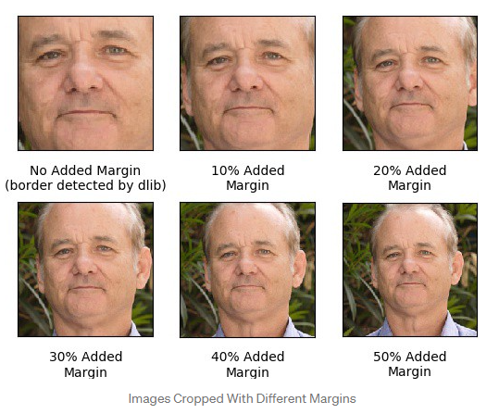
Contd.…
Fig 1:Image Preprocessing

Slide 10
PROPOSED TECHNIQUE
Image Augmentation:-
i) To increase the number of times each original training image could be used to train the network.
ii) The image augmentation and face detection library MTCNN was used.

Slide 11
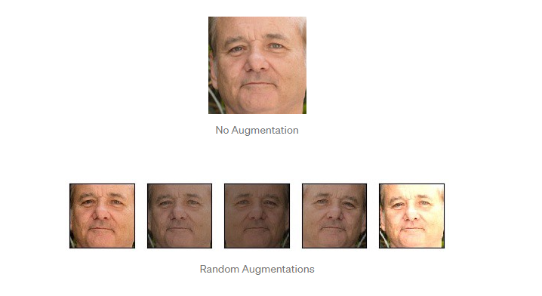
Fig 2: Image Augmented

Slide 12
PROPOSED TECHNIQUE
Convolutional Neural Network(CNN)-:
CNN
– A kind of neural network where the input is image
– Contains less fully connectivity between neurons
■ CNN layers
– Input layer – Fully connected layer
– Convolutional layer – Loss layer
– Pooling layer – Activation Functions

Slide 13
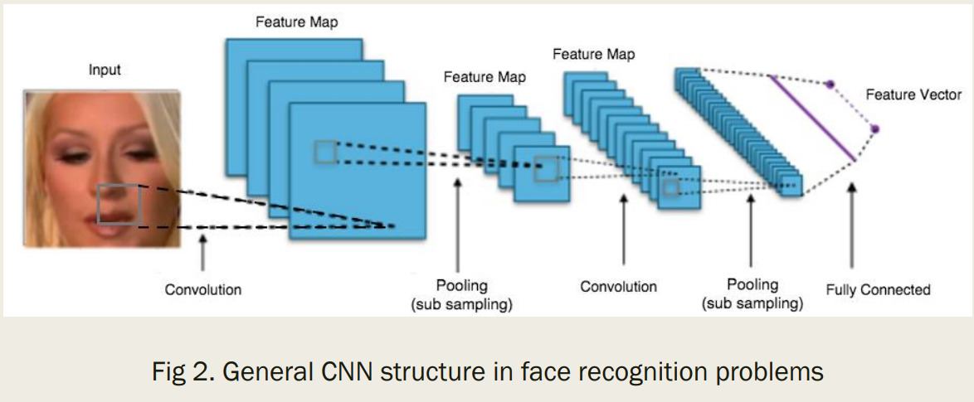
PROPOSED TECHNIQUE

Slide 14
Advantages of BMI using face image
In Medical, BMI prediction can be non invasive.
No need to measure height and weight in order to compute his or her BMI.
Practical uses such as online photos and surveillance videos can be used.

Slide 15
Disadvantages of BMI using face image
Poor performance when evaluating images captured from an angle.
Inaccuracy in prediction of image when subject is in dark environment and is illuminated by a concentrated source of light.

Slide 16
Applications of BMI using face image
BMI prediction are applied in medical.
Using verification to outperform face detection.
Designing a face tracking method based on face verification.
BMI used in cadet selection in military.

Slide 17
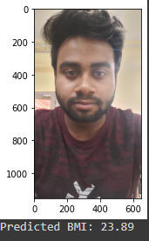
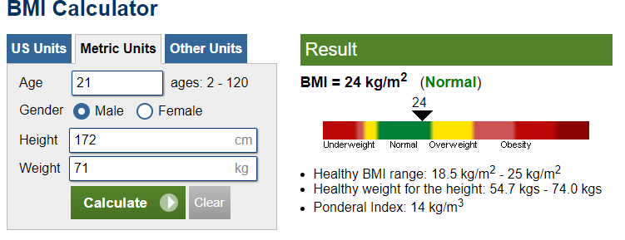
RESULT ANALYSIS
Below are the results as follows.

Slide 18
FUTURE WORK
BMI being one of the essential criteria to help medical diagnosis ,increase in accuracy is needed.
The study of use of face image in predicting BMI being in its research phase has a lot of unturned pages.
Study age or ethnicity group specific features to better characterize the facial appearance.

Slide 19
CONCLUSION
BMI being one of the essential criteria to help medical diagnosis ,increase in accuracy is needed.
The study of use of face image in predicting BMI being in its research phase has a lot of unturned pages.

Slide 20
REFERENCES
Guodong Guo “Body Weight Analysis From Human Body Images”IEEE Transactions on Information Forensics and Security ( Volume: 14, Issue: 10, Oct. 2019)
J. Bekios-Calfa, J. M. Buenaposada, and L. Baumela, “Robust gender recognition by exploiting facial attributes dependencies,” PRL, 2013.
J. C. Klontz and A. K. Jain, “A case study on unconstrained facial recognition using the boston marathon bombings suspects,” Technical Report, no. MSU-CSE-13-4, 2013
A. Dantcheva, C. Velardo, A. D’angelo, and J.-L. Dugelay, “Bag of soft biometrics for person identification,” Multimedia Tools and Applications, vol. 51, no. 2, pp. 739–777, 2011.
L. Wen and G.-D. Guo, “A computational approach to body mass index prediction from face images,” Image and Vision Computing, vol. 31, no. 5, pp. 392–400, 2013.
Keys et al (1972). Indices of Relative Weight and Obesity. Pergamon Press, Britain. J Chron Dis 1972. Vol. 25, pp. 329- 343.
Ian Janssen, Peter T Katzmarzyk, and Robert Ross(2004). Waist Circumference and Not Body Mass Index Explains Obesity Related Health Risk. American Journal of Clinical Nutrition. Retrieved March 4, 2014 cited in Google.com,
Shrikant, J. Honade (2013). ―Height, Weight and Body Mass Index Measurement Using MATLAB.‖ International Journal of Advanced Research in Engineering and Technology, Vol. 4, Issue 5, July – August 2013, pp.35-45. Retrieved August 31, 2013 cited in Google.com

Slide 21
THANK YOU

