Slide 1
Configuration Space, Task Space, Workspace and Introduction to ROS
CS 6301 Special Topics: Introduction to Robot Manipulation and Navigation
Professor Yu Xiang
The University of Texas at Dallas

Slide 2
Configuration Space of a Robot
The configuration of a robot is a complete specification of the position of every point of the robot.
The minimum number n of real-valued coordinates needed to represent the configuration is the number of degrees of freedom (DOF) of the robot.
The n-dimensional space containing all possible configurations of the robot is called the configuration space (C-space).
The configuration of a robot is represented by a point in its C-space.
4 revolute joints
4 DOFs

Slide 3

Configuration Space Topology
Configuration specifies the position of a robot
For a robot with n joints, the configuration is a vector in
C-space
Joints may have limits, upper bound and lower bound
Topology: shape of the space
Consider all the feasible points in the configuration space

Slide 4


Configuration Space Topology
n-dimensional Euclidean space
n-dimensional sphere in a (n+1)-dimensional Euclidean space
Two-dimensional surface of a sphere in three-dimensional space
The C-space can have different representations, but its shape is the same
A point on a unit circle can have two representations
angle , or coordinates (x, y)

Slide 5
Configuration Space Topology
C-space as Cartesian product (all ordered pairs)
A rigid body in the plane
A PR robot (Prismatic-Revolute)
Ignore joint limits
A 2R robot
n-dimensional surface of a torus in an (n+1)-dimensional space
sample representation

Slide 6
Configuration Space Topology
C-space of a planar rigid body (chassis of a mobile robot) with a 2R robot arm
C-space of a rigid body in 3D space
3D translation
3D rotation

Slide 7

Task Space
The task space is a space in which the robot’s task can be naturally expressed
Task examples
Draw on a piece of paper:
Manipulate a rigid body: C-space of the rigid body
Task space is driven by the task, independently of the robot

Slide 8
Workspace
The workspace is a specification of the configurations that the end-effector of the robot can reach.
Depends on the robot structure, independent of the task
a planar 2R open chain
a planar 3R open chain
a spherical 2R open chain

Slide 9
SCARA Robot
End-effector configuration
Task space
Workspace
Reachable

Slide 10
A 6R Robot
spray nozzle
End-effector configuration
Cartesian position of the nozzle
Spherical coordinates to describe
the direction in which the nozzle is pointing
Task space
Workspace
Reachable
A spray-painting robot

Slide 11
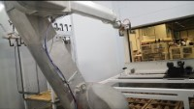
https://www.rnaautomation.com/case-study/robotic-spray-booth/

Slide 12
Robot Programming
Sensing
How to receive data from sensors on the robot?
RGB image, depth image, lidar scan, odometry, joint state
Computation
Use the sensor data for computation
Object recognition, motion planning, compute control command, etc.
Control
How to send the control command to the robot?

Slide 13
Robot Operating System (ROS)
ROS is a set of software libraries and tools that can be used to build robot applications
Drivers, algorithms, developer tools, etc.
Goal of ROS: support code reuse in robotics research and development
Operating systems: Unix-based platforms (Ubuntu)
https://www.ros.org/
https://wiki.ros.org/

Slide 14

Robot Operating System (ROS)
https://www.ros.org/

Slide 15
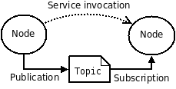
ROS Computation Graph
The computation graph is the peer-to-peer network of ROS processes that are processing data together
Computation graph concepts
Nodes: processes that perform computation
ROS Master: provides name registration and lookup, nodes can find each other via ROS master
Messages: nodes communicate by passing messages, a data structure with type fields (integer, floating, arrays, etc.)

Slide 16
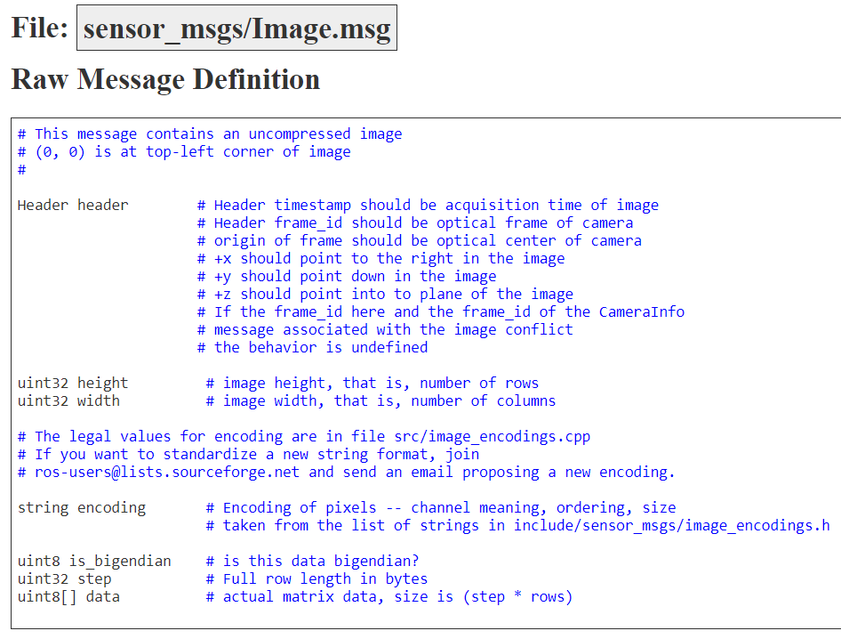
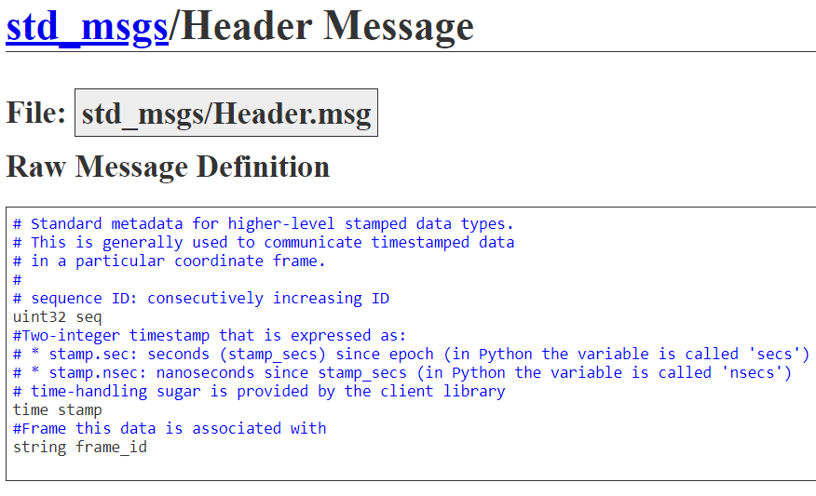
ROS Message Example

Slide 17
ROS Computation Graph
Topics: a node publishes messages to a topic. The topic is the name to identify the content of the message
Node: Head camera
Node: Object detection
Topic: /rgb_image
Message: sensor_msgs/Image

Slide 18
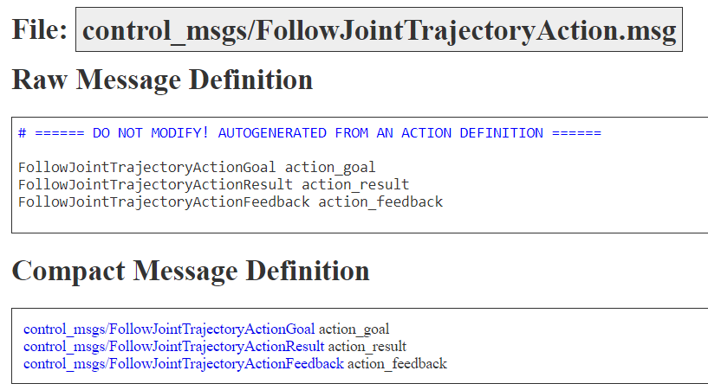
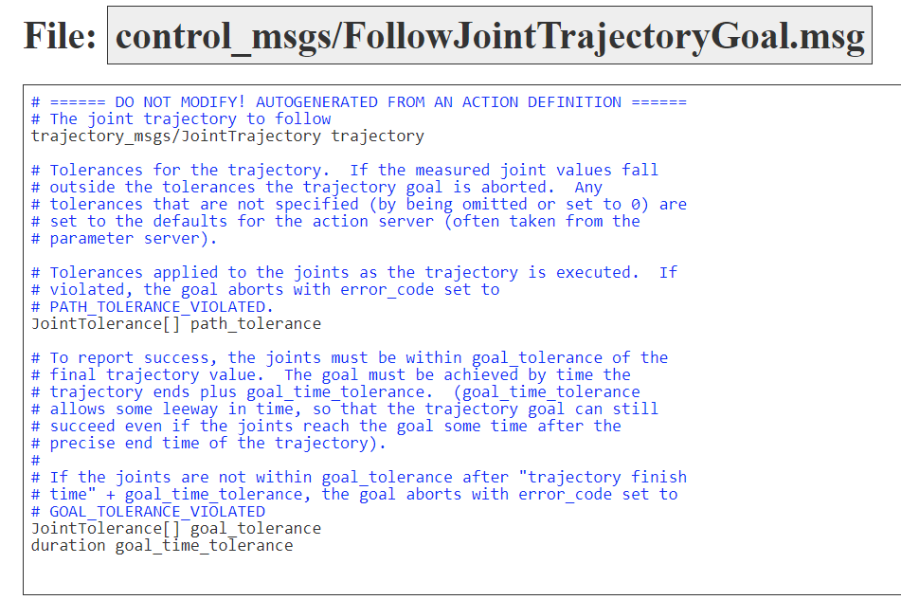
ROS Computation Graph
Service: request and reply interactions
Service: FollowJointTrajectory
Node: Motion Planner
Node: Arm Controller

Slide 19
ROS Computation Graph
ROS bags
A format for saving and playing back ROS message data
We can save sensor data into a ros bag, and use it for development

Slide 20
Using ROS
Ubuntu users
Mac users
Windows users

Slide 21
Using ROS with Ubuntu
Install ROS http://wiki.ros.org/noetic/Installation/Ubuntu

Slide 22
Using ROS with Mac
Download the Ubuntu 20.04 .iso from https://cdimage.ubuntu.com/releases/focal/release/ (pick arm or amd based on if you have m1 or intel mac)
Download UTM from https://mac.getutm.app/
Follow this video to install the ubuntu image in Mac https://www.youtube.com/watch?v=1WWj6qoWhJw
Use ROS as in Ubuntu

Slide 23
Docker: Using ROS with Windows
An open platform that enables you to separate your applications from your infrastructure
Container
A lightweight environment that contains everything to run an application
A container is a runnable instance of an image
Image
A read-only template with instructions for creating a docker container

Slide 24
Ubuntu in Docker
Download the ubuntu docker image https://hub.docker.com/_/ubuntu
docker pull ubuntu:20.04
Command
Docker image name
Docker image tag

Slide 25
Docker
docker run -i -t ubuntu:20.04 /bin/bash
Run an ubuntu container
You need to have an ubuntu image locally, if not, the command will pull an ubuntu image as by docker pull ubuntu
Docker creates a new container as though you had run docker container create
Docker starts the container and execute /bin/bash
-i, -t the container is running interactively and attached to your terminal
When exit, the container stops but is not removed

Slide 26
ROS in Docker
Install Docker Desktop https://docs.docker.com/get-docker/
Start the Docker Desktop
Ubuntu images https://hub.docker.com/_/ubuntu
Run command “docker run –i –t ubuntu:20.04 /bin/bash”
No need to use sudo in docker, do an “apt update” first
Install ROS http://wiki.ros.org/noetic/Installation/Ubuntu
Install terminator https://manpages.ubuntu.com/manpages/bionic/en/man1/terminator.1.html

Slide 27
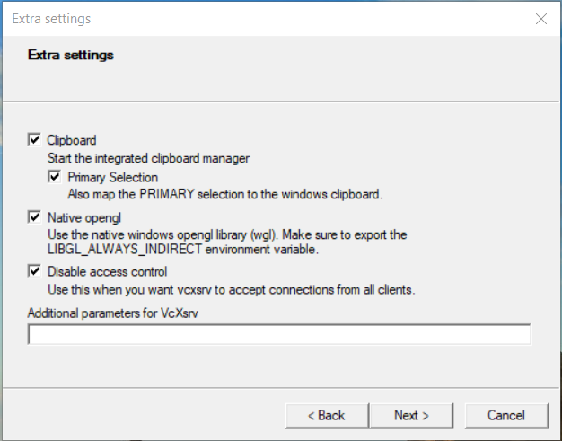
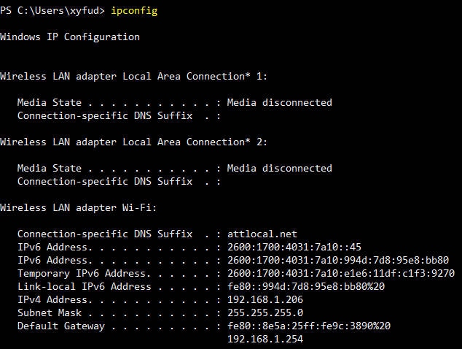
ROS in Docker
Install X server
Windows: VcXsrv Windows X Server https://sourceforge.net/projects/vcxsrv/
Mac: Xquartz https://www.xquartz.org/
Start the X server
Check IP address
In Ubuntu terminal
Export DISPLAY=my_ip:0.0
https://medium.com/@potatowagon/how-to-use-gui-apps-in-linux-docker-container-from-windows-host-485d3e1c64a3

Slide 28
ROS in Docker
Test ROS installation
In one terminator terminal, start roscore
source /opt/ros/noetic/setup.bash
roscore
In another terminator terminal, start rviz
source /opt/ros/noetic/setup.bash
rosrun rviz rviz

Slide 29
Commit Your Docker Image
After you exit the docker container
Run the command “docker container list -a” to see all the containers. Find the container ID of the latest one
Run the command “docker container commit <CONTAINER_ID>”
Run the command “docker image list -a” to see the latest image ID
Run the command “docker image tag <IMAGE_ID> TAG”. Give a name to this image such as “ubuntu:ros”

Slide 30
ROS in Docker
After install all needed packages, exit
docker container commit CONTAINER_ID
docker image tag <IMAGE_ID> TAG
Useful commands
docker container list –a
docker image list -a
The new tagged image will have all the installed packages

Slide 31
Summary
Task space
Workspace
ROS
Docker

Slide 32
Further Reading
Chapter 2 in Kevin M. Lynch and Frank C. Park. Modern Robotics: Mechanics, Planning, and Control. 1st Edition, 2017 http://hades.mech.northwestern.edu/images/7/7f/MR.pdf
ROS wiki https://wiki.ros.org/
Docker document https://docs.docker.com/get-started/overview/

