Slide 1
TCP Behaviour Inference Tool
ANKITA PAL
1ST SEM MTECH CNE

Slide 2
On Inferring TCP Behavior
Jitendra Padhye and Sally Floyd (AT&T Center for Internet Research at ICSI (ACIRI))
Published in SIGCOMM ‘01

Slide 3
Features
Developed a tool called TBIT (TCP Behavior Inference Tool) to characterize the behavior of remote web servers, bugs, and non-compliance
Based on Sting

Slide 4
Motivations and Requirements
“Is it appropriate to base Internet simulation and analysis on Reno TCP?”
“What are the initial windows used in TCP connections in the Internet?”
Is end-to-end congestion control being used?
To identify and correct TCP implementation bugs
Testing the TCP behavior of the equipment en route to the target
Should be able to test any web server, any time
TBIT traffic should not be hostile, or even appear to be hostile (or anomalous)

Slide 5
Initial Value of Congestion Window (ICW)
Sends TCP SYN to target, port 80, with large receiver window and desired MSS
Upon receiving SYN/ACK, HTTP 1.0 GET request is sent (along with ACK)
TBIT does not acknowledge any more packets, so the target will only send packets that fit in its ICW
Once TBIT sees a retransmission, it sends a RST to close the connection

Slide 6
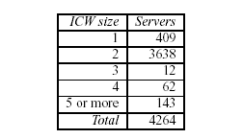
ICW Results

Slide 7
Congestion Control Algorithm (CCA)
Connection is established with a small MSS (~100 bytes) to force several packets to be sent (receiver window is set to 5*MSS)
Request is made
All packets are acknowledged up to 13th packet
This packet is dropped
The 14th and 15th packets arrive and are acknowledged (duplicate ACKs)
Packet 16 is dropped, all further packets are acknowledged
Connection is closed once 25 data packets are received, including retransmissions

Slide 8
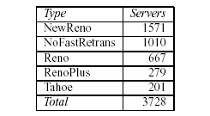
CCA Results

Slide 9
Conformant Congestion Control (CCC)
Connection is established and request made, with a small MSS
All packets acknowledged until packet 15 is received, which is dropped
All are ACKed, with duplicate ACKs sent for packet 14 until 15 is retransmitted (which is ACKed)
Size of reduced congestion window is the difference between the maximum sequence number received and the highest sequence number acknowledged

Slide 10
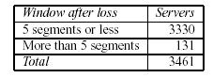
CCC Results

Slide 11
Response to SACK
SYN with small MSS and SACK_PERMITTED sent
If SYN/ACK with SACK_PERMITTED is not received, test is terminated
Else packets are received and ACKed until packet 15 is received. 15, 17, and 19 are dropped and an appropriate SACK for 16 and 18 is sent
TBIT waits, sending appropriate SACKs, until 15, 17, and 19 are received
Connection is closed

Slide 12
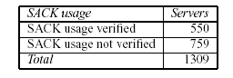
Response to SACK Results

Slide 13
Time Wait Duration
A three-way handshake (FIN, FIN/ACK, ACK) is used for closing connections
TCP standard specifies after ACKing the FIN, the target should wait 2*MSL (Maximum Segment Lifetime) before port can be reused

Slide 14
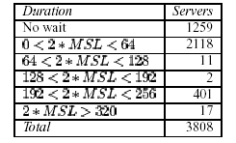
Time Wait Duration Results

Slide 15
Response to ECN
ECN-setup SYN is sent
If no SYN/ACK is received after three retries, or if RST is received, TBIT concludes failure
Else, SYN/ACK is checked for ECN-setup (ECN_ECHO set, CWR unset)
HTTP request sent with ECT and CE bits set
If ACK is received, check for ECN_ECHO, else give up after three retries

Slide 16
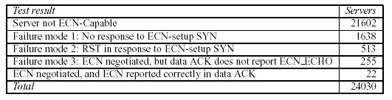
Response to ECN Results

Slide 17
Future Work
Further Tests of TCP implementation
DSACK (RFC 2883)
Limited Transmit (RFC 3042)
Congestion Window Validation (RFC 2861)
Test for Standards Compliance
Use TBIT to generate models of TCP implementations for simulators such as NS

Slide 18
TCP Congestion Avoidance Algorithm Identification
There is very little work on the performance and stability study of the Internet with heterogeneous congestion control
CAAI can identify all default TCP algorithms (e.g., RENO, CUBIC, and CTCP) and most non-default TCP algorithms of major operating system families.
CAAI can identify all default TCP algorithms (i.e., RENO, BIC, CUBIC, and CTCP) and most non-default TCP algorithms of major operating system families and can be used to conduct the TCP algorithm census.

Slide 19
Design goals of CAAI
Design goal 1: It can identify all default TCP algorithms and most non-default TCP algorithms of major operating system families.
Design goal 2: It is insensitive to the operating system of a Web server, insensitive to network conditions, and insensitive to TCP components other than the congestion avoidance

Slide 20
CAAI Steps
Step 1: Trace Gathering. CAAI gathers the TCP window traces of a remote Web server in some emulated network environments.
Step 2: Feature Extraction. CAAI extracts the two TCP algorithm features from the gathered TCP window traces.
Step 3: Algorithm Classification. CAAI finally identifies the TCP algorithm by comparing the extracted features to the training features.

Slide 21
Limitations
The current CAAI does not consider some other TCP congestion control algorithms, such as FAST, which is not available in any operating system but has been used by some Web servers
Does not consider XCP, VCP, and PERT, which have recently been proposed but not yet incorporated into any operating system

Slide 22
References
Jitendra Pahdye, Sally Floyd, “On inferring TCP Behaviour” SIGCOMM '01 Proceedings of the 2001 conference on Applications, technologies, architectures, and protocols for computer communications.
Peng Yang, Juan Shao, Wen Luo, “TCP Congestion Avoidance Algorithm Identification”, IEEE/ACM Transactions on Networking (Volume: 22, Issue: 4, Aug. 2014).

