Slide 1
ASYNCHRONOUS COMMUNICATION USING RETURN TO ZERO PROTOCOL IN SSL
BY: B.I.PAVITRA
1st MTECH,CNE
RVCE

Slide 2
CONTENTS
Introduction
Literature survey
Objective
Applications
Design
Implementation
Results
Conclusion
References

Slide 3
INTRODUCTION
Communication modes
Synchronous communication
Asynchronous communication
Handshake protocols^{[1]}
Request
sender
receiver
Acknowledge

Slide 4
ASYNCHRONOUS COMMUNICATION^{[2]}
Automated process
Establishes communication channel
Transport layer security
Simple and complex protocols
SMTP

Slide 5
THREE WAY HANDSHAKE PROTOCOL
Client Server
SYN (sequence number=x)
SYN+ACK (y,x+1)
ACK (Y+1)

Slide 6
HANDSHAKE PROTOCOLS
Bundled data Protocols
4-phase dual-rail protocol
2-phase dual-rail protocol
Four Phase Protocol
Two Phase Protocol

Slide 7
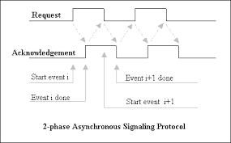
TWO PHASE PROTOCOL

Slide 8
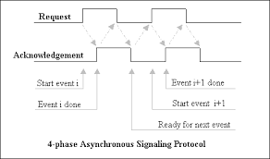
FOUR PHASE PROTOCOL

Slide 9
LITERATURE SURVEY
Vincent Wing-Yun Sit, Chiu-Sing Choy, and Cheong-Fat Chan, proposes a theory to use a Four-Phase Handshaking Asynchronous Static RAM Design for Self-Timed Systems.
The Family of 4-phase Latch Protocols is reviewed by Graham Birtwistle and Kenneth S. Stevens with the respective VLSI designs.
Tradeoffs Between RTO and RTZ in Asynchronous Design by Matheus T. Moreira, Julian J. H. Pontes, Ney L. V. Calazans compares both the protocols in the networ scenario.

Slide 10
CONTD…
Analysis of the Experimental Results for Quantum Key Distribution Cryptography in IEEE 802.11 Networks by Xu Huang, Shirantha Wijesekera, Dharmendra Sharma proposes the dual rail protocols for the wireless networks.
Joint Time and Spatial Reuse Handshake Protocol for Underwater Acoustic Communication Networks by Roee Diamant, Lutz Lampe

Slide 11
OBJECTIVE
Overview
Use of 4 phase in SSL handshake
Implementation of 4-phase handshake protocol.

Slide 12
APPLICATIONS
Simple and unambiguous.
Delay insensitive.
Power efficient.
Certificate and key exchange in SSL.

Slide 13
FOUR PHASE HANDSHAKE PROTOCOL DESIGN^{[4][5]}
Signaling
Data encoding
Acknowledge
Balanced path
Muller C element Z = XY + Z (X+Y)

Slide 14
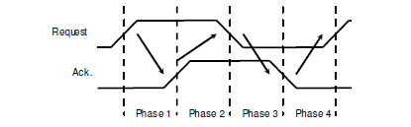
FOUR PHASE PROTOCOL^{[3]}
Phase 1: Sender wants to transfer data / enable to receiver Raises req
Phase 2: Receiver detects rise in req, raises ack
Phase 3: Sender detects rise in ack, lowers req
Phase 4: Receiver detects low req, lowers ack

Slide 15
TWO PHASE PROTOCOL HANDSHAKING CODE^{[7]}
o1.send(D)
{
data=D;
sync();
a=ack;
req=!req;
while(a==ack) wait();
}
o2.recv()
{
r=req;
while(r==req) wait();
D=data;
ack=!ack;
return D;
}

Slide 16
FOUR PHASE HANDSHAKING CODE
o1.send(D)
{
while(ack) wait(A);
data=D;
sync();
req=1;
R.signal();
while(!ack) wait(A);
req=0;
R.signal();
}
o2.recv()
{
while(!req) wait(R);
D=data;
ack=1;
A.signal();
while(req) wait(R);
ack=0;
A.signal();
return D;
}

Slide 17
IMPLEMENTATION
Semaphores
Inter Process Communication
Sockets

Slide 18
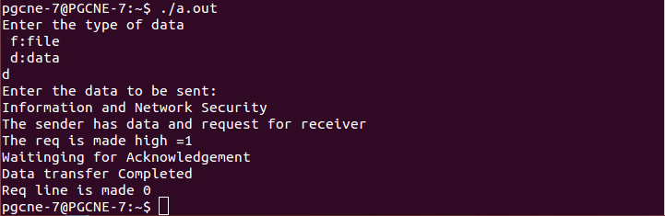
OUTPUT
SENDER SIDE

Slide 19
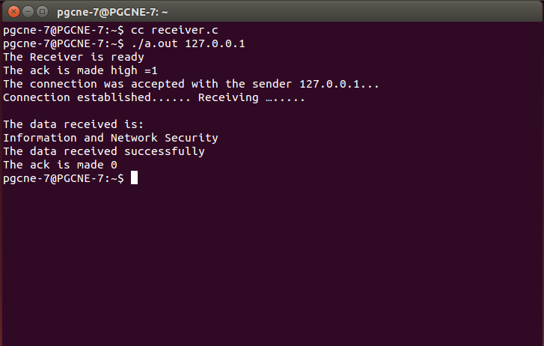
OUTPUT
RECEIVER SIDE

Slide 20
RESULTS
Connection establishes between sender and receiver.
Sender sends the data only when ACK of receiver is set to 1.
After the data transfer both REQ and ACK will be set to 0.
Slow when compared to 2-phase protocol.

Slide 21
CONCLUSION
Survey of 4-phase handshake protocol.
Synchronization in asynchronous communication.
Advantages over 2-phase handshake protocol.
Usage of sockets.

Slide 22
REFERENCES
[1]ECE620_special_topics_asynchronous_circuits_part2_pdf
[2] https://en.wikipedia.org/wiki/Handshaking
[3]www.areata.org/.../2004_Modeling_and_synthesis_of_multi-rail_multi-protocol_QD
[4]citeseerx.ist.psu.edu/viewdoc/download?doi=10.1.1.124.818&rep=rep1.pdf
[5] DPA on quasi delay insensitive asynchronous circuits: formalization and improvement by G. F. Bouesse; M. Renaudin; S. Dumont; F. Germain Design, Automation and Test in EuropeYear: 2005 Pages: 424 - 429 Vol. 1, DOI: 10.1109/DATE.2005.124
[6]www.mi.parisdescartes.fr/~mea/cours/DU/TLS_SSL_DUsec.pdf

Slide 23
REFERENCES
[7]https://www.ics.forth.gr/carv/async/demo/literature/handshakeprotocols.pdf
[8] Proceedings of the Design, Automation and Test in Europe Conference and Exhibition (DATE’05)1530-1591/05 IEEE
[9] IEEE journal of solid-state circuits, vol. 34, no. 1, january 1999.
[10] Quantum Cryptography Based Key Distribution in IEEE 802.11 Networks –Wijesekera, Xu Huang, Dharmendra Sharma 2011 IEEE
[11] 2011 Ninth IEEE/IFIP International Conference on Embedded and Ubiquitous Computing

Slide 24
THANK YOU

