Slide 1

Manjunath K N
M.Tech (CNE)

Slide 2

Introduction
Quick Overview of Mobile Devices
Mobile Threats and Attacks
Countermeasures
Elements of security
References

Slide 3
Mobile devices have become an essential element for organizations as part of the overall network infrastructure.It is the central element of access.
Because of their widespread use and unique characteristics, security for mobile devices is a pressing and complex issue.
In essence, an organization needs to implement a security policy through a combination of security features built into the mobile devices and additional security controls provided by network components that regulate the use of the mobile device

Slide 4
Literature Survey/ History
This short history started in June 2004, when a group of professional virus writers known as 29A created the first virus for smartphones. The virus called itself ‘Caribe’. It was written for the Symbian operating system, and spread via Bluetooth.
Many mobile devices lost, stolen each year
  113 mobile phones lost/stolen every minute in the U.S.
  56% of us misplace our mobile phone or laptop each month.
  Lookout Security found $2.5 billion worth of phones in 2011 via its Android app.
  Symantec placed 50 “lost” smartphones throughout U.S. cities.

Slide 5
In February 2012, a cybersecurity firm, Symantec Corporation, reported that a large number of Android devices in China were infected with malware that connected them to a botnet.
In January 2012, an antivirus company reported that hackers had subverted the search results for certain popular mobile applications so that they would redirect users to a web page where they were encouraged to download a fake antivirus program containing malware.
In May 2012, a regulatory agency in the United Kingdom fined a company for distributing malware versions of popular gaming applications.

Slide 6
Aim and Objectives:
To increase the security of the mobile devices
To block the threats affecting the system
Increasing system performances by reducing
security issues.
Network security mechanisms and policies
Mechanical devices are built which blocks threat
causing factors eg: Malwares, Hackers etc.

Slide 7

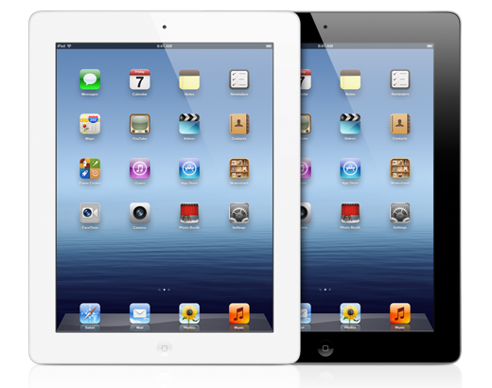

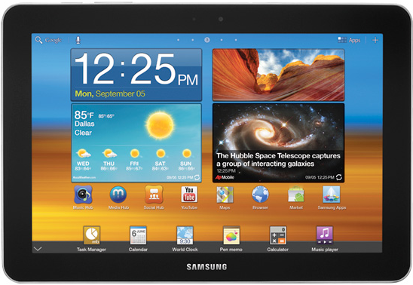
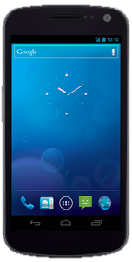
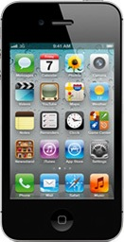
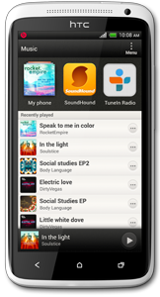








Mobile computers:
  Mainly smartphones, tablets
  Sensors: GPS, camera, accelerometer, etc.
  Computation: powerful CPUs (≥ 1 GHz, multi-core)
Communication: any connect to cellular networks: billing system
Cisco: 7 billion mobile devices will have been sold.
  cellular/4G, Wi-Fi, near field communication (NFC), etc.
Organization

Slide 8
Device Malware
iOS malware: very little
Android malware growth keeps increasing
Main categories:
  Trojans
  Monitoring apps/spyware
  Adware
SECURITY THREATS
Mobile devices need additional, specialized protection measures beyond those implemented for other client devices, such as desktop and laptop.
The common reasons for mobile security threats are
Lack of physical security controls
Use of untrusted mobile devices and networks
Use of applications created by unknown parties
Use of untrusted contents and location controls

Slide 9
OTHER ATTACKS
Bluetooth attacks
One of the least serious and harmless Bluetooth attacks is called BlueJacking. This attack takes advantage of a small loophole in the messaging protocol and allows a Bluetooth device to send an anonymous message to a target Bluetooth
device.
The simplest action can be taken is to disable Bluetooth completely on the mobile phone. Alternately, the mobile phone’s Bluetooth settings can be switched to an undiscoverable or hidden.

Slide 10
Mobile DOS attack:
MDoS attacks can congest available bandwidth causing all data transfers stop, leading the phone to freeze, crash, or even restart. While there are different types of MDoS attacks, they all usually follow a similar pattern on how the attack is implemented
The attacker first uses some sort of packet-generation software in order to create infinite and sometimes malicious packets.These packets can then be sent to the victim’s mobile phone using a specified protocol.

Slide 11
One of the simplest things a user can do is to keep their phone up to date by downloading and installing the latest patches and upgrading their mobile phone. Another countermeasure is simply not to accept an unknown incoming message via
Bluetooth.
Wifi also threatened by security attack i.e Penetration attack.
Backtrack software can break this within a few
minutes.

Slide 12
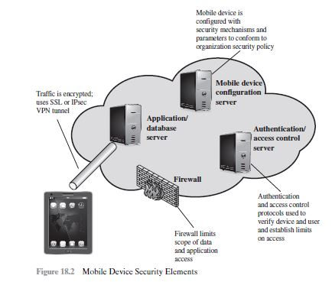
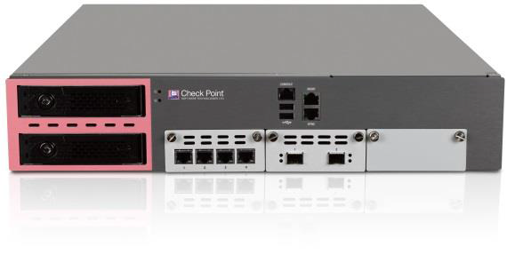
MOBILE DEVICE SECURITY ELEMENTS
Mobile device security carried by several factors Mobile access control by the elements like firewalls, authentication servers, database server carries prevention from threats.
Along with that threat removing sandbox type of devices prevents malwares and softwares like antivirus security, malware internet security enhances mobile device security

Slide 13

Authentication generally based on:
  Something supplicant knows
    Password/passphrase
    Unlock pattern
  Something supplicant has
    Magnetic key card
    Smart card
    Token device
  Something supplicant is
    Fingerprint
    Retina scan

Slide 14

Cheapest, easiest form of authentication
Works well with most applications
Also the weakest form of access control
  Lazy users’ passwords: 1234, password, letmein, etc.
  Can be defeated using dictionary, brute force attacks
Requires administrative controls to be effective
  Minimum length/complexity
  Password aging
  Limit failed attempts

Slide 15

More expensive, harder to implement
Vulnerability: prone to loss or theft
Very strong when combined with another form of authentication, e.g., a password
Does not work well in all applications
  Try carrying a smart card in addition to a mobile device!
  AUTHENTICATION: BIOMETRICS
More expensive/harder to implement
Prone to error:
  False negatives: not authenticate authorized user
  False positives: authenticate unauthorized user
Strong authentication when it works
Does not work well in all applications

Slide 16

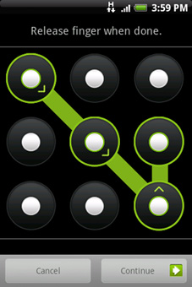
Swipe path of length
4–9 on 3 x 3 grid
Easy to use, suitable for mobile devices
Problems:
  389,112 possible patterns; (456,976 possible patterns for 4-char case-insensitive alphabetic password!)
  Attacker can see pattern from finger oils on screen
  AUTHENTICATION:COMPARISION
 | Passwords | Smart Cards | Biometrics | Pattern Lock
Security | Weak | Strong | Strong | Weak
Ease of Use | Easy | Medium | Hard | Easy
Implementation | Easy | Hard | Hard | Easy
Works for phones | Yes | No | Possible | Yes

Slide 17

Many targeted attacks begin with exploiting software vulnerabilities in downloaded files and email attachments.
the Threat Emulation engine picks up malware at the exploit phase, even before hackers can apply evasion techniques attempting to bypass the sandbox.
Files are quickly quarantined and inspected, running in a virtual sandbox to discover malicious behavior before it enters your network. This innovative solution combines CPU-level inspection and OS-level sandboxing to prevent infection from the most dangerous exploits, and zero-day and targeted attacks.
the SandBlast Threat Extraction capability immediately provides a safe version of potentially malicious content to users. Exploitable content, including active content and various forms of embedded objects, are extracted out of the reconstructed file to eliminate potential threats. Access to the original suspicious version is blocked.

Slide 18

We design differentiated user access control model
  Different users use smartphone in different contexts
  User classification: admin, “normal,” guest
Hard to achieve fine-grained mobile device management:
  Control app installation/gaming
  Parental controls
Smartphone Privileges |  | Admin | Normal | Guest
Personal Info | SMS | ✔ | ✔ | ✘
 | Contacts | ✔ | ✔ | ✘
Resource Access | WiFi | ✔ | ✔ | Limit‼
 | GPS | ✔ | ✔ | Limit‼
 | Bluetooth | ✔ | ✔ | Limit‼
Apps | App Install | ✔ | Limit | ✘
 | Sensitive Apps | ✔ | Limit | ✘
Source: [31], Table 1.

Slide 19

Types of mobile device information sources:
  Internal to device (e.g., GPS location, IMEI, etc.)
  External sources (e.g., CNN, Chase Bank, etc.)
Third-party mobile apps can leak info to external sources
  Send out device ID (IMEI/EID), contacts, location, etc.
  Apps ask permission to access such info; users can ignore!
  Apps can intercept info sent to a source, send to different destination!
Motives:
  Monitor employees’ activity using accelerometers (cited in [32])
  Ads, market research (include user location, behavior, etc.)

Slide 20

1. Cisco, “Cisco Visual Networking Index: Global Mobile Data Traffic Forecast Update, 2011–2016”, 14 Feb. 2012
http://www.cisco.com/en/US/solutions/collateral/ns341/ns525/ns537/
ns705/ns827/white_paper_c11-520862.html
2. Presentation organization inspired by T. Eston, “Android vs. iOS Security Showdown,” 2012,
http://www.slideshare.net/agent0x0/the-android-vs-apple-ios-security-showdown
3.H. Lockheimer, “Android and Security,” 2 Feb. 2012, http://googlemobile.blogspot.com/
2012/02/android-and-security.html
4. F-Secure, “Mobile Threat Report Q2 2012,” 7 Aug. 2012, http://www.slideshare.net/fsecure/mobile-threat-report-q2-2012
5. Wikipedia, http://en.wikipedia.org/wiki/Mobile_device_forensics

