Slide 1
Elliptic Curve Cryptography
Meghana K A
1st Sem,CNE

Slide 2
Introduction
Public key cryptography means two different keys are used for encryption and decryption.
The main problem of conventional public key cryptography systems is that the key size has to be sufficient large in order to meet the high-level security requirement. This results in lower speed and consumption of more bandwidth. Hence Elliptic Curve Cryptography system comes to existance.
Elliptic curve cryptography (ECC) is an approach to public-key cryptography based on the algebraic structure of elliptic curves over finite fields. ECC requires smaller keys compared to non-ECC cryptography to provide equivalent security.

Slide 3
Literature Survey
The ECC technique was first proposed individually by Neal Koblitz and Victor Miller in 1985.
In the late 1990`s, ECC was standardized by a number of organizations and it started receiving commercial acceptance.
Nowadays, it is mainly used in the resource constrained environments, such as ad-hoc wireless networks and mobile networks.
Menezes and Jurisic, in their paper [JM97], said that to achieve reasonable security, a 1024-bit modulus would have to be used in a RSA system, while 160-bit modulus should be sufficient for ECC.

Slide 4
RSA key-size (in bits) | ECC key-size (in bits)
512 | 106
768 | 132
1024 | 160
2048 | 210
21000 | 600
Table 1: Comparison of key size of RSA and ECC

Slide 5
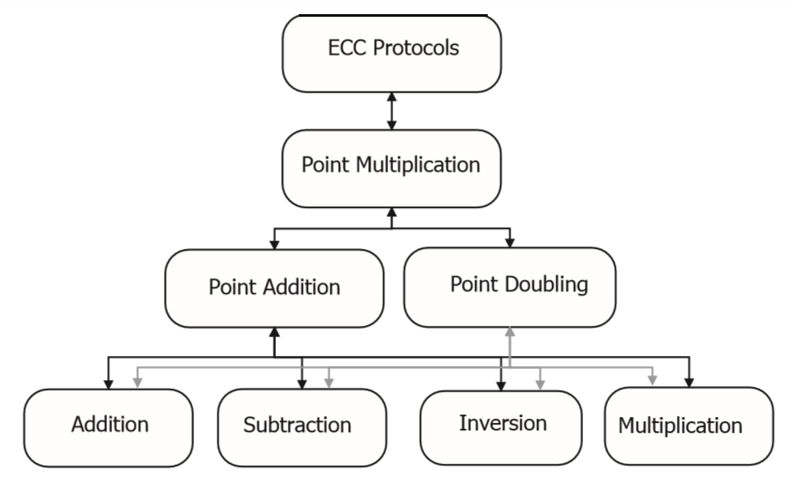
Figure 1.1 Layers of Elliptic Curve Cryptography

Slide 6
Objective
To provide same security as other public key cryptography methods by using smaller size keys.
To reduce power consumption.
To increase speed of computation and to utilize bandwidth efficiently.

Slide 7
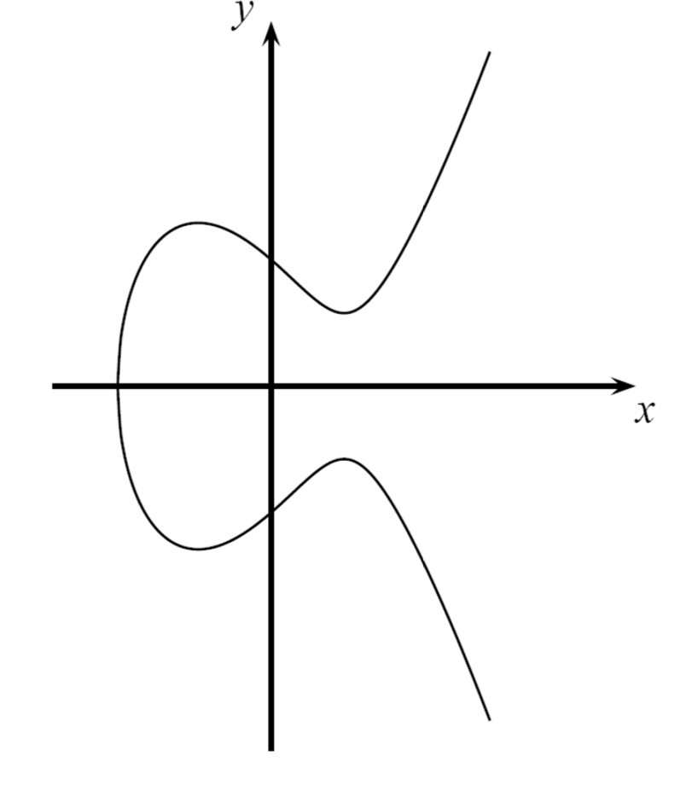
Definition
An elliptic curve E over R(real numbers) is defined by a Weierstrass equation.
y²=x³+ax+b
where x and y are real numbers belongs to finate field. a and b are constants which gives shape to elliptic curve.
Fig1:Elliptic curve

Slide 8
Abelian Group
Addition law of elliptic curve E has the following properties of abelian group :
Identity: P+0 = 0+P=P ∀ P∈E
Inverse: P+(-P) = 0 ∀ P∈E
Associative: P+(R+Q)=(P+R)+Q ∀ P, Q, R ∈E
Commutative: P+Q=Q+R ∀ P, Q ∈E

Slide 9
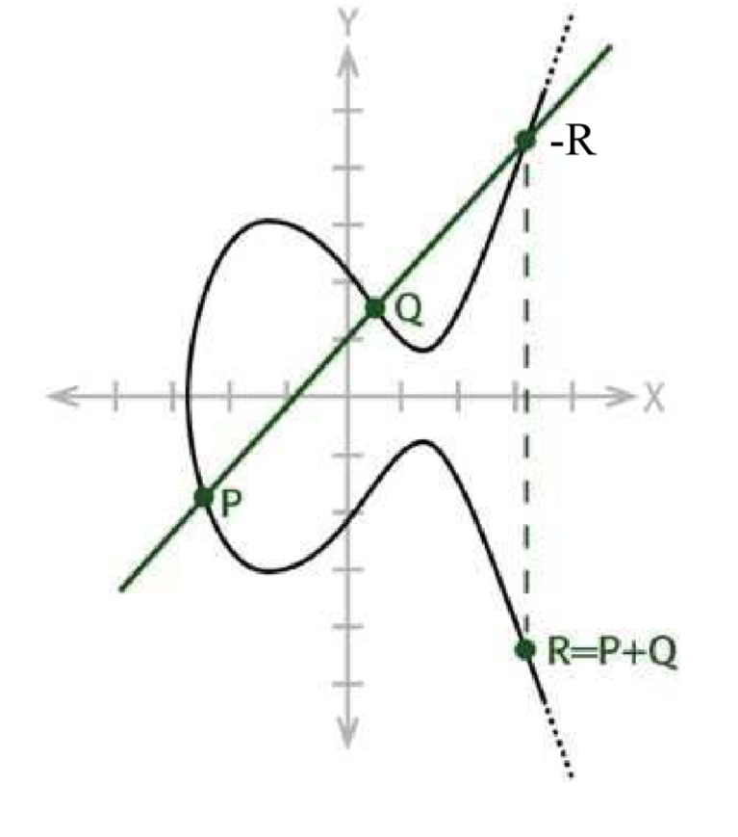
Point addition
Geometry approach:
To add two distinct points P and Q on an elliptic curve, draw a straight line between them. The line will intersect the elliptic cure at exactly one more point -R. The reflection of the point -R with respect to x-axis gives the point R, which is the results of addition of points R and Q
=-R
R
Fig2:poit addition

Slide 10
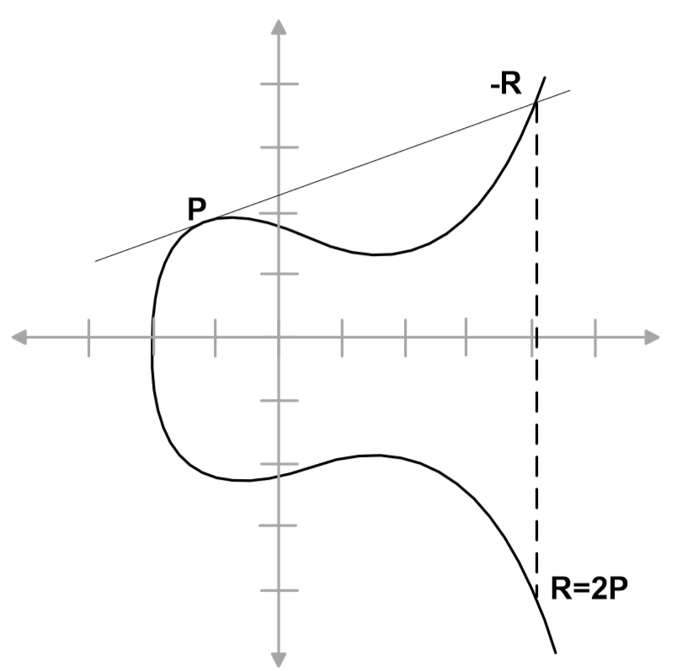
Point doubling
Geometry approach:
To the point P on elliptic curve, draw the tangent line to the elliptic curve at P. The line intersects the elliptic cure at the point -R. The reflection of the point -R with respect to x-axis gives the point R, which is the results of doubling of point P.
Fig3:point doubling

Slide 11
Scalar Multiplication
Intuitive approach:
kP= (P+P+…+P)
k
It requires k-1 times point addition over the elliptic curve.
For example:
To compute 17 P, we could start with 2P, double that, and that two more times, finally add P, i.e. 17P=2(2(2(2P)))+P. This needs only 4 point doublings and one point addition instead of 16 point additions in the intuitive approach. This is called Double-and-Add algorithm.

Slide 12
Double and Add Algorithm
Require k=(km-1,km-2,…..,k0)2,km=1
Compute Q=kP
Q=P
For i=m-2 to 0
Q=2Q
if ki =1 then
Q=Q+P
End if
End for
Return Q

Slide 13
Example
Compute 7P
7=(111)2
7P=2(2(P)+P)+P
Compute 6P
6=(110)2
6P=2(2(P)+P)

Slide 14
Elliptic Curve Diffie-Hellman (ECDH) KeyExchange
ECDH operates by providing the two parties sharing a secret key with a public key, which in this case is a point P on elliptic curve E.
Alice performs scalar multiplication using this point P and a scalar multiple a, which is secret key of Alice. (a.P) now becomes publickey of Alice which she can share with the other party.
On the other end, Bob performs scalar multiplication using point P and a scalar multiple of his choice i.e. b, which is secret key of Bob. (b.P) becomes publickey of Bob which he shares with Alice.
Alice performs scalar multiplication of public key of Alice (b.P) with her secret key a to get a.b.P. Bob also does the same with his secret key b and public key of Alice (a.P) to get the same a.b.P. This entity i.e. a.b.P is same for both the parties and is their shared key.

Slide 15
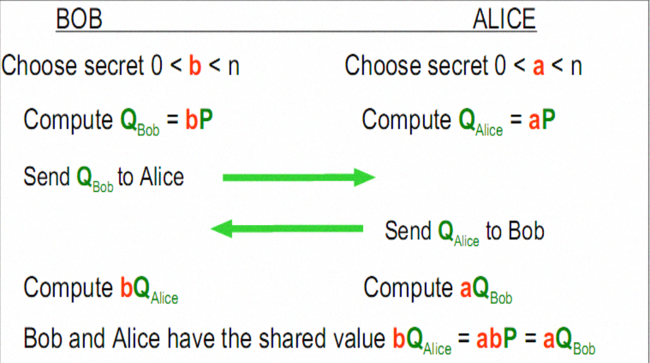
Fig4:Elliptic Curve Deffie Hellman(ECDH)

Slide 16
CONCLUSION
Comparision of the performance of ECC with RSA is done in terms of key sizes for the same level of security, data sizes, encrypted message sizes, and computational power. RSA takes sub exponential time and ECC takes full exponential time. The security of Elliptic Curve Cryptosystem depends on how difficult it is to determine x given xP and P. This is referred to as the elliptic curve logarithm problem.

Slide 17
References
[1].William Stallings “Cryptography and Network Security” ,principles and practice Sixth edition.
[2]. Muhammad Yasir Malik " Efficient Implementation ofElliptic Curve Cryptography Using Low-power Digital Signal Processor" Feb. 7-10, 2010 ICACT 2010 ISBN 978-89-5519-146-2
[3]. Nejmeddine ALIMI, Younes LAHBIB, Mohsen MACHHOUT & Rached TOURKI "On Elliptic Curve Cryptography implementations and evaluation" 978-1-4673-8526-8/16 2016 IEEE.
[4].William J Caelli, Professor Edward P Dawson and Scott A Rea "PKI, Elliptic Curve Cryptography, and Digital Signatures" Computers & Security, 18 (1999) 47-66.
[5]. Krists Magons " Applications and Beneﬁts of Elliptic Curve Cryptography" .
[6]. Joppe W. Bos1, J. Alex Halderman, Nadia Heninger, Jonathan Moore, Michael Naehrig, and Eric Wustrow " Elliptic Curve Cryptography in Practic"

Slide 18
Thank you

