Slide 1
Remote User Authentication
By Priyanka
Mtech(1st sem)
CNE

Slide 2
INTRODUCTION User Authentication
fundamental security building block
basis of access control & user accountability
is the process of verifying an identity claimed by or for a system entity
has two steps:
identification - specify identifier
verification - bind entity (person) and identifier

Slide 3
Means of User Authentication
four means of authenticating user's identity
based one something the individual
knows - e.g. password, PIN
possesses - e.g. key, token, smartcard
is (static biometrics) - e.g. fingerprint, retina
does (dynamic biometrics) - e.g. voice, sign
can use alone or combined
all can provide user authentication
all have issues

Slide 4
Literature Survey
In 1981, Lamport proposed a remote user authentication scheme with password table [1].
Several schemes and improvements using the static identity (ID) are included. [2]-[4]Since the user’s login ID is static in these verifier-free schemes, it may leak partial information about the user’s login messages so that the adversary can use it to forge the user’s login messages by some subtle means.X. H. Yang et al.262
One of the solutions to the problem is to employ dynamic ID in different login.In 2004, Das et al. [5] proposed a dynamic ID-based remote user authentication scheme, which can resist replay,masquerade, and insider attacks.

Slide 5
OBJECTIVE Password Authentication
widely used user authentication method
user provides name/login and password
system compares password with that saved for specified login
authenticates ID of user logging and
that the user is authorized to access system
determines the user’s privileges
is used in discretionary access control

Slide 6
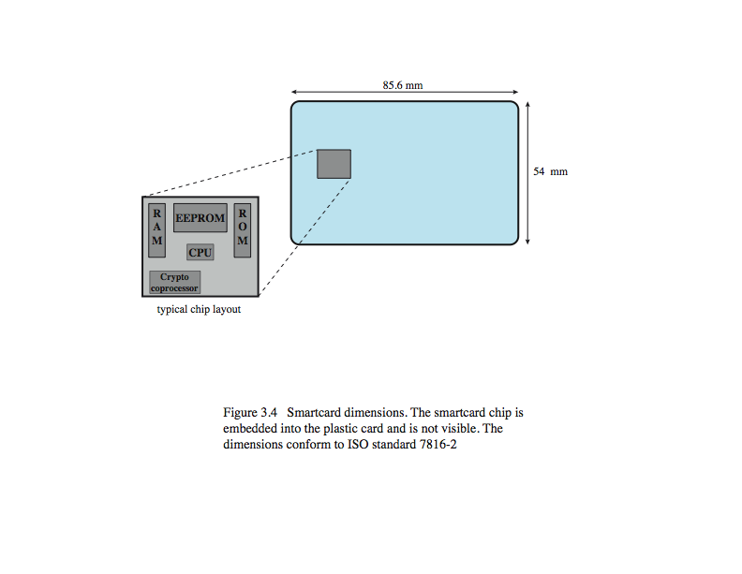
Smartcard
credit-card like
has own processor, memory, I/O ports
wired or wireless access by reader
may have crypto co-processor
ROM, EEPROM, RAM memory
executes protocol to authenticate with reader/computer
also have USB dongles

Slide 7
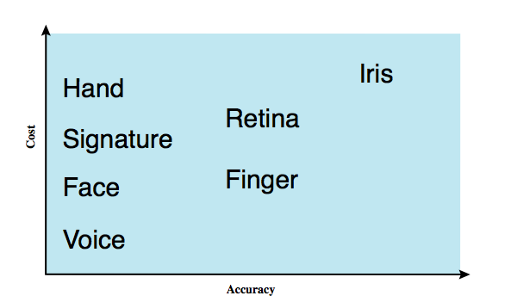
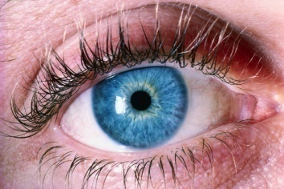
Biometric Authentication
authenticate user based on one of their physical characteristics

Slide 8
Remote User Authentication
authentication over network is more complex
problems of eavesdropping, replay
generally use challenge-response
user sends identity
host responds with random number
user computes f(r,h(P)) and sends back
host compares value from user with own computed value, if match user authenticated
protects against a number of attacks

Slide 9
Authentication Security Issues
client attacks
host attacks
eavesdropping
replay
trojan horse
denial-of-service

Slide 10
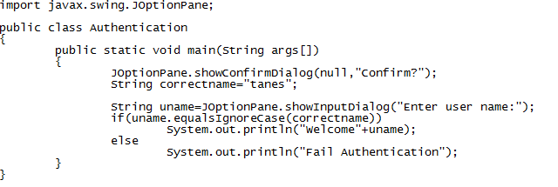
IMPLEMENTATION

Slide 11
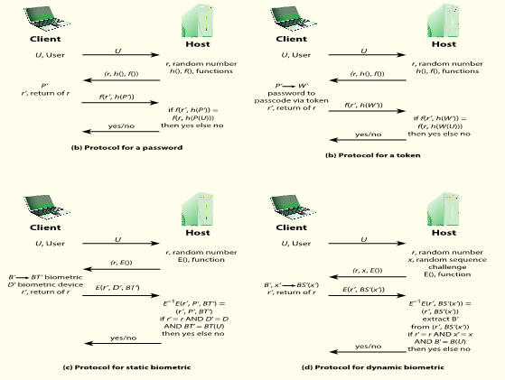
DESIGN

Slide 12
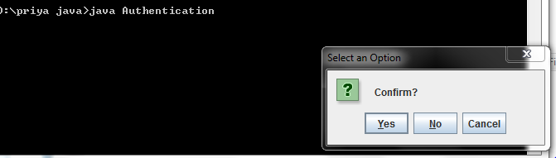
RESULTS

Slide 13
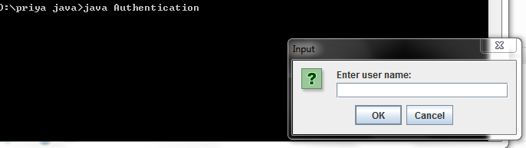

Slide 14
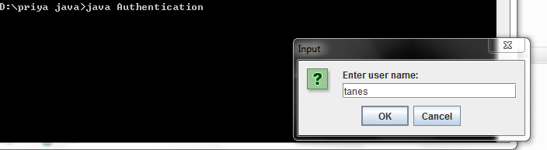

Slide 15
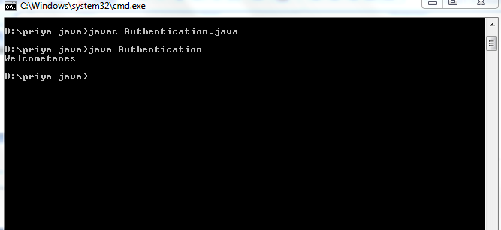

Slide 16
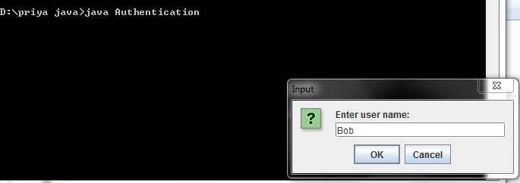

Slide 17
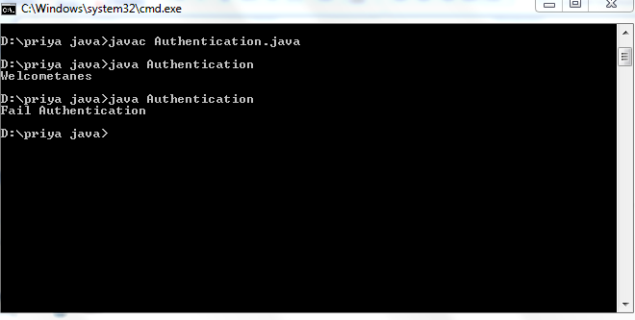

Slide 18
CONCLUSION
Several dynamic user authentication schemes have weaknesses and attacks because of using timestamps.
Besides, the implement of strict and safe time synchronization is very difficult and increases network
overhead. To eliminate these weaknesses, a new dynamic user authentication scheme based on nonce instead of timestamps has to be proposed. Mutual authentication is performed using a challenge-response handshake between
user and remote server.

Slide 19
References
[1] Lamport, L. (1981) Password Authentication with Insecure Communication. Communications of the ACM, 24, 770-772. http://dx.doi.org/10.1145/358790.358797
[2] Yoon, E.J., Ryu, E.K. and Yoo, K.Y. (2004) Further Improvement of an Efficient Password Based Remote User Authentication Scheme Using Smart Cards. IEEE Transactions on Consumer Electronics, 50, 612-614.http://dx.doi.org/10.1109/TCE.2004.1309437
[3] Tina, X., Zhu, R.W. and Wong, D.S. (2007) Improved Efficient Remote User Authentication Schemes. International Journal of Network Security, 4, 149-154.
[4] Yang, L. and Ma, J.F. (2011) Trusted Mutual Authentication Scheme with Smart Cards and Passwords. Journal of University of Electronic Science and Technology of China, 4, 128-133.
[5] Das, M.L., Saxena, A. and Gulati, P. (2004) A Dynamic Id-Based Remote User Authentication Scheme. IEEE Transactions on Consumer Electronics, 50, 629-631. http://dx.doi.org/10.1109/TCE.2004.1309441

Slide 20
Thank you…

