Slide 1
DIGITAL SIGNATURES
SAI HARISH
MTECH(CNE)

Slide 2
INTRODCTION
The authenticity of many legal, financial, and other documents is done by the presence or absence of an authorized handwritten signature.
“Digital Signature” is the best solution for authenticity in various fields.
A digital signature is nothing but an attachment to any piece of electronic information, which represents the content of the document and the identity of the owner of that document uniquely
Digital signatures are a standard element of most cryptographic protocol suites, and are commonly used for software distribution, financial transactions, contract management software, and in other cases where it is important to detect forgery or tampering.

Slide 3
LITERATURE SURVEY
In 1976, Whitfield Diffie and Martin Hellman first described the notion of a digital signature scheme
Ronald Rivest, Adi Shamir, and Len Adleman invented the RSA algorithm, which could be used to produce primitive digital signatures
Digital Image Authentication and Encryption usingDigital Signature
Research of Web Resources Protection Based on Digital Watermarking and Digital Signature
Image Feature Based Authentication and Digital Signature for Wireless Data Transmission

Slide 4
objective
The main theme is to know that how authenticity is provided using digital signatures
To understand the overview of digital signatures and its types
To apply the digital signatures to various real time problems

Slide 5
APPLICATIONS
Electronic Mail
Data storage
Electronic funds transfer
Software Distribution
Smart Cards
e-Tax filing
e-Passports
Time Stamped Signature
Blind Signatures

Slide 6
WHAT IS DIGITAL SIGNATURE?
A digital signature or digital signature scheme is a mathematical scheme for demonstrating the authenticity of a digital message or document.
A digital signature can be used with any kind of message, whether it is encrypted or not, simply so that the receiver can be sure of the sender's identity and that the message arrived intact.
A digital signature scheme typically consists of three algorithms:
HASHING algorithm
Signature Generation Algorithm
A signature verifying algorithm that, given a message, public key and a signature, either accepts or rejects the message's claim to authenticity.

Slide 7
Types of signatures
Blind signature
A form of digital signature in which the content of a message is disguised (blinded) before it is signed. The resulting blind signature can be publicly verified against the original, unblinded message in the manner of a regular digital signature. Blind signatures are typically employed in privacy-related protocols where the signer and message author are different parties
Detached signature
A detached signature is a type of digital signature that is kept separate from its signed data, as opposed to bundled together into a single file

Slide 8
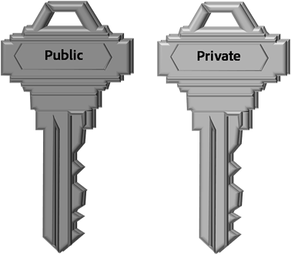
requirements
Private Key
The private key is one which is accessible only to the signer. It is used to generate the digital signature which is then attached to the message.
Public Key
The public key is made available to all those who receive the signed messages from the sender. It is used for verification of the received message.
Digital Signature Certificate
A subscriber of the private key and public key pair makes the public key available to all those who are intended to receive the signed messages from the subscriber.
But in case of any dispute between the two sides, there must be some entity with the receiver which will allow the receiver of the message to prove that the message was sent by the subscriber of the key pair. This can be done with the Digital Signature Certificate.

Slide 9
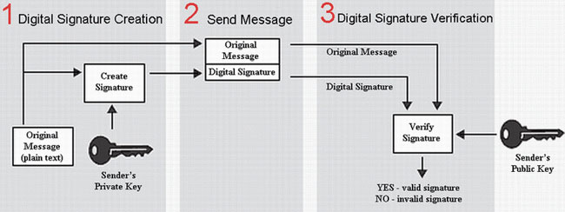

Slide 10
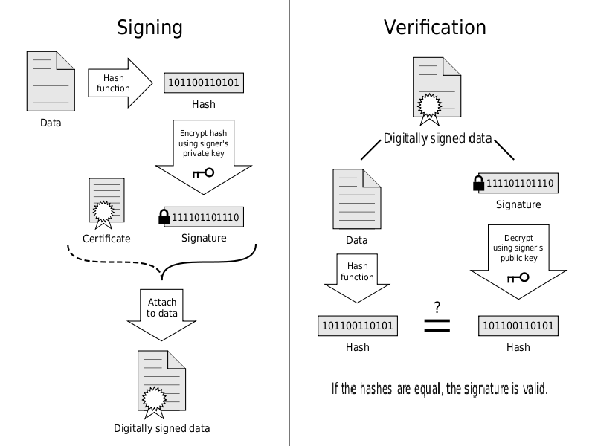

Slide 11
Digital signatures samples
I agree
Efcc61c1c03db8d8ea8569545c073c814a0ed755
I am an Engineer.
Ea0ae29b3b2c20fc018aaca45c3746a057b893e7
I am 62 years old.
0e6d7d56c4520756f59235b6ae981cdb5f9820a0

Slide 12
Digital Image Authentication and Encryption using Digital Signature
The security of digital images has become more and more crucial since the communications of digital products over internet are taking place more and more frequently.
Digital signature is sent along with the encrypted image which decreases the probability of meticulous attack by the intruder

Slide 13
How it works??
ENCRYPTION
Block diagram of encryption process

Slide 14
DECRYPTION

Slide 15
SIMULATION RESULTS
Original image
Encoded image
Altered image

Slide 16
DRAWBACKS
The private key must be kept in a secured manner.
The process of generation and verification of digital signature requires considerable amount of time. So, for frequent exchange of messages the speed of communication will reduce.
For using the digital signature the user has to obtain private and public key, the receiver has to obtain the digital signature certificate also. This requires them to pay additional amount of money.
Although digital signature provides authenticity, it does not ensure secrecy of the data. To provide the secrecy, some other technique such as encryption and decryption needs to be used.

Slide 17
CONCLUSION
Digital signatures are of much important in todays technology. it should provide integrity,authenticity,non-repudiation and confidentiality, and used in public distrusts, including national security agencies, law enforcement agencies, and consumer marketing companies.

Slide 18
REFERENCES
https://en.m.wikipedia.org/wiki/Digital_Signature
www.google.com
www.computerfun4u.blogspot.com
www.slideshare.net
Cryptography & Network Security : Principal & Practise ,William Stallings

Slide 19
THANK YOU….

