Slide 1
Encryption and Decryption Standard
AES
Implementation in C

Slide 2
INTRODUCTION (HISTORY)
In 1997, NIST started looking for replacement for DES, which would be called as AES.
In 1999, 5 out of 15 candidates were selected as finalists.
The candidates were MARS, RC6, Rijndael, Serpent and Twofish.
In 2000, Rijndael was selected as the Advanced Encryption Standard.
In 2001, NIST announced a draft that was available to public for review and comments.

Slide 3
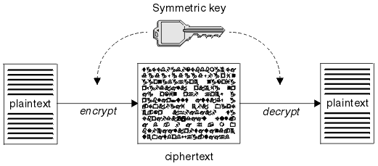
INTRODUCTION
AES is symmetric key cipher (one key for both encryption and decryption).
AES is a block cipher, where each data block is of 128 bits(16Bytes) in size.

Slide 4
INTRODUCTION
The number of rounds in an algorithm depends on the key length.
The key size can be 128(16Bytes), 192(24Bytes) or 256(32Bytes).
Thus number of rounds being 10, 12 or 14 respectively.
AES is an open algorithm which is available to public.
AES has been adopted by National Security Agency to encrypt confidential or sensitive information.

Slide 5
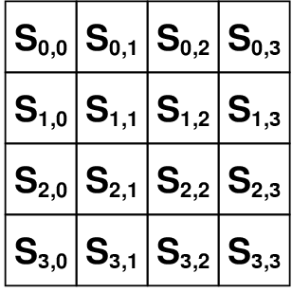
INTRODUCTION
AES is based on a design principle known as a substitution-permutation network, combination of both substitution and permutation.
Thus it is fast in both software and hardware.
AES operates on a 4 × 4 matrix of bytes, termed state.

Slide 6
OBJECTIVE
The main objective of this self study is to get more insight and understand the operations in AES algorithm.
To understand the different transformations applied in each round and implement the same in C program.

Slide 7
APPLICATIONS
Encrypt sensitive information for protection.
Military and governments use AES encryption to facilitate secret communication.
Prevent unauthorized use or reproduction of copyrighted material and protect software against reverse engineering.
Encryption is also used to protect data in transit, for example data being transmitted via networks.

Slide 8
DESIGN
SubBytes—a non-linear substitution step where each byte is replaced with another according to a lookup table.
ShiftRows—a transposition step where the last three rows of the state are shifted cyclically a certain number of steps.
MixColumns—a mixing operation which operates on the columns of the state, combining the four bytes in each column.
KeyExpansions—round keys are derived from the cipher key.
AddRoundKey—each byte of the state is combined with a block of the round key using bitwise xor.

Slide 9
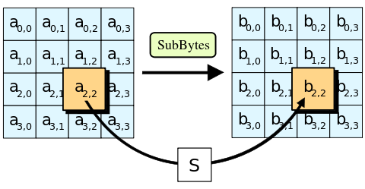
DESIGN SubBytes

Slide 10
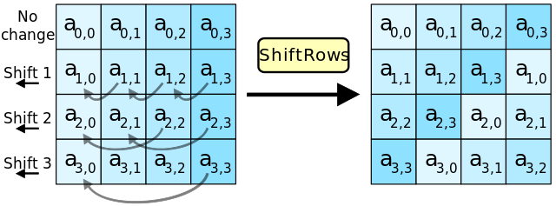
DESIGN ShiftRows

Slide 11
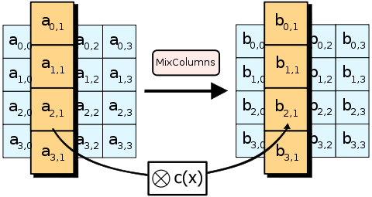
DESIGN MixColumns

Slide 12
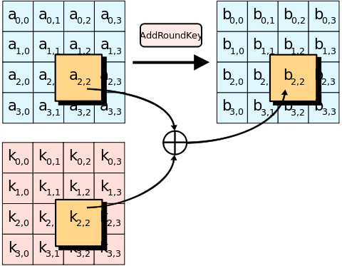
DESIGN AddRoundKey

Slide 13
IMPLEMENTATION

Slide 14
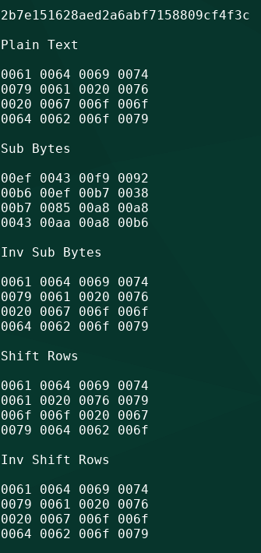
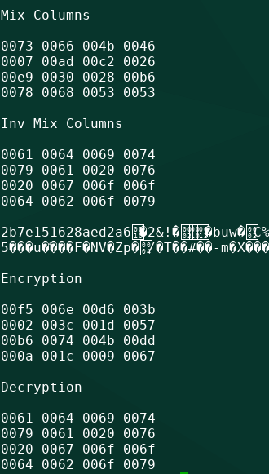
OUTPUT

Slide 15
LITERATURE SURVEY
FPGA based hardware implementation of AES Rijndael algorithm for Encryption and Decryption by N. S. Sai Srinivas and Md. Akramuddin. Published in Electrical, Electronics, and Optimization Techniques (ICEEOT)
Area optimized and high throughput AES algorithm based on permutation data scramble approach by V. Dilna and C. Babu. Published in Electrical, Electronics, and Optimization Techniques (ICEEOT)

Slide 16
Thank You

