Slide 1



SMARTSCREEN
AN AI POWERED RESUME SCREENING SYSTEM

Slide 2

WHAT IS
SMARTSCREEN
SmartScreen AI is an intelligent resume screening system that uses advanced AI to understand the meaning and context of resumes and job descriptions

Slide 3


VISION
To create a smarter, fairer, and more efficient hiring process by leveraging AI to understand candidates beyond keywords unlocking diverse talent, reducing bias, and enabling organizations to find the best people for every role.

Slide 4
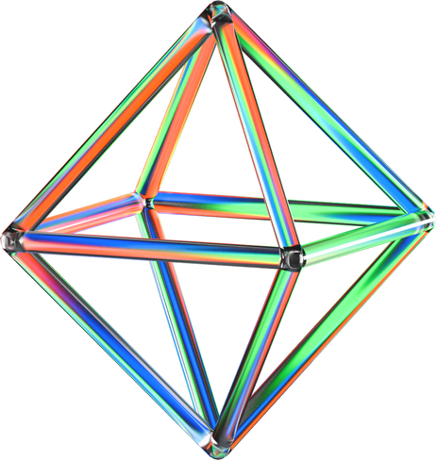
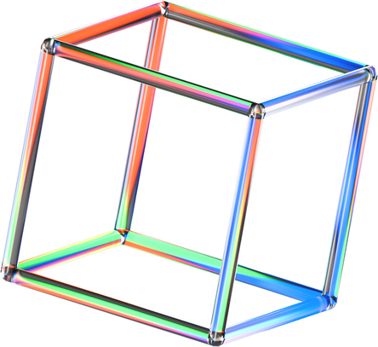
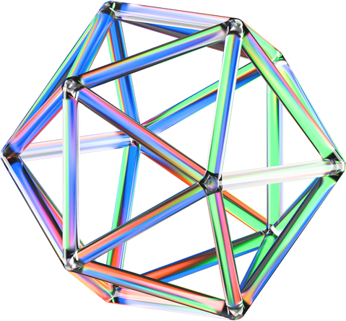
TOOLS AND TECHNOLOGIES
Programming languate:
PYTHON
PyPDF2, python-docx, pytesseract, custom python for txt & html
spaCy, NLTK & custom Python scripts for text processing

Slide 5
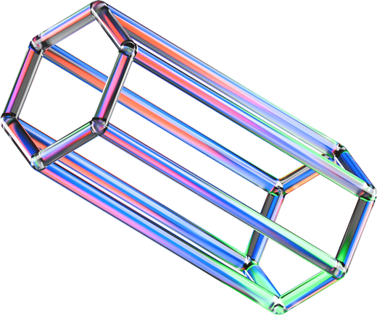
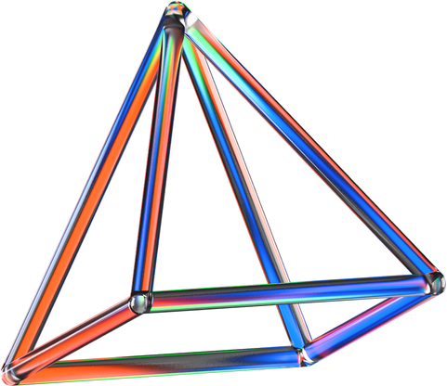
TOOLS AND TECHNOLOGIES
SBERT or Hugging Face Transformers for semantic embedding
FAISS for semantic similarity search
scikit-learn for initial candidate ranking

Slide 6
TOOLS AND TECHNOLOGIES
SHAP or LIME
for Bias & Interpretability
HTML, CSS and JS
for frontend
we will be greatful for any other recommendation from your side

Slide 7

ROADMAP
Resume & Job Desc Ingestion
Doc Parsing
Text Preprocessing
Semantic Embedding
Semantic Similarity Search
Fairness & Interpretability
Initial Ranking
Happy HR

Slide 8

STEP 1
SmartScreen Login
DASHBOARD
STEP 4
Review & get Top K applicants
STEP 2
Entering Job Desc & Upload Resumes
SMARTSCREEN
STEP 3
AI-Powered Screening & Results

Slide 9
SmartScreen AI transforms hiring by combining advanced AI and semantic understanding to deliver faster, fairer, and more accurate resume screening helping companies discover the best talent with confidence.
CONCLUSION

Slide 10
THANK YOU

