Slide 1


POWER INVERTERS : SIMULATION
Mid-Term Project - Analog Electronics I
Aditya Raj | Amrinder Singh Saini
2K20/EC/014 2K20/EC/027

Slide 2
PROJECT OUTLINE
Introduction to Inverters - Classification & Applications
Component selection for circuit design
Ideal Half Bridge Inverter
Practical Half Bridge Inverter using MOSFETs with simulation
Ideal Full Bridge Inverter
Practical Full Bridge Inverter using MOSFETs with simulation

Slide 3
INTRODUCTION TO INVERTERS

Slide 4
Introduction to Inverters
Power inverters are electronic devices that consist of an inversion circuit which efficiently transforms a DC power source such as a battery to an AC power source.
Two methods for inversion :-
Convert low voltage DC to high voltage DC and then convert this high voltage DC to AC using Pulse Width Modulation.
Convert low voltage DC to low voltage using AC using inverter circuit and then use a step up transformer.
Inverter circuits are heavily dependent on the functioning of switches.
Traditional inverters used mechanical switches for functioning. Heavy, costly and inefficient.
Modern day inverters use transistor switches for operation. Fast and reliable.
Classification :-
Based on the output waveforms
Based on the source of the inverter : VSI and CSI
Based on the type of Load : Single phase, three phase

Slide 5
Choice of Components
MOSFET as Switch
Inverter circuits require electrical switches with efficient switching properties.
MOSFETs are excellent switches as they have faster switching rates.
Gate pulse given to MOSFET to toggle between cutoff and saturation mode of operation.
PMOS or NMOS
NMOS provide faster switching as their majority carriers are electrons.
Improve efficiency of the circuit.
Pulse Generator
The pulse generator is used to provide input to the MOSFET gate in order to enable switching when required.
Pulse Width is set to 50%. Practically, Pulse width shall be set around 45%.
Time period of the pulse shall be 20ms as required frequency of the output is 50Hz.
Load
Load shall be set as per requirement.
Resistive Load : Square waveforms of both current and voltage.
Inductive Load : Square waveform for voltage. Current waveform shall be similar to a sinusoidal waveform with ripples.

Slide 6
HALF BRIDGE INVERTER

Slide 7
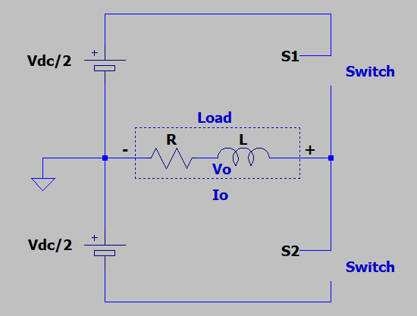
Ideal Half Bridge Inverter
Circuit Description :-
2 ideal switches - S1 and S2 complimenting
DC Voltage source
Load
Switching States
S1 and S2 OFF : Voltage = 0V
S1 OFF and S2 ON : Voltage = -Vdc/2
S1 ON and S2 OFF : Voltage = +Vdc/2
S1 ON and S2 ON: Voltage = 0V
Now for the first half, i.e. from 0 to T/2, the switch S1 is in the ON state and S2 is in the OFF state. During this time period, the voltage across remains +Vdc/2. During the second half, i.e. from T/2 to T, switch S1 turned to OFF state and switch S2 is in the ON state. This implies that the voltage across the load becomes, -Vdc/2. When we analyse the voltage across the load during the period T, we obtain a square wave which is an Alternating Current waveform. Thus, we have successfully converted a DC power source to a square AC wave.

Slide 8
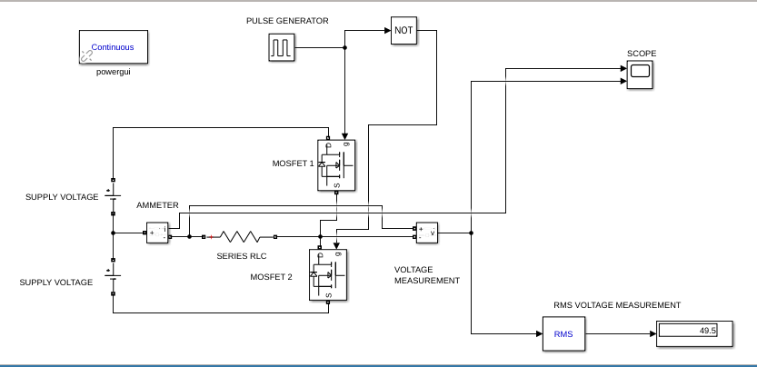
Practical Half Bridge Inverter - Simulink Model
Components Used :-
2 MOSFETs
DC Power Source (50V+50V)
Pulse generator
Current and Voltage measurement blocks.
Output
For resistive Load : V_{out} = 49.5V
For RL Load : V_{out} = 49.91 V

Slide 9
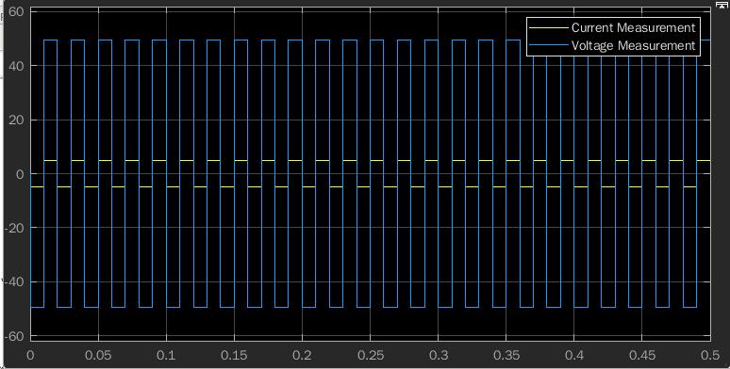
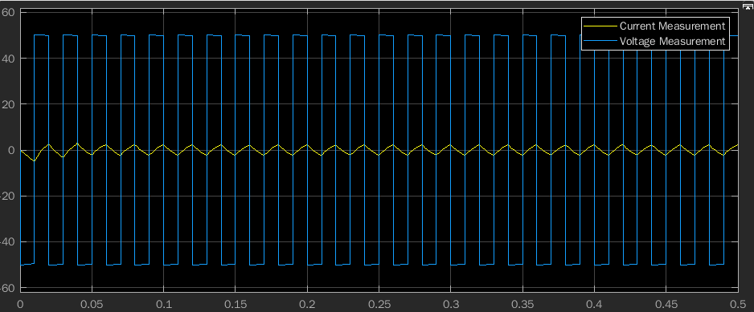
Ideal Half Bridge Inverter - Output Waveforms
Resistive Load
RL Load

Slide 10
FULL BRIDGE INVERTER

Slide 11
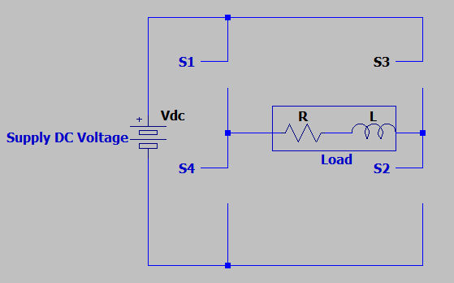
Ideal Full Bridge Inverter
Circuit Description :-
4 ideal switches - S1/S4 and S2/S3 complimenting
DC Voltage source
Load
Switching States
S1 and S2 ON : Voltage = V_{DC}
S1 and S3 ON : Voltage = 0V short circuited.
S3 and S4 ON : Voltage = -V_{DC}
S2 and S4 ON : Voltage = 0V short circuited
Advantages :-
Single DC Source
Three voltage values + max voltage equal to input voltage.

Slide 12
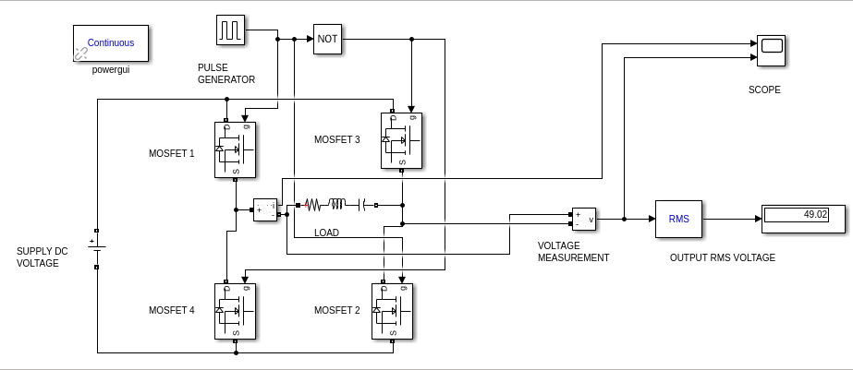
Practical Full Bridge Inverter - Simulink Model
Components Used :-
4 MOSFETs
DC Power Source (50V)
Pulse generator
Current and Voltage measurement blocks.
Output
For resistive Load : V_{out} = 49.02V
For RL Load : V_{out} = 49.81 V

Slide 13
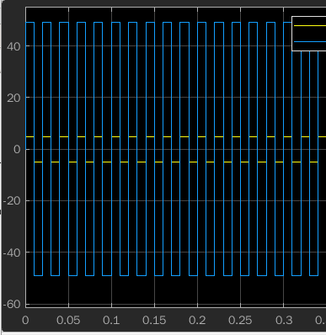
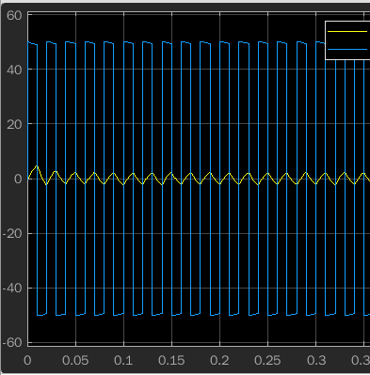
Practical Full Bridge Inverter - Output Waveforms
Resistive Load
RL Load

Slide 14
SCOPE FOR IMPROVEMENT

Slide 15
Scope for Improvement
Conclusion
In an advanced design, Pulse Width Modulation shall be used that results in a sinusoidal output waveform for current and voltage.
MOSFETs as switches are excellent, however IGBT switches have proved to be more efficient in inverter circuits and shall be used for application.
In the half bridge design, rather than using two DC voltage sources, a single DC voltage shall be used and two capacitors shall be connected across that source.
There is always a requirement for reliable and efficient inverter circuits, especially in areas which do not have adequate power supply or the supply is inconsistent.
Through our project, we identified what basically are inverter circuits and why do we actually need them.
Putting the theory to practical application we simulated half bridge and full bridge circuits in SIMULINK and obtained output waveforms.

Slide 16
Thank You

