Slide 1



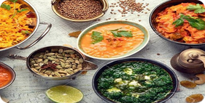

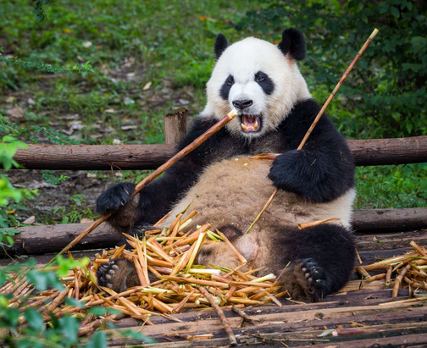
Save or Copy Recipe
Indian Food 101
Food Express
GPT 3.5- Turbo
Pandas

