Slide 1

Sprocket Central Pty Ltd
Data analytics approach
[Division Name] - [Engagement Manager], [Senior Consultant], [Junior Consultant]

Slide 2
Agenda
Introduction
Data Exploration
Model Development
Interpretation

Slide 3
Introduction
Sprocket Central Pty Ltd is a long-standing KPMG client whom specializes in high-quality bikes and accessible cycling accessories to riders. Their marketing team is looking to boost business by analyzing their existing customer dataset to determine customer trends and behavior.
With this presentation, we would like to target the new customer database of 1000 customers.
Sprocket Central Pty Ltd has given us a new list of 1000 potential customers with their demographics and attributes. However, these customers do not have prior transaction history with the organization.
The marketing team at Sprocket Central Pty Ltd is sure that, if correctly analyzed, the data would reveal useful customer insights which could help optimize resource allocation for targeted marketing. Hence, improve performance by focusing on high value customers.

Slide 4
Data Exploration
By observing the data provided, we got to highlight some major attributes like age, gender, wealth status of the loyal customers.
By observing the data from “Customers Demographic” worksheet, we highlighted some major attributes by which we can sort the targeted audience.
Age Bracket- We divided the customer database in 5 categories with, some people having invalid data or not available data, namely Gen Z(20-24), Millennials (25-39), Gen X (40-54), Baby Boomers (55-74) and Interwar (75+)

Slide 5
Data Exploration
Gender- We divided the customers database into 3 categories namely, Male, Female and the people didn’t want to disclose their genders. ( As shown in the pie chart, it shows that there is almost an equal distribution among both the genders, so couldn’t be correlated)
Whether the old customers owned a car or not, but by looking at that data we didn’t find any relation that we expected, because it was basically equal.
people who own car | 2024
people who don't own car | 1976

Slide 6
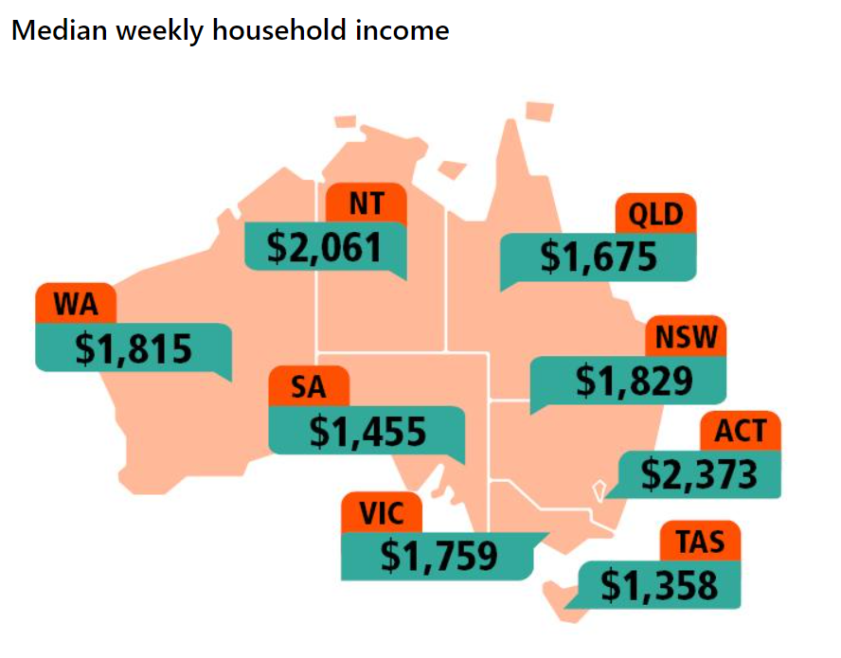
Data Exploration
Wealth Segment- The Society was divided into 3 categories by the company as High Net Worth, Affluent Customer and Mass Customer. (taking only the states of VIC, QLD, NSW)

Slide 7
Model Development
So as for a solution, we want to target the audience that holds the conditions mentioned below:
The targeted audience should be the ones that doesn’t own a car, the middle aged bracket (i.e. Millennials, Gen X, Baby Boomers) and the people lying in “Mass Customer” wealth bracket.
The highlighted segment should be the priority target for the company.
Owns a car(wealth bracket) | Baby Boomers | Gen X | Millenials | Gen Z | Interwar | data_invalid | Grand Total
No | 164 | 161 | 103 | 20 | 49 | 10 | 507
Affluent Customer | 33 | 40 | 21 | 9 | 9 | 4 | 116
High Net Worth | 48 | 45 | 27 | 4 | 13 | 0 | 137
Mass Customer | 83 | 76 | 55 | 7 | 27 | 6 | 254
Yes | 173 | 138 | 96 | 22 | 57 | 7 | 493
Grand Total | 337 | 299 | 199 | 42 | 106 | 17 | 1000

Slide 8
Interpretation
Giving reference to previous slides and the database we analysed, we can interpret the following points:
The Sprocket Central Pty Ltd is a company that produces bikes (assuming both motor-bikes and bicycles) and their accessories that are economically feasible to their customers.
The bikes and the accessories are designed in a way that is unisex viz. not focused on any particular gender. This means that their target audience is everyone irrespective of any gender.
As we discussed earlier, that they produce economic range of quality bikes and accessories, so focussing mainly on middle class( i.e. majority portion of society). Other wealth status people buy these products because, the upper class people buy them from health point of view and the lower class don’t have an option because of their financial status.
People who don’t have a car, don’t have any other option so they have to buy a vehicle as a mode of transportation.

Slide 9
Appendix

Slide 10
Appendix
https://www.abs.gov.au/statistics/people/population/population-census/2021
https://www.abs.gov.au/statistics/labour/earnings-and-working-conditions/income-and-work-census/2021
Data provided by the organisation

