Slide 1

MedLedger
A Blockchain-Based Anti-Counterfeit Pharmaceutical Supply Chain
SUBMITTED BY
Aditya Yadav (25BCE1639) Suyash Singh (25BCE5267) Avantika Battamsetty (25BCE1767)

Slide 2

The Counterfeit Crisis
10.5%
$30.5B
of medical products in developing
countries are substandard or falsified
lost annually worldwide on
ineffective, falsified treatments
These medicines fail to treat disease, contribute to avoidable deaths, and accelerate antimicrobial resistance.
The current supply chain suffers from fragmented databases, creating vulnerabilities that counterfeiters exploit.

Slide 3



Core Problem Statement
Fragmented Data
Lack of Trust
Zero Traceability
Organizations maintain private, disconnected databases. A single, shared, trustworthy record of a product's journey does not currently exist across the chain.
Commercial competitors cannot share a centralized database due to lack of mutual trust. Without verification, falsified records and products easily enter the system.
During an emergency, reconciling records across multiple companies takes days. Recalls are extremely slow, endangering public health and patient safety.

Slide 4

A conventional centralized database cannot solve this problem on its own. Combining a blockchain with a relational database and a graph database yields a system that is trustworthy, efficient, and analytically powerful.
THE MEDLEDGER MOTIVATION

Slide 5


Polyglot Persistence Architecture
OPERATIONAL LAYER
TRUST LAYER
ANALYTICAL LAYER
Oracle Relational DB
Hyperledger Fabric
Neo4j Graph DB
Stores high-volume, detailed data including batches, quality tests, and privacy-sensitive dispensing records natively.
A permissioned blockchain maintaining an immutable record of custody handoffs requiring multi-party endorsement.
Mirrors blockchain custody events as graph nodes. Enables rapid provenance tracing and counterfeit pattern detection.

Slide 6


EER Model: Advanced Concepts
Generalization / Specialization
Aggregation for Traceability
The PARTY entity is generalized into four distinct subclasses: Manufacturer, Distributor, Pharmacy, and Regulator. This is an attribute-defined, disjoint, and total specialization. Each party plays exactly one role (Disjoint) and must belong to one of these subclasses (Total), sharing a common party_id.
The custody transfer event (PARTY SENDS SHIPMENT RECEIVES) is treated as a single higher-level object. This aggregation is crucial because the transaction is mirrored as one custody-transfer on Hyperledger Fabric and as one edge between PARTY nodes in the Neo4j provenance graph.

Slide 7
Relational Schema Mapping (Subset)
Relation | Attributes | Foreign Keys (Dependencies)
PARTY | party_id (PK), party_name, address, phone… | —
BATCH | batch_id (PK), batch_status, manufacture_date… | drug_id, manufacturer_id, recall_id
PACKAGE | package_id (PK), package_size, packaged_at… | batch_id, dispense_id
SHIPMENT | shipment_id (PK), shipment_date, status, mode | sender_party_id, receiver_party_id
Note: Full schema includes TEST, DISPENSING, and RECALL relations, each enforcing 3NF/BCNF integrity.

Slide 8
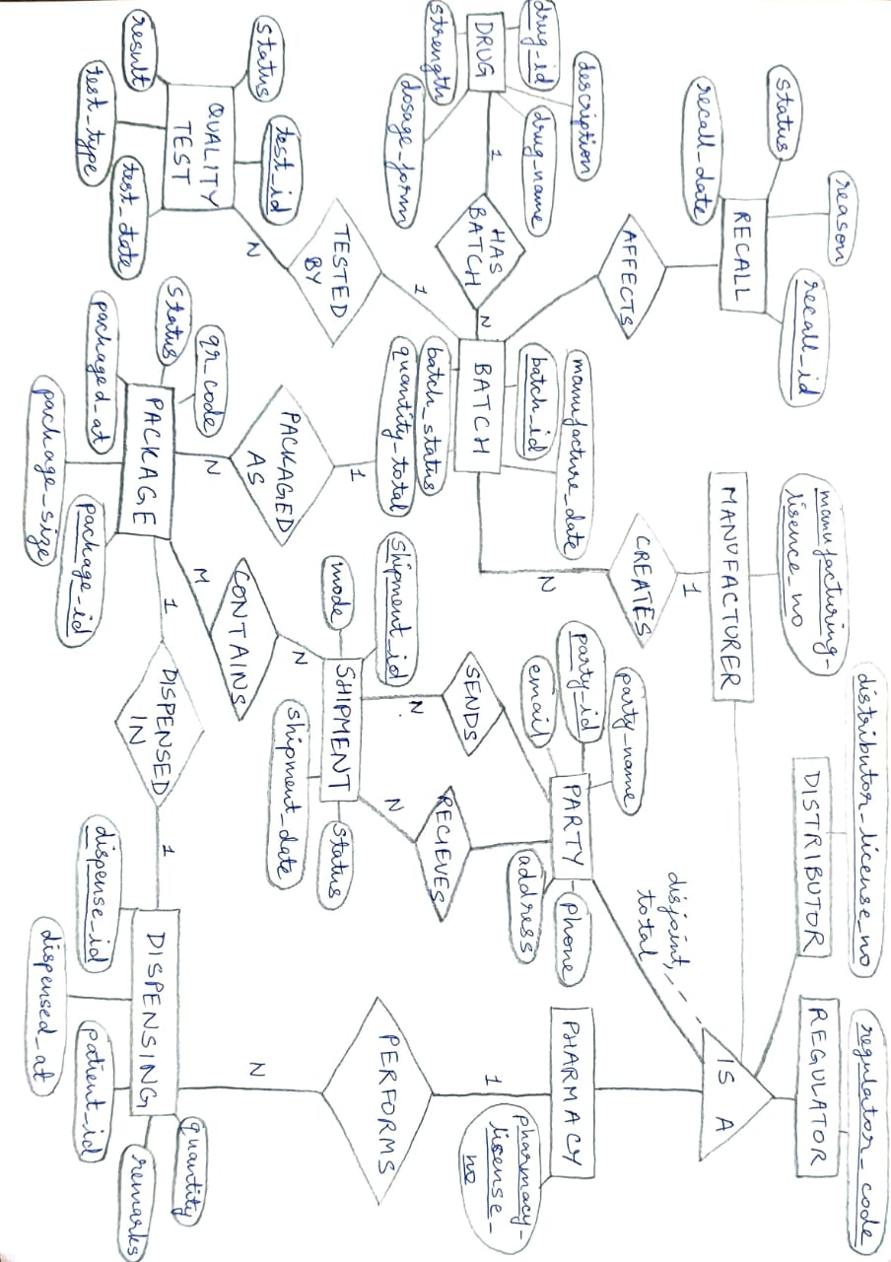
Database Normalization
1
1NF → 2NF
Removed partial dependencies. Attributes purely dependent on batch_id or test_id were split into separate BATCH and TEST relations.
2
2NF → 3NF
Removed transitive dependencies. We isolated PACKAGE, SHIPMENT, and DISPENSING into clean, separate tables.
3
BCNF Verification
Rigorous checks ensured that in all final relations (PARTY, MANUFACTURER, PACKAGE, etc.), the only determinants are candidate keys.
This strict progression guarantees maximum structural integrity and eliminates update anomalies across the operational layer.

Slide 9



Tracing & Verification
End-to-End Transparency
The Neo4j graph architecture maps the physical journey of a medical package. By treating transfers as connected nodes, the system identifies illogical patterns — such as duplicated package events or impossible geographical jumps — instantly flagging counterfeits.
Cryptographic QR Verification
Every unit of medicine carries a cryptographic QR code encoding a unique package_id. Consumers, pharmacists, or regulators simply scan the code to seamlessly interface across the Oracle and Hyperledger layers, confirming authenticity on the spot.

Slide 10




Summary & Impact
Comprehensive Security
Optimized Polyglot Architecture
Eliminates reliance on untrusted central databases by enforcing multi-party endorsements for every custody transfer.
Intelligently delegates operational detail to Oracle, immutable trust to Hyperledger, and complex supply chain analytics to Neo4j.
Rapid Incident Response
Patient Empowerment
Revolutionizes product recalls; graph-based tracing lets stakeholders identify impacted downstream nodes in milliseconds.
Democratizes safety by placing authenticity verification directly into the hands of the end-user via standard mobile scanning.

Slide 11

Questions?
Thank you for exploring the MedLedger Project Proposal.
CLINICAL AQUACARE | MODERN HEALTHCARE TECHNOLOGY

Slide 12
Image Sources
www.pharmtech.com
cdn.sanity.io/.../58973d42e62bafeff2e93605877c8a095646941d-1280x720.jpg
www.oloid.com
cdn.prod.website-files.com/.../contactless-authentication.webp

