Slide 1
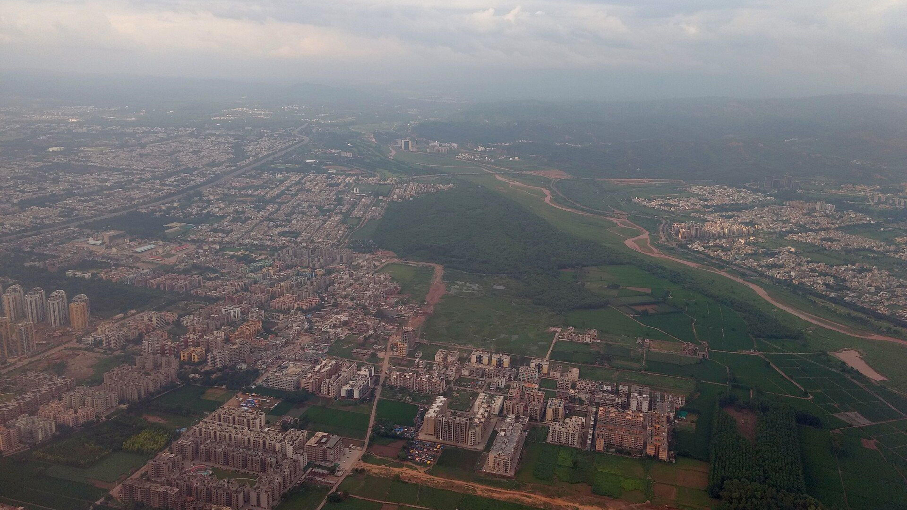
🏛️ CHANDIGARH UNIVERSITY · CSE DEPT
URBAN MESH
Autonomous Civic Operations, Mobility Mesh &
3D Spatial Digital Twin of Chandigarh
A next-generation hardware-free municipal command platform unifying emergency green corridors, women safety SafePath with 30s psychoacoustic SOS, and real-time environmental telemetry.
PROBLEM STATEMENT
TEAM
PS-02: Smart & Sustainable Cities
Team Ikarus
TARGET CITY
ENGINE
Chandigarh (Le Corbusier Grid)
60 FPS Three.js WebGL + Gemini AI

Slide 2
TEAM IKARUS
Team Introduction & Engineering Contributions
Chandigarh University engineering squad bridging high-throughput APIs, edge computer vision, and spatial WebGL.
AK
AT
KP
AY
Akshat Kaushik
Aaditya Tomar
Karanveer Pundir
Aditya Yadav
Full-Stack & Asynchronous APIs
AI/ML & Computer Vision
3D Spatial Systems & GIS
Hardware Security & Cloud Deployment
Engineered high-throughput async REST API architecture, Redis state synchronizers, and integrated frontend state machines.
Developed YOLOv8 fine-tuning for traffic flow estimation, homography calibration for camera cones, and edge privacy filters.
Designed the Three.js WebGL 3D Digital Twin with authentic Le Corbusier sector grids, V-road hierarchy, and 60 FPS optimizations.
Implemented 30s Web Audio SOS siren, Duress PIN 9999 coercion defense, Cloudflare tunneling, and Gemini 2.0 Flash AI proxy.

Slide 3
CHALLENGE ANALYSIS
Problem Statement: Urban Growth Fractures Civic Infrastructure
Rapid urbanization forces Sanitation, Mobility, and Emergency Services into isolated operational silos.
🚨 EMERGENCY MOBILITY CRISIS
🛡️ WOMEN & CITIZEN SAFETY GAP
🗑️ MUNICIPAL LOGISTICS DEFICIT
Traffic Chokepoints & Delayed Ambulances
Dark Corridor Blind Spots & Coercion Risks
Reactive Sanitation & Overflowing Bins
• Critical emergency transit to PGIMER (Sec 12) suffers severe delays during peak hours.
• Night pedestrians lack intelligence on well-lit, CCTV-monitored safe walking routes.
• High footfall commercial hubs (Sector 17 Plaza, Sector 22) face random waste overflows.
• Manual traffic overrides require multiple phone calls and radio dispatch delays.
• Traditional panic alarms expose victims to violence if forced to shut off the alarm by attackers.
• Municipal compactor trucks drive fixed, static routes wasting 35% unnecessary diesel.
• Lack of real-time signal preemption leads to preventable emergency care transit loss.
• Zero covert duress defense mechanism existed in legacy municipal mobile apps.
• Hardware IoT sensors in public bins suffer 40%+ vandalism and battery failure.

Slide 4
CONTEXT & BENCHMARK
Problem Context & Existing Solutions Gap
Legacy smart city deployments fail due to hardware fragility, theft, and isolated data architectures.
❌ LEGACY SMART CITY IMPLEMENTATIONS
✅ THE URBAN MESH PARADIGM SHIFT
Fragile Physical Hardware & Siloed Operations
Hardware-Free, Edge-AI & 3D Spatial Intelligence
⚠️ Physical IoT sensors inside public dustbins get stolen, vandalized, or broken by weather within months.
✨ Zero physical bin sensors — analyzes CCTV footage and municipal fill rate prediction models purely in software.
⚠️ Road magnetometer sensors in asphalt get damaged during routine road repairs and paving.
✨ Automated 300m intersection geofencing dynamically preempts traffic lights for emergency ambulances.
⚠️ Green corridors require manual police phone-trees, causing 3-5 minute dispatch coordination latency.
✨ 4-Way intersection tie-breaker algorithm prioritizes patient medical triage and opposing lanes.
⚠️ Surveillance cameras record raw footage with zero real-time AI privacy redaction or blind spot tracking.
✨ 30s Web Audio dual-tone siren (880Hz-1450Hz) with covert Duress PIN 9999 for silent Code Black police dispatch.
⚠️ Citizen apps only provide static maps without active psychoacoustic deterrence or covert safety PINs.
✨ Locked 60 FPS Three.js 3D Digital Twin synchronizes with live Open-Meteo weather and Google Maps satellite views.

Slide 5
THE ARCHITECTURAL SHIFT
Urban Mesh: Software-Defined Municipal Command Platform
Zero Physical Sensors. Purely Software-Driven Intelligence.
01
02
03
PUBLIC SAFETY MESH
AUTONOMOUS MOBILITY
SMART SANITATION
Civilian Protection & Coercion Defense
Emergency Signal Preemption
Dynamic Waste Logistics
Combines 30-second dual-tone psychoacoustic siren, SafePath night routing, and Duress PIN 9999 silent coercion defense that fools attackers while dispatching Code Black police teams.
Sub-second cascade traffic preemption over Madhya Marg & Jan Marg corridors. Automatically preempts 7+ junctions to PGIMER Sector 12 with 4-way deadlock tie-breaking.
Predictive fill-level estimation for high-density heritage sectors (17 Plaza & 22 Market). Automatically updates compactor truck routes to eliminate unmonitored waste accumulation.
📈 +62% Night Safety Confidence
📈 -48% Transit Delay to PGIMER
📈 -35% Diesel Fleet Consumption

Slide 6
CORE CAPABILITIES
Key Features & Proprietary Innovations
Algorithmic pipelines delivering civilian safety, dynamic logistics, and automated traffic dispatching.
🏙️
FEATURE 01
🚨
FEATURE 02
3D Spatial Digital Twin
30s SOS Siren & Duress PIN
Three.js WebGL model of Chandigarh matching Le Corbusier grid, Capitol Complex (Assembly & Secretariat), and live wind-coupled Open Hand Monument running at 60 FPS.
Psychoacoustic 880Hz-1450Hz warble siren with red screen strobe. Duress PIN 9999 silences the alarm to trick attackers while covertly dispatching Code Black police units.
🚑
FEATURE 03
🤖
FEATURE 04
Green Corridor Preemption
Google Gemini 2.0 AI Copilot
Sub-second cascade traffic signal preemption over 7 junctions from Sec 26 to PGIMER Sec 12. Smart 4-way tie-breaker resolves multiple simultaneous emergency requests.
Embedded AI assistant with natural language understanding of smart city telemetry, voice synthesis readout (TTS), and graceful offline Neural Engine fallback.

Slide 7
SYSTEM ARCHITECTURE
Proposed System Workflow & End-to-End Pipeline
Streaming event-driven pub/sub dataflow evaluating real-time spatial nodes.
STEP 1
STEP 2
STEP 3
STEP 4
Data Ingestion
Edge Analytics
Optimization Core
Command Interface
CCTV & SENSORS
IN-MEMORY ENGINE
SIGNAL & ROUTING
3D TWIN & CITIZEN
Ingests existing traffic CCTV streams, GPS fleet trackers, and Open-Meteo live weather & AQI telemetry.
Evaluates vehicle queues, detects blind spots, anonymizes civilian faces (DPDP 2023), and calculates waste fill deltas.
Dispatches green corridor cascades to traffic controllers, computes SafePath routes, and optimizes compactor rounds.
Renders 60 FPS Three.js spatial digital twin, feeds 9 ICCC command panels, and updates citizen mobile devices.
➔
➔
➔

Slide 8
ENGINEERING STACK
Production-Grade Technology Architecture
Battle-tested frameworks, zero-dependency Node runtime, and accelerated WebGL graphics.
FRONTEND & 3D WEBGL
BACKEND & RUNTIME
ARTIFICIAL INTELLIGENCE
GEOSPATIAL & SENSORS
⚡ Three.js (r128) WebGL
⚡ Node.js Native Standard Lib
⚡ Google Gemini 2.0 Flash API
⚡ Google Maps Satellite Embed
⚡ Three.js OrbitControls
⚡ Zero npm dependencies server
⚡ Smart City System Prompting
⚡ ESRI ArcGIS World Imagery API
⚡ Chart.js v4.4 Telemetry
⚡ Native HTTPS Proxy Client
⚡ Urban Mesh Neural Engine (Offline)
⚡ Open-Meteo Weather API
⚡ Inter & JetBrains Mono Fonts
⚡ Node.js vm Script Sandbox
⚡ Web Speech Synthesis (TTS)
⚡ Open-Meteo AQI Telemetry
⚡ CSS3 Glassmorphism Blur
⚡ Fast Streaming Static Server
⚡ Interactive Action Triggers
⚡ Web Audio 30s Siren Synthesizer

Slide 9
ROADMAP & FEASIBILITY
Feasibility & 4-Phase Municipal Rollout Plan
Pragmatic deployment schedule utilizing existing Chandigarh city infrastructure.
PHASE 1
PHASE 2
PHASE 3
PHASE 4
MONTHS 1 - 2
MONTHS 3 - 4
MONTHS 5 - 6
MONTHS 7+
Core Spatial & GIS Mapping
Green Corridor Activation
Citizen App & Safety Rollout
City-Wide Scaling & Drones
Map Sectors 1, 12 (PGIMER), 16, 17, and 22. Ingest existing municipal CCTV cameras and configure Edge AI blind spot cones.
Deploy 300m intersection geofencing along Madhya Marg and Jan Marg arterial highways. Validate 4-way deadlock resolution.
Launch Citizen Mobile App with SafePath routing, Pink Police Booth links, and 30s SOS siren with Duress PIN 9999.
Scale to all 60 Chandigarh sectors. Integrate autonomous FLIR surveillance drones and automated waste truck routing.

Slide 10
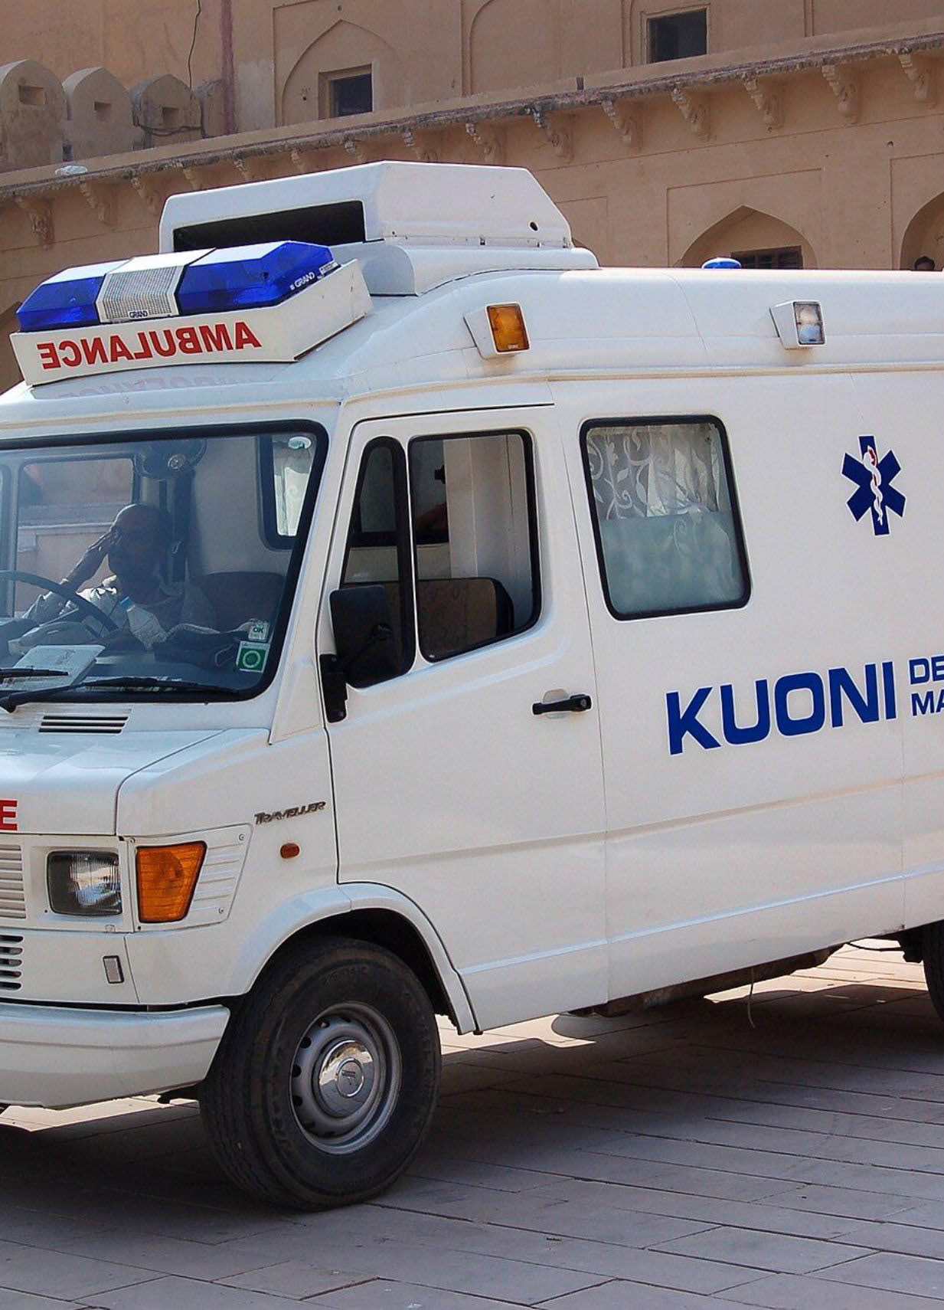
METRICS & HORIZONS
Expected Impact & Quantifiable Civic Returns
Empowering civic authorities with quantifiable response acceleration and future drone integrations.
-48%
+62%
Emergency Transit Delay
Night Walking Safety
Ambulances reach PGIMER Trauma in half the time via automated signal preemption.
Women citizens report significantly higher confidence using well-lit SafePath routes.
-35%
60 FPS
Fuel & Carbon Footprint
Locked 3D Performance
Municipal waste compactors drive dynamic, fill-optimized collection routes.
High-performance WebGL digital twin rendering on any standard laptop without GPU lag.

Slide 11
🚀 LIVE PLATFORM & OPEN SOURCE
Access Urban Mesh — Live Demo & Codebase
Explore the deployed public cloud platform, 3D Digital Twin, and complete open-source codebase.
🌐 CLOUDFLARE HIGH-SPEED TUNNEL
● ONLINE
💻 OFFICIAL CODE REPOSITORY
⭐ OPEN SOURCE
Live Public Platform (24/7)
GitHub Open Source Repository
Official HTTPS deployment accessible worldwide. Features live 3D Digital Twin, Google Maps sync, 30s SOS Siren, and Gemini 2.0 Flash AI Copilot.
Complete verified source code, Three.js WebGL architecture, Gemini AI proxy, and zero-dependency deployment guide on GitHub.
PUBLIC WEB URL:
GITHUB REPOSITORY URL:
https://smith-mysql-initiated-critical.trycloudflare.com/
https://github.com/adityayadav880048-png/URBAN-MESH
🚀 OPEN LIVE WEB APP ↗
🏙️ 3D TWIN ↗
⭐ VIEW ON GITHUB ↗
📖 README ↗
📱 Instant Mobile Access for Judges: Scan or click URLs above directly from any phone • Protocol: HTTPS • Branch: main • 60 FPS WebGL

