Slide 1
Basic Introduction of Arduino
2016. 08. 30.
Jinhyuk Yim (jinhyuk@uns.ajou.ac.kr)
Eungkyu Lee (eungkyu@uns.ajou.ac.kr)

Slide 2
IoT
Arduino
What is Arduino?
Capability
Installing Arduino IDE Tool
Arduino Programming
Sketch
Examples
Practice

Slide 3
Internet of Things

Slide 4
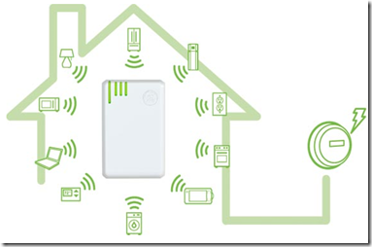
What is the IoT
IoT (Internet of Things)
A network of uniquely identifiable “things” that communicate without human interaction using IP connectivity

Slide 5

IoT’s Key components
The four key components for realization of the above IoT architecture

Slide 6
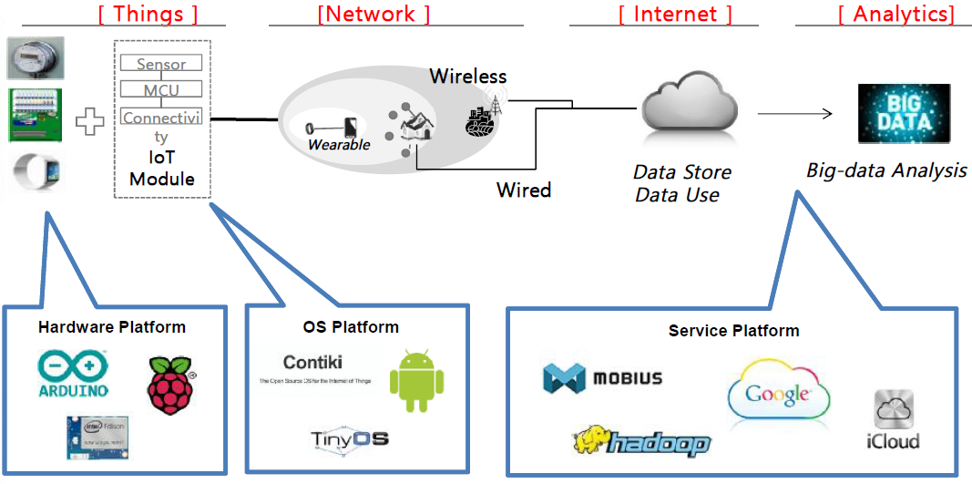
IoT Platform
Why is it needed?
The architecture should be easy to implement and manage in a common method

Slide 7
Arduino

Slide 8


What is Arduino?
Microcontroller board
It contains on-board power supply, USB port to communicate with PC, and an Atmel microcontroller chip.
It simplify the process of creating any control system by providing the standard board that can be programmed and connected to the system without the need to any sophisticated PCB design and implementation.
Open source hardware
any one can get the details of its design and modify it or make his own one himself.

Slide 9
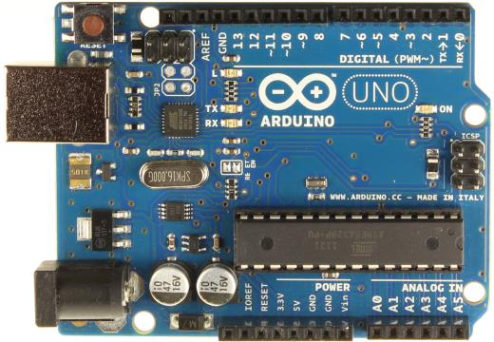
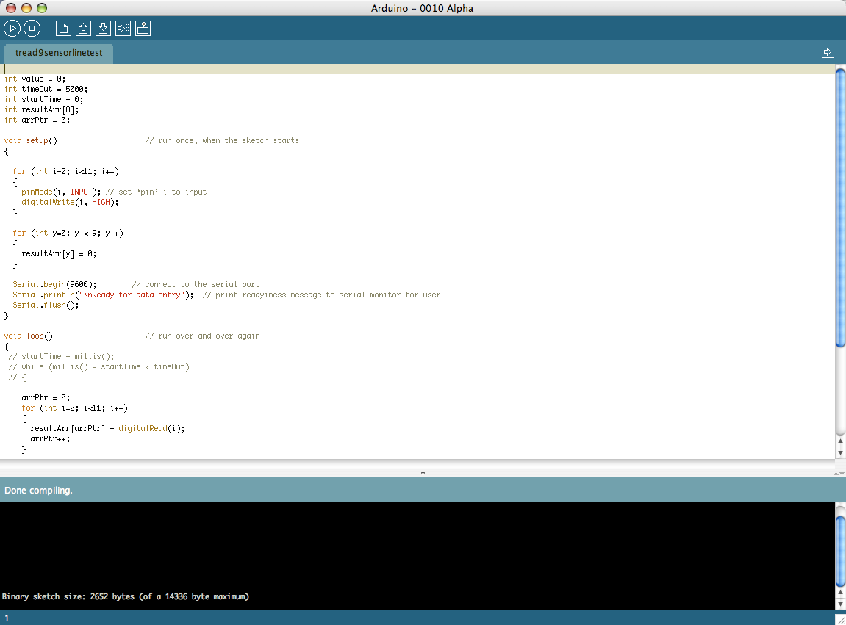
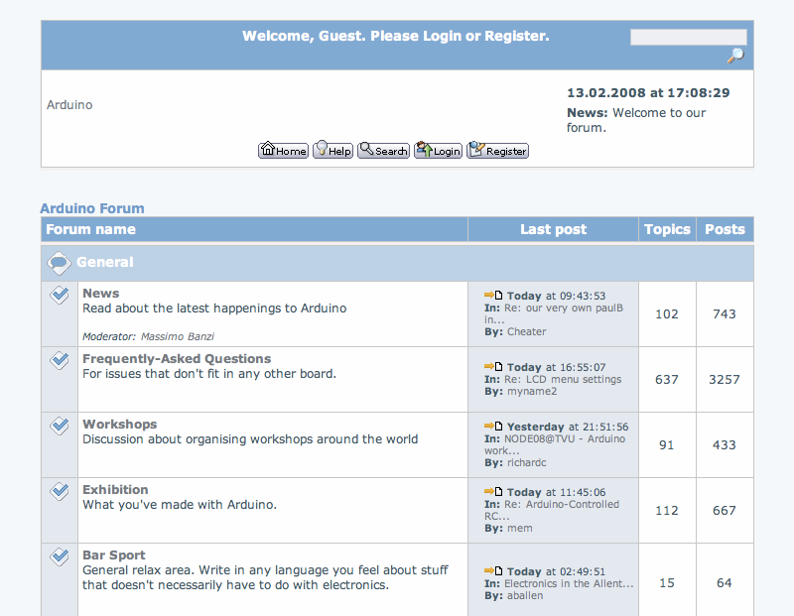
Arduino
Hardware
Development Environment
Community

Slide 10
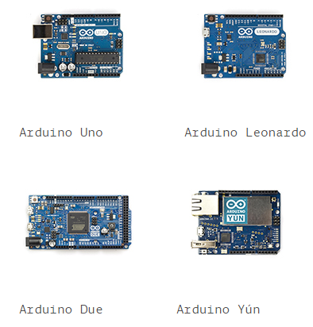
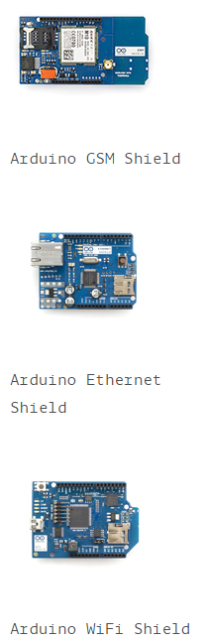
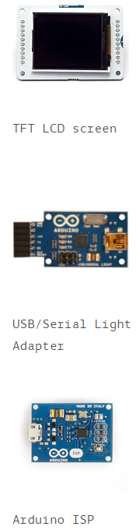
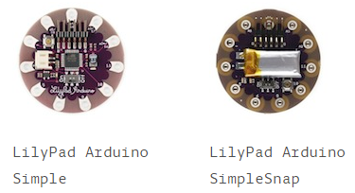
Arduino boards
……
http://arduino.cc/en/Main/Products

Slide 11
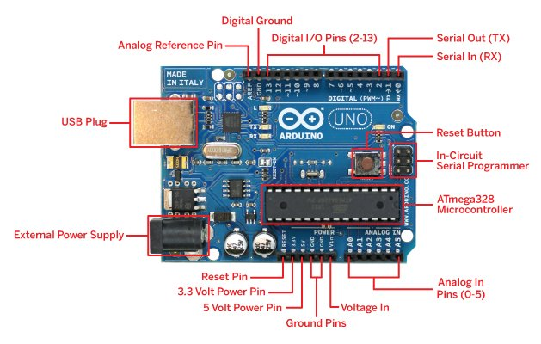
Arduino Uno – basic model

Slide 12
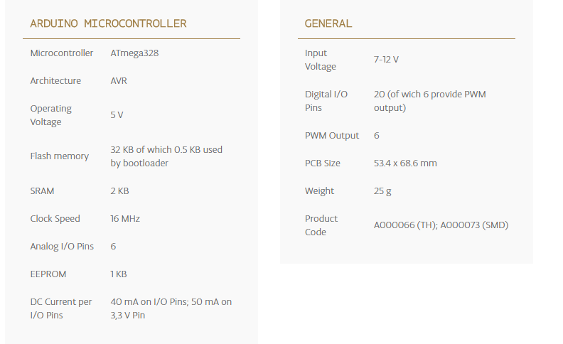
Arduino Uno Specification

Slide 13
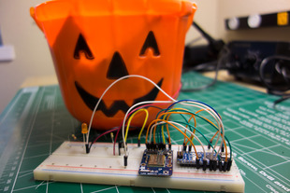
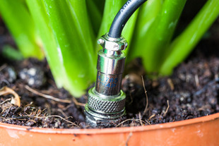
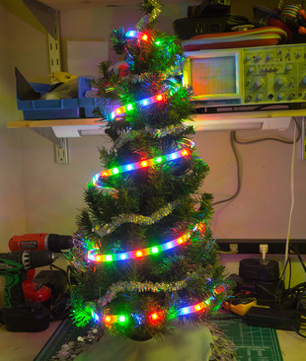
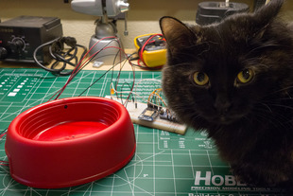
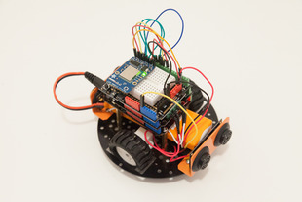
What can we do?
Wi-Fi Candy Bowl Monitor
Wireless gardening with Arduino
Wi-Fi controlled LED X-Max Tree
SMS Texting Pet Food Dish
Wi-Fi controlled mobile robot

Slide 14
Install & Setting the Arduino IDE Tool

Slide 15
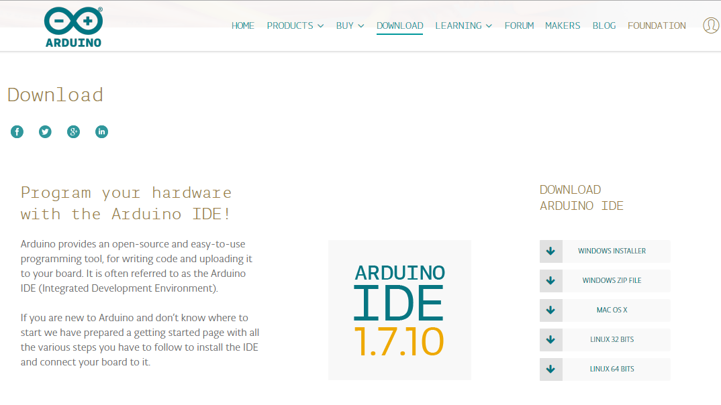
Download the IDE Tool
Go to http://www.arduino.org/downloads

Slide 16
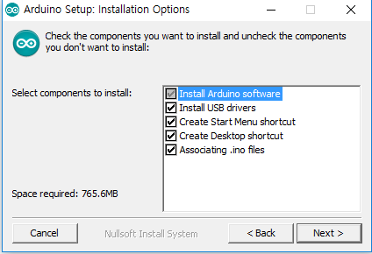
Install the IDE Tool
Please make sure that ‘Install USB drivers’ is checked
Then keep press ‘Next’ button

Slide 17
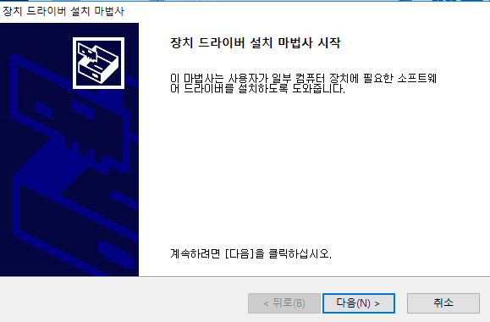
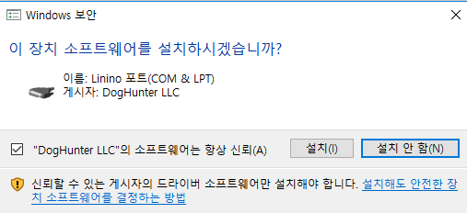
Install the USB Driver
When the Arduino IDE tool is installed in your PC, it will automatically install the USB driver for Arduino
Now you are ready to make an Arduino program

Slide 18
Arduino Programming

Slide 19
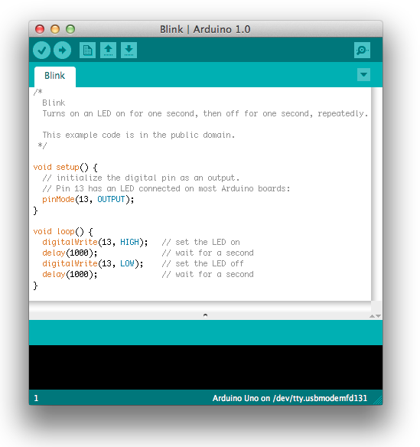
Procedure of Arduino Programming
3 steps to make your own Arduino program
1. Make an Arduino source program using Arduino IDE tool
2. Compile the source program
3. Upload the source program to Arduino board

Slide 20
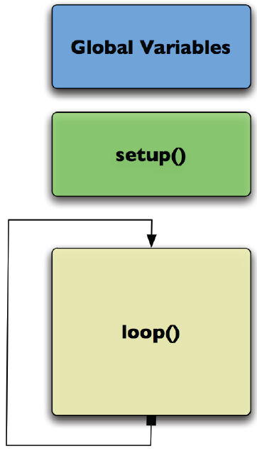
Arduino Sketch
Global variables
Declare variables at top
Setup()
Initialize H/W, Run once at beginning
pinMode() - set a pin as input or output
Serial.Begin() - setup to terminal
Loop()
Run repeatedly after setup
digitalWrite() – set a digital pin high/low
digitalRead() – read a digital pin’s state
analogRead() – read an analog pin
analogWrite() – write an analog PWM value
delay() – wait an amount of time

Slide 21
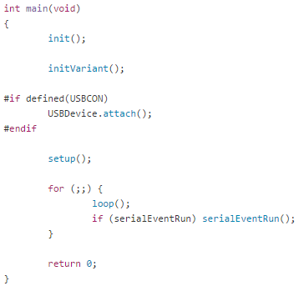
Arduino Main routine (main.cpp)
System initializatiONcode

Slide 22
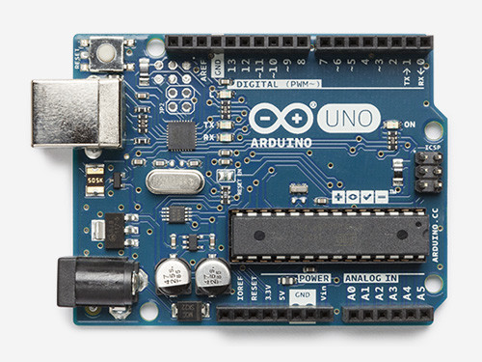
Arduino Sketch Example

Slide 23
Practice

Slide 24

Practice #1 – Basic LED control
Control the LED blink period
Step 1: LED ON– 500ms, LED OFF – 500ms for 5 seconds
Step 2: Then, LED ON– 250ms, LED OFF – 250ms for next 5 seconds
Step 3: Then, LED ON– 125ms, LED OFF – 125ms for next 5 seconds
Hint: Use iteration statement (ex. while, for, etc.)

Slide 25
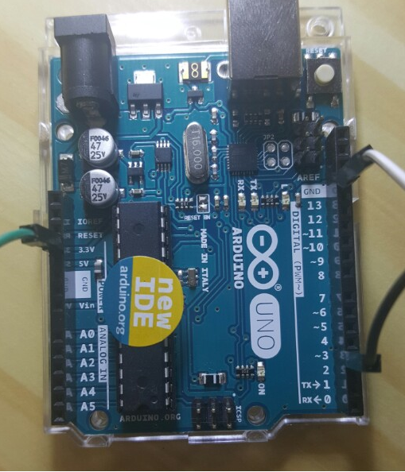
Practice #2 – Control LED with Button (1/2)
Turn on the LED using Button
Step 1: Connect the button to Arduino
Connect Signal(S), Voltage(V), Ground(G) line

Slide 26
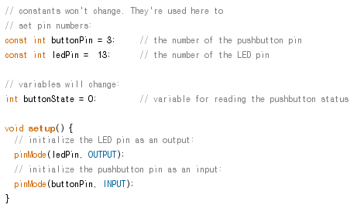
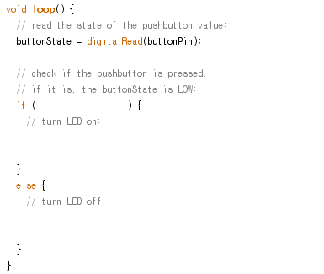
Practice #2 – Control LED with Button (2/2)
Turn on the LED using Button
Step 2: Turn on the LED when the button is pushed, and turn off the LED when the button is released

