Slide 1
Design and Analysis of a Dual-action End-effector for Robotic Assistance in Leafy-vegetables Farming
Master of Technology in Mechanical Engineering
Presented by:
Aditya Singh
(2024MEM1037)
Under The Supervision of:
Dr. Ekta Singla & Dr. Himanshu Tyagi

Slide 2
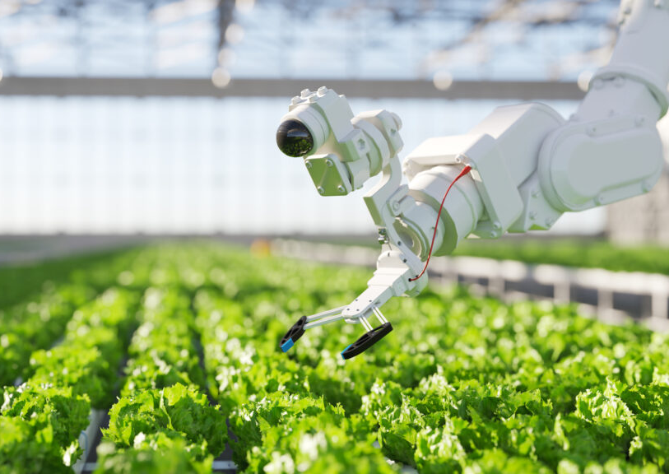
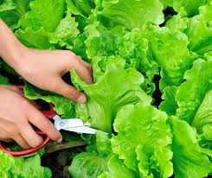
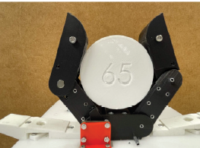
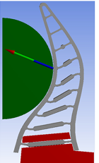
Motivation
Automation in agriculture is rapidly expanding, and there is a need of advanced end-effectors to improve the efficiency.
Traditional grippers are limited to single tasks, while modern agriculture demands multi-task functionality.
Harvesting of leafy vegetables requires delicate handling to maintain quality, with end-effectors still a major challenge in automation.
Adaptive grippers can handle varying geometry and soft stems of leafy vegetables.
Figure (i)
Figure (ii) Harvesting of leafy vegetables
Figure (iii) Tendon-driven adaptative gripper [1]
Figure (iv) Fin-ray inspired gripper’s finger [4]
Ref: Figure(i) https://teguar.com/wp-content/uploads/2024/03/iStock-1447011226-1024x576.jpg
Ref: Figure(iv) https://brightlanegardens.com/wp-content/uploads/2024/01/3-3.png

Slide 3



Literature
Paper by | Year | Important information taken
Mart Bluiminck et.al. | 2023 | 2-finger, underactuated, tendon-driven gripper with variable stiffness to handle fragile, deformable agri-food products.
Johannes F.Elferich et.al. | 2022 | This paper gives review of soft robotics grippers for crop handling or harvesting.
Ji Hyeon Shin et.al. | 2021 | This study enhances the design through structural optimization, switchable grip modes, and friction pads, achieving improvement in load capacity and handling of high–aspect ratio objects.
Xiaowei Shan et.al. | 2020 | This paper explores Fin Ray–based adaptive robotic fingers, which adapt naturally to an object’s shape.
Wenqi Wang et.al. | 2020 | It gives information about physical and mechanical properties of hydroponic lettuce for automatic harvesting.
Z. Samadikhoshkho et.al. | 2019 | Robotic grippers are classified based on configuration, actuation, application, size, and stiffness.
Baozeng Jia et.al. | 2009 | Developed an integrated gripper-cutter mainly targeting peduncle cutting of fruiting vegetables.

Slide 4
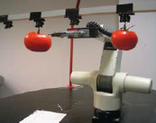
Gap/Novelty
The literature mainly focuses on the gripper design for fruits or flowering vegetables, while limited work has been reported for leafy vegetables.
Leafy vegetables require adaptive gripping because of their delicate and irregular structure but most vegetable grippers lack this adaptiveness.
The robotic assistance normally involves one manipulator, which is the bottleneck in replicating human work using two-arms.
Figure (i) Integrated gripper-cutter mainly targeting peduncle of flowering vegetables [7]
Figure (ii) Harvesting of leafy vegetables

Slide 5
Objectives
Concept Design and CAD Modelling of an Adaptive Gripper integrated with a cutter mechanism.
Analysis of the gripper’s finger to determine its optimal shape.
Study of cutting and gripping forces of proposed end-effector.
Fabrication of the Dual -Action Gripper.
Adaptive gripper
Cutter
Dual- Action End-Effector

Slide 6
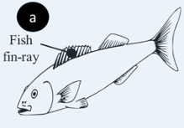
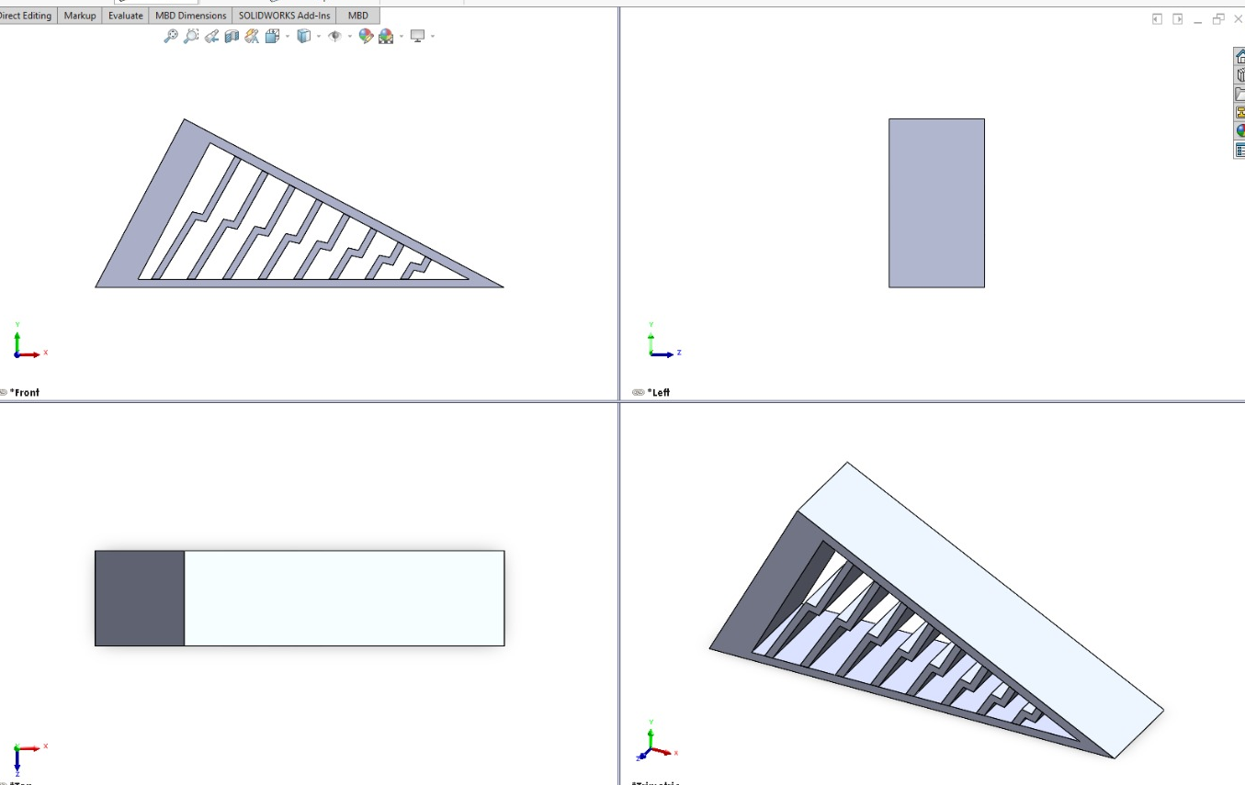
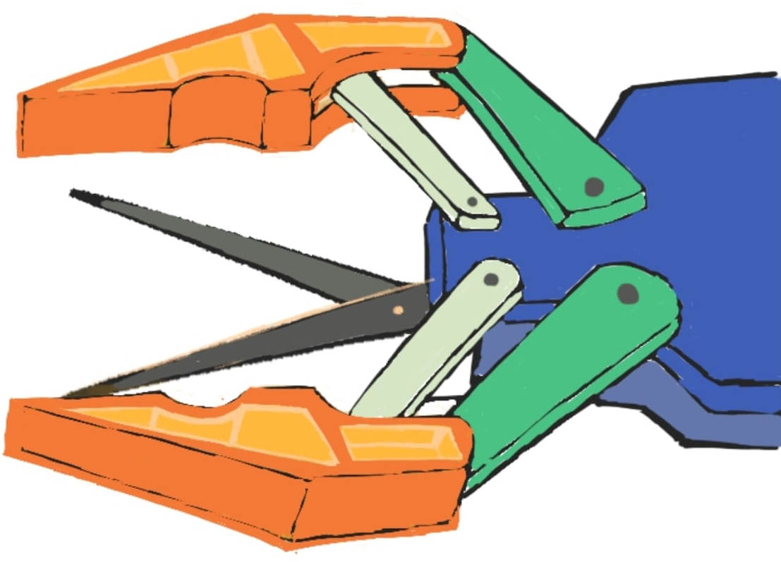
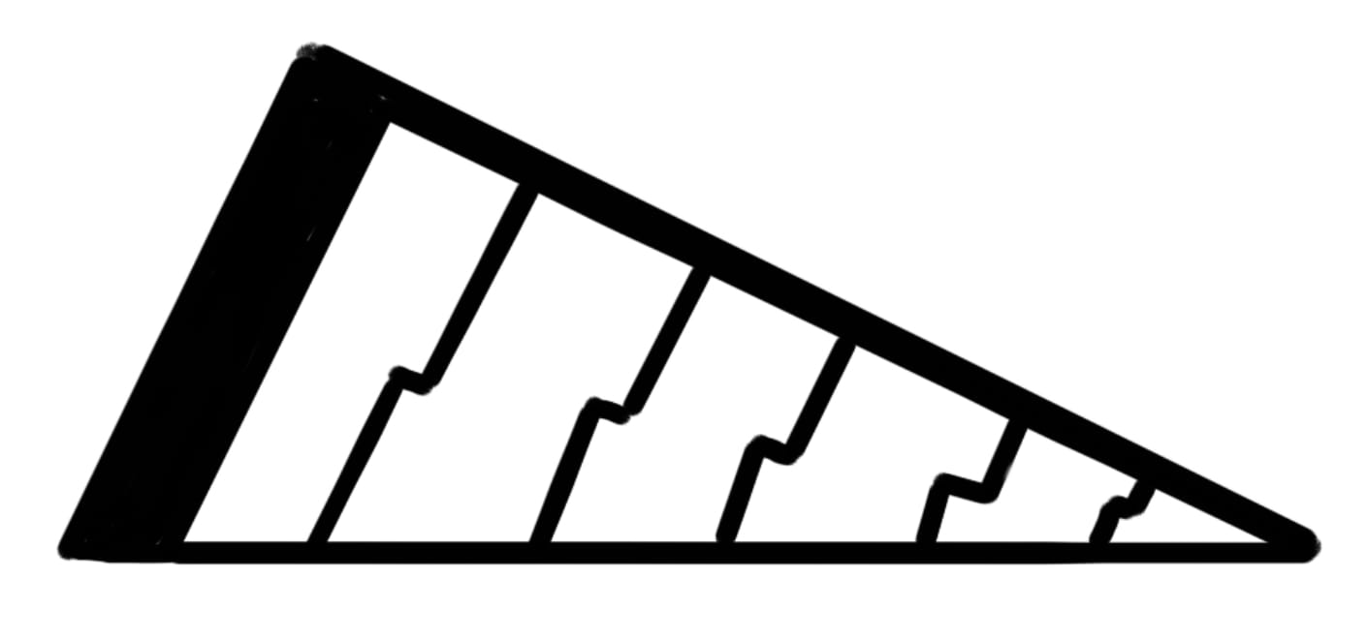
Work Done
The initial focus is on the gripping part. For adaptive gripping, the fin-ray inspired gripper has been identified.
The fin ray principle draws inspiration from the properties of fish fins.
The current focus is to develop CAD model of dual-action gripper.
Figure(ii)
Figure(i) Concept diagram of the dual-action gripper
Figure(iii) Concept diagram of fin-ray inspired finger
Figure(iv) SolidWorks model of fin-ray inspired finger

Slide 7
Timeline
Task | June | July | Aug | Sep | Oct | Nov | Dec | Jan | Feb | Mar | April | May
Literature review
SolidWorks Modelling
Analysis of Finger
Analysis of integrated end-effector
Model fabrication
Thesis Report

Slide 8
Thank You

